Slide 1
THE DESIGN AND IMPLEMENTATION
OF A LOG-STRUCTURED
FILE SYSTEM
M. Rosenblum and J. K. Ousterhout
University of California, Berkeley

Slide 2
THE PAPER
Presents a new file system architecture allowing mostly sequential writes
Assumes most data will be in RAM cache
  Settles for more complex, slower disk reads
Describes a mechanism for reclaiming disk space
  Essential part of paper

Slide 3
OVERVIEW
Introduction
Key ideas
Data structures
Simulation results
Sprite implementation
Conclusion

Slide 4
INTRODUCTION
Processor speeds increase at an exponential rate
Main memory sizes increase at an exponential rate
Disk capacities are improving rapidly
Disk access times have evolved much more slowly

Slide 5
Consequences
Larger memory sizes mean larger caches
  Caches will capture most read accesses
  Disk traffic will be dominated by writes
  Caches can act as write buffers replacing many small writes by fewer bigger writes
Key issue is to increase disk write performance by eliminating seeks

Slide 6
Workload considerations
Disk system performance is strongly affected by workload
Office and engineering workloads are dominated by accesses to small files
  Many random disk accesses
  File creation and deletion times dominated by directory and i-node updates
  Hardest on file system

Slide 7
Limitations of existing file systems
They spread information around the disk
  I-nodes stored apart from data blocks
  less than 5% of disk bandwidth is used to access new data
Use synchronous writes to update directories and i-nodes
  Required for consistency
  Less efficient than asynchronous writes

Slide 8
KEY IDEA
Write all modifications to disk sequentially in a log-like structure
  Convert many small random writes into large sequential transfers
  Use file cache as write buffer

Slide 9
Main advantages
Replaces many small random writes by fewer sequential writes
Faster recovery after a crash
  All blocks that were recently written are at the tail end of log
  No need to check whole file system for inconsistencies
    Like UNIX and Windows 95/98 do

Slide 10
THE LOG
Only structure on disk
Contains i-nodes and data blocks
Includes indexing information so that files can be read back from the log relatively efficiently
Most reads will access data that are already in the cache

Slide 11
Disk layouts of LFS and UNIX
dir1
dir2
Log
Disk
LFS
file1
file2
file1
file2
Disk
Unix FFS
dir1
dir2
Inode
Directory
Data
Inode map

Slide 12
Index structures
I-node map maintains the location of all i-node blocks
  I-node map blocks are stored on the log
    Along with data blocks and i-node blocks
  Active blocks are cached in main memory
A fixed checkpoint region on each disk contains the addresses of all i-node map blocks at checkpoint time

Slide 13
Accessing an i-node
Fixed location
but not up to date
Checkpoint Area
I-node map blocks
spread on the log
Log
I-node blocks also
spread on the log
Log

Slide 14
The way it works
Fixed location
but not up to date
Checkpoint Area
Active blocks
cached in RAM
I-node map blocks
spread on the log
Log
I-node blocks also
spread on the log
Active blocks
cached in RAM
Log

Slide 15
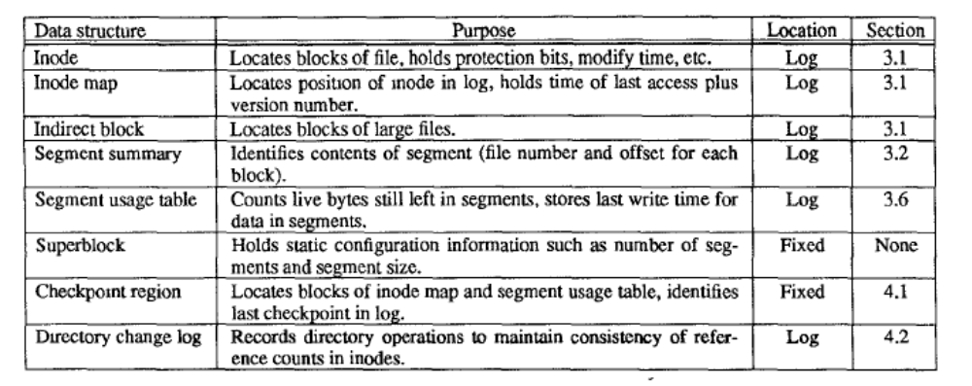
Summary

Slide 16
Segments
Must maintain large free extents for writing new data
Disk is divided into large fixed-size extents called segments (512 kB in Sprite LFS)
Segments are always written sequentially from one end to the other
Old segments must be cleaned before they are reused

Slide 17
Segment usage table
One entry per segment
Contains
  Number of free blocks in segment
  Time of last write
Used by the segment cleaner to decide which segments to clean first

Slide 18
Segment cleaning (I)
Old segments contain
  live data
  “dead data” belonging to files that were overwritten or deleted
Segment cleaning involves writing out the live data
A segment summary block identifies each piece of information in the segment

Slide 19
Segment cleaning (II)
Segment cleaning process involves
  Reading a number of segments into memory
  Identifying the live data
  Writing them back to a smaller number of clean segments
Key issue is where to write these live data
  Want to avoid repeated moves of stable files

Slide 20
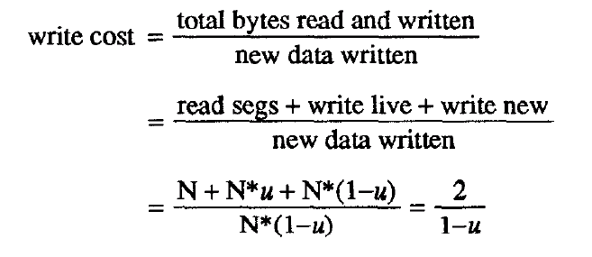
Write cost
u = utilization

Slide 21
Segment Cleaning Policies
Greedy policy: always cleans the least-utilized segments

Slide 22
Simulation results (I)
Consider two file access patterns
  Uniform
  Hot-and-cold: (100 - x) % of the accesses involve x % of the files
  90% of the accesses involve 10% of the files
  (a rather crude model)

Slide 23
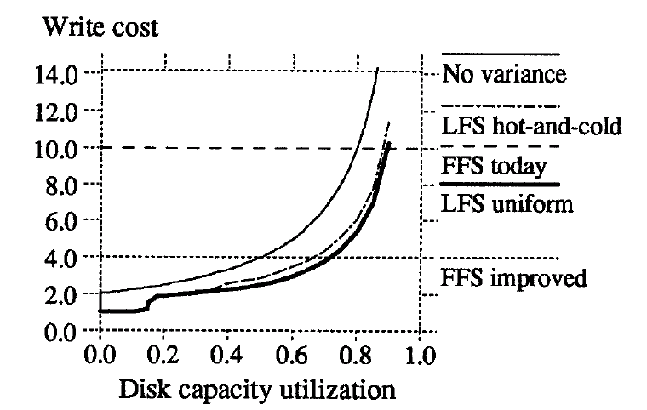
Greedy policy
No variance
= formula

Slide 24
Key
No variance displays write cost computed from formula assuming that all segments have the same utilization u (not true!)
LFS uniform uses a greedy policy
LFS hot-and-cold uses a greedy policy that sorts live blocks by age
FFS improved is an estimation of the best possible FFS performance

Slide 25
Comments
Write cost is very sensitive to disk utilization
  Higher disk utilizations result in more frequent segment cleanings
Free space in cold segments is more valuable than free space in hot segments
  Value of a segment free space depends on the stability of live blocks in segment

Slide 26
Copying live blocks
Age sort:
  Sorts the blocks by the time they were last modified
  Groups blocks of similar age together into new segments
Age of a block is good predictor of its survival

Slide 27
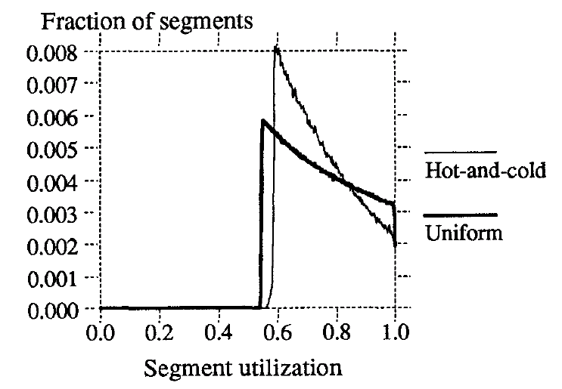
Segment utilizations

Slide 28
Comments
Locality causes the distribution to be more skewed towards the utilization at which cleaning occurs.
Segments are cleaned at higher utilizations than they could

Slide 29
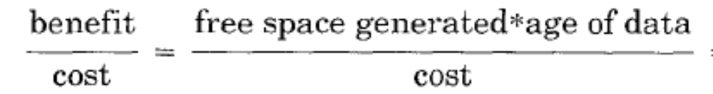
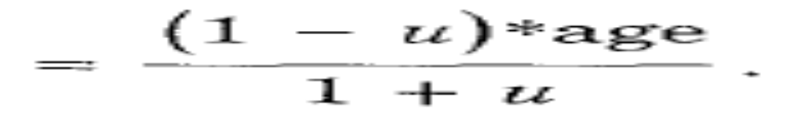
Cost benefit policy
Uses criterion

Slide 30
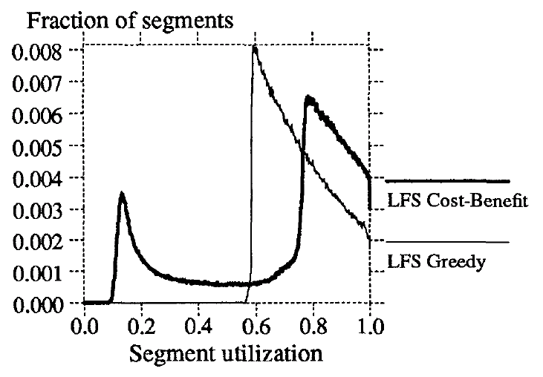
Using a cost-benefit policy
75%
15%

Slide 31
What happens
Hot and cold segments are now cleaned at different utilization thresholds
  75% utilization for cold segments
  15% utilization for hot segments
And it works much better!

Slide 32
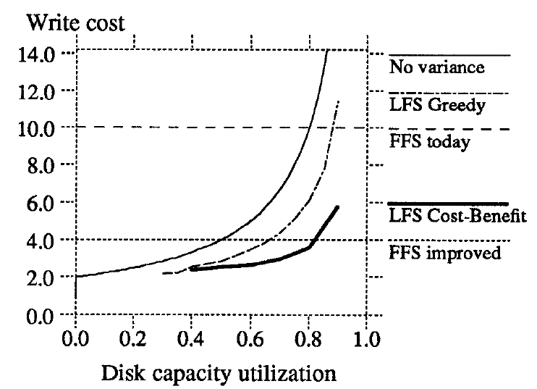
Using a cost benefit policy

Slide 33
Comments
Cost benefit policy works much better

Slide 34
Sprite LFS
Outperforms current Unix file systems by an order of magnitude for writes to small files
Matches or exceeds Unix performance for reads and large writes
Even when segment cleaning overhead is included
  Can use 70% of the disk bandwidth for writing
  Unix file systems typically can use only 5-10%

Slide 35
Crash recovery (I)
Uses checkpoints
  Position in the log at which all file system structures are consistent and complete
Sprite LFS performs checkpoints at periodic intervals or when the file system is unmounted or shut down
Checkpoint region is then written on a special fixed position; contains addresses of all blocks in inode map and segment usage table

Slide 36
Crash recovery (II)
Last Checkpoint
The Log
Roll Forward
Checkpoint
Area

Slide 37
Crash recovery (III)
Recovering to latest checkpoint would result in loss of too many recently written data blocks
Sprite LFS also includes roll-forward
  When system restarts after a crash, it scans through the log segments that were written after the last checkpoint
  When summary block indicates presence of a new i-node, Sprite LFS updates the i-node map

Slide 38
SUMMARY
Log-structured file system
  Writes much larger amounts of new data to disk per disk I/O
  Uses most of the disk’s bandwidth
Free space management done through dividing disk into fixed-size segments
Lowest segment cleaning overhead achieved with cost-benefit policy

Slide 39
ACKNOWLEDGMENTS
Most figures were lifted from a PowerPoint presentation of same paper by Yongsuk Lee

