Slide 1
Memory Resource Management in VMware ESX Server
  Carl A. Waldspurger
  VMware, Inc.
  Appears in SOSDI 2002
  Presented by: Lei Yang

Slide 2


Outline
Introduction
  Background
  Motivation
Featuring techniques
Memory virtualization
Extra level of address translation
Memory reclamation
Ballooning
  Content-based page sharing
Memory sharing
Idle memory taxation
Memory utilization
Higher level allocation policies
Conclusions

Slide 3
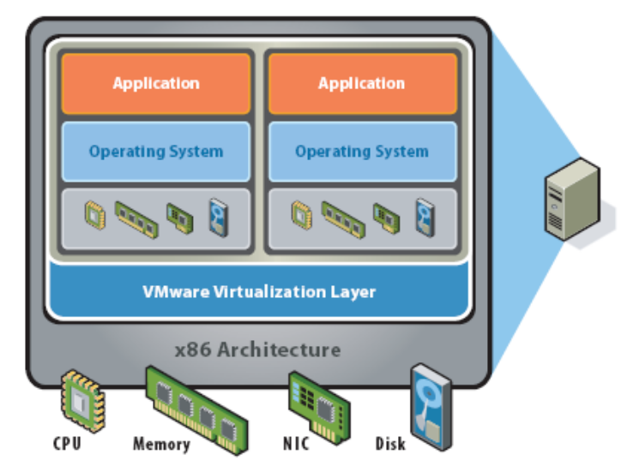
Background
Virtual Machine Monitor
  Diso, Cellular Diso
  VMware
VMware ESX Server
  A thin software layer
  designed to multiplex hardware
  resources efficiently among virtual
  machines running unmodified
  commodity operating systems
  Differs from VMware Workstation
    The latter needs a hosted OS, e.g., a Linux-host VM running a Windows XP guest OS.
    ESX Server manage system hardware directly.
  Current system virtualizes the Intel IA-32 architecture

Slide 4
Motivation
Problem
  How to flexibly overcommit memory to reap the benefits of statistical multiplexing, while…
  Still providing resource guarantees to VMs of varying importance?
  Need for efficient memory management techniques!
Goal
  Allocating memory across virtual machines running existing operating systems without modification

Slide 5
Memory Virtualization
Guest OS expects a zero-based physical address space
ESX Server gives each VM this illusion, by
  Adding an extra level of address translation
  Machine address: actual hardware memory
  Physical address: illusion of hardware memory to VM
  Pmap: physical-to-machine page mapping
  Shadow page table: virtual-to-machine page mapping
Consistent!
No additional performance overhead
  Hardware TLB will cache direct virtual-to-machine address
  translations read from the shadow page table
Flexible
  Server can remap a “physical page” by changing pmap
  Server can monitor guest memory access

Slide 6
Memory Reclamation
Memory overcommitment
  Total size configured for all running VM exceeds the total amount of actual machine memory
  When memory is overcommitted, reclaim space from one or more of the VMs
Conventional page replacement
  Introduce an extra level of paging: moving some VM “physical” pages to a swap area on disk
  Problems:
    Choose VM first and then choose pages ☹
    Performance anomalies ☹
    Diverse OS replacement policies ☹
    Double paging ☹

Slide 7
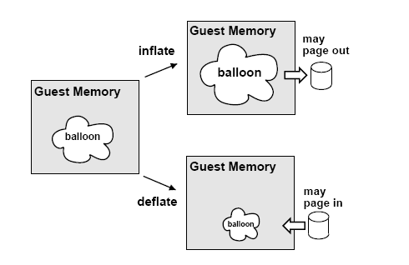
Ballooning
Implicitly coaxes a guest OS into reclaiming memory using its own native page replacement algorithms.

Slide 8
Ballooning, pros and cons
Goal achieved, more or less
  A VM from which memory has been reclaimed should perform as if it had been configured with less memory
Limitations
  As a kernel module, balloon driver can be uninstalled or disabled explicitly
  Not available while a guest OS is booting
  Temporarily unable to reclaim memory quickly enough
  Upper bounds of balloon sizes?

Slide 9
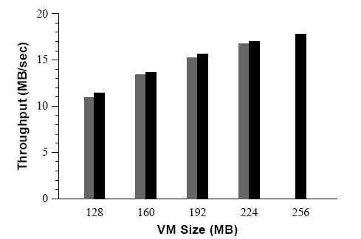
Balloon Performance
Throughput of single Linux VM running dbench with 40 clients, as a function of VM size
Black: VM configured with different fixed memory size
Gray: same VM configured with 256MB,
ballooned down to specified size
Overhead:
4.4% to 1.4%

Slide 10
Memory Sharing
When could memory sharing happen?
  VMs running instances of same guest OS
  VMs have same applications or components loaded
  VMs application contain common data
  Why waste memory? Share!
Conventional transparent page sharing
  Introduced by Disco
  Idea: identify redundant page copies when created, map multiple guest “physical” pages to one same machine page
  Shared pages are marked COW. Writing to a shared page causes a fault that generate a private copy
  Requires guest OS modifications

Slide 11
Content-based Page Sharing
Goal
  No modification to guest OS or application interface
Idea
  Identify page copies by their contents
  Pages with identical contents can be shared regardless of when, where, or how they were generated -- More opportunities for sharing
Identify common pages – Hashing
  Comparing each page with every other page: O(n^2)
  A hash function compute a checksum of a page, which is used as a lookup key
  Chaining is used to handle collisions
Problem: when and where to scan?
  Current implementation: randomly
  More sophisticated approaches are possible

Slide 12
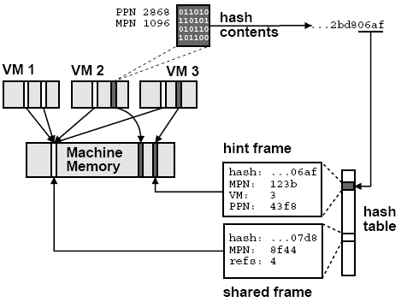
Hashing illustrated
If hash value matches an existing entry, possible, but
Perform a full comparison of page contents
Once match identified, COW to share the page
An unshared page is not marked COW, but tagged as a hint entry

Slide 13
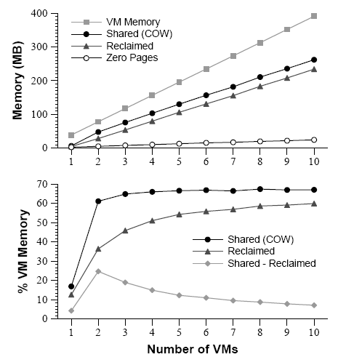
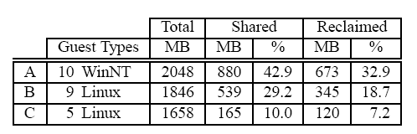
Content-based Page Sharing Performance
Best case workload
Space overhead: less than 0.5% of system memory
Some sharing with ONE VM!
Total amount of memory shared increases linearly with # of VMs
Amount of memory needed to contain single copy remains nearly constant
Little sharing is due to zero pages
CPU overhead negligible. Aggregate throughput sometimes slightly higher with sharing enabled (locality)
Real world workload

Slide 14
Shares vs. Working Sets
Memory allocation among VMs
  Improve system-wide performance metric, or
  Provide quality-of-service guarantees to clients of varying importance
Conventional share-based allocation
  Resource rights are encapsulated by shares
  Resources are allocated proportional to the share
  Problem
    Do not incorporate any information about active memory usage or working sets
    Idle clients with many shares can hoard memory unproductively, while active clients with few shares suffer under severe memory pressure

Slide 15
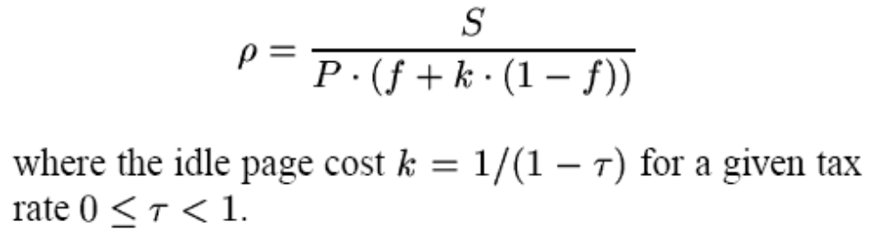
Idle Memory Taxation
Goal
  Achieve efficient memory utilization while maintaining memory performance isolation guarantees.
Idea
  Introducing an idle memory tax
  Charge a client more for an idle page than for one it is actively using. When memory is scarce, pages will be reclaimed preferentially from clients that are not actively using their full allocations.
  A tax rate specifies the maximum fraction of idle pages that may be reclaimed from a client
  Using statistical sampling to obtain aggregate VM working set estimates directly

Slide 16
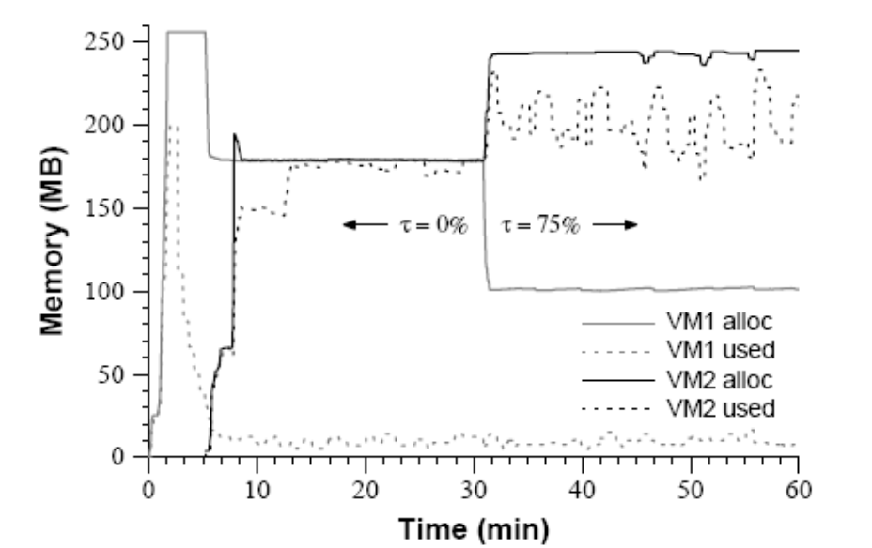
Idle Memory Taxation Performance
Two VMs with identical share allocations, configured with 256MB in an overcommitted system.
VM1 runs Windows, remains idle after booting
VM2 runs Linux, executes a memory-intensive workload

Slide 17
Putting Things All Together
Higher level memory management policies
  Allocation parameters
    Min size: lower bound of amount of memory allocated to VM
    Max size: unless overcommited, VMs will be allocated max size
    Memory shares: fraction of physical memory
  Admission control
    Ensures that sufficient unreserved memory and server swap space is available before a VM is allowed to power on
    Machine memory must be reserved for : min + overheads
    Disk swap space must be reserved for : max - min
  Dynamic reallocation (in more details)

Slide 18
Dynamic Reallocation
Recompute memory allocations in response to
  Changes to system-wide or per-VM allocation parameters
  Addition or removal of a VM to/from the system
  Changes in the amount of free memory that cross predefined thresholds
  Changes in idle memory estimates for each VM
Four thresholds to reflect different reclamation states
  High (6% of system memory) -- no reclamation performed
  Soft (4% of system memory) -- ballooning (possibly paging)
  Hard (2% of system memory) -- paging
  Low (1% of system memory) -- continue paging, block execution of all VMs
In all states, system computes target allocations for VMs to drive the aggregate amount of free space above the high threshold
System transitions back to the next higher state only after significantly exceeding the higher threshold (to prevent rapid state fluctuations).

Slide 19
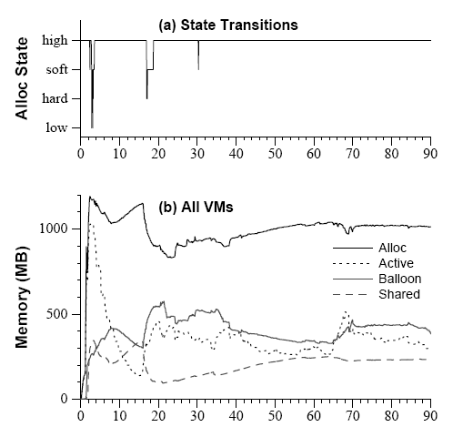
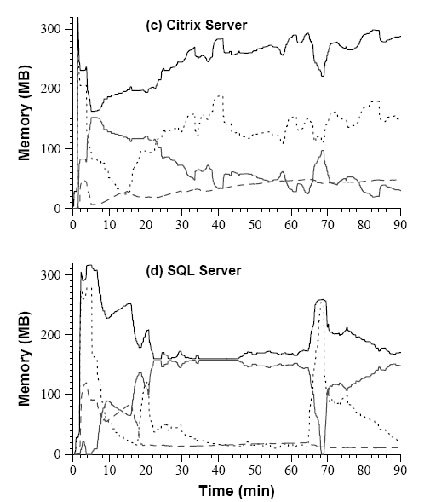
Dynamic reallocation Performance

Slide 20
Conclusions
What was the goal?
  Efficiently manage memory across virtual machines running unmodified commodity operating systems
How they achieved it?
  Ballooning technique for page reclaiming
  Content-based transparent page sharing
  Idle memory tax for share-based management
  Higher level dynamic reallocation policy coordinates all the above
Experiments were carefully designed and results are convincible and good

