Slide 1

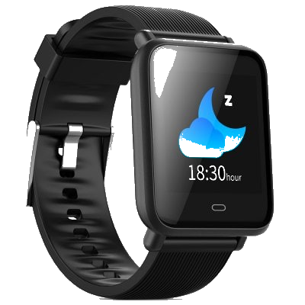
Bite Counter
An energy intake tracker.
-Srihith Alwala
Shashi Shivaraju

Slide 2

Introduction
The Bite Counter is a wearable device which tracks the wrist motion,in order to monitor the food intake of the user.
The bite counter is a tool to help people track their energy intake and can be used with any exercise or weight loss plan.
The purpose of the bite counter is to provide real-time feedback during eating and to simplify long-term energy intake monitoring.
This product is envisioned to target the mobile health industry.

Slide 3

Technology
The human wrist rolls in a distinctive pattern during eating.
The Bite Counter tracks wrist motion and by detecting above shown distinctive pattern in wrist motion, it can identify when a bite of food has been taken.

Slide 4
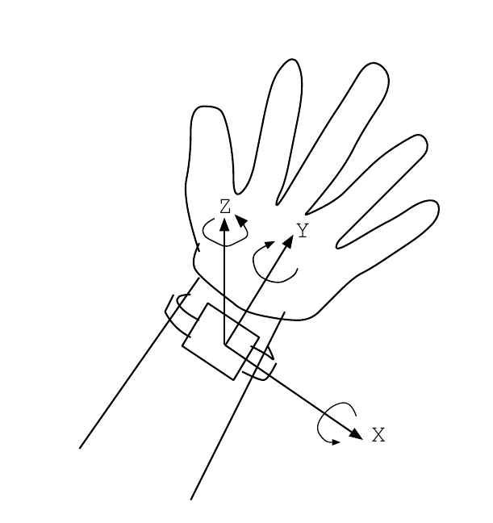
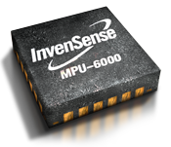
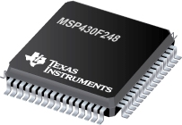
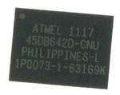
System Implementation
Recording wrist movement data requires four basic components:
Accelerometer for record translational motion
Gyroscope for record rotational Motion
Memory for Data storage
Microprocessor for computation and interface
Memory
Sensors
Processor

Slide 5
SWOT Analysis
Strength :
Unique feature of counting bites and determining the energy intake during a meal.
A tool to assist in weight loss program and fight against obesity.
A wearable device which can be used as a normal watch.
Weakness:
Inaccurate Metrics – Sensor data can be inaccurate & Algorithms involve certain level of guessing.
Opportunities:
Improve Algorithms to reduce errors.
Incorporate features of activity trackers such as pedometer,heart rate sensor to make the product more marketable with additional features.
Threats:
Smart watches – have necessary hardware to implement all the functions of activity tracker along with premium design.

Slide 6


