Slide 1
Overlapping Finite Elements in JULIA
18.337 Final Project Presentation
Angus Foo

Slide 2
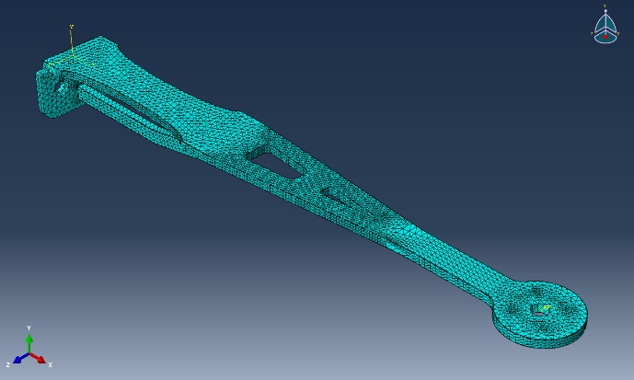
Introduction
Finite Element Methods (FEM) provide a numerical means of solving various complex PDEs
Used in Solid Mechanics, Heat Transfer, Fluid Dynamics etc
Traditional FEM generates solutions that are dependent on quality of mesh
Generating high quality meshes for arbitrary complex geometries is hard
Overlapping Finite Elements attempt to resolve the above by
Reducing the reliance of FEM solutions on mesh quality
Provides accurate solutions with simple meshing methods
A 3D mesh (comprising tetrahedral and brick/hex elements) of a quadcopter rotor arm generated in the FEA software ANSYS
F
F
σ = 0 since none of the triangular element nodes are displaced
Stress Field non-zero everywhere

Slide 3
Introduction
Motivation – need a language that
Works naturally with matrices (productivity)
Ideally also having support for efficient implementations (performance)
Enables easy implementation of parallel processing (performance and productivity)
Handles graphs
Visual debugging (productivity)
Support for meshing (performance and productivity)
Runs fast (performance)
Advisor: “MATLAB is too slow. Implement code in FORTRAN or C/C++.”
Was struggling to develop/debug the theory/algorithm in C++
Decided to switch over to JULIA

Slide 4
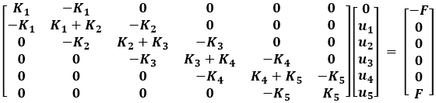


Introduction
x
Basic FEM Theory:
Consider Geometry of 1D Bar
Discretize Geometry
Consider Local Element
Write Constitutive Equations
Assemble Global Stiffness Matrix
Solve Sparse Matrix
Post-Processing of Data
F
Node 0
1
2
3
4
5
F
F₂
F₃
$$F3–F_{2}=K_{3}(x_{3}−x_{2})$$
$$\left[\begin{matrix}K_{3} & −K_{3} \\ −K_{3} & K_{3}\end{matrix}\right]\left[\begin{matrix}u_{2} \\ u_{3}\end{matrix}\right]= \left[\begin{matrix}−F_{2}+F_{3} \\ F_{2}−F_{3}\end{matrix}\right]$$
*Relative change in position (Δx) = Relative change in displacement (Δu)

Slide 5
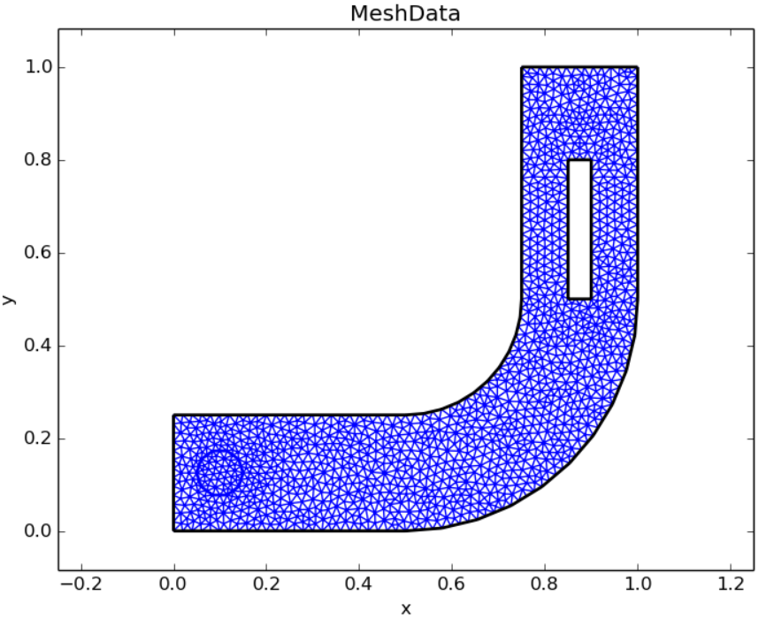
Introduction
Basic FEM Theory:
Consider Geometry of 1D Bar
Discretize Geometry
Consider Local Element
Write Constitutive Equations
Assemble Global Stiffness Matrix
Solve Sparse Matrix
Post-Processing of Data
Graph Theory
Meshing generally works on Voronoi Diagrams (using Delaunay Triangulation)
Development of meshing algorithms would be enhanced with graphing support
Visual Debugging
Outputs can be graphed for debugging purposes
EllipticFEM.jl MeshData using LightGraphs.jl.
Image taken from https://github.com/gerhardtulzer/EllipticFEM.jl

Slide 6


Introduction
Basic FEM Theory:
Consider Geometry of 1D Bar
Discretize Geometry
Consider Local Element
Write Constitutive Equations
Assemble Global Stiffness Matrix
Solve Sparse Matrix
Post-Processing of Data
Potential for Massive Parallelism
Local Stiffness Matrix for each element can be computed independently from each other
Computation of Local Stiffness Matrix is done by quadrature
Need for a fast language
Evaluating B in the Local Stiffness Matrix computation for “meshless methods” like that used in the Overlapping Finite Elements Theory is extremely expensive

Slide 7
Introduction
Basic FEM Theory:
Consider Geometry of 1D Bar
Discretize Geometry
Consider Local Element
Write Constitutive Equations
Assemble Global Stiffness Matrix
Solve Sparse Matrix
Post-Processing of Data
Linear Algebra module built around LAPACK
Need to solve sparse matrices efficiently
GPU acceleration for solving matrices a possible advantage
Global Stiffness Matrix is generally sparse

Slide 8
Introduction
Traditional FEM
Solution field is local to one element
Compatibility constraints are only on the boundary of each element
Method of Finite Spheres
Local solution fields are defined in a sphere around a node
Solution field of intersection between spheres has to be compatible with each other

Slide 9
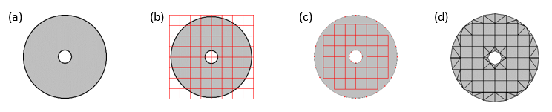
Introduction
Overlapping Finite Elements
Coupling of traditional Finite Elements with Finite Spheres
Regions of intersection between traditional elements and finite spheres have to be compatible as well
Allows for easy generation of nodal points (mesh) which is significantly more distortion insensitive (useful in 2D, extremely important in 3D)
Proposed Mesh Generation for 2D coupled OFE method. (a) Original CAD geometry. (b) Implementing a grid-based mesh on the geometry. (c) Removing quadrilateral elements that are not completely in the geometry. (d) Triangulating over boundary nodes of geometry and quadrilateral elements.
For a sphere at Node i, need to find all neighbouring elements (traditional FE and Finite Spheres) to determine regions of compatibility constraints

Slide 10
Dependencies
Current
LinearAlgebra
SparseArrays
ArrayFire
Plots/PyPlots
Base.Threads
Future
LightGraphs
gmsh

Slide 11
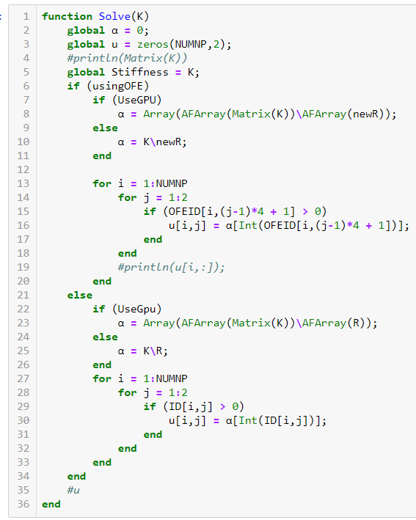
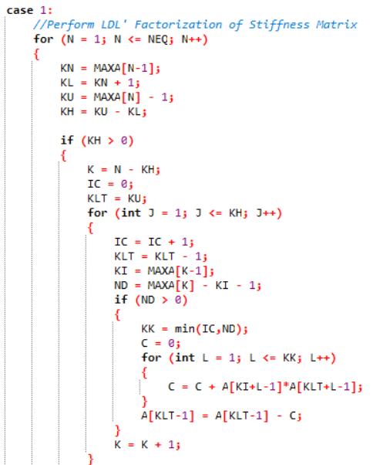
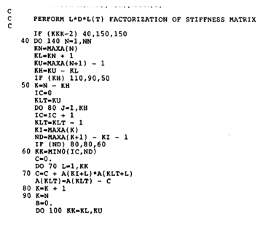
Results
VS
Bathe, K.J (2014). Finite Element Procedures.
Original implementation of OFE code in C++.
Current implementation of OFE code in JULIA.
Naïve implementations of sparse matrix solvers (using LDL factorization) in FORTRAN and C++, using ~100 lines of code.
One backslash operation in JULIA (and MATLAB)

Slide 12
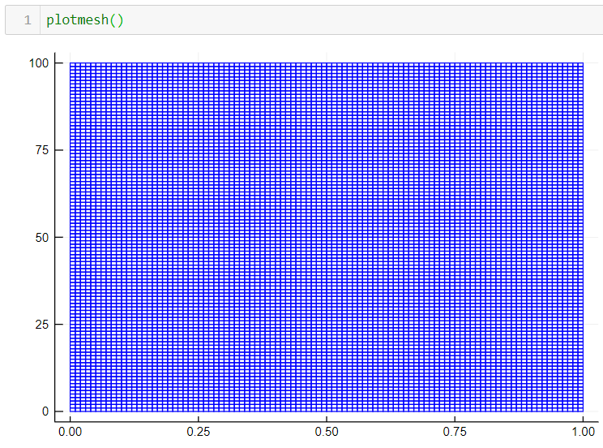
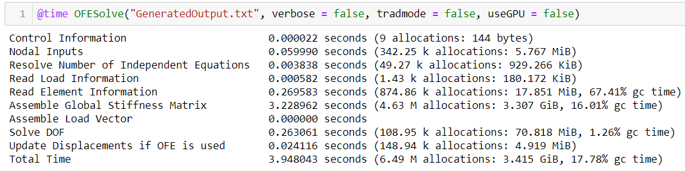
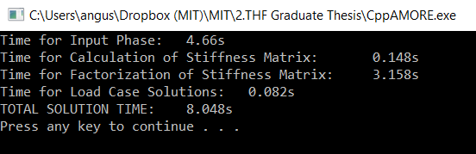
Results
Solving for a 20200x20200 matrix for traditional FEM
JULIA is much faster in most operations
 | C++ | JULIA
Input Phase | 4.66s | 0.334s
Stiffness Matrix Calculation | 0.148s | 3.23s
Matrix Solve | 3.24s | 0.263s
Total Time | 8.05s | 3.83s

Slide 13
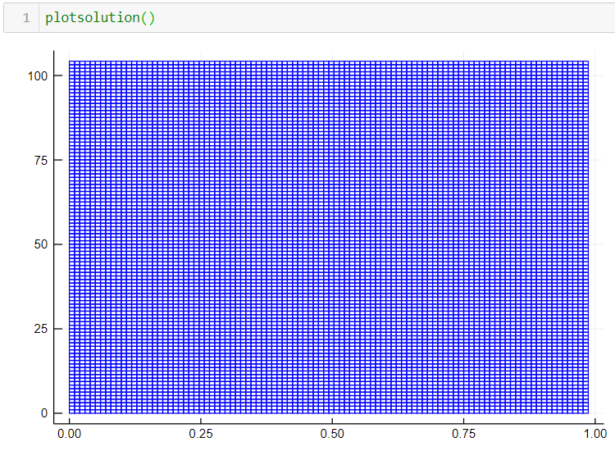
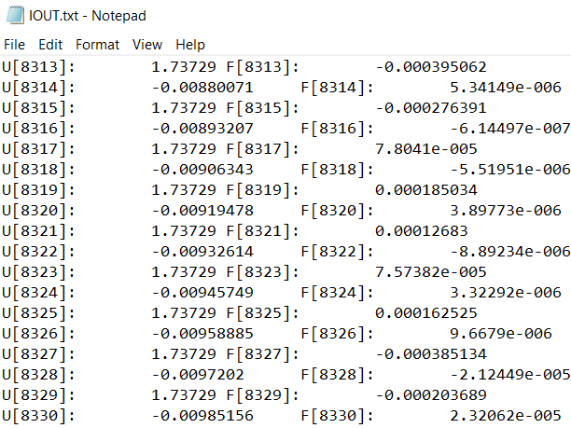
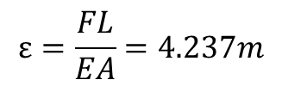
Results
$$ε=\frac{FL}{EA}=4.237m$$
F = 5x10⁹N
Analysis of output
Better productivity on JULIA
E = 118GPa
A = 1m²
L = 100m
VS
Ability to conduct visualization on JULIA
Need for additional data processing on C++

Slide 14
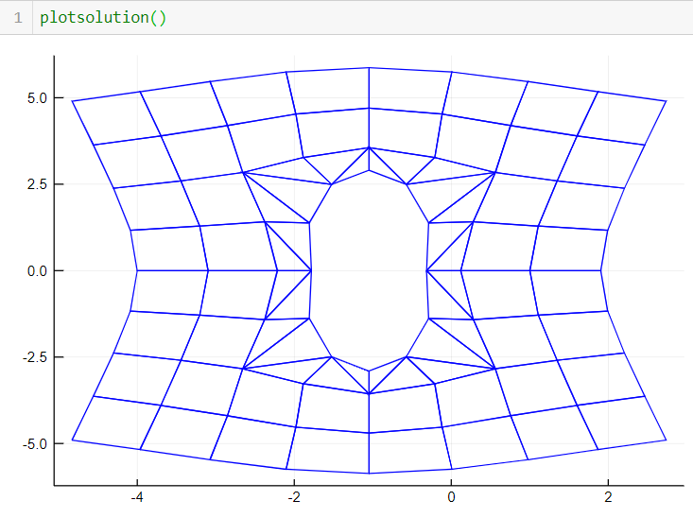
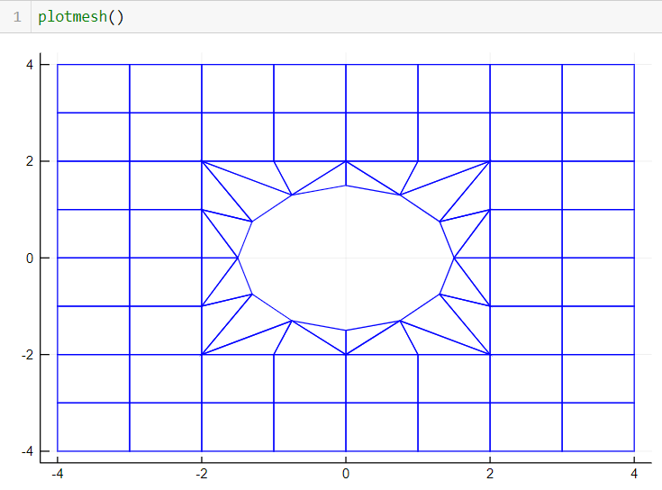
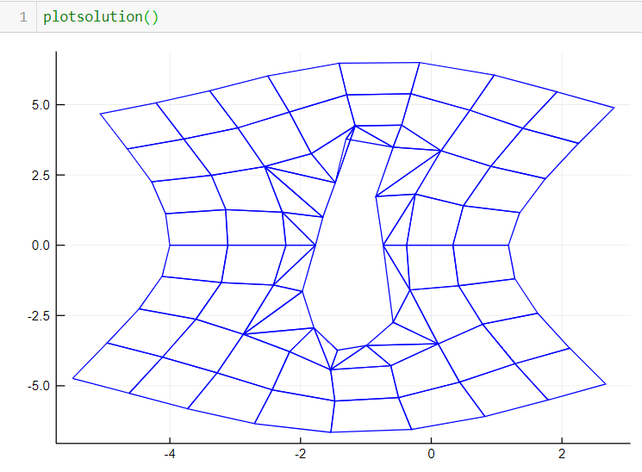
Results
Visual Debugging
Able to immediately debug theoretical developments (in OFE research), as well as other optimisations such as multi-threading
Have confidence in solution because mesh is symmetric in X and Y.
F
Obvious bugs. No need to analyse data further.
F

Slide 15
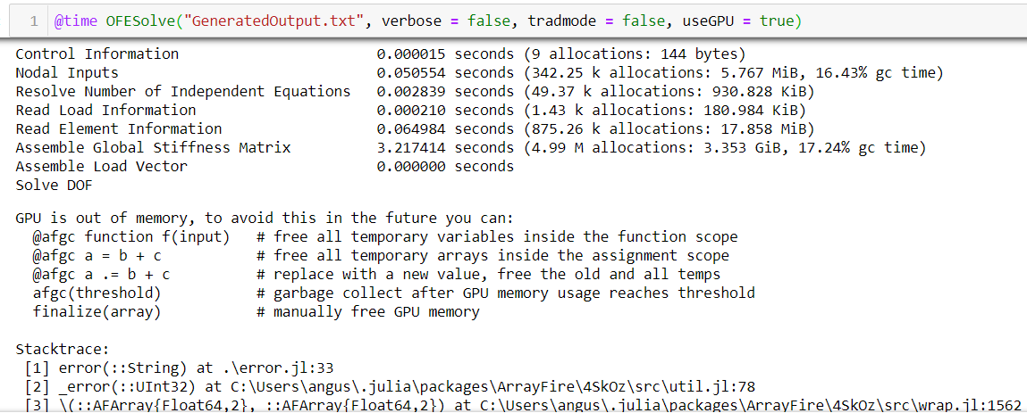
Results
GPU acceleration using ArrayFire.jl
Shown in previous projects to require > 10⁶ DOFs to be able to observe computational speed-ups on GPU (Cohen, B.S. GPU Implementations for Finite Element Methods, 2016).
My GPU is currently unable to handle > 10⁴ DOFs

Slide 16
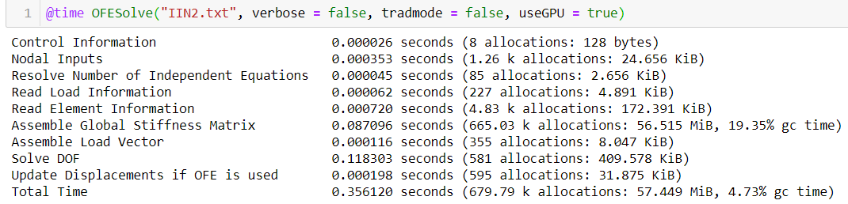
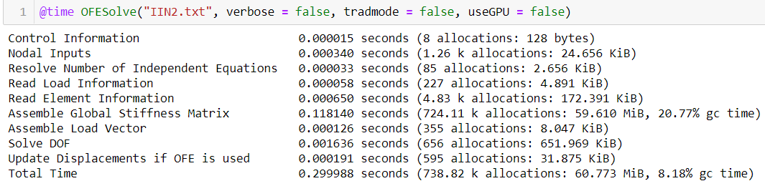
Results
GPU acceleration using ArrayFire.jl
With smaller DOFs, no speed-ups are observed as expected (slow downs observed due to overheads)
Moreover, main bottleneck occurs in assembly of Global Stiffness Matrix rather than in solving matrix (for now)
Solve DOF: 0.118303s (with GPU)
Solve DOF: 0.001636 (w/o GPU)

Slide 17
Results
Multi-threading
2 embarrassingly parallel code sections
Compute local stiffness matrix for all elements
Each element’s local stiffness matrix is independent from other elements
Compute quadrature for each individual element
Overlapping Finite Elements require at least 12 quadrature points per element (computational complexity of each quadrature point is high)
No obvious requirements of locks (expensive) due to how @threads is set-up
Able to index and store into a container using iteration number in parallel threads, then sequentially adding up upon finishing threads (useful for embarrassingly parallel code, but not very useful otherwise)
Currently still debugging concurrency bugs
Preliminary (erroneous) results with 8 threads suggests ~1.5x speed-up with 10000 traditional elements (20200x20200 matrix)

Slide 18
Conclusion
 | JULIA | C++ /FORTRAN | MATLAB
Productivity
Working with matrices
Visual debugging
Easy to implement parallelism | *
Performance
Runs fast |  | **
Meshing support***
GPU acceleration****
* Multi-threading still experimental (e.g. println() crashes kernel, makes debugging hard)
** Naïve implementation of banded LU is slower than existing solvers in JULIA
*** Both JULIA and MATLAB have graphing support (MATLAB has built-in meshing algorithms; JULIA has LightGraphs.jl and gmsh.jl; C++ also has gmsh)
**** All 3 languages are able to work with CUDA, although there are more packages such as ArrayFire for JULIA and C++.

Slide 19
Conclusion
JULIA has shown great efficiency in handling both traditional FEM and Overlapping Finite Element (OFE) algorithm implementations (in both performance and efficiency)
Multi-threading is still difficult in JULIA due to being unable to print out debugging information while threaded code is running
Future work
Develop meshing algorithm compatible with OFE using LightGraphs.jl and gmsh.jl (or possibly create wrapper functions around EllipticFEM.jl)

