Slide 1
Adversarial Machine Learning in Julia
Paul Gibby
12/10/2018

Slide 2
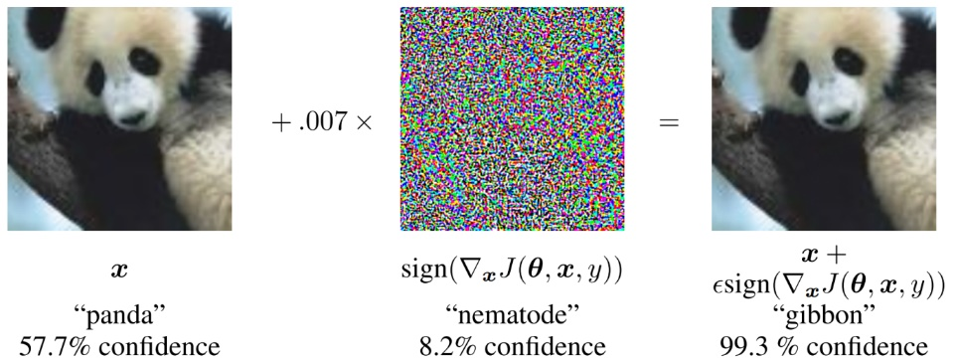
Adversarial Machine Learning
Adversarial machine learning is when you take input and perturb it imperceptibly to make a machine learning algorithm respond “incorrectly”
Most attacks currently target image classifiers
The existence of these adversarial examples means that we can’t fully trust the output of machine learning if an adversary can control the input.
This is most dangerous in the case of malware classification

Slide 3
Why Julia?
Julia is well suited for machine learning and optimization problems, and does them very fast.
Easily extendable
Many helpful libraries like Knet
Easy parallelization
Currently doesn’t seem to exist yet in Julia (closest is a couple of implementations of GAN)

Slide 4
Adversarial Algorithms
L-BFGS
Optimization of a cost function with box constraints
Fast Gradient Sign Method (FGSM)
A single step of gradient descent. Weakest method, but very fast
Iterative Gradient Sign Method (IGSM)
Multiple steps of gradient descent
JSMA
For each step, finds a pair of pixels that if changed will have the greatest effect of moving the image to the target
Carlini-Wagner
A sophisticated attack that bypasses an early attempt at defense. Similar to L-BFGS, but optimized over a tanh space and a different cost function

Slide 5
Distance Metrics
We assess whether a change to an image is imperceptible by measuring its distance from the original
L2 distance – Standard Euclidean distance between flattened images
Simple and fast
DSSIM – a measurement of visual distortion between two images
More complicated, but better reflects human vision

Slide 6
To the Demo!

Slide 7
Comparison with CleverHans
Attack | CleverHans (Python) | Julia
FGSM | 0.14 | .05
JSMA | 20,000 | 75

Slide 8
Practical Application – Malware Detection
Took data of traits (API calls, etc) of malware and trained a classifier on it.
With a simple algorithm, each malware could have a single feature added to it that causes a misclassification

Slide 9
Thank You!

