Slide 1



infoganJL: Julia implementation of InfoGAN neural network for semi-supervised clustering of breast cancer cells
Christian Landeros
Harvard-MIT Program in Health Sciences and Technology
Center for Systems Biology, Massachusetts General Hospital

Slide 2
Overview
Problem Motivation
InfoGAN Background
Implementation Design & Results

Slide 3
Overview
Problem Motivation
InfoGAN Background
Implementation Design & Results

Slide 4
Problem Motivation
Breast Cancer Biopsy Analysis
Presence of key hormone and growth factor receptors on breast cancer cells inform clinical decision-making

Slide 5
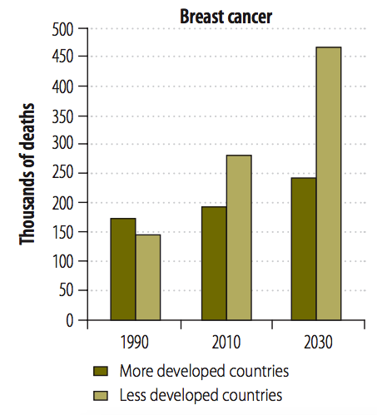
Problem Motivation
Breast Cancer Biopsy Analysis
Presence of key hormone and growth factor receptors on breast cancer cells inform clinical decision-making
For low-resource settings, time-consuming and costly biopsy analysis methods create diagnostic bottlenecks
Tsu, V. D., Jeronimo, J., & Anderson, B. O. (2013). Why the time is right to tackle breast and cervical cancer in low-resource settings. Bulletin of the World Health Organization, 91, 683-690.

Slide 6
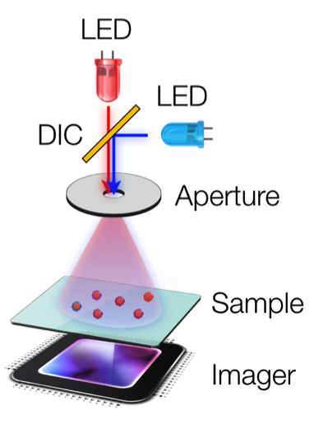
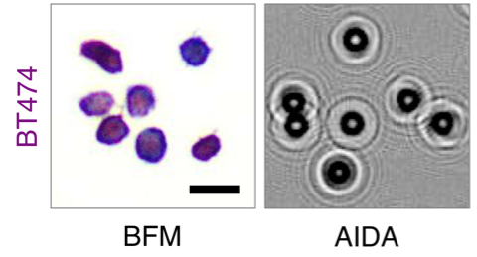
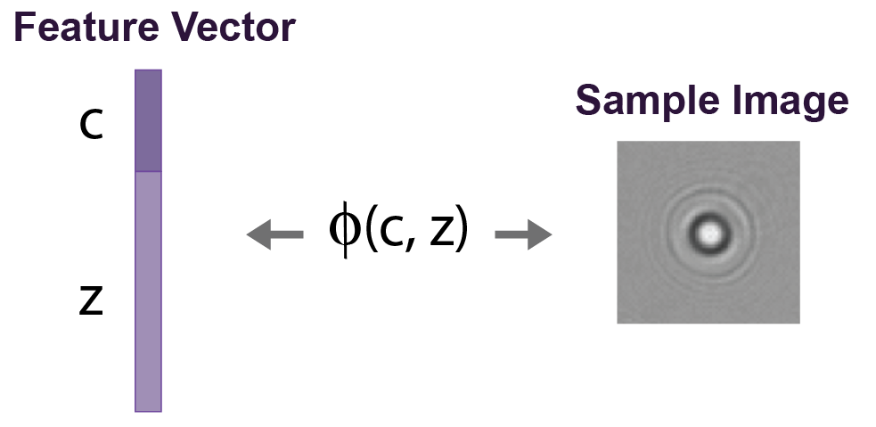
Problem Motivation
Digital Holography for Low-Cost Molecular Data Aquisition
Computational
Reconstruction
Digital Holography
Bright-field
Image

Slide 7
Problem Motivation
Digital Holography for Low-Cost Molecular Data Aquisition
Not very feasible for low-resource settings
Computational
Reconstruction
Digital Holography
Bright-field
Image

Slide 8
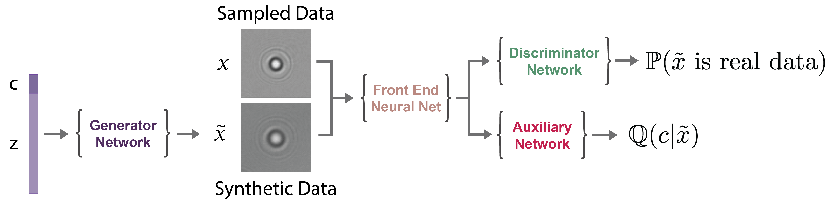
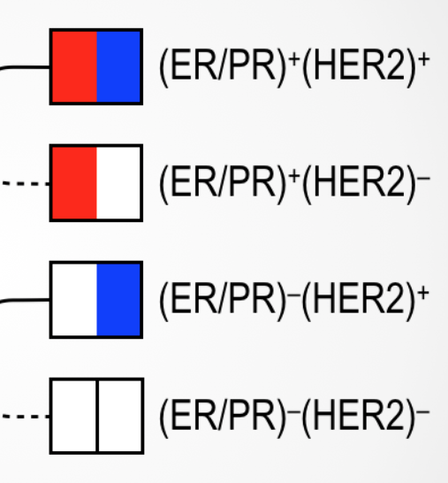
Problem Motivation
Breast Cancer Biopsy Analysis
Single-cell Cut-outs
size = (64,64,2)

Slide 9
Overview
Problem Motivation
InfoGAN Background
Implementation Design & Results

Slide 10
InfoGAN Background
Classification by Generative Adversarial Networks
Single cell under imaged by digital holography
Key assumption: Any data sample is the end result of a generative process where complex interactions from many independent factors generate data variability

Slide 11
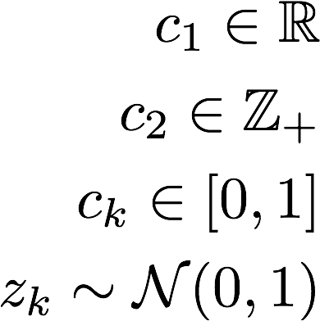
InfoGAN Background
Classification by Generative Adversarial Networks
Example:
“background illumination”
“number of cells”
…
“red coloration”
…
“ovalness of cell #1”
Key assumption: Any data sample is the end result of a generative process where complex interactions from many independent factors generate data variability

Slide 12
InfoGAN Background
Classification by Generative Adversarial Networks
Example:
“background illumination”
“number of cells”
Features that we care about and want to learn
…
“red coloration”
…
“ovalness of cell #1”
Key assumption: Any data sample is the end result of a generative process where complex interactions from many independent factors generate data variability

Slide 13
InfoGAN Background
Classification by Generative Adversarial Networks

Slide 14
InfoGAN Background
Classification by Generative Adversarial Networks

Slide 15
InfoGAN Background
Classification by Generative Adversarial Networks

Slide 16
InfoGAN Background
Classification by Generative Adversarial Networks
We want to minimize “entropy” of this distribution to so that c provides maximum information

Slide 17
Overview
Problem Motivation
InfoGAN Background
Implementation Design & Results

Slide 18
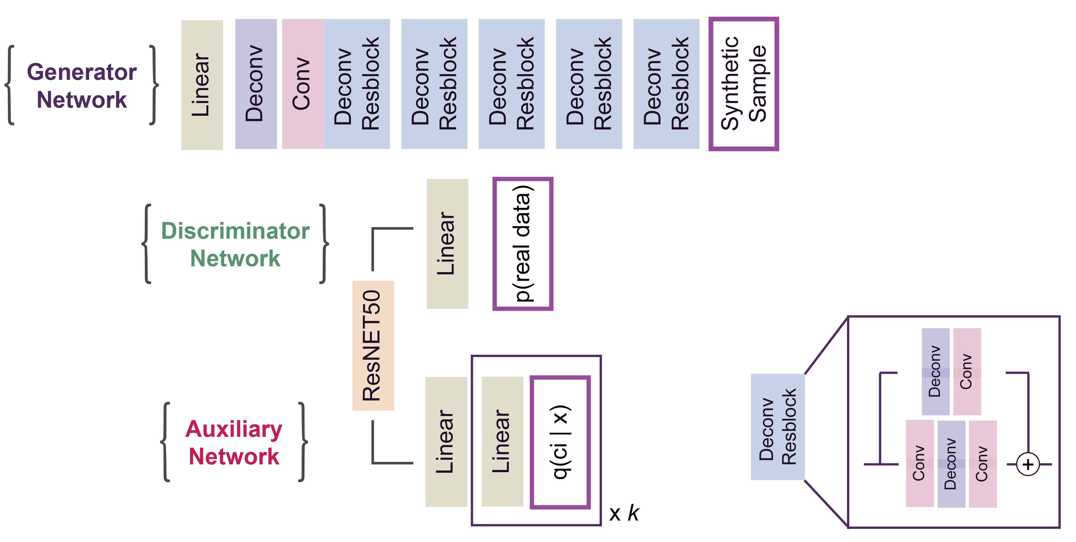
Implementation Design & Results
Network Architectures

Slide 19
Implementation Design & Results
Network Architectures

