Slide 1
Identifying the Optimum Perovskite Catalyst for Water Splitting using Julia
Yusu Liu
10/10/2018

Slide 2
Background
Hydrogen Economy
Highest mass energy density
~10% yearly growth but 96% of generation in 2016 from hydrocarbon fuels
Energy Storage
Coupling of electrochemical water splitting devices grid scale renewable energy harvesting technologies
NASA Goddard Institute for Space Studies - http://data.giss.nasa.gov/gistemp/graphs/
Notes:
Local energy storage option

Slide 3
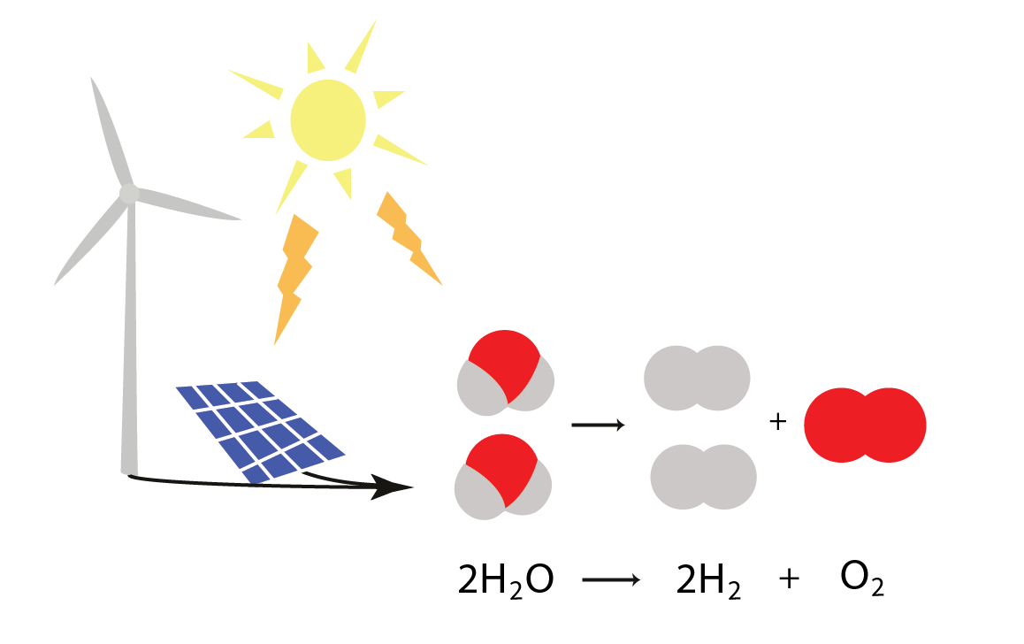
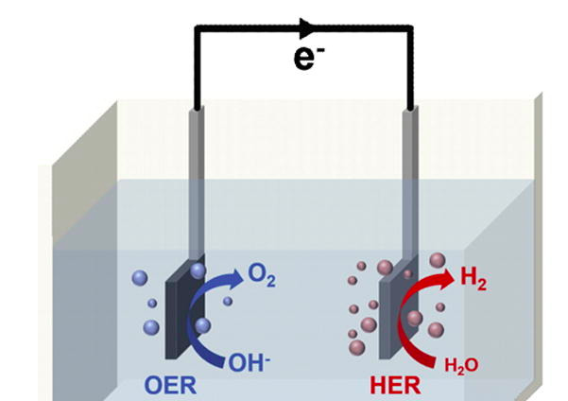

Water Splitting Process
Oxygen evolution reaction (OER)
substantial overpotential and slow kinetics
need catalysts
Hydrogen evolution reaction (HER)
Notes:
Equilibrium potential
Vop=Veq+Va(kinetic)+Vc(kinetic)+resistance

Slide 4
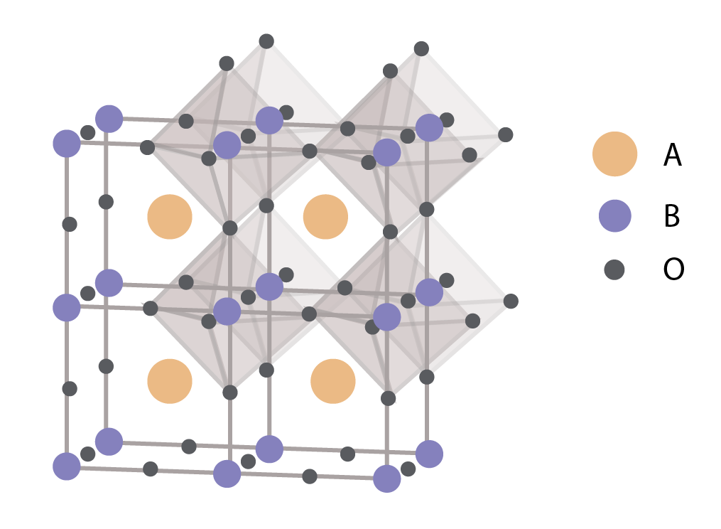
Perovskites
A-site ions: alkaline earth or rare earth metals
B site ions: 3d, 4d, 5d transition metal elements
Perovskites: ABO₃
Tunable properties
Stability under alkaline OER conditions
Surpass golden standards such as IrO₂ and RuO₂ for OER

Slide 5
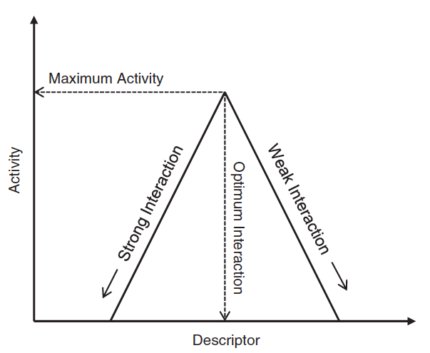
Scaling Relations
Sabatier’s Principle: the best catalyst binds the intermediate neither too weakly nor too strongly
The best descriptors describe the interaction between a key reaction intermediate and the catalytic surface (oxygen adsorption energy in the OER case)
What is the most efficient way to predict oxygen adsorption energy given a perovskite structure?
Experiments and computational chemistry too expensive
Train an ML network? How to represent chemistry?
Sabatier P (1911) Hydrogenation and dehydrogenation by catalysis. Ber Dtsch Chem Ges 44:1984–2001
Doyle, Richard L., and Michael EG Lyons. "The oxygen evolution reaction: mechanistic concepts and catalyst design." Photoelectrochemical solar fuel production. Springer, Cham, 2016. 41-104.

Slide 6
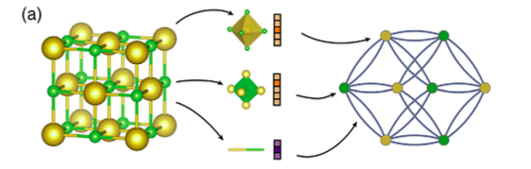
Method – 2 ways of representing a structure
Chemical formula only
Encoding structural information
A site(s), B site(s) and adsorption site
Vector (or the average of n vectors for perovskites with multiple A or B sites) encodes information from the periodic table such as period, group, electronegativity, atom size, polarizability.
Crystals are converted to graphs with nodes representing atoms in the unit cell and edges representing atom connections. Nodes and edges are characterized by vectors corresponding to the atoms and bonds in the crystal, respectively
CGCNN – convolutional layers iteratively update local information, pooling layer updates overall feature vector for the cyrstal
https://journals.aps.org/prl/pdf/10.1103/PhysRevLett.120.145301

Slide 7
Data collection
B site
A site
ABO₃, AA’BB’O_{3,} ABB’O₃, AA’BO₃

Slide 8
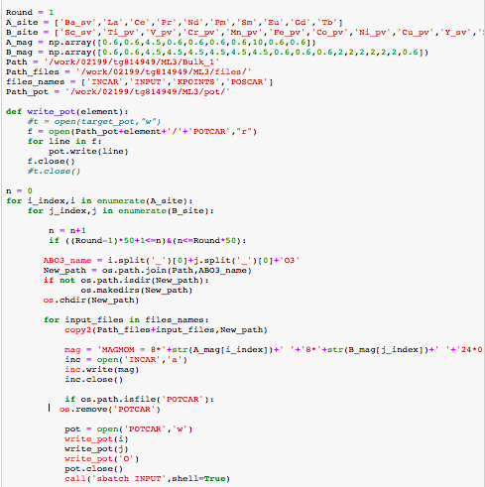
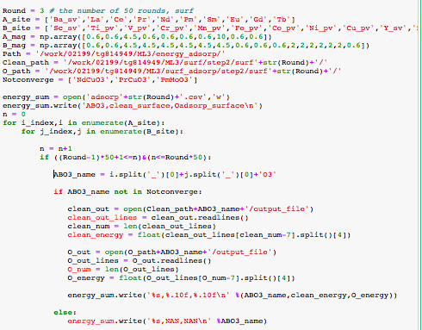
From periodic table to simulation
Set up calculations
Get oxygen adsorption energy
Input element combinations
…
…
Oxygen adsorption energy calculation done with Density Functional Theory in VASP
1004 stable structures

Slide 9
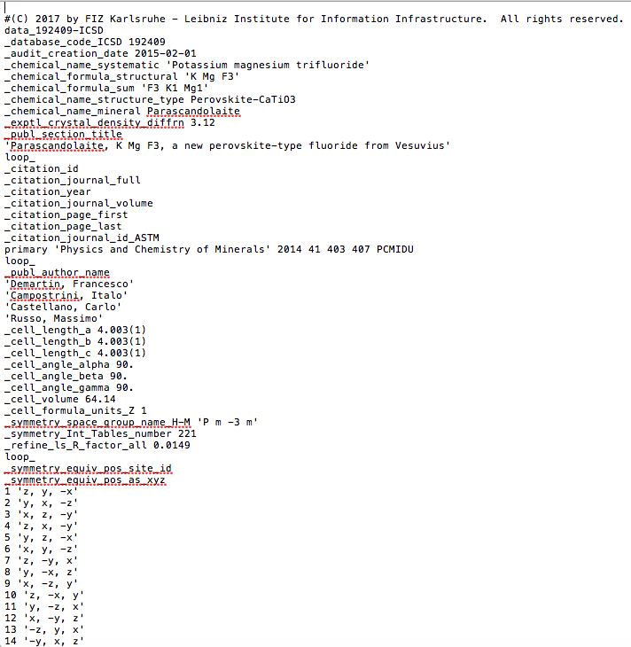
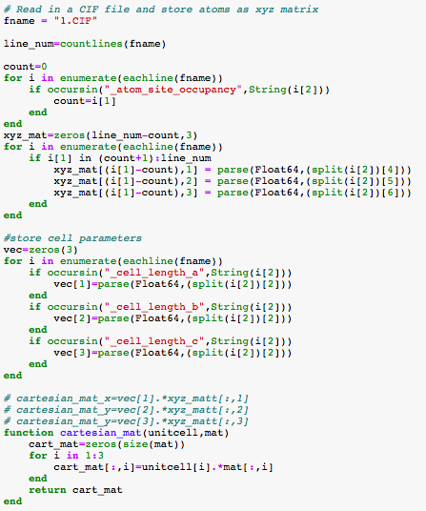
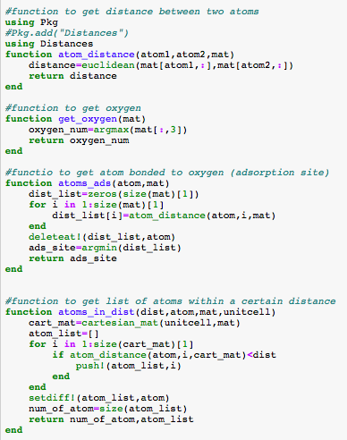
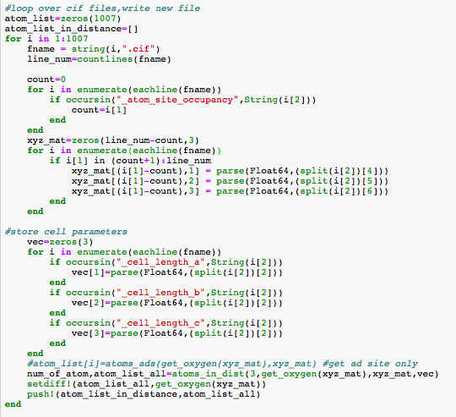
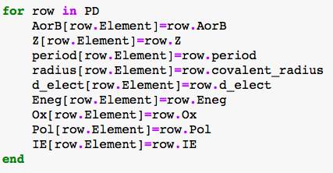
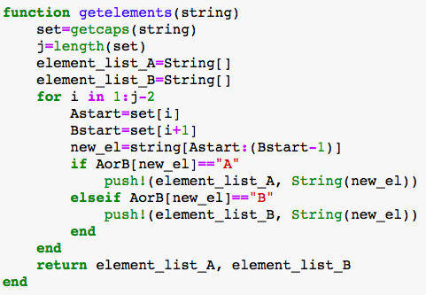
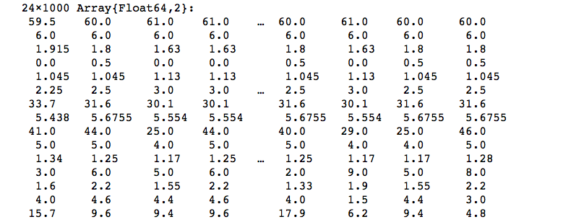
From CIF or chemical formula to vectors
…
Reads in CIF (Crystallographic Information File) or chemical formula, gets information about unit cell and element information from periodic table and make vector representations of compounds

Slide 10
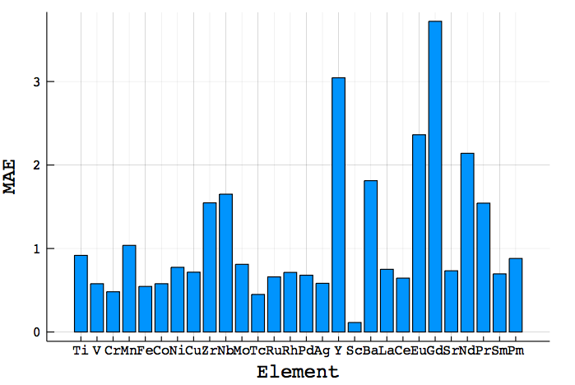
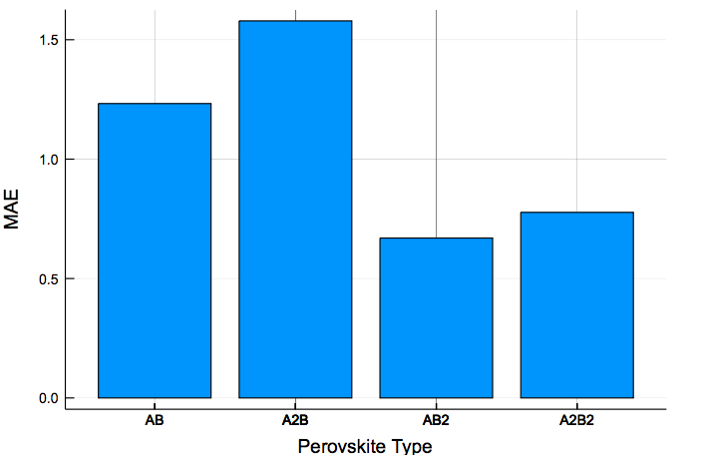
Results
Linear regression on only chemical formula information can get to 0.9 eV MAE
Most weight to electronic properties of adsorption site (d electron count, electronegativity, polarizability)

Slide 11
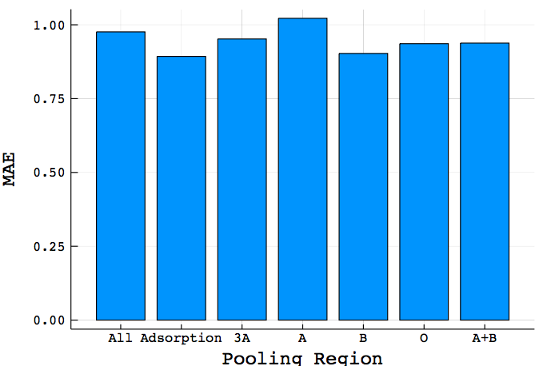
Results
Using crystal graph does not perform significantly better than linear regression
Geometry doesn't matter as much as atom identity
Pooling only adsorption site or B atoms gives the best result – local information contributes the most!

Slide 12
Chemistry lessons
Oxygen doesn't ‘see’ far enough for the bulk crystal properties to matter – surface adsorption site is the most important input, followed by surface layer.
Can bypass computational chemistry inputs and directly use information from the periodic table (acceleration!)
Predicting surface properties with ML deviates significantly from predicting bulk properties

Slide 13
Thank you!

Slide 14
Technical summary
Julia packages used
CSV
Autograd
Knet
Distributions
Plots
Distances
Julia contribution helpful to other users
Really no computational chemistry Julia ’helpers’ out there
Parsing of crystal structures and chemical formula into vectors/arrays for ML, library of periodic table properties
Python portion
CGCNN in Python with pooling
VASP job generation

