Slide 1
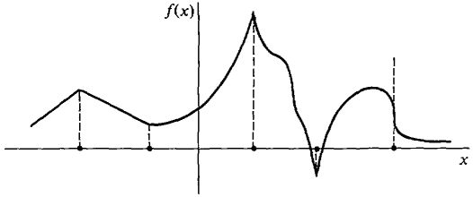
Automatic differentiation methods for nonsmooth functions
Suzane Cavalcanti and Caroline Nielsen
18.337: Modern Numerical Computing
Massachusetts Institute of Technology
December 12, 2018

Slide 2
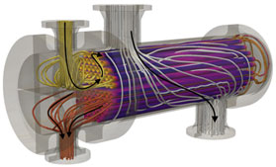
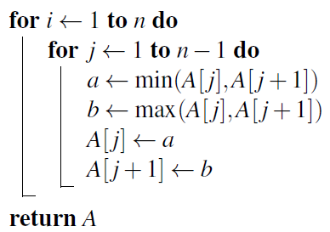

Nonsmooth functions: Applications
Physical systems with multiple regimes of operation
Sorting algorithms
Machine learning: ReLU
Notes:
Sorting algorithm and machine learning
Physical systems/process models (flash, column, heat exchanger).
- This graph - Need for Jacobians:

Slide 3
Generalized 1st derivatives for nonsmooth functions
Steady state model simulation:
Solve with Newton methods…
B-subdifferential: the set of limiting Jacobians…
…how to compute them?
The LD-derivative:
Chain rule
Automatic computation
Directions matrix
Nonsmooth “derivative” rules
K. A. Khan, and P. I. Barton. Optimization Methods and Software. 30(6):1185-1212, 2015.

Slide 4
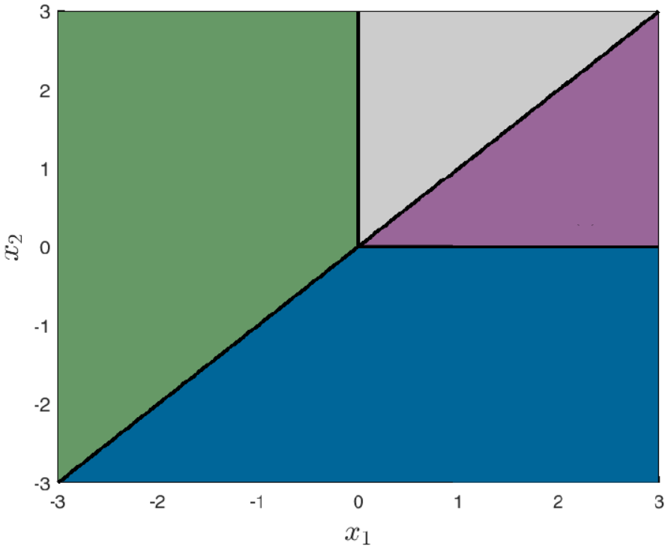

Why do we need LD derivatives?
2 pieces
3 pieces
Combining active pieces of each equation doesn’t guarantee an essentially active function!

Slide 5
How do LD derivatives work?
Directions matrix:
LD derivative:
Computed with forward automatic differentiation

Slide 6
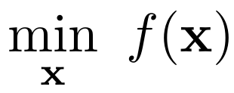

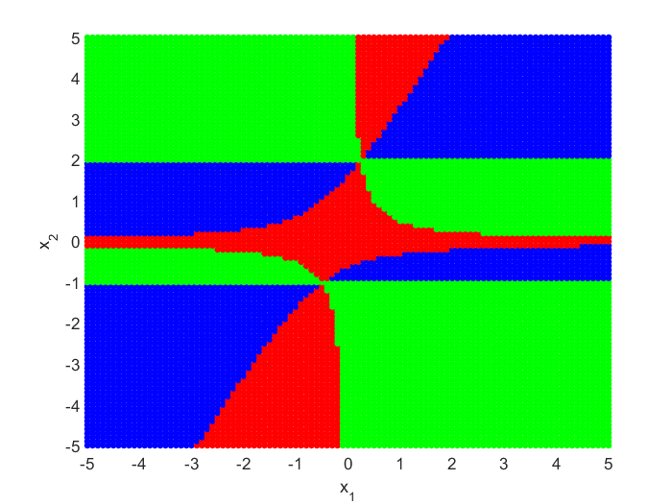

Generalized 2nd derivatives…?
Optimization of nonsmooth functions:
Generalized Hessians are not defined in the literature!
But… can’t we think of the set of limiting Hessians?
NEW: 2nd LD-derivative rules
Exact limiting Hessians!

