Slide 1





ALGOSTROM 2K25 organized by AUC
PROBLEM : ” The hidden dangers of cracked apps , free comes at a cost”
TEAM
TECH OYSTERS
Shashi Bhushan [team leader]
Tazmeen Iqbal
Dristi Sundarka

Slide 2
Problem
Many users download cracked apps to avoid for original software.
Cracked apps often contains hidden viruses , malware, or ransomware.
These threats can steal sensitive data like banking credentials and personal information.
Devices may get damaged , slowed down or hacked due to malicious code.
Widespread use of cracked apps contributes to growing global cybersecurity risks.

Slide 3
Global rise in cybersecurity threats due to cracked apps
Between just January and September 2023, there were 5.6 billion attempted malware attacks globally , with an average of 400,000 new malware variants created daily. As of early 2023 , over 1 billion malware programs were known.
Globally , the average ransom demand hit $55.2 million in 2024, with 153 countries
affected and 1424 major industrial enterprise attacks [ a 15% increase from 2023].
In 2023, 66% of organizations were ransom targets , and average ransom payouts surged from $812,380(2022) to $1.54 million (2023).

Slide 4
solution
WEB SHIELD helps verify the authenticity and safety of applications before installation.
It scans APK’S or software files for potential malware using trusted security API’S.
With a quick safety score , users can instantly know whether an app is genuine or a hidden cyber threat.

Slide 5
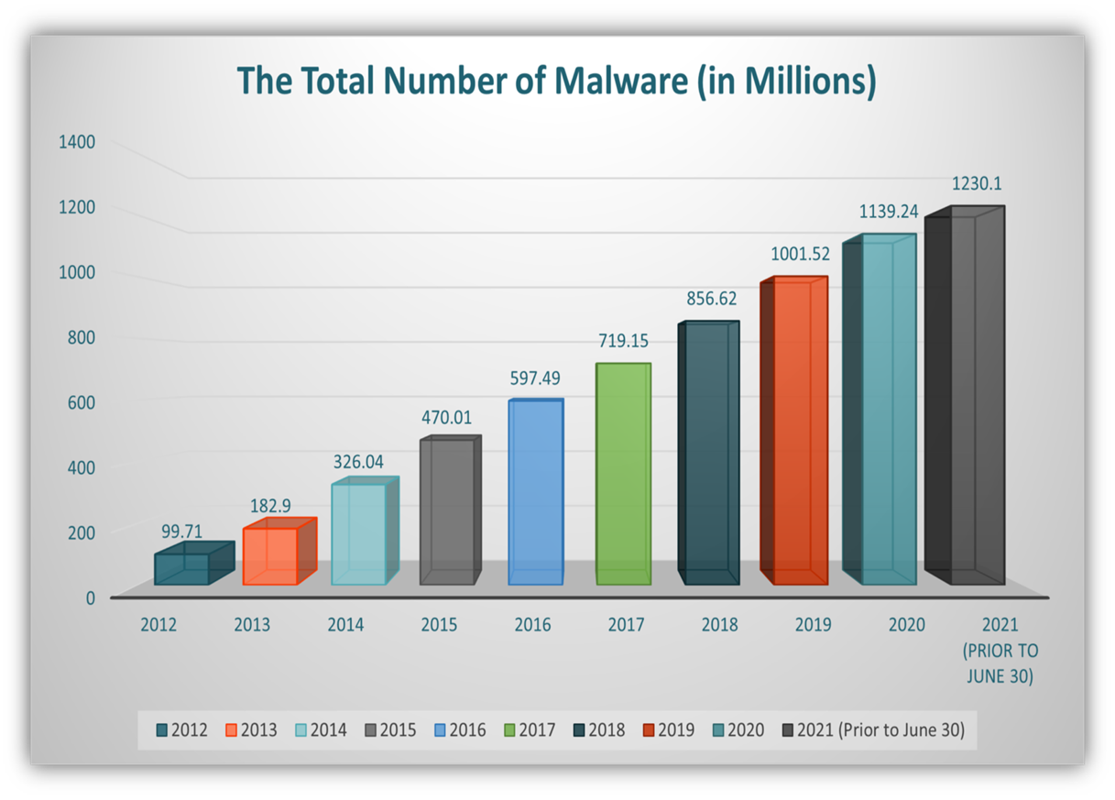
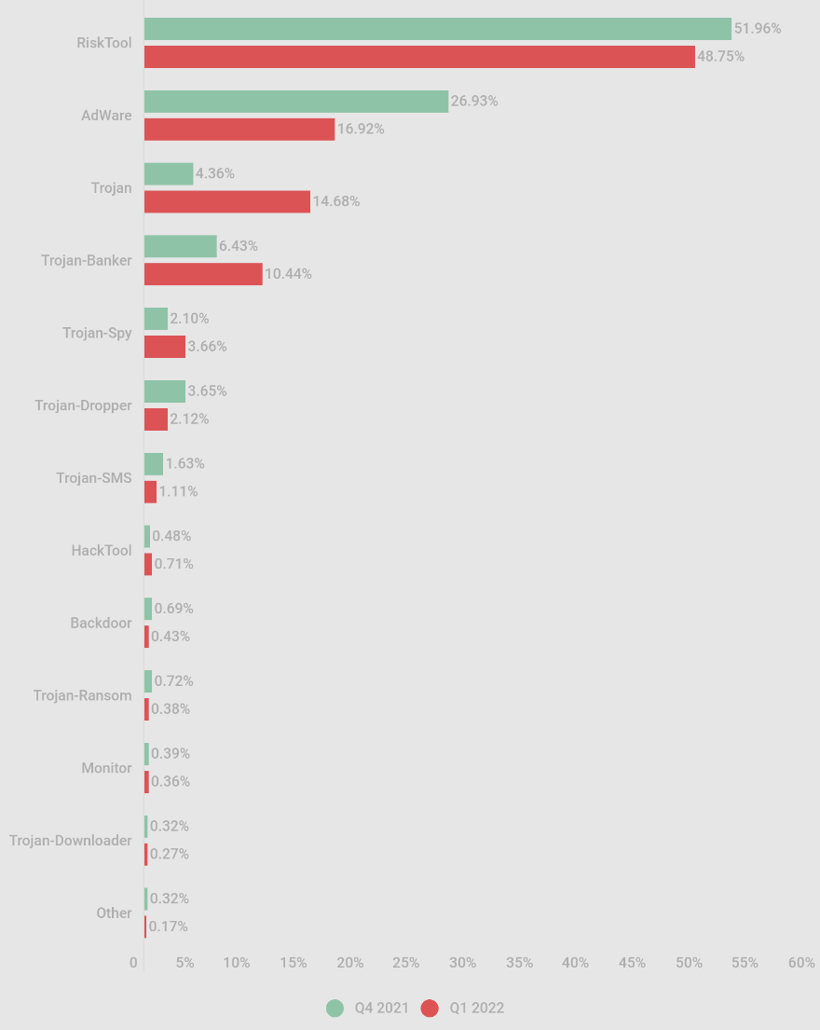

Slide 6
Case examples of cracked applications
1- MICROSOFT OFFICE CRACK (2023)
A cracked version of Microsoft office spread through torrent
sites was found to contain ransomware. Thousands of businesses
were attacked , leading to data loss and millions in damages.
2- ABODE PHOTOSHOP CRACKS
Popular cracked photoshop installers were bundled with cryptojacking
malware. Once installed , they secretly used the victim’s computer power
to mine cryptocurrency, slowing devices and increasing electricity bills.

Slide 7
FUTURE SCOPES
1. Proliferation of Fake and Infected App Stores
In response to the demand for cracked apps, more fake and potentially malicious app stores could emerge, posing even greater risks to users. These stores might offer pirated versions of popular apps and games, with little or no quality control, leading to more widespread infections.
2 . Global cyber security ecosystem
As the use of cracked apps grows, the global cybersecurity infrastructure will likely come under immense pressure. More resources may be needed to monitor, prevent, and respond to threats. This could result in rising costs for businesses, governments, and individuals to secure their networks and data, impacting global productivity and safety.

Slide 8



THANK YOU!

