Slide 1
UBER
BY
HIMANSHU AGARWAL
SHASHI SHEKHAR
NIKHIL

Slide 2
INFORMATION GATHERING
HOW UBER WORKS?
WHO ARE INVOLVED?
WHAT KIND OF DATAS?
VOLUME OF DATA?

Slide 3
BASIC SETUP
CREATED GIT REPOSITORY
SET UP BASIC STRUCTURE OF THE PROJECT
SETUP DATABASE CONNECTION ON ORACLE

Slide 4
EER DIAGRAM
CUSTOMER EER DIAGRAM
DRIVER AND IT’S REALTED EER DIAGRAM
TRANSACTION EER DIAGRAM
MADE ONE COMPLETE EER DIAGRAM USING ALL THE REALTIONSHIP

Slide 5
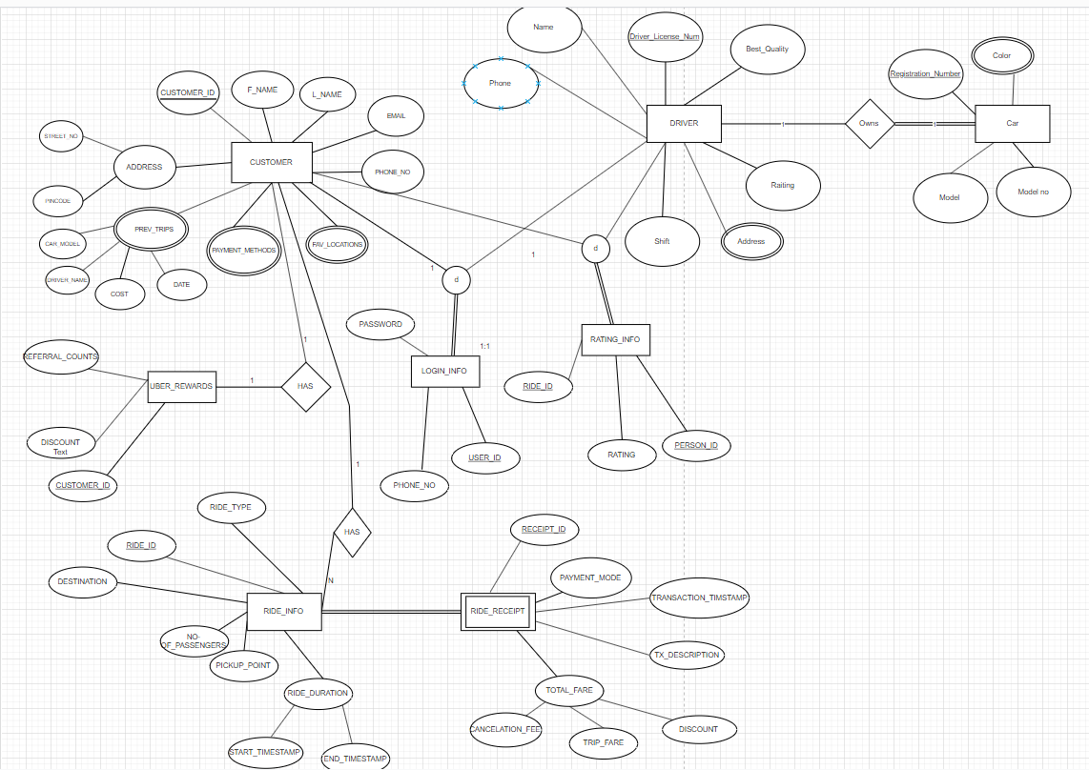
EER DIAGRAM

Slide 6
RELATIONAL DATABASE SCHEMA
STARTED WRITING RELATIONAL DATABASE SCHEMA
FOLLOWED NORMALIZATION RULE
WE TAKE CARE OF 1ST NF,2ND NF, 3RD NF
SEGREGATED RELATIONSHIP ACCORDINGLY

Slide 7
TABLE CREATION
DRIVER, CUSTOMER AND OTHER BASIC TABLE CREATED
PRIMARY KEY AND FOREIGN KEYS CONSTRAINT ARE MAINTAINED IN THE TABLE
ON DELETE SET NULL/CASCADE ARE TAKEN CARE IN DATABASE

Slide 8
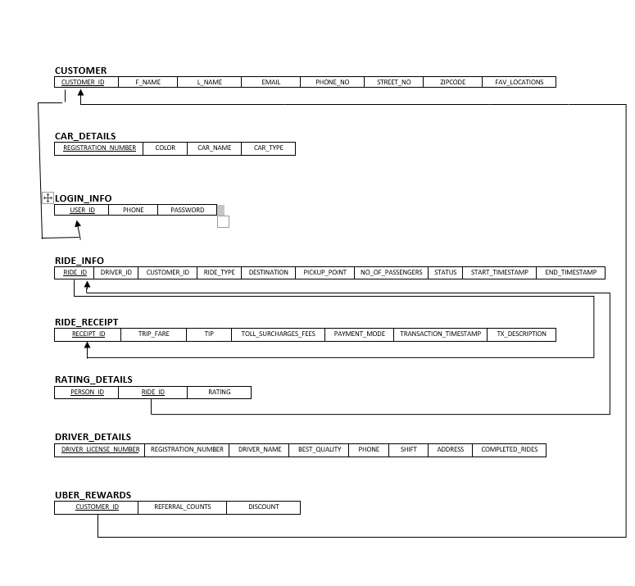
SCHEMA

Slide 9
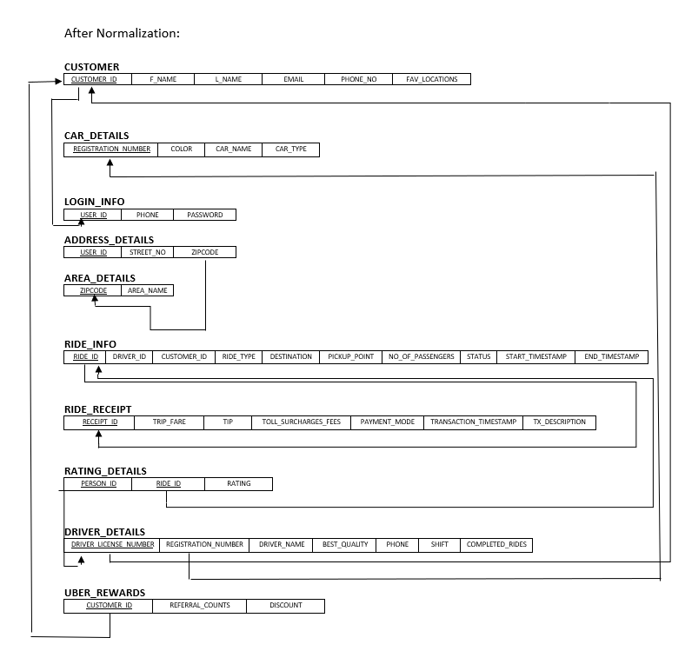
NORMALIZED SCHEMA

Slide 10
TRIGGER AND PROCEDURE
CREATED TWO PROCEDURE AND TWO TRIGGER IN OUR DATABASE
TRIGGER S ARE CONDITIONAL AND LET USER KNOW ABOUT CHANGE IN DISCOUNT AND RIDE COMPLETED STATUS
PROCEUDER IS THERE TO UPDATE THESE IN DATABASE

Slide 11
TESTING AND VALIDATION

Slide 12
Q&A THANK YOU

