Slide 1
ASEPTIC STERILIZATION AND PACKING SYSTEM
SIP, PRODUCTION, CIP OPERATIONS PROCESS FLOW DAIGRAMS

Slide 2
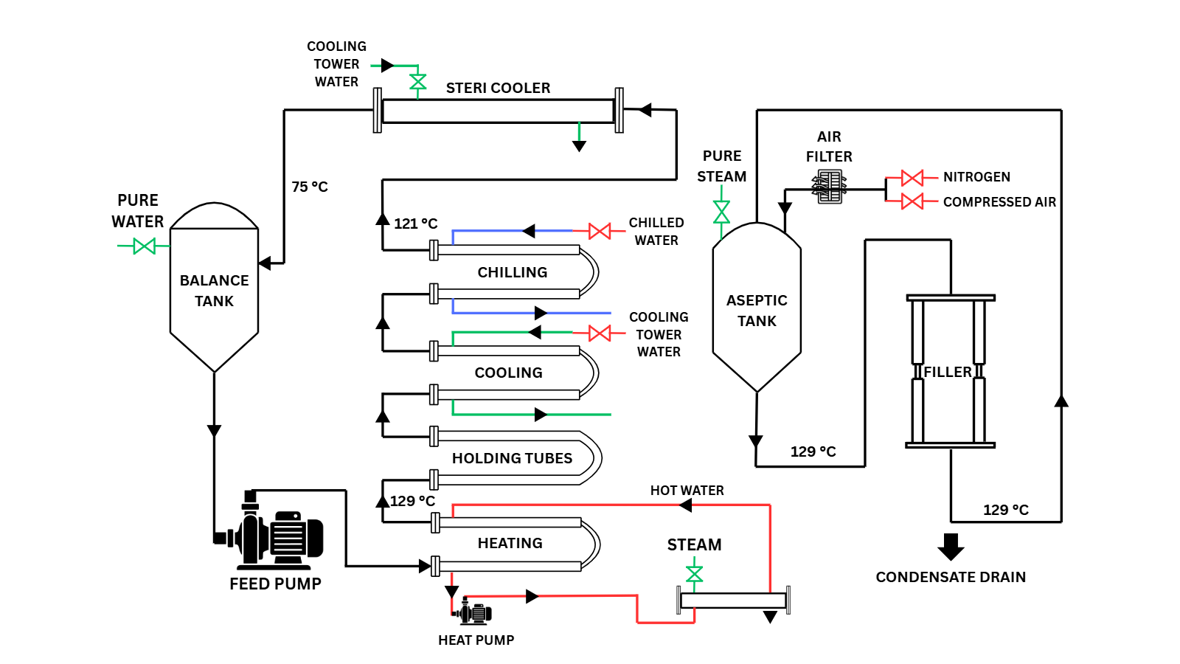
STERILIZATION IN PLACE (SIP)

Slide 3
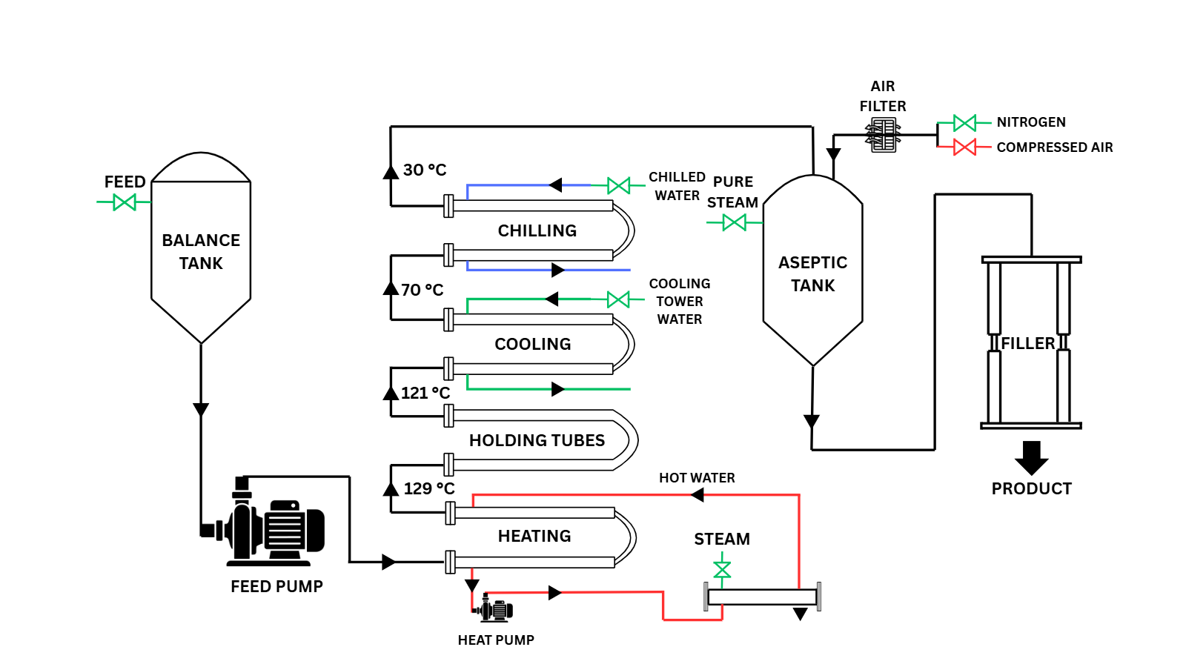
PRODUCTION

Slide 4
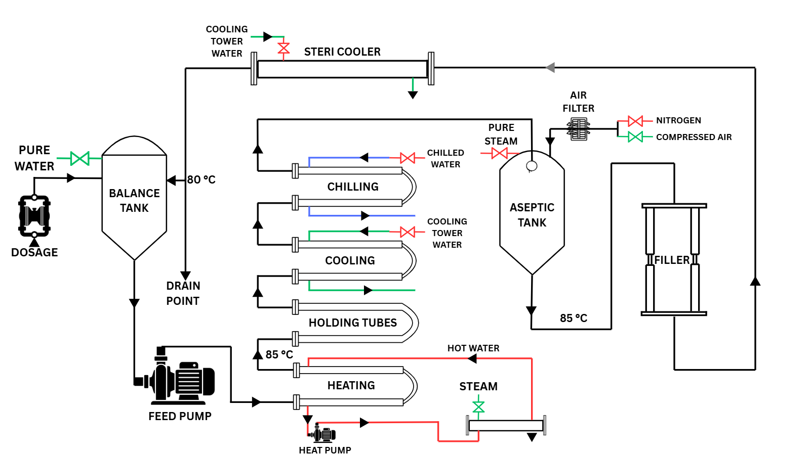
CLEANING IN PLACE (CIP)

Slide 5
THANK YOU

