Slide 1
Introduction to Data Science (CS244)
Air Quality Index
Group – 10

Slide 2
Team Members
Pritam Raj 2001ME52
Priyanshu Patra 2001ME55
Pushpanjay 2001ME57
Rudrransh Saxena 2001ME63
Sanskar Singh 2001ME66
Shashi Ranjan Kumar 2001ME67

Slide 3
About Project
Interpretation and visualization of air quality in different cities of India.
We have taken the concentration of different pollutants in different cities for some specific year intervals.
We have pre-processed the data, visualised it, tested our hypothesis and given our conclusion.

Slide 4
Contents
Data Collection
Data Preprocessing and Cleaning
Data Visualization
Data Statistics
Hypothesis Testing

Slide 5
Data Collection
Data collection is the process of gathering and measuring information on variables of interest, in an established systematic fashion that enables one to answer stated research questions, test hypotheses and evaluate outcomes.
We have downloaded our data from https://www.kaggle.com/rohanrao/air-quality-data-in-india .

Slide 6
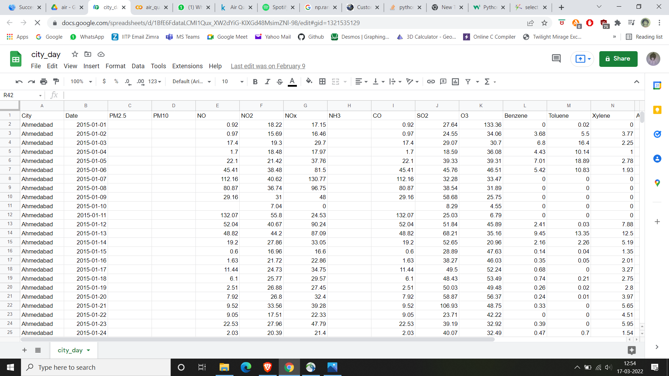
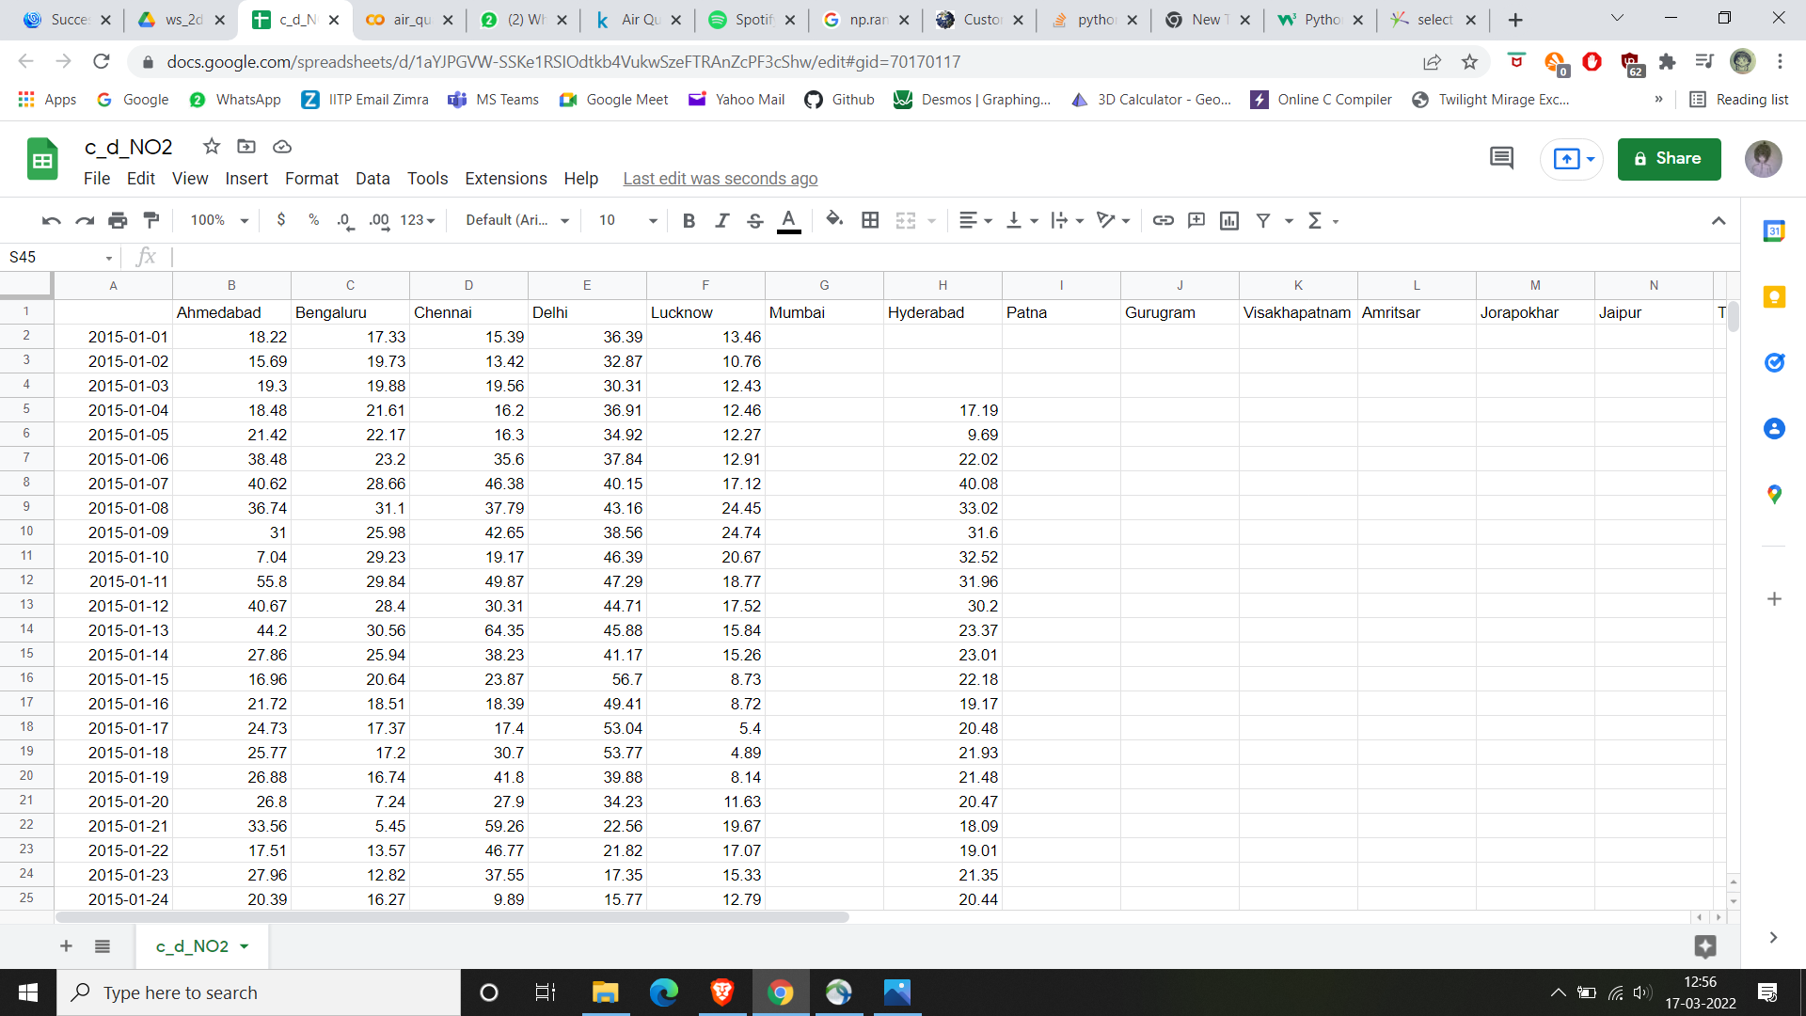
Data Pre-processing and Cleaning
Main csv file(3D) has been converted into Pollutant-wise csv file(2D)

Slide 7
Data Pre-processing and Cleaning
The missing data points had been filled using Arithmetic Progression(AP), for maximum 5 missing data points between 2 available data points.
[ Available data point 1 a
Missing data point 1 a+d
Missing data point 2 a+2d
---------- -----
---------- -----
Available data point 2 a+nd (n<=6)]
After this, cities having more than 80% available data points (in the time interval 2015-2020) have been selected.
There were 5 cities common in each pollutant, having more than 80% data points available.

Slide 8
Data Pre-processing and Cleaning
Then, we found that these 5 cities had approx. 100% available data points in time interval 2017-2020.
We thought that it might happen that cities having less than 80% data points in time interval 2015-2020, might have more than 80% data points in 2017-2020.
So, after applying the ‘80% available data point filtering step’ in the years 2017-2020 for different pollutants, we got 7 common cities and we did our further analysis mainly on these cities:
i) Bangalore v) Jaipur ii) Chennai vi) Lucknow iii) Delhi vii) Thiruvananthapuram iv) Hyderabad

Slide 9
Data Visualization
We have visualized the data pollutant-wise.
In our graphs, we have fixed the pollutant and displayed the variation of concentration of pollutants for different cities with respect to a range of time(i.e. 2017-2020).
We saw that there were some crests (peak points) which meant that the concentration of the specific pollutant was high for that date and vice-versa for troughs.

Slide 10
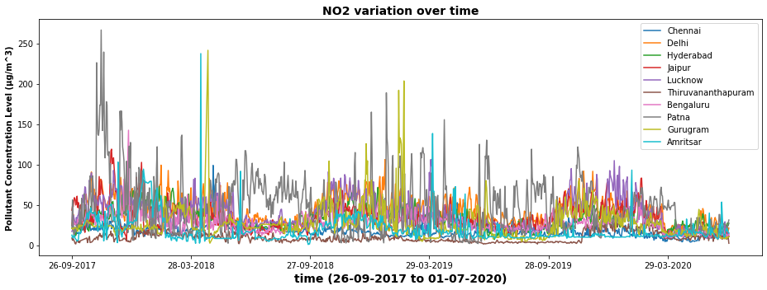
Data Visualization
For example:
This is the graph of NO2, which shows the variation of its concentration for different cities over the years 2017-2020.

Slide 11
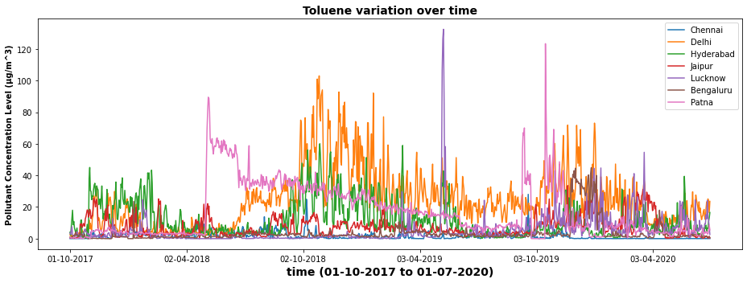
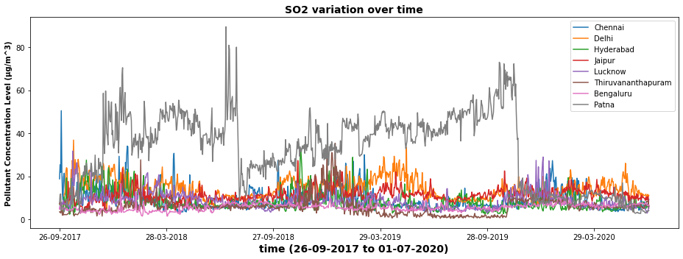

Slide 12
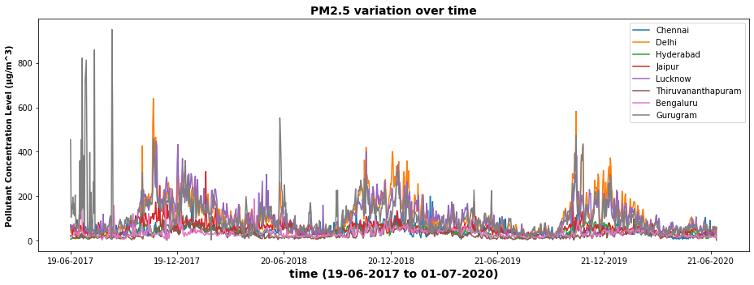
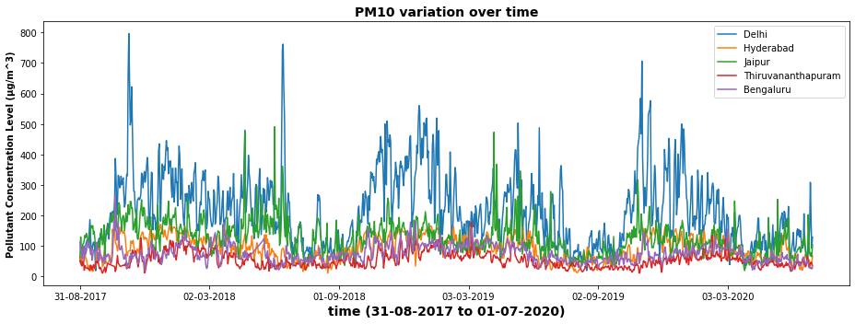

Slide 13
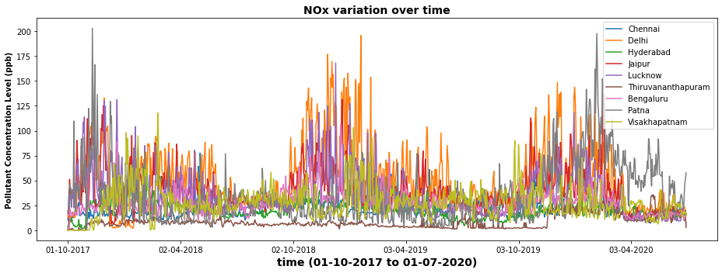
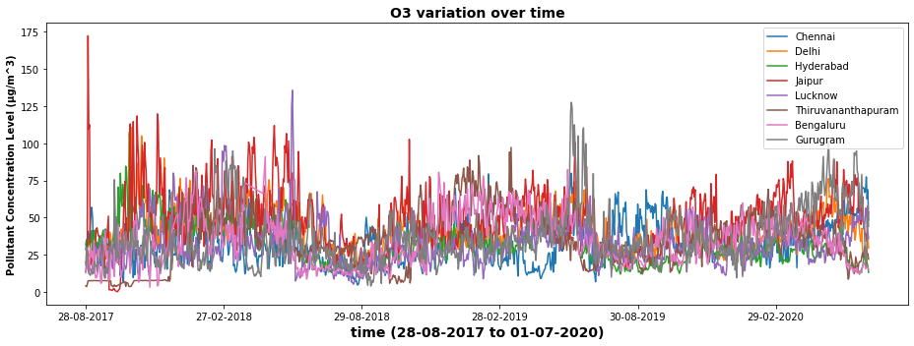

Slide 14
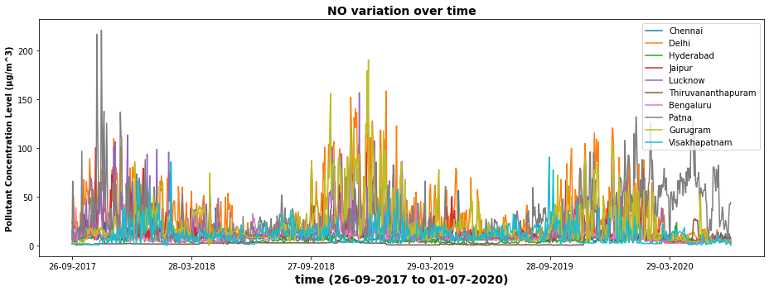
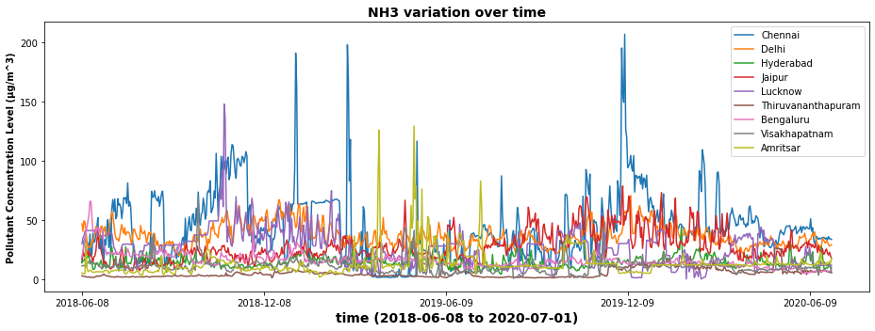

Slide 15
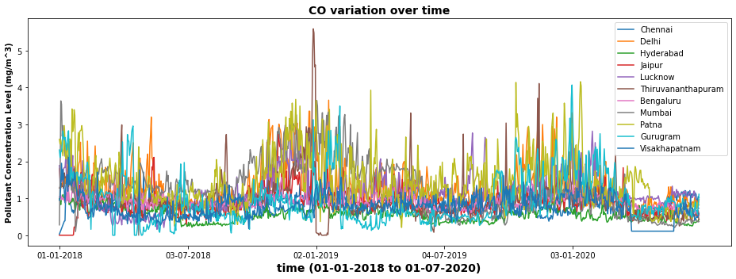
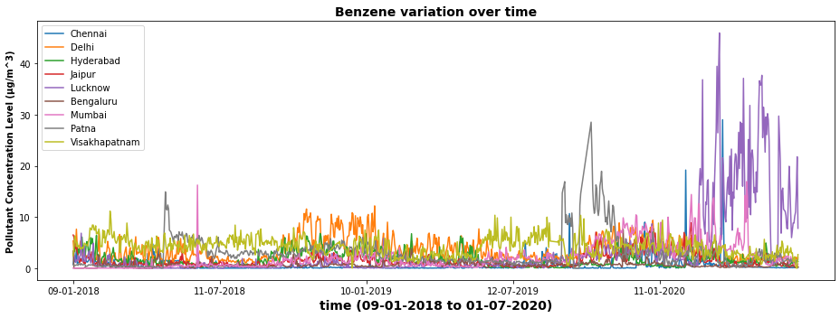

Slide 16
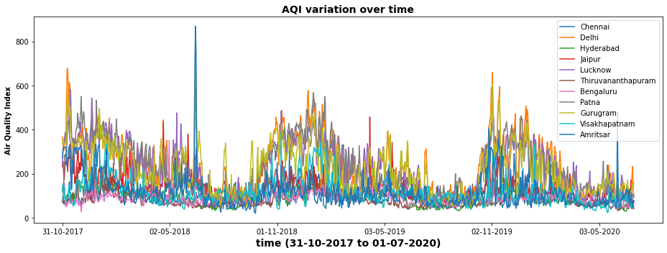
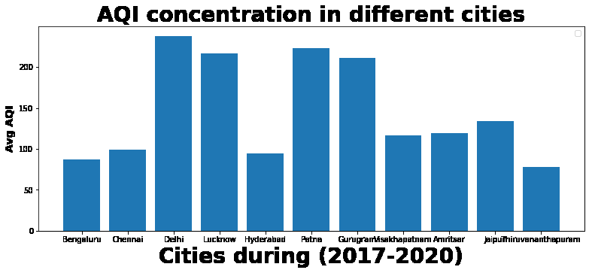

Slide 17
Data Statistics
YEAR(-->) | 2018 |  | 2019 |  | 2020
Pollutant | Highest | Lowest | Highest | Lowest | Highest | Lowest
NO2 | Delhi (45.923) | Thiruvanantha puram (10.106) | Delhi (45.236) | Thiruvanantha puram (6.983) | Delhi (33.202) | Chennai (11.245)
Toluene | Delhi (24.315) | Lucknow (1.225) | Delhi (28.941) | Chennai (1.417) | Delhi (19.813) | Bengaluru (3.905)
SO2 | Thiruvanantha puram (13.643) | Bengaluru (5.530) | Delhi (14.031) | Thiruvanantha puram (4.678) | Delhi (13.912) | Hyderabad (6.612)
PM2.5 | Lucknow (119.246) | Thiruvanantha puram (32.751) | Delhi (108.501) | Thiruvanantha puram (24.895) | Delhi (80.318) | Thiruvanantha puram (26.850)
PM10 | Delhi (240.110) | Thiruvanantha puram (58.426) | Delhi (215.075) | Thiruvanantha puram (51.262) | Delhi (157.034) | Thiruvanantha puram (51.473)

Slide 18
Data Statistics
NOx | Delhi (57.259) | Thiruvanantha puram (7.424) | Delhi (53.248) | Thiruvanantha puram (5.994) | Delhi (38.840) | Thiruvanantha puram (17.585)
O3 | Jaipur (49.017) | Chennai (28.372) | Jaipur (44.872) | Hyderabad (28.976) | Jaipur (55.560) | Hyderabad (26.788)
NO | Delhi (36.496) | Thiruvanantha puram (2.756) | Delhi (32.114) | Thiruvanantha puram (2.327) | Delhi (22.692) | Bengaluru (5.308)
NH3 | Chennai (50.184) | Thiruvanantha puram (3.004) | Chennai (39.811) | Thiruvanantha puram (3.979) | Chennai (45.666) | Thiruvanantha puram (9.203)
CO | Delhi (1.407) | Hyderabad (0.622) | Delhi (1.372) | Hyderabad (0.570) | Lucknow (1.197) | Hyderabad (0.465)
Benzene | Delhi (3.598) | Chennai (0.501) | Delhi (3.804) | Chennai (0.393) | Lucknow (12.232) | Bengaluru (0.458)
AQI | Delhi (249.159) | Thiruvanantha puram (83.430) | Delhi (232.104) | Thiruvanantha puram (75.144) | Delhi (181.672) | Thiruvanantha puram (66.464)

Slide 19
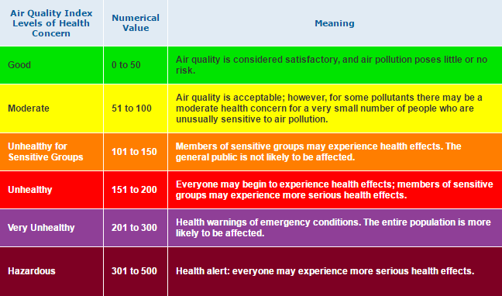
Data Statistics

Slide 20
Data Statistics
City | Average AQI for 2017-20 | Comment on AQI Level
Bengaluru | 87 | Moderate
Chennai | 99 | Moderate
Delhi | 237 | Very Unhealthy
Lucknow | 216 | Very Unhealthy
Hyderabad | 94 | Moderate
Patna | 222 | Very Unhealthy
Gurugram | 211 | Very Unhealthy
Visakhapatnam | 116 | Slight Unhealthy
Amritsar | 119 | Slight Unhealthy
Jaipur | 133 | Slight Unhealthy
Thiruvananthapuram | 77 | Moderate

Slide 21
Hypothesis Testing
Delhi is the capital city of India and is also one of the most polluted cities. So, we will perform our hypothesis testing on the air quality data of Delhi.
We will try to verify our hypothesis- “Air Quality Index of Delhi has decreased over the years.”
Null hypothesis, H₀: µ_{AQI(2019)}= µ_{AQI(2015-2019)} Alternate hypothesis, H₁: µ_{AQI(2019)}< µ_{AQI(2015-2019)}
NOTE: We do not consider data of 2020 since due to covid pandemic pollution levels had abnormally decreased.

Slide 22
Hypothesis Testing
From our data: AQI₂₀₁₅₋₂₀₁₉: µ = 264.998 σ = 117.641 AQI₂₀₁₉: x̄ = 228.931 n = 365
σ_{M} = σ/sqrt(n) = 6.158

Slide 23
Hypothesis Testing
It is a one-tailed test, where we take critical value, p = 0.05
Critical region: 5% in tail(left) Consulting z table for 5% -> z_{crit} = -1.645
We have: z = (x̄ - µ)/σ_{M} = -5.857
DECISION: z < z_{crit} => z lies in critical region null hypothesis (H₀) is proven false So, our hypothesis that AQI of Delhi has decreased over the years. (Since, mean AQI₂₀₁₉ < mean AQI₂₀₁₅₋₂₀₁₉ )

Slide 24
Conclusion
During the analysis, we found that Delhi has the highest overall pollution while Thiruvananthapuram has the lowest overall pollution.
Despite having the highest average pollution in Delhi, the pollution is decreasing over the years.
This prove that the Indian Government is taking some serious steps to improve the air quality of the country.

Slide 26
THANK YOU

