Slide 1
CPSC 6127 Project 2
Large-Scale Book Review Analysis using Hadoop MapReduce
K V RAMANA REDDY
DHEER MADHAV BALUSU
SHASHIDHAR BATTU

Slide 2
Dataset
Dataset: https://www.kaggle.com/datasets/mohamedbakhet/amazon-books-reviews?select=Books_rating.csv
This dataset offers a rich tapestry of book reviews, capturing the voices of myriad readers as they share their thoughts on over 212,404 unique books. Comprising 3 million reviews [number of records ], it serves as a vibrant forum where readers from diverse backgrounds converge, each review accompanied by a unique identifier that links to both the book and the reviewer.
Book Details:
Each book is uniquely identified by an Id, and is presented alongside its Title and Price. The price data is especially comprehensive, spread across a variety of ranges, reflecting the economic diversity of the books included.

Slide 3
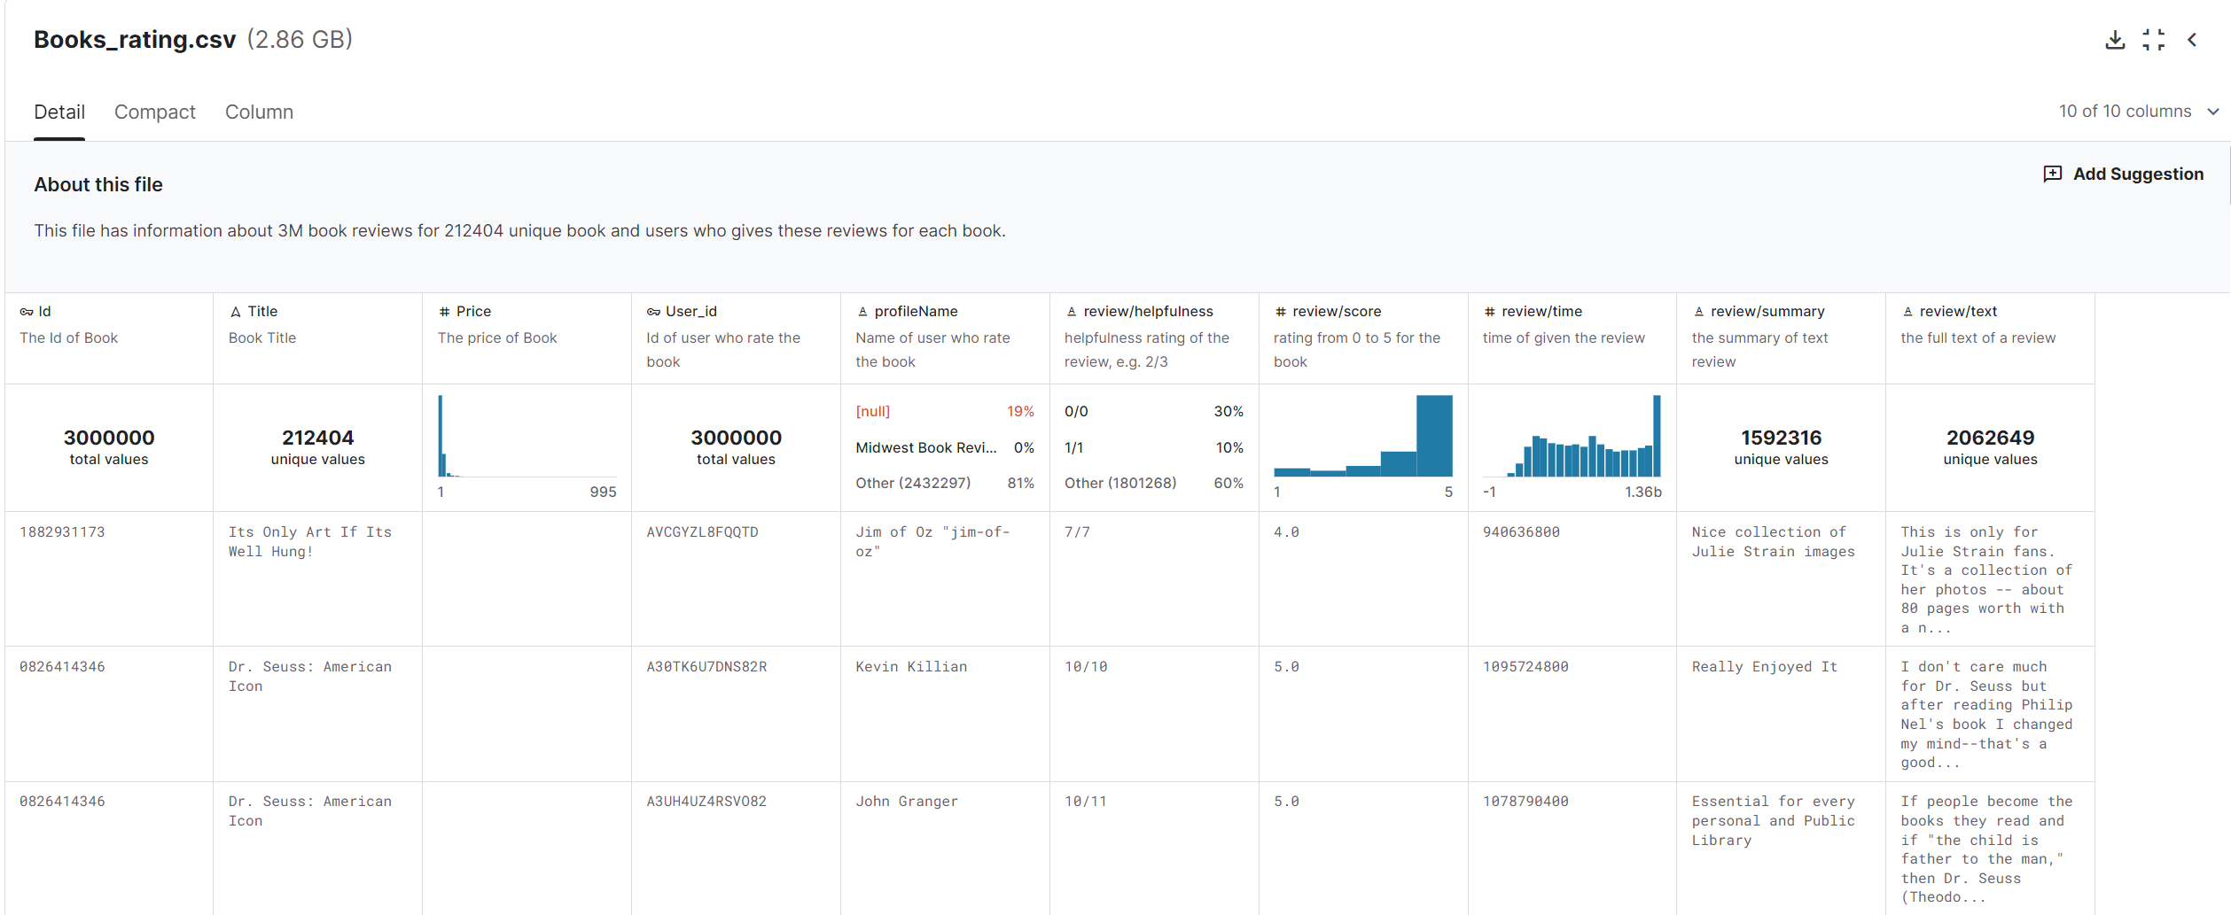

Slide 4
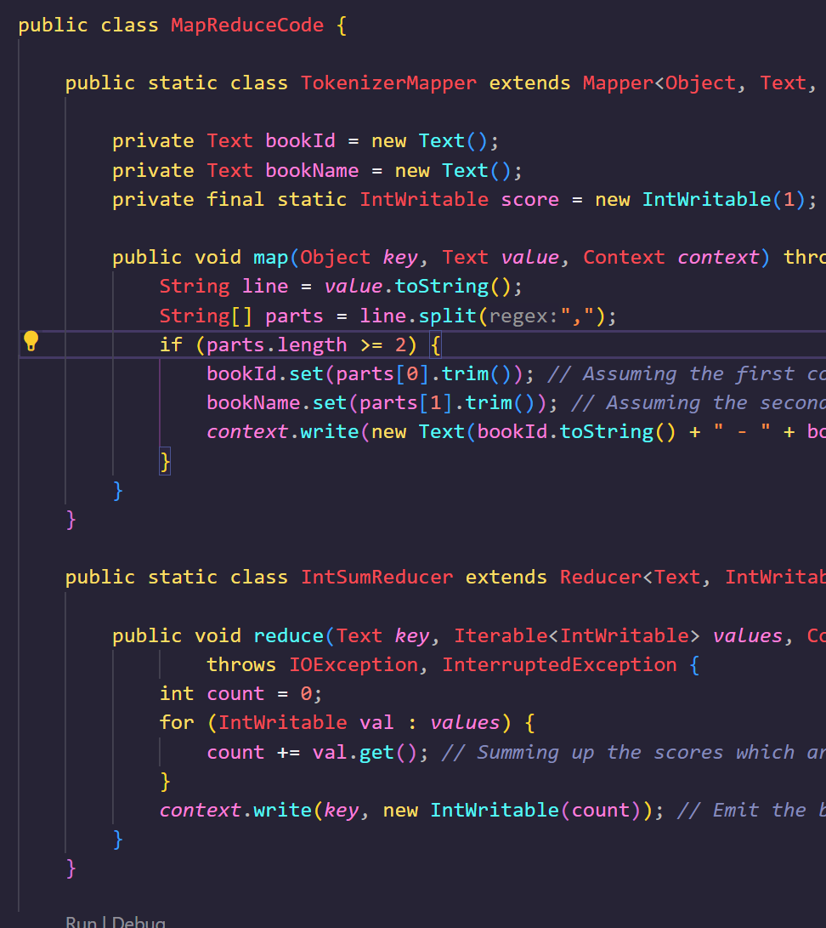
Problem 1
to summarize number of reviews for each book
[Summarization pattern]

Slide 5
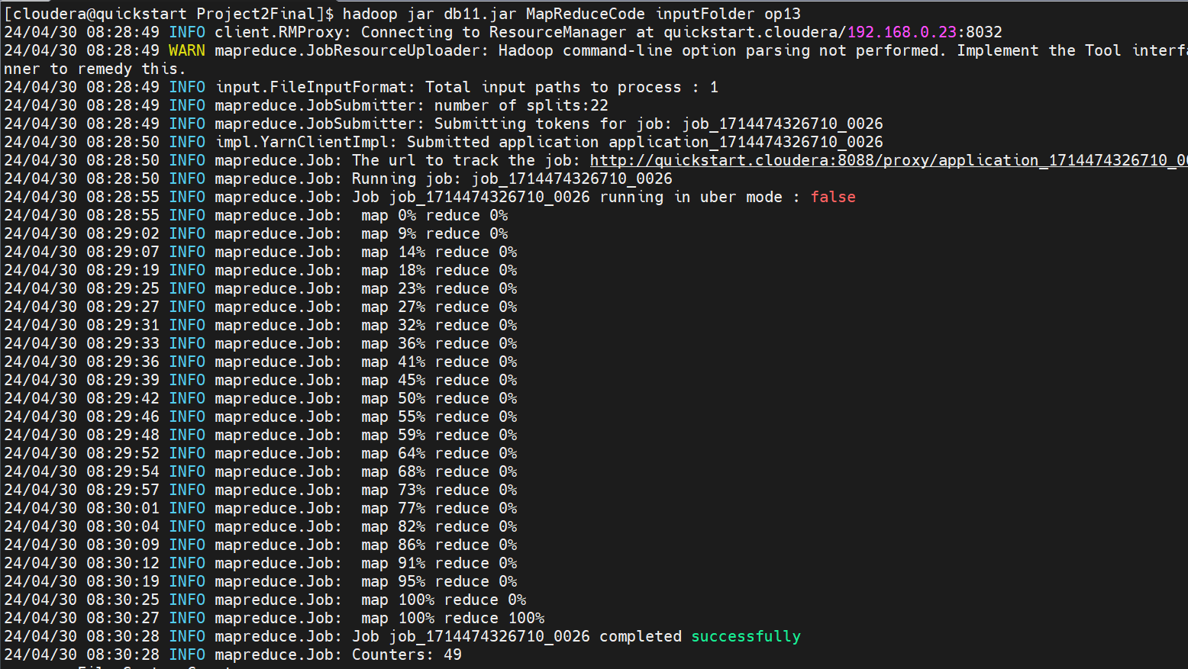
Execution output

Slide 6
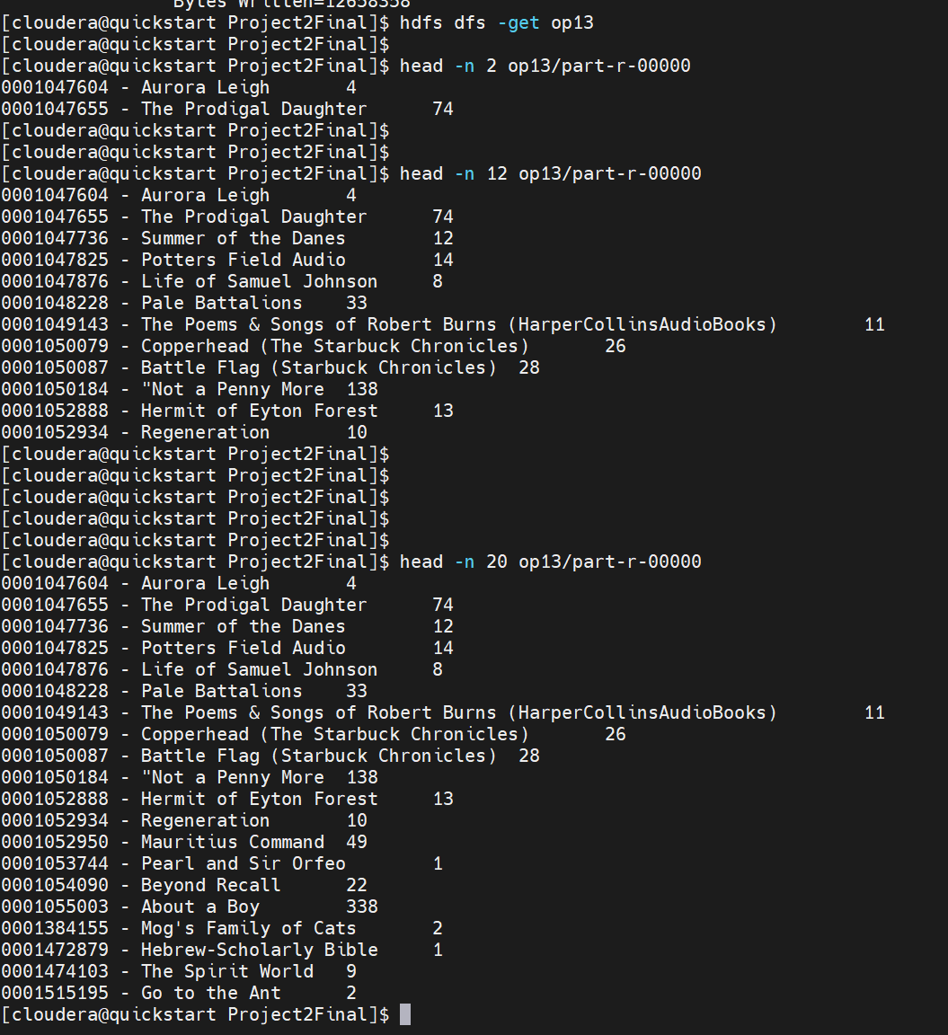
Execution output

Slide 7
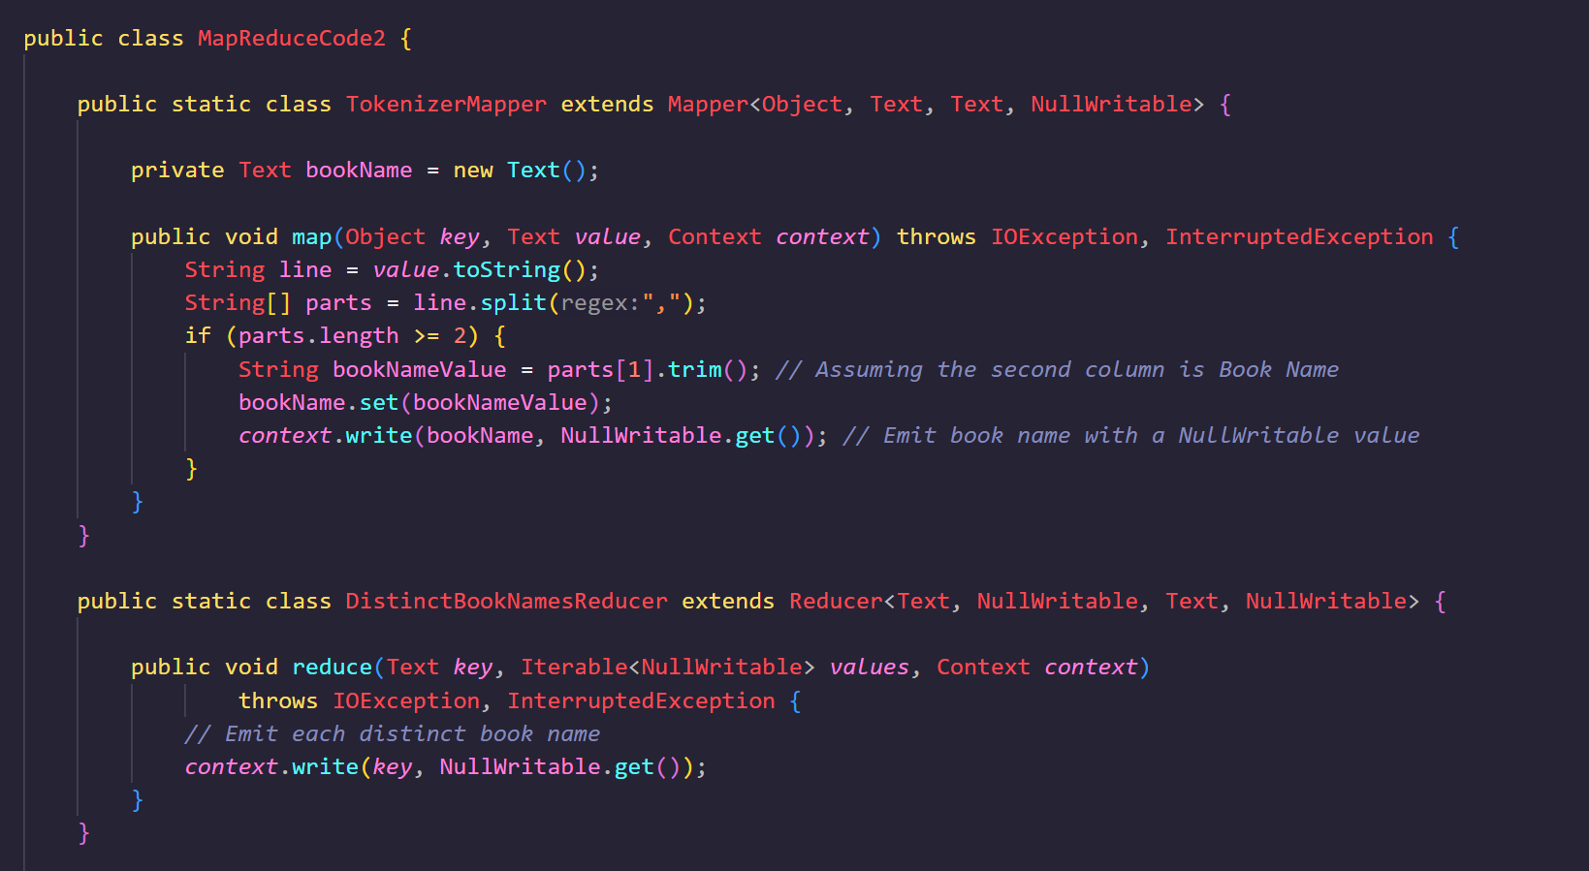
Problem 2
Filter the distinct booknames in the dataset
[Filtering Pattern]

Slide 8
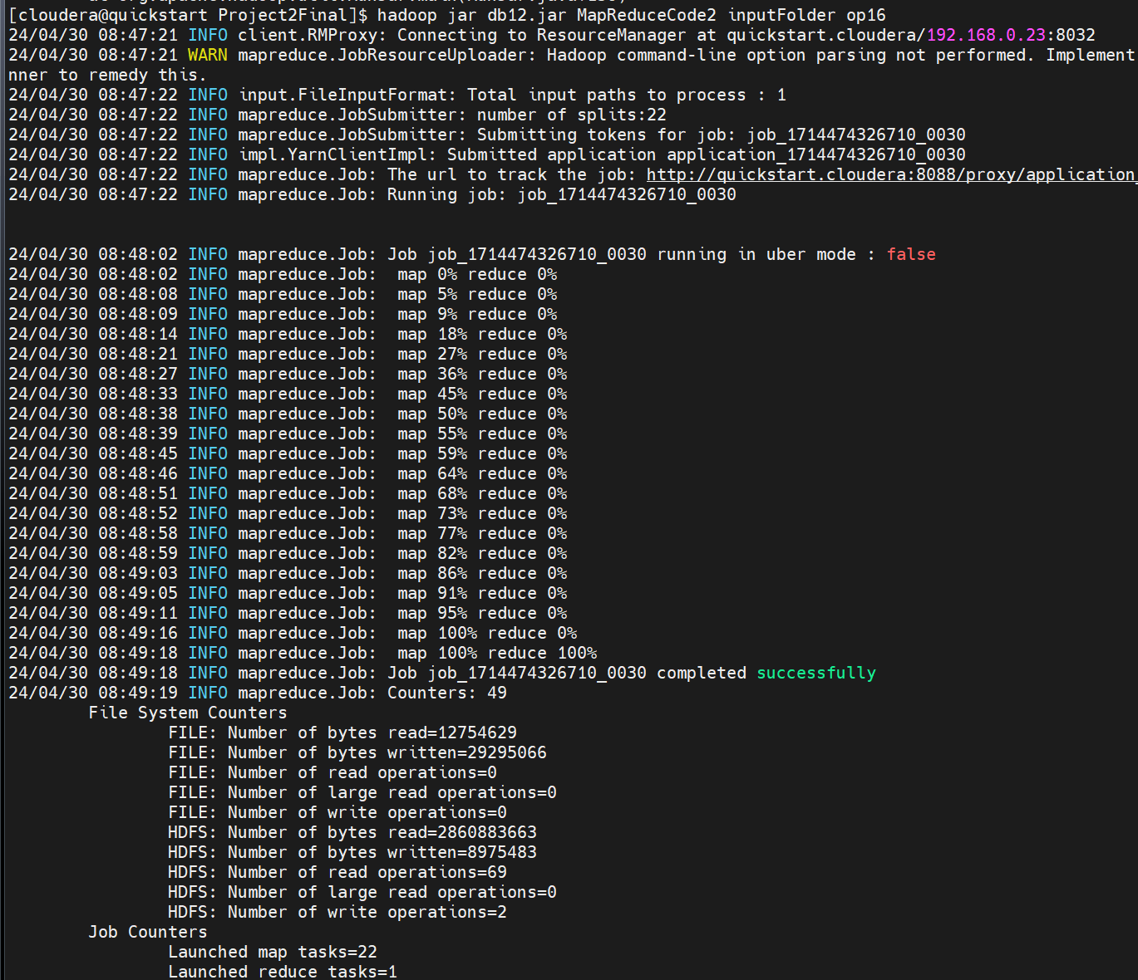
Execution output

Slide 9
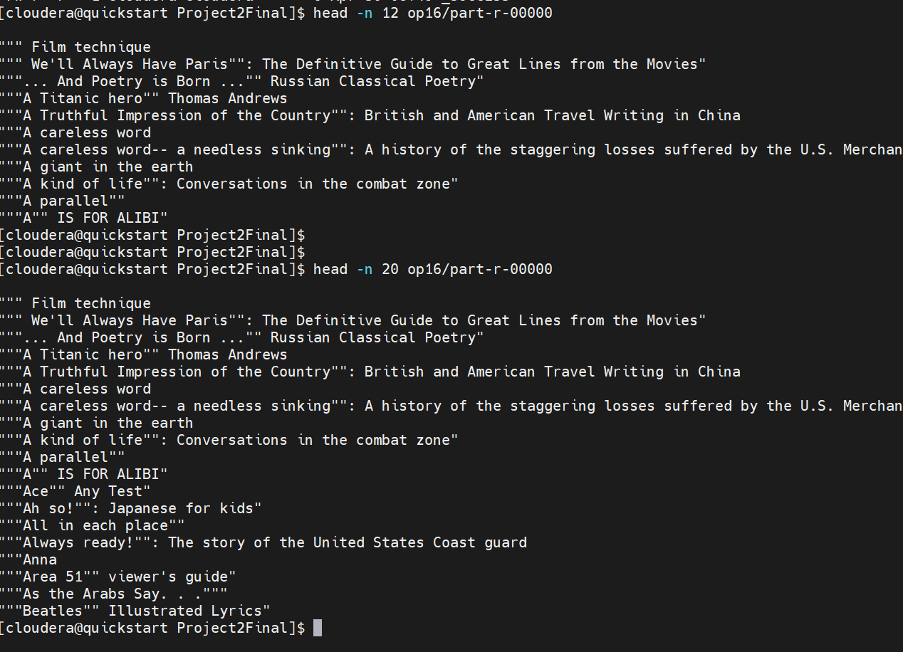
Execution output

