Slide 1

Employee mangement system
Matrusri Engineering College
Approved by AICTE & Affliated to Osmania University
V.Shashi chandra (1608-17-733-067)
V .Amulya sri(1608-17-733-068)
D .Dinesh(1608-17-733-069)
Guided by :a.v muralikrishna

Slide 2
abstract
The basic idea is to build a tool which helps to manage the details of employees working in any organization.
A webpage can serve the cause. It enables users to create and store Employee Records. The webservice provides an interface to manage and manipulate data of employee in an effortless manner. The system even has the option for only viewing the employee’s activities .
There is an option where only the supervisor (the top-level manager) can have direct access to the employee’s activities. No other employee of the same designation or same level of hierarchy can do this

Slide 3
Existing system
Not much user friendly
Falls shortage of employee records and managements
Not compatible for every operating system
Uses lot of paper work

Slide 4
Drawbacks of existing system
Employees can’t track their existing profiles
Danger of loosing files in some cases
Need for extra manual effort

Slide 5
Proposed system
User friendly interface
Allows employee to track their status
Secured
Cross platform operable

Slide 6
Modules of our system
Login credentials
Salary
Registering with admin permission
Add or delete employee record
Update employee record

Slide 7



Software used
Server :-XAMPP 5.6.40
Database :-MYSQLI 5.1
Text editor:- atoms text editor 1.34.0

Slide 8



Hardware requirements & scripting languages used
Hardware requirements:-
1 gb ram
Pentium (x86 architecture), 1.6 gHz
Hard disk memory (HDD) 9 GB
Scripting languages used
HTML
PHP (Hypertext Preprocessor 5)
CSS(cascading style sheets)

Slide 9
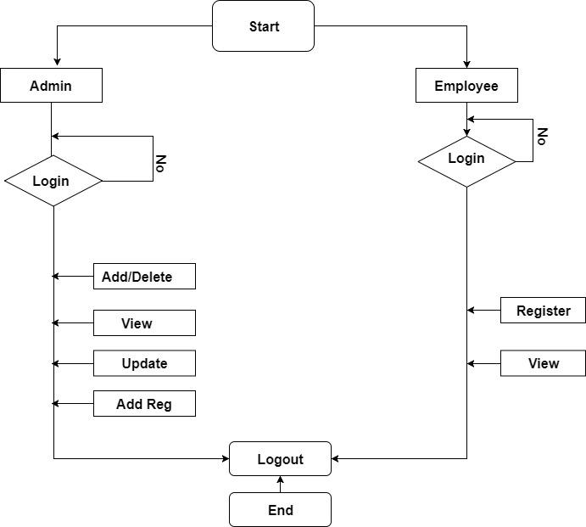
FLOW CHART OF SYSTEM

Slide 10
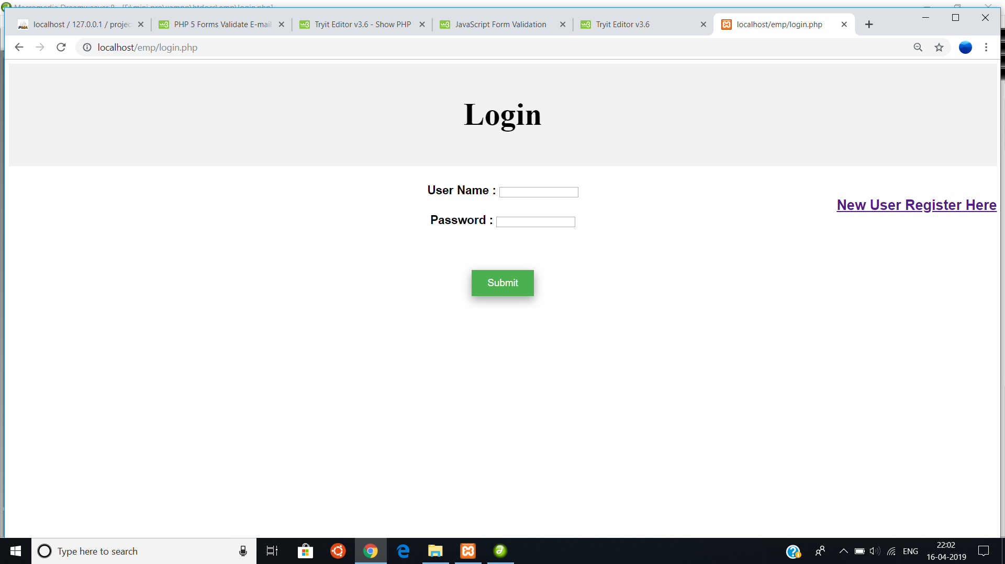
LOGIN PAGE

Slide 11
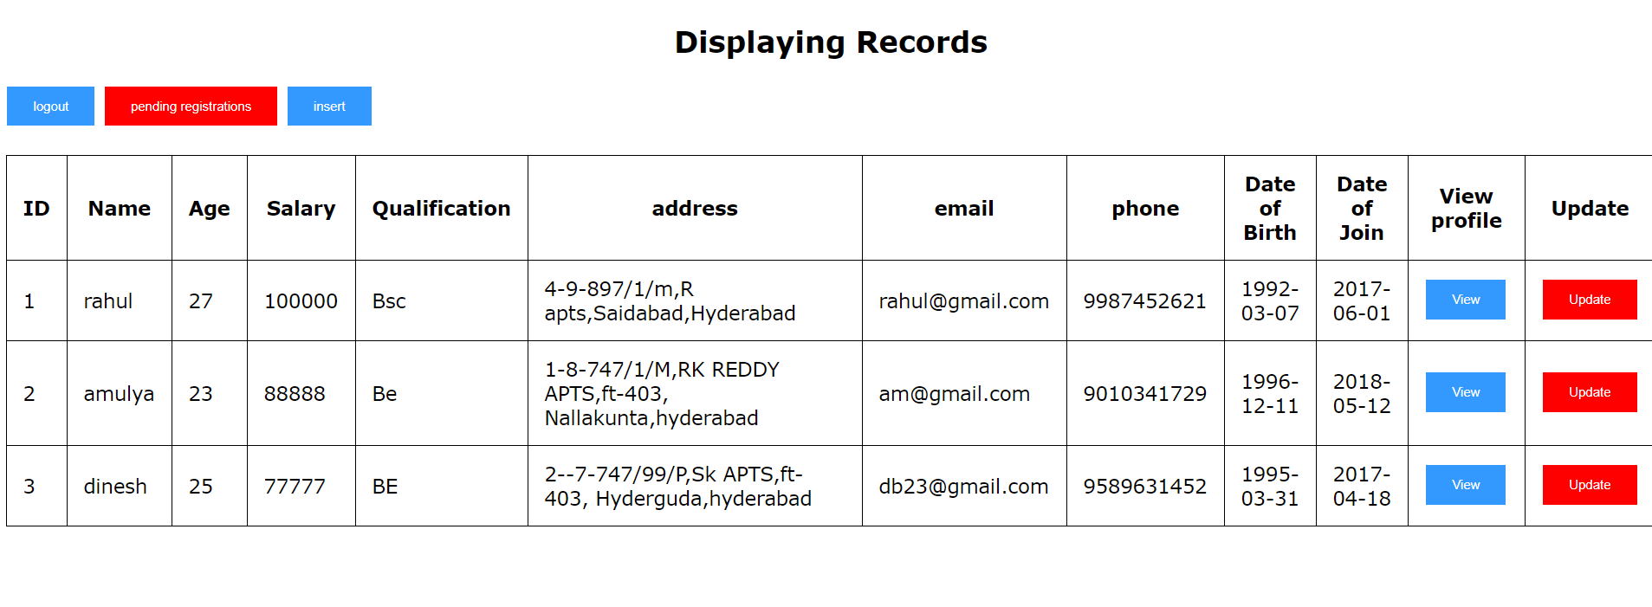
ADMIN LOGIN PAGE

Slide 12
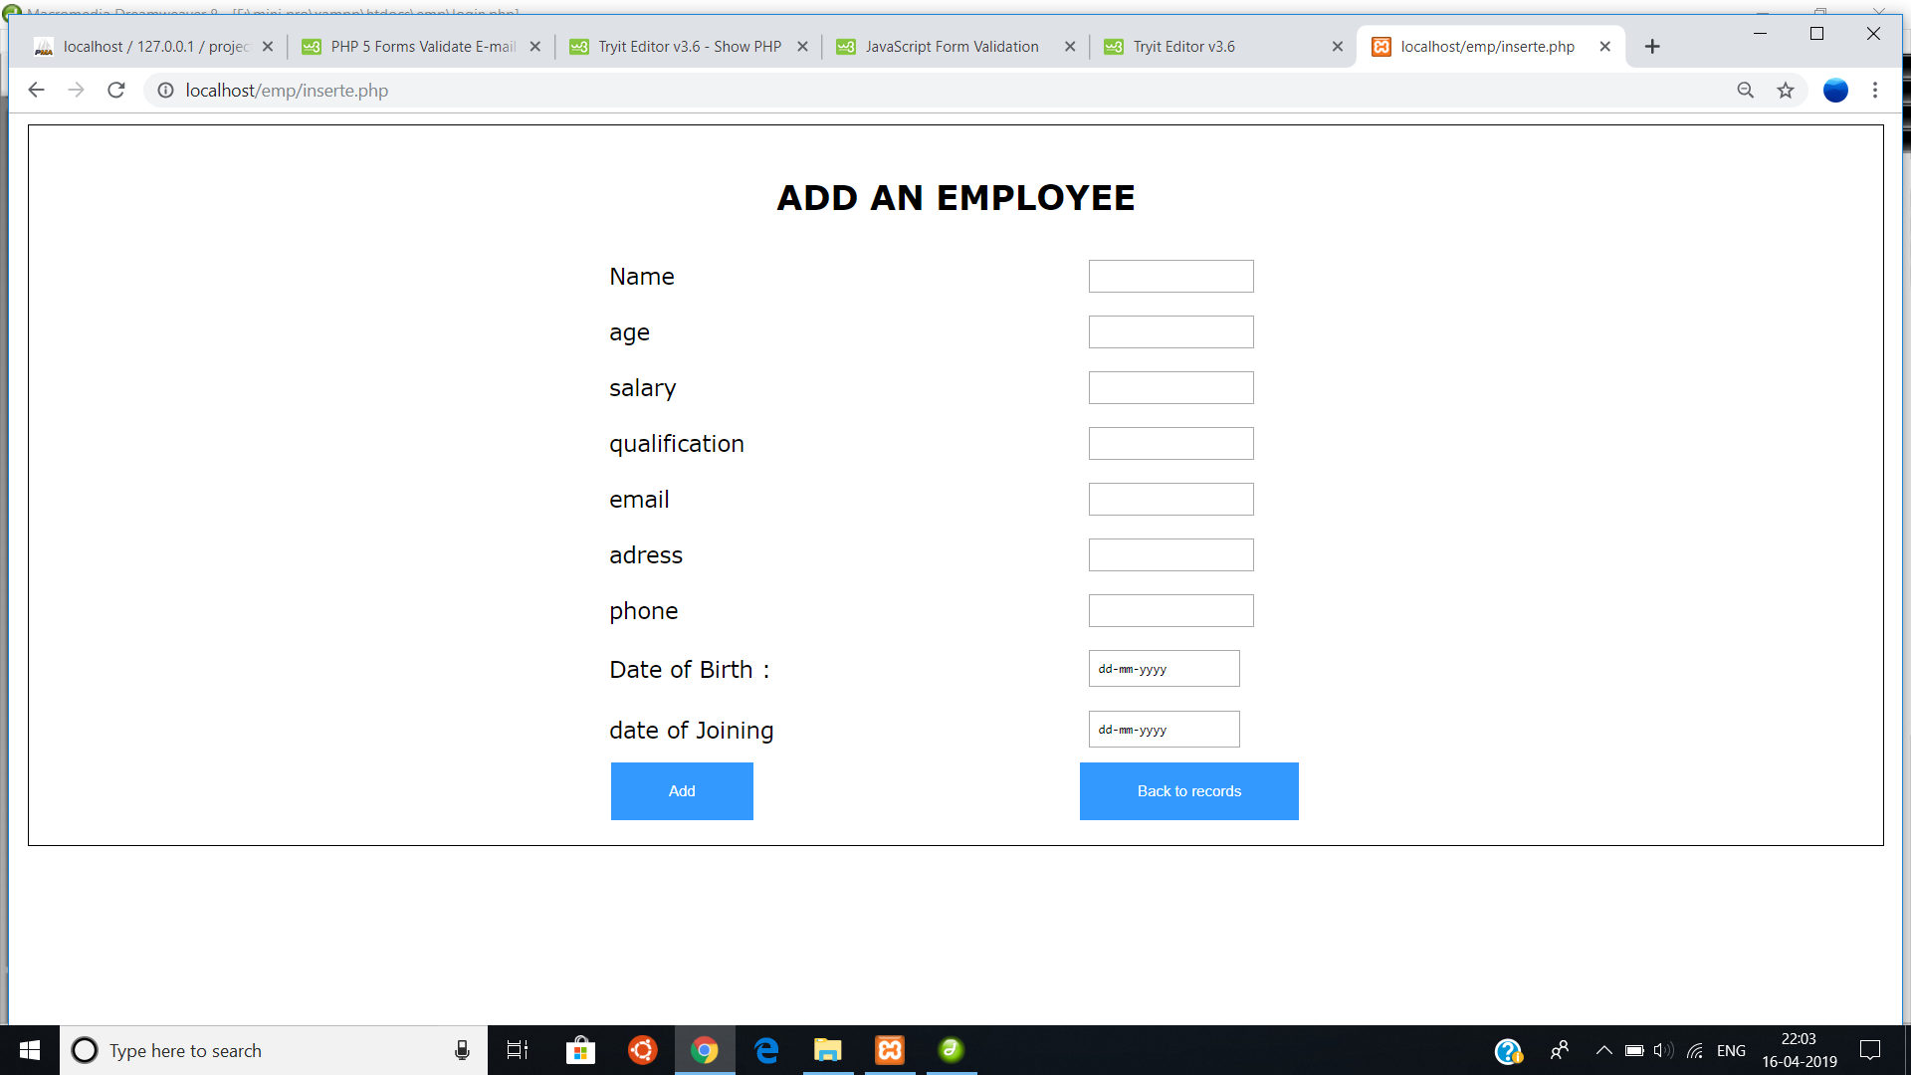
EMPLOYEE INSERTION BY SUPERVISOR

Slide 13
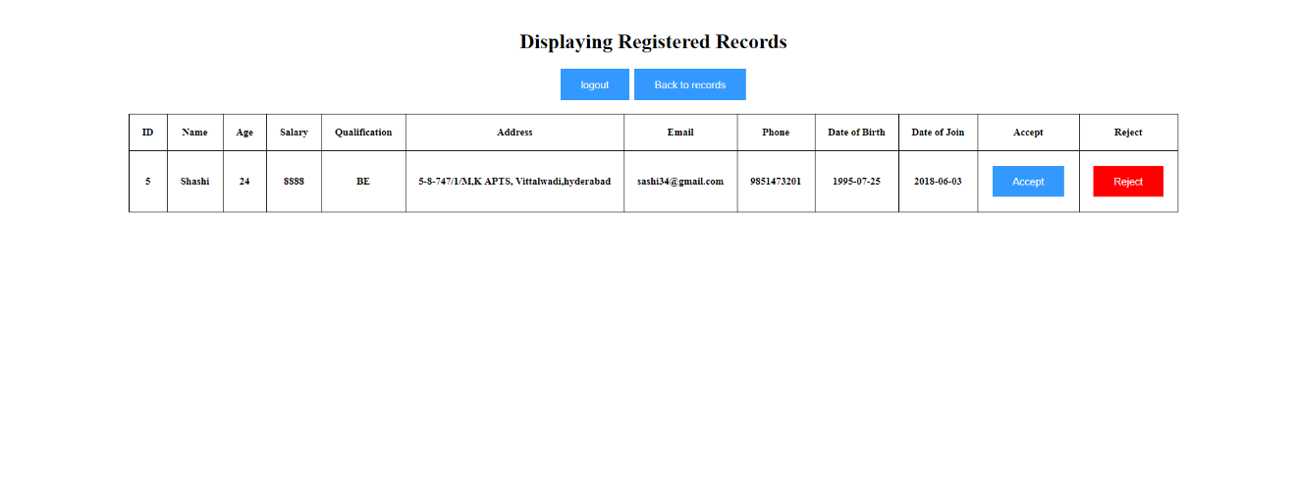
PENDING REGISTRATIONS

Slide 14
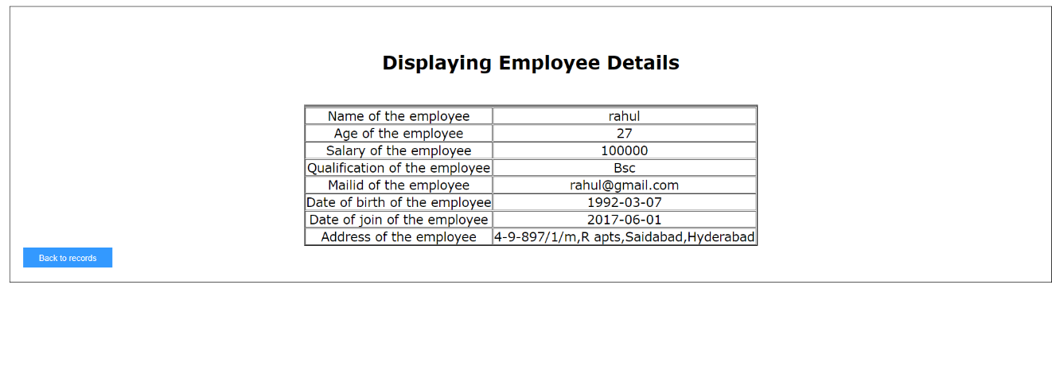
ADMIN VIEW EMPLOYEE

Slide 15
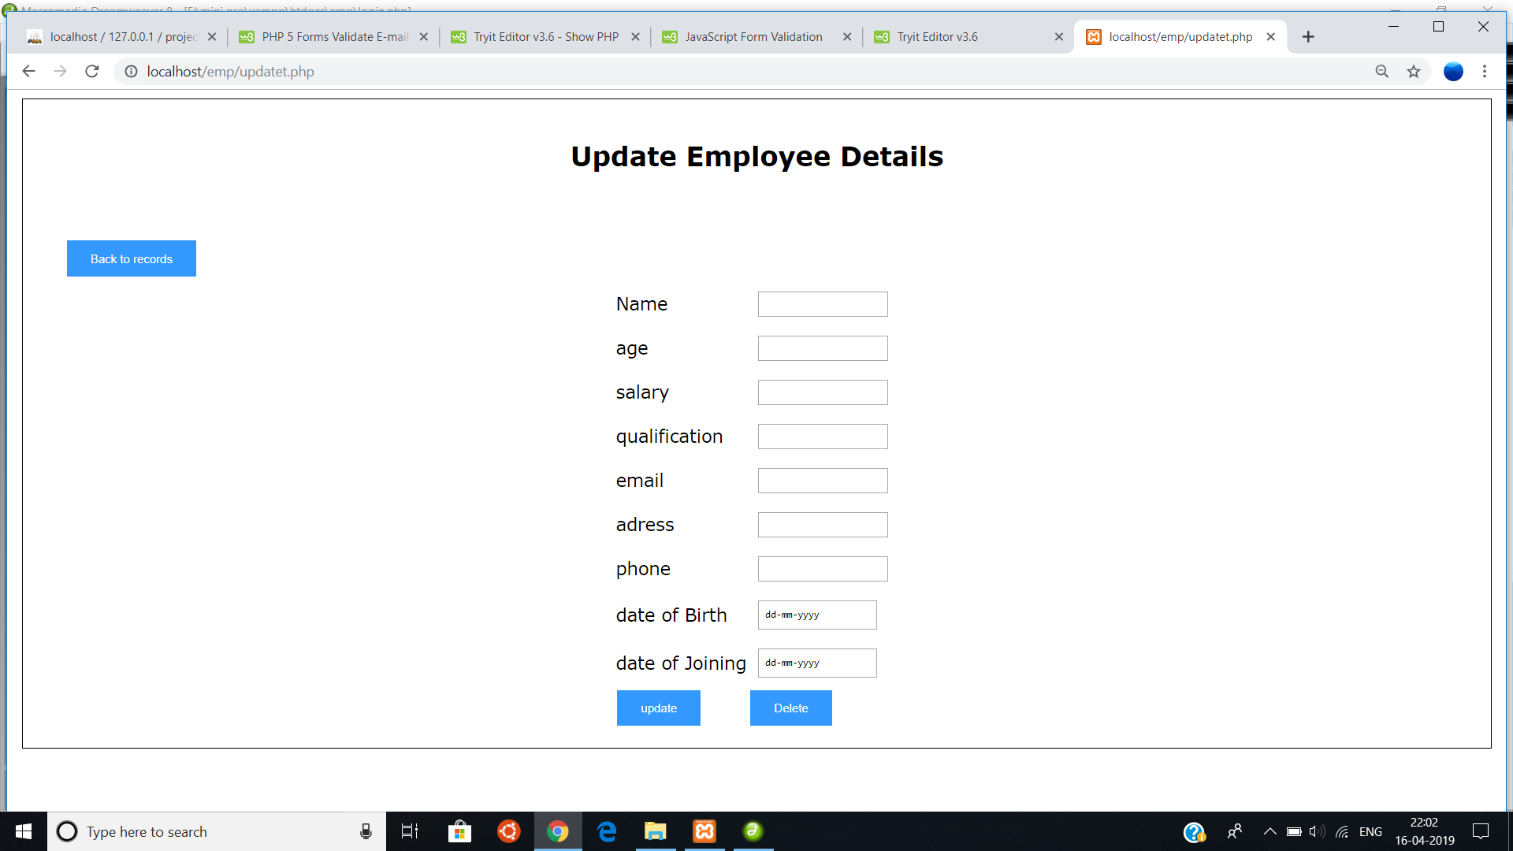
UPDATE EMPLOLYEE

Slide 16

REGISTRATION FORM

Slide 17
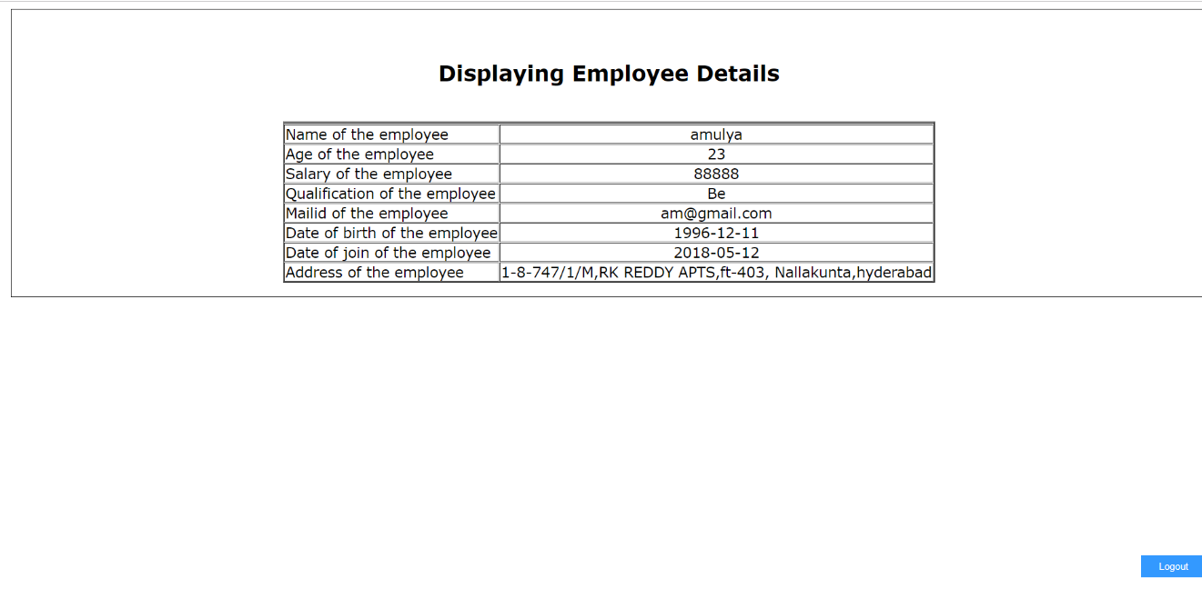
EMPLOYEE DETAILS DISPLAY

