Slide 1


High Cloud Airlines Analytics Project
Group Presentation | Shashidhar, Vyshnavi, Narender, Omkar Patil, Shivanjali, Tanya Upadhyay, Samruddhi Kadam

Slide 2
Introduction
Highcloud Airlines,a leading player in the aviation sector has been at the forefront of providing seamless air travel experiences
Established with a commitment to excellence,High cloud has consistently set industry standards in terms of reliability,safety, and customer satisfaction.
Extensive network of routes spans across regions,connecting people and cultures,making Highcloud a preferred choice for millions of travellers globally.
HighCloud embraces innovation and modern technology to enhance operational efficiency and stay at the forefront of the aviation lanscape.

Slide 3

Project Overview
This project applies advanced data analytics to six years of High Cloud Airlines operational data, uncovering performance patterns and strategic opportunities. Through SQL, Power BI, and Tableau, we transform 3 million flight records into actionable intelligence for revenue optimization and capacity planning.

Slide 4

Project Objective
1
Analyze Performance
Examine High Cloud Airlines' operational and financial performance across key metrics and time periods.
2
Extract Insights
Derive actionable intelligence from flight, passenger, and load factor datasets.
3
Build Dashboards
Develop real-time business intelligence dashboards for ongoing monitoring and decision support.

Slide 5
Data Sources & Tools
📊 Data
Flight records, passenger counts, seat availability, and distance metrics spanning the full analysis period.
🛠 Tools
SQL queries, Excel dashboards, Power BI, and Tableau visualizations for multi-layer analysis.
📅 Time Period
2008–2013 historical data providing six years of airline industry performance records.

Slide 6
Key Metrics at a Glance
3M
Total Flights
Across all routes and carriers in the dataset
187M
Total Passengers
Travellers served over the analysis period
244M
Available Seats
Seat capacity offered across all flights
77%
Load Factor
Average seat utilization rate achieved
82M
Miles Flown
Total distance covered across all routes

Slide 7
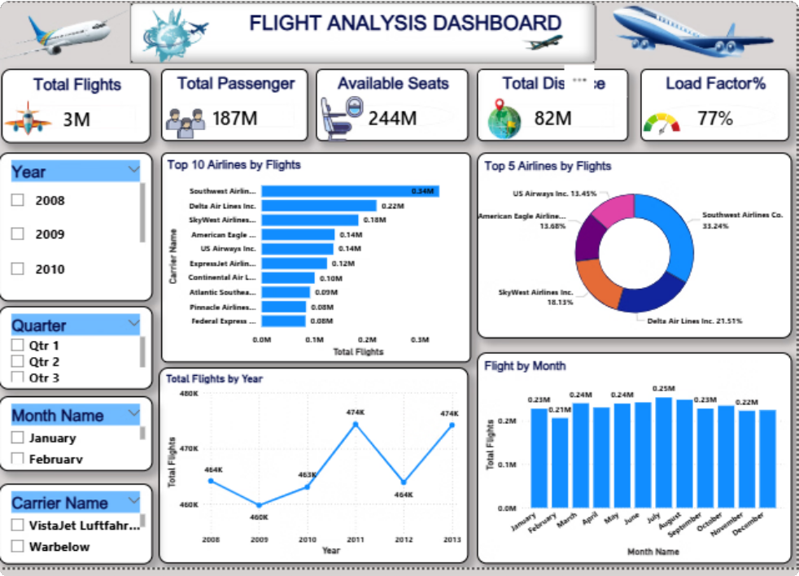

Flight Volume Trends
Key Findings
3 million total flights across the complete dataset
Consistent year-over-year growth in flight operations
Peak performance concentrated in Q3 and Q4 quarters
Power BI dashboard below illustrates actual flight volume trends and carrier breakdowns.

Slide 8
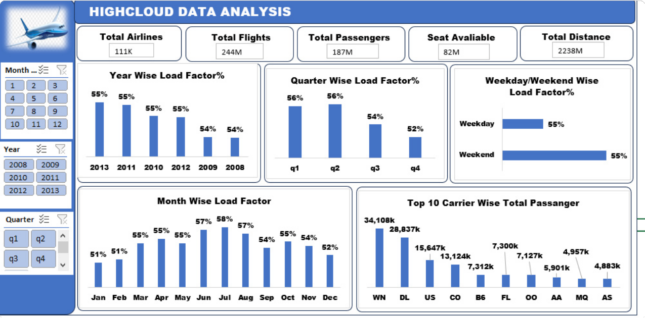
Excel Dashboard-Overview

Slide 9
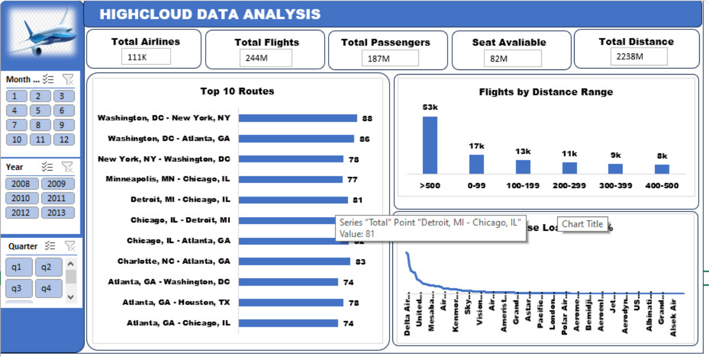
Top 10 Routes by Flight Count
Major Hub Activity
Atlanta, Dallas, Chicago, and Los Angeles emerge as the highest-traffic connection points in the network.

Slide 10
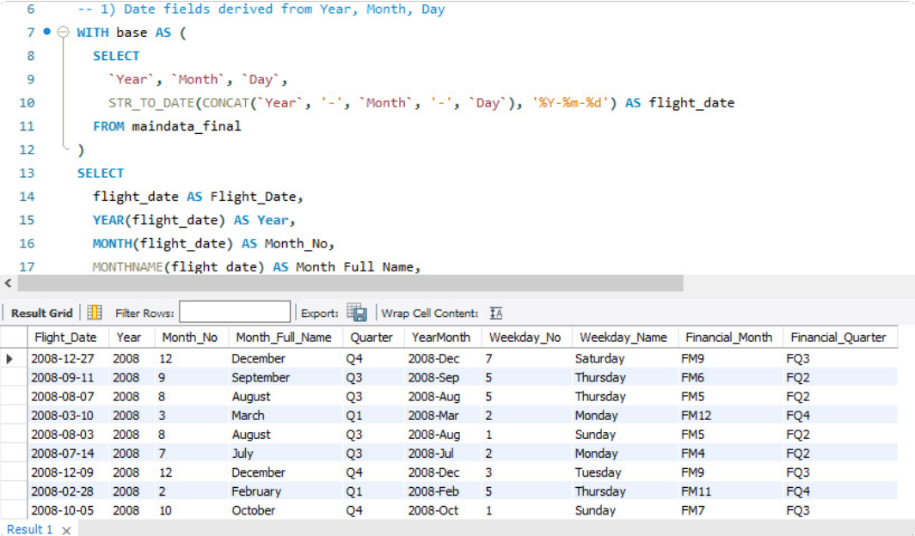
SQL-Data Preparation

Slide 11
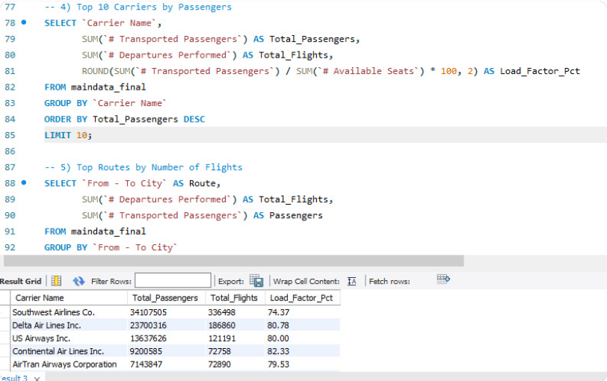
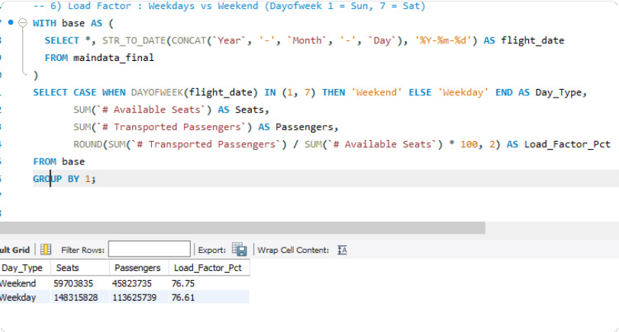
SQL-Time Based analysis and Carrier wise Performance

Slide 12
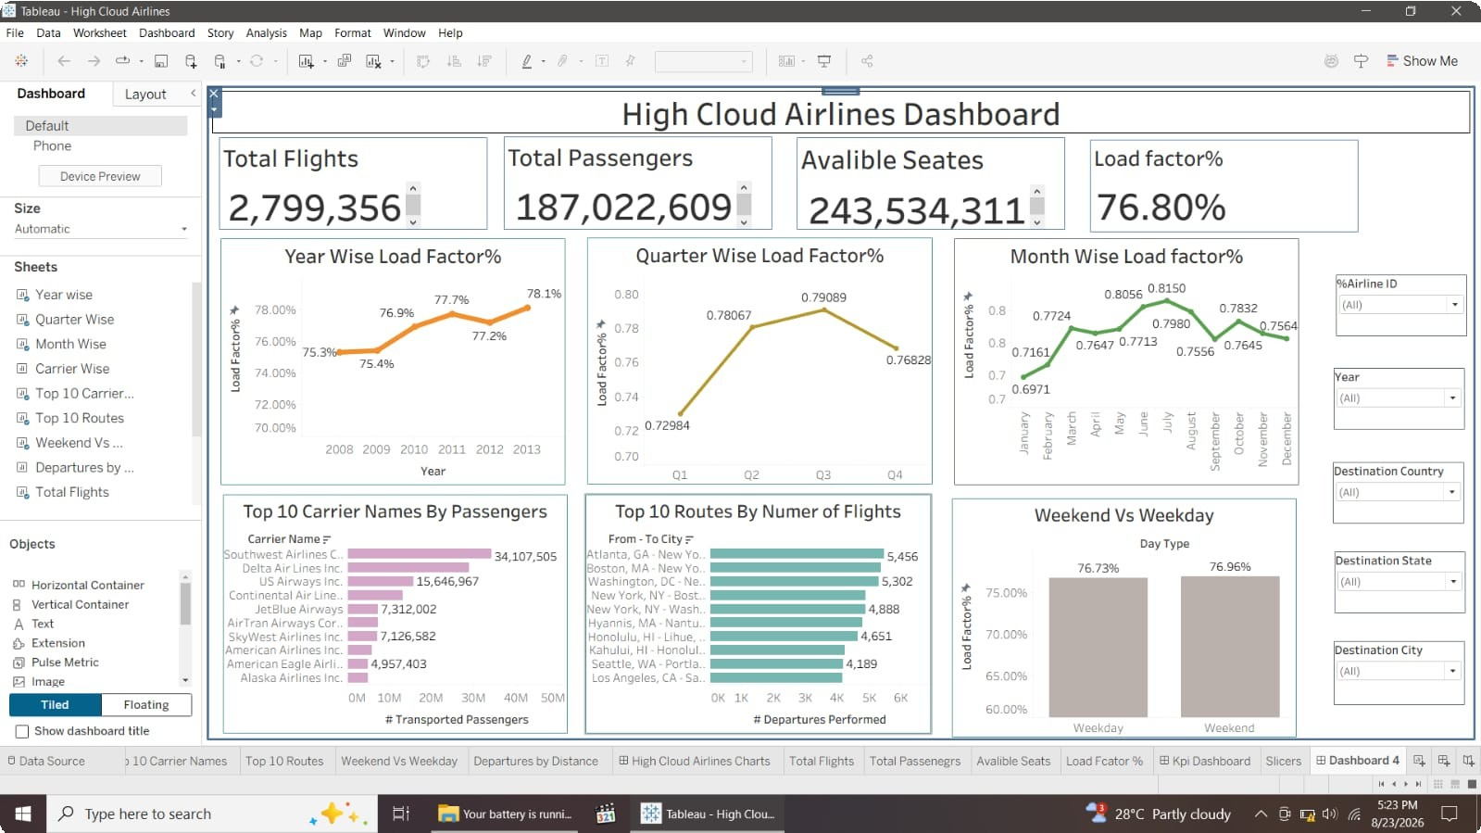
Tableau DashBoard

Slide 13
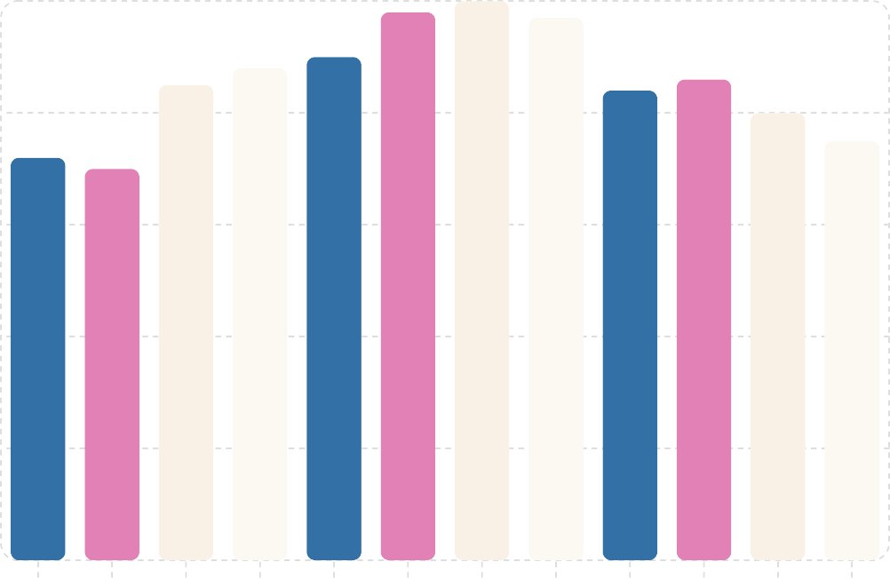
Flights by Month — Seasonal Patterns
Relative Flight Volume
100
Seasonal Insights
Summer Peak (Jun–Aug): Highest travel demand driven by leisure and vacation traffic
Winter Dip (Dec–Feb): Seasonal slowdown with reduced business and leisure travel
Holiday Spikes: Thanksgiving and Christmas periods generate sharp short-term volume surges
80
60
40
20
Understanding seasonality enables smarter capacity planning and targeted pricing strategies for revenue optimization.
0
Jan Feb Mar Apr May Jun Jul Aug Sep Oct Nov Dec
Month

Slide 14

Carrier Performance Comparison
Competitive Landscape
Southwest Airlines
Leads in total flight operations — high frequency, cost-efficient model
Delta & United
Strong competitive positions with broad domestic and international networks
Regional Carriers
Niche market specialization serving underserved routes effectively

Slide 15
Recommendations
Optimize Flight Routes: Utilize insights from top routes and flights to optimize schedules and resource allocation.
Enhance Load Factor: Leverage load factor analysis to identify trends and implement strategies for increased efficiency.
Strategic Carrier Partnerships: Collaborate with top carriers to maximize passenger transportation and enhance overall performance.
Resource allocation: Allocate resources strategically based on flight schedules and passenger volume data.This ensures efficient operations and minimizes wait times at Airports with passenger traffic.

Slide 16
Conclusion
High Cloud Analysis empowers the aviation industry with actionable insights,fostering efficiency and strategic decision-making.The presented KPI's offer a glimpse into the vast potential for improvement and growth within the industry .By harnessing the power of data,we can drive positive changes,ensuring a brighter future for High Cloud Analysis and its partners in the aviation sector.

Slide 17
Thank You

