Slide 1
PROBABILITY AND STATISTICS CASE STUDY
BAMAT207
Final Review
TITLE PAGE
SAMPLE TRACE
Course: BAMAT207 Probability and Statistics
Project title: Statistical Modelling of Packet-Loss Patterns in Computer Networks
Focus: Distribution fitting, tests of independence and Bayesian estimation
Tracks: Track 3 (core), Track 1 and Track 5 (supporting)
Stage: Final review (Phase 1 simulation study, Phase 2 real-network lab)
TEAM
Kyra Panwar
25BBS0095
Shashank Tiwari
25BDS0053
Aashman Biyani
25BBS0100
3
network conditions
540,000
packets analysed
6
objectives
Each bar is one second of traffic. Several losses often fall in the same second.
Statistical Modelling of Packet-Loss Patterns
1
Notes:
Introduce the team and the course. This is the final review. The results come from Phase 1, a simulation study with known parameters. Phase 2 will apply the same analysis to measured network traces.

Slide 2
PROGRESS SINCE REVIEW 1
BAMAT207
Final Review
SHOWN AT REVIEW 1
ADDED SINCE
FINAL DELIVERABLES
Problem: objectives and hypotheses.
Model: Good/Bad loss model and simulation design.
Results: distribution fits and independence tests.
Inference: Bayesian estimates and interval coverage.
Planning: power study for Phase 2.
Testing: automated tests for edge cases, correctness and reproducibility.
Fixes: empty traces and zero-loss cases now handled safely.
Phase 2: real-packet probe and the Real Network Lab.
Web app: Packet-Loss Lab with live and simulated pages.
IEEE paper: seven-page conference paper with all results.
Code: one Python pipeline, public on GitHub.
Lab: streamlit run lab.py records and analyses real runs.
Results: 7 figures, results.json and summary.md.
Paper: IEEE format, PDF and Word.
Slides: this deck, built from the same data.
540,000
packets analysed
2,000
simulated captures per Monte Carlo point
2026
seed: every number reproducible
7 pages
IEEE conference paper
Statistical Modelling of Packet-Loss Patterns
2
Notes:
At Review 1 we showed the analysis and first results. Since then we tested every module, built an interactive web app and wrote the IEEE paper. All numbers in this deck still come from the same pipeline with seed 2026.

Slide 3
INTRODUCTION
BAMAT207
Final Review
Basic loss models assume that each packet is lost independently. Under this assumption, loss counts are Poisson and gaps are exponential. Measured traffic often shows losses grouped close together.
INDEPENDENT AND DEPENDENT LOSSES
CONTEXT
REAL-TIME MEDIA
Several losses in a row are harder to conceal than isolated ones.
PROTOCOL SETTINGS
Retransmission and error-correction settings use loss statistics.
SERVICE LEVELS
A reported loss rate is only useful if the model behind it holds.
STATISTICAL INFERENCE
Ignoring dependence makes standard errors too small.
RESEARCH QUESTIONS
1. Do loss counts and gaps follow the Poisson model?
2. Which distributions describe them better?
3. How much does dependence affect interval estimates?
Both series have a loss rate of 1.29%. The Wi-Fi series has more seconds with no loss and a few seconds with many.
Statistical Modelling of Packet-Loss Patterns
3
Notes:
Basic loss models assume each packet is lost independently. Under that assumption the number of losses per second is Poisson and the time between losses is exponential. The two charts on the right have the same loss rate of 1.29%. The second one comes from our Wi-Fi scenario and shows grouped losses.

Slide 4
OBJECTIVES AND HYPOTHESES
BAMAT207
Final Review
OBJECTIVES
HYPOTHESES
O1 LOSS COUNTS
Compare Poisson and Negative Binomial models for losses per second.
O2 INTER-LOSS GAPS
Fit exponential and two-phase hyperexponential models.
 | Null hypothesis H0 | Alternative H1
H1 | Losses per second are Poisson (random) | Too spread out: losses cluster
H2 | Gaps between losses are exponential | Gaps are not exponential
H3 | Each packet is lost independently | A loss changes the next packet's chance: P(L|L) ≠ P(L|N)
H4 | All networks behave the same | At least one network differs
O3 INDEPENDENCE
Runs test and Markov chain likelihood ratio test.
O4 NETWORK COMPARISON
Compare the 3 networks with rank-based tests.
O5 BAYESIAN ESTIMATION
Loss rates and burst parameters with credible intervals.
O6 RELIABILITY
Power of the tests and coverage of the intervals.
All tests use a significance level of α = 0.05.
TRACK MAPPING
Track 3 (core):
O1 and O2, distribution modelling
Track 5:
O3, O4 and O6a, hypothesis testing
Track 1:
O5 and O6b, Bayesian inference
Statistical Modelling of Packet-Loss Patterns
4
Notes:
Objectives one and two cover distribution modelling. Objectives three and four are hypothesis tests. Objective five is the Bayesian part. Objective six checks the tests and intervals by simulation. Each objective has a matching null and alternative hypothesis, tested at alpha equal to 0.05.

Slide 5
LOSS MODEL AND DATA
BAMAT207
Final Review
GILBERT-ELLIOTT TWO-STATE MODEL
SCENARIO PARAMETERS
Network | p | r | hG | hB | πB | True loss | Mean Bad spell
Wired | 0.0005 | 0.3 | 0.002 | 0.5 | 0.17% | 0.283% | 3.3 pkts
Wi-Fi | 0.002 | 0.15 | 0.004 | 0.6 | 1.32% | 1.184% | 6.7 pkts
Mobile | 0.004 | 0.08 | 0.006 | 0.7 | 4.76% | 3.905% | 12.5 pkts
GOOD
loss prob. hG
p
BAD
loss prob. hB
r
stays with prob. 1 - p
stays with prob. 1 - r
πB = p / (p + r)
Share of time the network spends in the Bad state.
p and r are per-packet transition probabilities. hG and hB are the loss probabilities in each state.
P(loss) = (1 − πB) × hG + πB × hB
Total loss = Good loss × Good time + Bad loss × Bad time.
SAMPLING SETUP
50/s
packets (20 ms apart)
1 hour
per network
180,000
packets each
2026
random seed
Average stay = 1/p in Good, 1/r in Bad
If you leave with chance r per packet, you stay about 1/r packets.
The simulation draws complete sojourn times from the geometric distribution instead of updating the state for every packet.
PHASE 1 (COMPLETED)
Simulation with known parameters.
PHASE 2 (PLANNED)
Measured traces, same code.
Statistical Modelling of Packet-Loss Patterns
5
Notes:
The channel has two hidden states, Good and Bad. Before each packet it may change state with probability p or r. Losses are rare in Good and frequent in Bad. Since we set these parameters ourselves, the true loss rate of each network is known. Each network is simulated for 3600 seconds at 50 packets per second.

Slide 6
METHODOLOGY
BAMAT207
Final Review
ANALYSIS PIPELINE
REASON FOR A SIMULATION PHASE
SIMULATION
Gilbert-Elliott model, 3 networks, 1 hour each
The true parameters are known in advance.
Estimates can be compared with the true values.
The power study gives the capture length for Phase 2.
Phase 2 uses the same code on measured data.
PRE-PROCESSING
Counts per second, gaps, burst lengths
DISTRIBUTION FITTING
MLE, EM, AIC
HYPOTHESIS TESTING
Fit, independence, comparison
BAYESIAN ANALYSIS
Beta posteriors, Markov
SOFTWARE
Python 3
NumPy
MONTE CARLO STUDIES
Power and coverage, 2,000 replicates
SciPy
Matplotlib
Each statistical component is a separate module with one owner.
OUTPUT
Figures, results.json, summary.md
Statistical Modelling of Packet-Loss Patterns
6
Notes:
The analysis runs as one pipeline. The simulated traces are summarised first. Distribution fitting, hypothesis testing and Bayesian analysis then run on the same data. The Monte Carlo studies use 2000 replicates each. The output is a set of figures and two results files.

Slide 7
STATISTICAL METHODS
BAMAT207
Final Review
METHODS BY OBJECTIVE
Obj. | Method | Formula | What it does
O1 | Chi-square goodness of fit | χ² = Σ (O − E)² / E | Checks if the model's prediction matches what really happened.
O1 | Index of dispersion | D = s² / x̄ | Checks if losses are more spread out than random (clumping).
O2 | Kolmogorov-Smirnov (bootstrap) | D = max |Fn(t) − F(t)| | Checks if the waiting times between losses are random.
O2 | EM algorithm | guess → update → repeat | Splits the waiting times into short (in a burst) and long ones.
O3 | Runs test | z = (R − E[R]) / sd(R) | Checks if lost packets stick together in clumps.
O3 | Markov likelihood ratio | G² = 2 (ln L1 − ln L0) | Checks if one loss makes the next loss more likely.
O4 | Kruskal-Wallis, Mann-Whitney | p × number of pairs | Checks if the networks are really different, not just by luck.
O5 | Bayesian update | Beta(1 + k, 1 + n − k) | Estimates the loss rate and how sure we are.
O6 | Monte Carlo | SE = √(p(1 − p) / N) | Repeats the experiment 2,000 times to check our methods work.
AIC = 2k − 2 ln L
Picks the better model: the lower score wins.
Count window:
1 s = 50 packets, 3,600 windows
Design-effect blocks:
10 s = 500 packets
Statistical Modelling of Packet-Loss Patterns
7
Notes:
The table lists the method used for each objective. The Kolmogorov-Smirnov test uses a parametric bootstrap, because the rate is calculated from the sample being tested. The Markov test is a likelihood ratio test. By Wilks' theorem, G squared then follows a chi-square distribution with one degree of freedom.

Slide 8
DESCRIPTIVE STATISTICS
BAMAT207
Final Review
1 HOUR PER NETWORK, 180,000 PACKETS EACH
VARIANCE-TO-MEAN RATIO
Network | Loss rate | Mean / s | Variance | Var ÷ mean | Mean burst | Max burst
Wired | 0.27% | 0.138 | 0.219 | 1.59 | 1.12 | 6
Wi-Fi | 1.29% | 0.646 | 3.430 | 5.31 | 1.55 | 9
Mobile | 3.94% | 1.969 | 20.017 | 10.17 | 2.25 | 16
A burst is a run of consecutive lost packets.
SHARE OF LOSSES INSIDE BURSTS
KEY FIGURES
10.17
highest var ÷ mean (Mobile)
16
longest burst, packets (Mobile)
40
most losses in one second (Mobile)
For a Poisson process the variance-to-mean ratio would be close to 1. All 3 networks are above this value.
Statistical Modelling of Packet-Loss Patterns
8
Notes:
These summaries are computed before any model is fitted. For a Poisson process the variance of the counts equals the mean. The variance-to-mean ratio is 1.59, 5.31 and 10.17 for Wired, Wi-Fi and Mobile. The right-hand chart shows the share of losses that belong to a burst of two or more packets.

Slide 9
DISTRIBUTION OF LOSS COUNTS
BAMAT207
Final Review
WI-FI: PROBABILITY OF K LOSSES IN ONE SECOND
SECONDS WITH 5 OR MORE LOSSES (OF 3,600)
GOODNESS OF FIT
Network | Dispersion D | χ² Poisson | AIC Poisson | AIC Neg. Bin.
Wired | 1.59 | 22.5 | 3,143 | 2,992
Wi-Fi | 5.31 | 2544.2 | 10,607 | 7,186
Mobile | 10.17 | 15840.8 | 25,042 | 11,700
Values below 10⁻⁶ are plotted at the axis minimum.
RESULT: POISSON MODEL REJECTED FOR ALL 3 NETWORKS (DISPERSION TEST p < 10⁻¹⁰)
The Negative Binomial is a Poisson distribution whose rate follows a Gamma distribution. This lets the variance exceed the mean. Its AIC is lower for every network.
Statistical Modelling of Packet-Loss Patterns
9
Notes:
The left chart uses a logarithmic scale. The Poisson curve drops quickly after a few losses, while the observed frequencies decline slowly. The Negative Binomial curve stays close to the data. For Wi-Fi, the Poisson model expects 2 seconds with 5 or more losses. The trace contains 131.

Slide 10
DISTRIBUTION OF INTER-LOSS GAPS
BAMAT207
Final Review
WI-FI: PROBABILITY THAT A GAP EXCEEDS T
TWO-PHASE HYPEREXPONENTIAL FIT (EM)
Network | Fast share | Fast mean | Slow mean | KS exp. p | KS mix. p
Wired | 16% | 32 ms | 8.6 s | < 0.0005 | 0.15
Wi-Fi | 55% | 33 ms | 3.4 s | < 0.0005 | < 0.002
Mobile | 77% | 29 ms | 2.1 s | < 0.0005 | < 0.002
REDUCTION IN AIC WITH THE TWO-PHASE MODEL
FAST PHASE: GAPS INSIDE A BURST
Mean gap between 29 and 33 ms, about one or two packet intervals.
SLOW PHASE: GAPS BETWEEN BURSTS
Mean gap 8.6 s (Wired), 3.4 s (Wi-Fi), 2.1 s (Mobile).
Statistical Modelling of Packet-Loss Patterns
10
Notes:
Gaps between losses are exponential only when losses form a Poisson process. On a log scale the exponential survival curve is a straight line, and the observed curve departs from it. The two-phase mixture fitted with the EM algorithm matches it closely. The fast phase corresponds to gaps inside a burst and the slow phase to gaps between bursts.

Slide 11
TESTS OF INDEPENDENCE
BAMAT207
Final Review
LOSS PROBABILITY GIVEN THE PREVIOUS PACKET
NUMBER OF RUNS: EXPECTED AND OBSERVED
TEST RESULTS
31× to 43×
Increase in loss probability after a loss (posterior median of b/a). H3 is rejected for every network.
Network | Runs z | Markov G² | p-value | Ratio b/a | Mean burst
Wired | -43.5 | 288.4 | < 10⁻¹⁰ | 43× | 1.12 pkts
Wi-Fi | -146.7 | 4498.6 | < 10⁻¹⁰ | 42× | 1.55 pkts
Mobile | -228.2 | 18560.2 | < 10⁻¹⁰ | 31× | 2.25 pkts
Statistical Modelling of Packet-Loss Patterns
11
Notes:
If losses were independent, the chance of a loss would not depend on the previous packet. For Wi-Fi, it is 0.85% after a delivered packet and 35.4% after a lost one. The runs test agrees: there are fewer runs than independence predicts, which means losses are grouped.

Slide 12
BAYESIAN ESTIMATION
BAMAT207
Final Review
WI-FI: POSTERIOR AFTER MORE TRAFFIC
POSTERIOR LOSS RATE, FULL TRACE
Network | Posterior mean | 95% credible interval
Wired | 0.276% | [0.252%, 0.300%]
Wi-Fi | 1.293% | [1.241%, 1.345%]
Mobile | 3.938% | [3.848%, 4.028%]
COMPARING THE NETWORKS (H4)
Kruskal-Wallis: H = 937.3, p < 10⁻¹⁰
Chi-square homogeneity: 7143.0 on 2 df
Mann-Whitney pairs: largest Bonferroni p < 10⁻¹⁰
After 10 s: 3.78% [2.30%, 5.62%]. After 3600 s: 1.29% [1.24%, 1.35%].
Beta(1, 1) → Beta(1 + k, 1 + n − k)
Start knowing nothing. Add the k losses and n − k deliveries you saw.
ORDERING
P(Wired < Wi-Fi < Mobile) = 1.000 from 200,000 posterior draws.
MEAN BURST LENGTH
Posterior medians of 1.12, 1.55 and 2.25 packets.
Statistical Modelling of Packet-Loss Patterns
12
Notes:
We use a uniform Beta(1, 1) prior. With a binomial likelihood the posterior is also a Beta distribution. The chart shows the Wi-Fi posterior as more traffic is observed. After 10 seconds the interval is wide; after 3600 seconds it is narrow. The posterior probability that the networks are ordered Wired, Wi-Fi and Mobile by loss rate is 1.000.

Slide 13
PREDICTIVE CHECK AND DESIGN EFFECT
BAMAT207
Final Review
P(5 OR MORE LOSSES IN ONE SECOND)
DESIGN EFFECT (10-SECOND BLOCKS)
EFFECT OF POSITIVE CORRELATION
Var(ΣXᵢ) = ΣVar(Xᵢ) + 2ΣCov(Xᵢ, Xⱼ)
6,300×
Wired
77×
Wi-Fi
2.9×
Mobile
Total spread = each packet's own spread + extra spread from packets moving together
Inside a burst, neighbouring packets are positively correlated.
Design effect = real spread ÷ spread if losses were random.
Effective sample size n ÷ deff: for Wi-Fi, 180,000 packets count as about 28,000.
Observed frequency divided by the frequency predicted under independence.
Statistical Modelling of Packet-Loss Patterns
13
Notes:
The posterior predictive check asks how often the independent model expects 5 or more losses in one second. For Wi-Fi it predicts a probability of 4.7e-4. The observed frequency is 3.6%. The reason is positive correlation between nearby packets, which adds covariance terms to the variance of the total.

Slide 14
COVERAGE OF 95% INTERVALS
BAMAT207
Final Review
COVERAGE IN 2,000 SIMULATED 10-MINUTE CAPTURES
EXAMPLE: WI-FI, FULL TRACE
Naive: [1.241%, 1.345%], misses the true rate
Adjusted: [1.167%, 1.431%], contains the true rate
1.15%
1.25%
1.35%
1.45%
Dashed line: true long-run rate 1.184%
AVERAGE INTERVAL WIDTH
Network | Naive | Adjusted
Wired | 0.120 pp | 0.155 pp
Wi-Fi | 0.245 pp | 0.563 pp
Mobile | 0.438 pp | 1.599 pp
pp = percentage points.
Statistical Modelling of Packet-Loss Patterns
14
Notes:
We simulated 2,000 captures of 10 minutes per network and recorded how often each interval contained the true loss rate. A 95% interval should do so about 95% of the time. Naive coverage ranged from 40.3% to 85.7%. After dividing by the design effect it ranged from 93.3% to 94.0%.

Slide 15
POWER ANALYSIS
BAMAT207
Final Review
POWER OF THE RUNS TEST BY CAPTURE LENGTH
SHORTEST CAPTURE WITH POWER ≥ 0.80
Network | Dispersion | Runs | Markov
Wired | 300 s | 300 s | 300 s
Wi-Fi | 60 s | 30 s | 30 s
Mobile | 15 s | 15 s | 15 s
The runs test needs the shortest capture for every network.
2,000
replicates per point
≤ 0.011
Monte Carlo standard error
RECOMMENDATION FOR PHASE 2
Record at least 10 minutes per network. At this length every test has power of at least 0.97.
Statistical Modelling of Packet-Loss Patterns
15
Notes:
Power is the probability of rejecting independence when the losses really are dependent. For each capture length we simulated 2,000 captures and counted how often each test rejected. The table shows the shortest tested length with power of at least 0.80. Based on this, Phase 2 should record at least 10 minutes per network.

Slide 16
PHASE 2: MEASURING REAL NETWORKS
BAMAT207
Final Review
HOW A REAL RUN WORKS
VALIDATION: SAME LOSS RATE, BURSTY VS RANDOM
1. Send
50 numbered packets per second (one every 20 ms) to the router by ICMP ping, or by UDP to an echo server.
Measure | Test server: bursty drops | Test server: random drops
Loss rate | 1.28% (77 of 6,000) | 1.22% (73 of 6,000)
Variance ÷ mean, D | 3.82 | 0.92
Runs test z (p) | −24.5 (< 10⁻¹⁰) | −1.2 (0.231)
b/a | 36.8 | 3.0
Design effect | 4.43 | 1.00
Verdict | Losses come in bursts | No evidence of bursts
2. Match
Each reply is matched to its packet by sequence number; the round-trip time is stored.
3. Decide
No reply within 2 s means the packet is lost.
4. Record
The run becomes a 0/1 sequence, saved as CSV with its settings.
2-minute runs over the laptop's own loopback; the test server dropped replies on purpose.
50/s
packets, voice-call rate
2 s
timeout for a reply
10 minutes
per network: power ≥ 0.97
5. Analyse
The Phase 1 pipeline (O1 to O6) runs on it automatically.
Statistical Modelling of Packet-Loss Patterns
16
Notes:
Phase 2 takes the study onto real networks. The laptop sends 50 numbered packets per second, like a voice call, and waits up to 2 seconds for each reply. No reply means lost. That gives the same 0/1 sequence as the simulation, so every Phase 1 method runs on it unchanged. To check the tool, we ran a test server on the laptop that dropped replies on purpose: once in bursts, once at random, both near 1.2%. The tool gave opposite verdicts at the same loss rate, which is exactly what it must do. These two runs are a validation, not a real network.

Slide 17
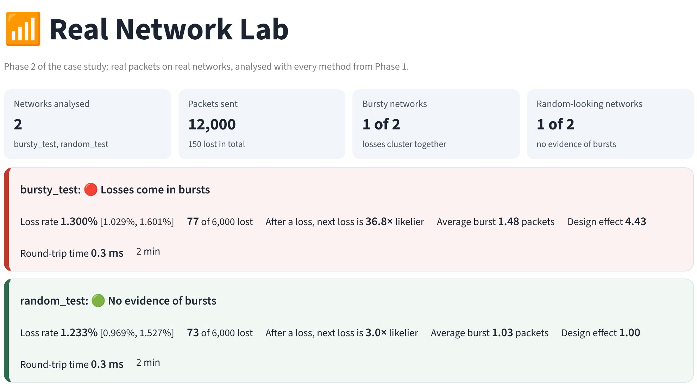
REAL NETWORK LAB: THE FINAL PRODUCT
BAMAT207
Final Review
WHAT IT DOES BY ITSELF
Record: pick the network, press Start; live loss rate on screen.
Verdict cards: bursty or random, loss rate with 95% CrI, b/a, deff.
O1 to O6 tabs: every fit, test and interval from Phase 1, as charts.
Live vs study: each run set against the matching study network.
Assumptions: what we assumed, what we found, and why.
Saved runs: keep runs with a name and note; compare all.
Read me: every formula and decision rule in the sidebar.
Home page with the two validation runs: one card per network, then a tab per objective.
RUN IT
streamlit run lab.py (from the project folder)
REPORT
One click downloads a zip: summary tables, figures and raw data.
Statistical Modelling of Packet-Loss Patterns
17
Notes:
This is the final product of the project. One command opens it. You press Start recording, and when the run ends it calculates everything on its own and shows a verdict card for each network, then one tab per objective. The screenshot uses the two validation runs. A second page holds the Phase 1 simulation.

Slide 18
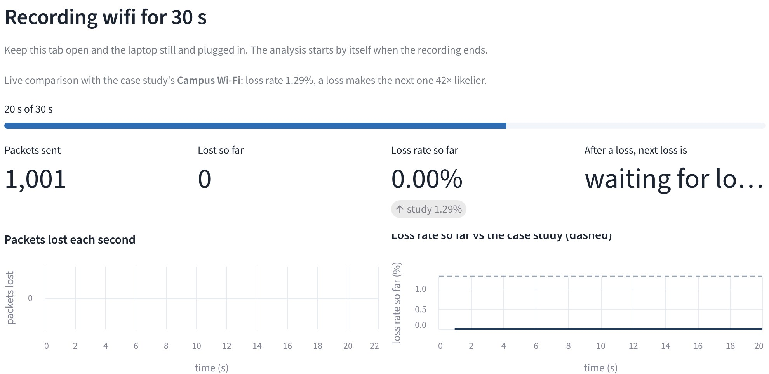
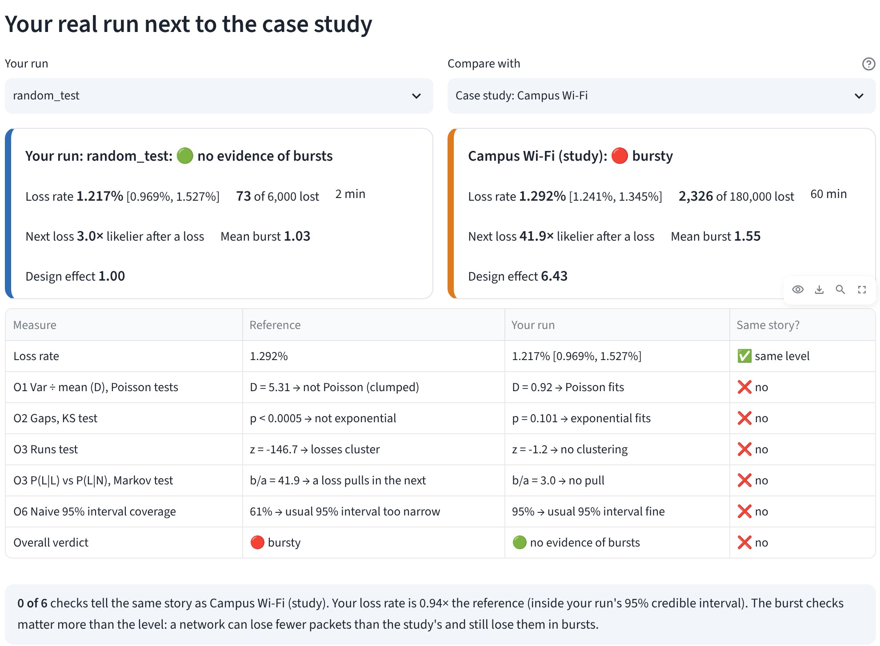
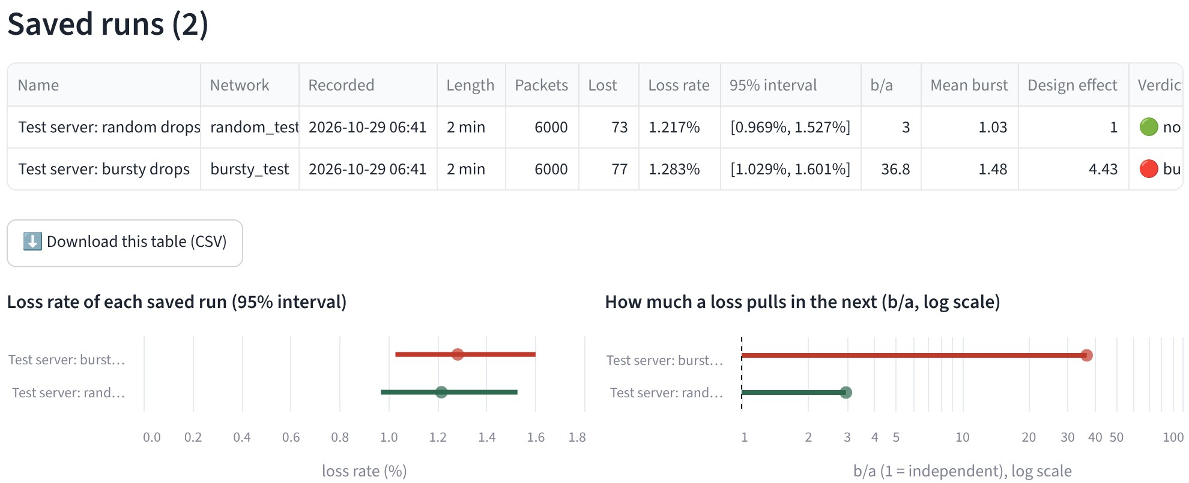
LIVE VS STUDY AND SAVED RUNS
BAMAT207
Final Review
While recording: live numbers against the study (dashed line)
After the run: every test side by side, with a same-story check
SAVED RUNS (BOTTOM LEFT)
Each run kept with its packets, results and note; reopen or delete any time.
Statistical Modelling of Packet-Loss Patterns
18
Notes:
While a run is recording, the loss rate and the after-a-loss multiplier appear live next to the case study's numbers. After the run, the Live vs study tab checks every test side by side and marks whether it tells the same story. Here the random-drop test server is set against the study's Wi-Fi: same loss level, but none of the burst checks match, as expected. Saved runs keep every result in one table.

Slide 19
WHAT WE ASSUMED VS WHAT WE FOUND
BAMAT207
Final Review
We assumed | The case study found | Why
Losses are independent | Rejected: a loss makes the next 31 to 43× likelier (p < 10⁻¹⁰). | Interference and full queues outlast the 20 ms between packets; the channel has memory.
Losses per second are Poisson | Rejected: variance ÷ mean 1.59 to 10.17; Negative Binomial wins. | Bursts pile losses into a few seconds and leave the rest empty.
Gaps between losses are exponential | Rejected (KS p < 0.0005); a two-phase mixture fits. | Two time scales: milliseconds inside a burst, seconds between bursts.
The usual 95% interval is fine | Held the truth only 40% to 86% of the time; corrected 93% to 94%. | Packets in a burst share one fate, so n ÷ deff is the real sample size.
All networks lose at the same rate | Rejected: Kruskal-Wallis H = 937, every pair differs. | Each link has different causes and amounts of loss.
A short capture is enough | Wired needs about 5 minutes for power 0.8. | Bursts are rare on a good link; power grows with length.
PHASE 2
The Lab's Assumptions tab adds a fourth column with what each real run shows.
Statistical Modelling of Packet-Loss Patterns
19
Notes:
Each row is a textbook assumption. The middle column is what the case study showed, and the last column is the reason. The Lab shows the same table with a fourth column filled in from each real run, so Phase 2 can confirm or challenge every row.

Slide 20
DISCUSSION
BAMAT207
Final Review
WHAT THE RESULTS MEAN
NAIVE COVERAGE FALLS AS DESIGN EFFECT GROWS
Burstiness is its own property. Mobile loses 14 times more than Wired. On both, a loss makes the next 31 to 43 times likelier.
Stronger bursts, worse intervals. Naive coverage is lowest on Mobile: 40.3% instead of 95%.
One step fixes it. Dividing n by the design effect gives 93.3% to 94.0% coverage.
WHY IT MATTERS IN PRACTICE
VIDEO AND VOICE
Error correction should cover a burst, not one packet. Mean burst: 1.12, 1.55 and 2.25 packets.
SERVICE REPORTS
A loss rate should come with a burst measure, such as P(L|L).
PROTOCOL TUNING
Retransmission timers tuned on random loss react badly to bursts.
STATISTICS
Check independence before trusting any standard error or interval.
Statistical Modelling of Packet-Loss Patterns
20
Notes:
The loss rate alone hides how losses are arranged. Mobile loses about 14 times more packets than Wired, yet both show strong bursts. Naive intervals get worse as bursts get stronger. The design-effect correction fixes this with one simple step.

Slide 21
LIMITATIONS
BAMAT207
Final Review
LIMITS OF THIS STUDY AND HOW WE HANDLE THEM
Limitation | Why it matters | How we handle it
Phase 1 data are simulated | Real links may add effects, such as busy hours. | Phase 2 lab runs the same code on real packets.
Dispersion test uses a Poisson baseline | Counts of 50 packets are Binomial, a little less spread out. | The test can only under-state burstiness, never over-state it.
Runs and Markov tests are approximate | In very short captures the false-alarm rate can drift from 5%. | Our traces last 1 hour, where the rate is close to 5%.
Tail models are not perfect | Negative Binomial and two-phase fits are still rejected for some networks. | Future work: hidden Markov and three-phase models.
Design effect depends on block size | Other block sizes give slightly different interval widths. | 10-second blocks are far longer than any Bad spell.
One trace per network | A single run could be unusual. | The Monte Carlo studies repeat the experiment 2,000 times.
Statistical Modelling of Packet-Loss Patterns
21
Notes:
Every study has limits. The main one is that Phase 1 data are simulated. The other points are about test approximations and model choices. For each one we list how we handle it now, or how Phase 2 will.

Slide 22
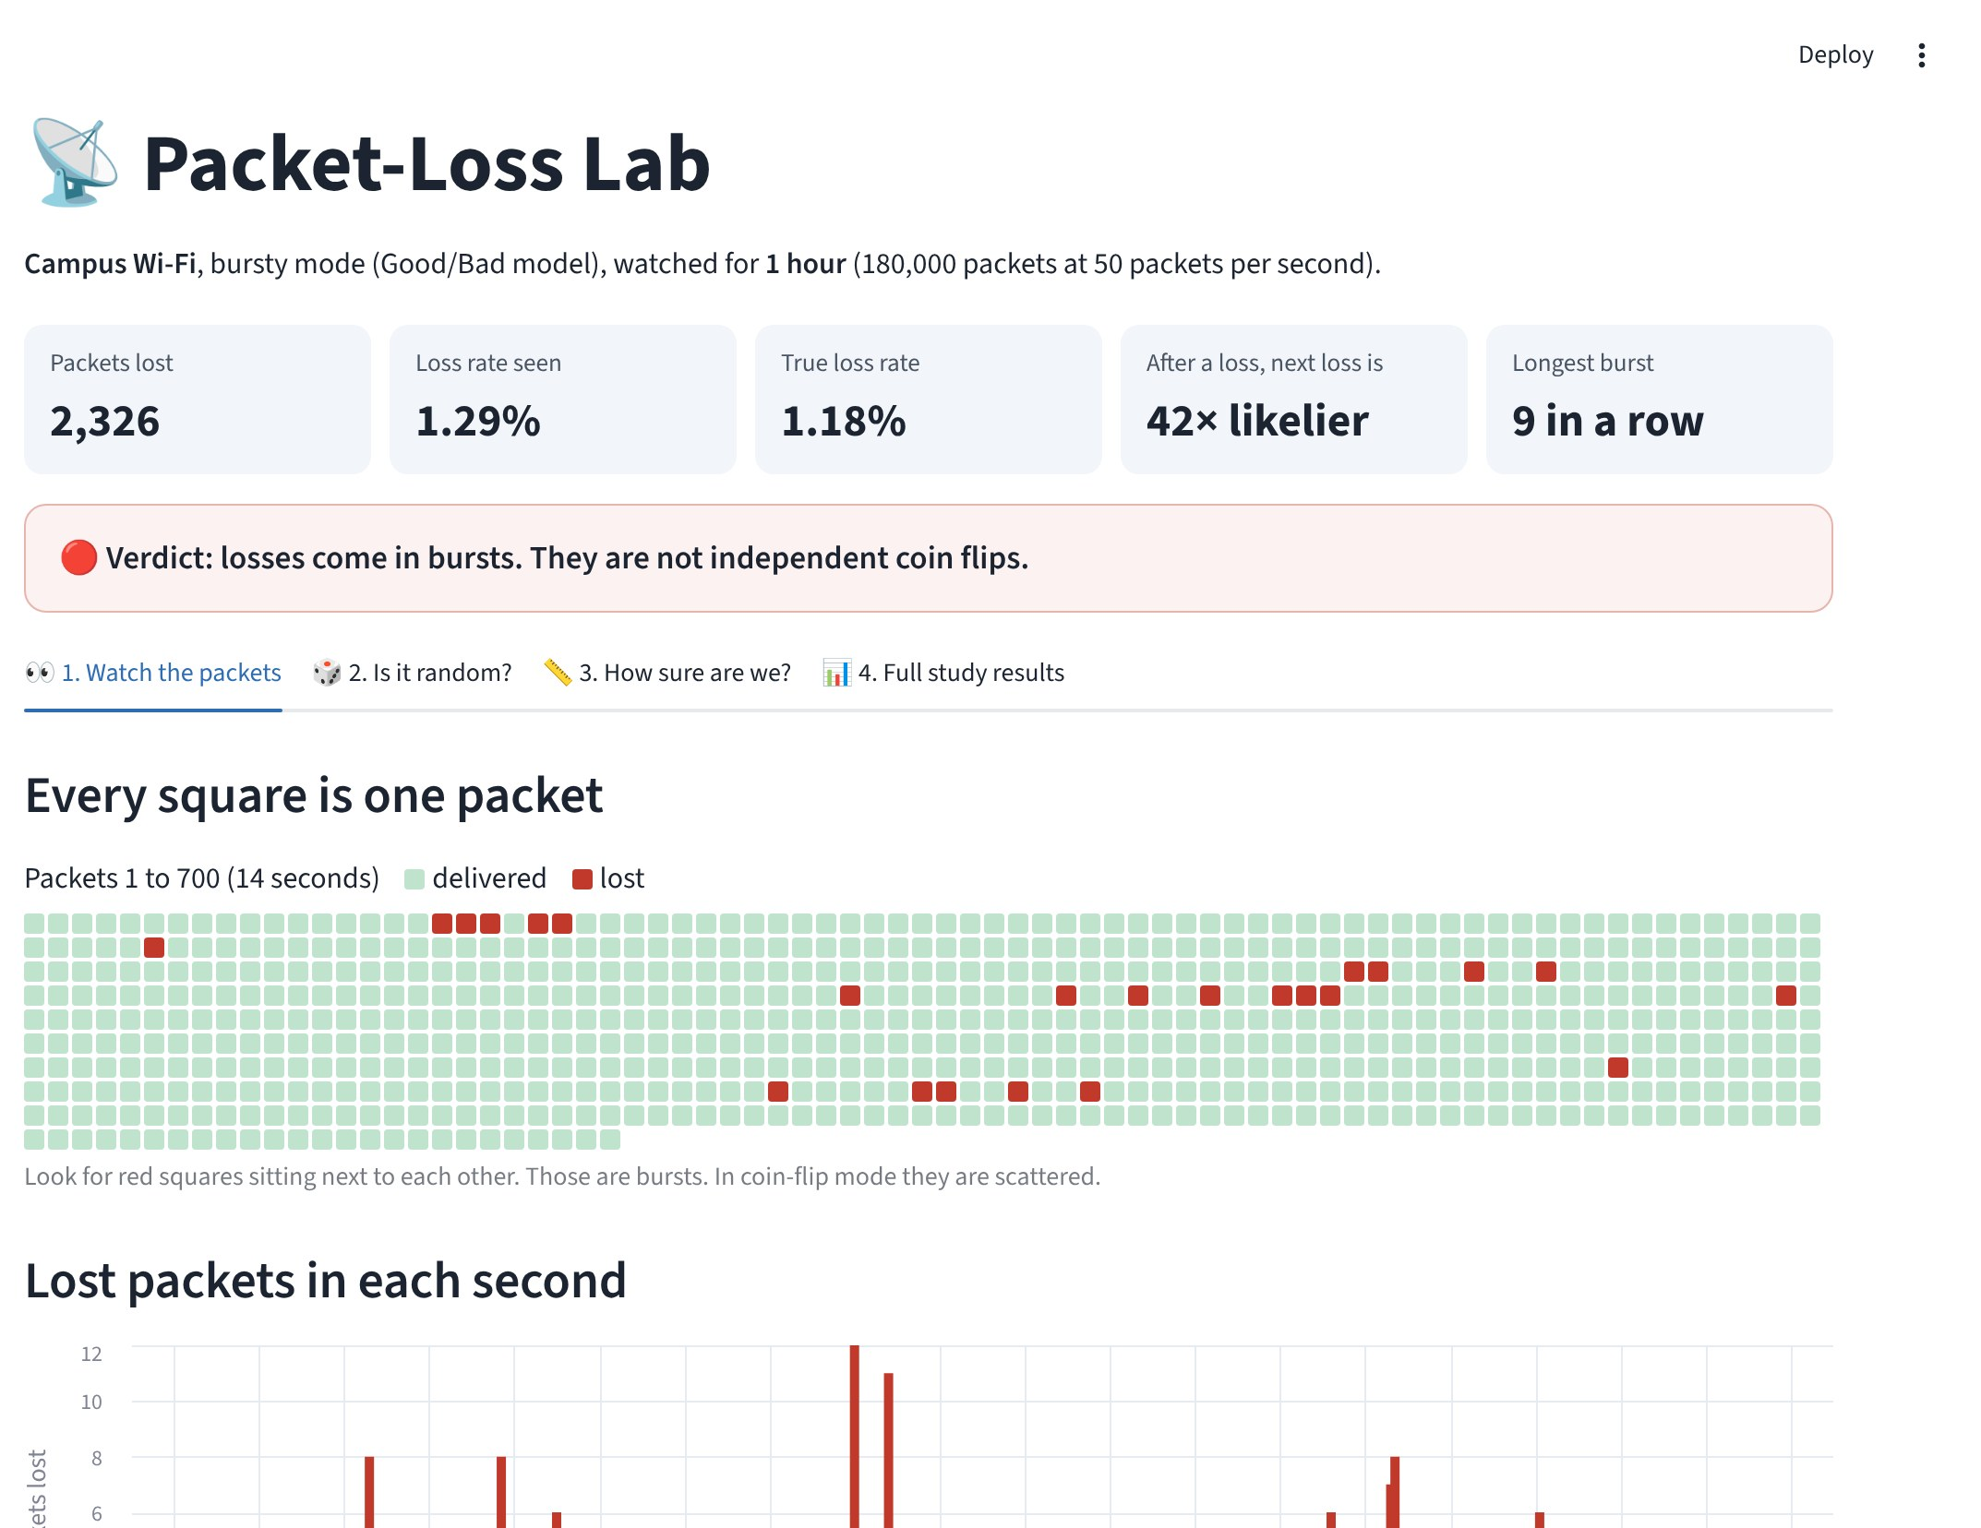
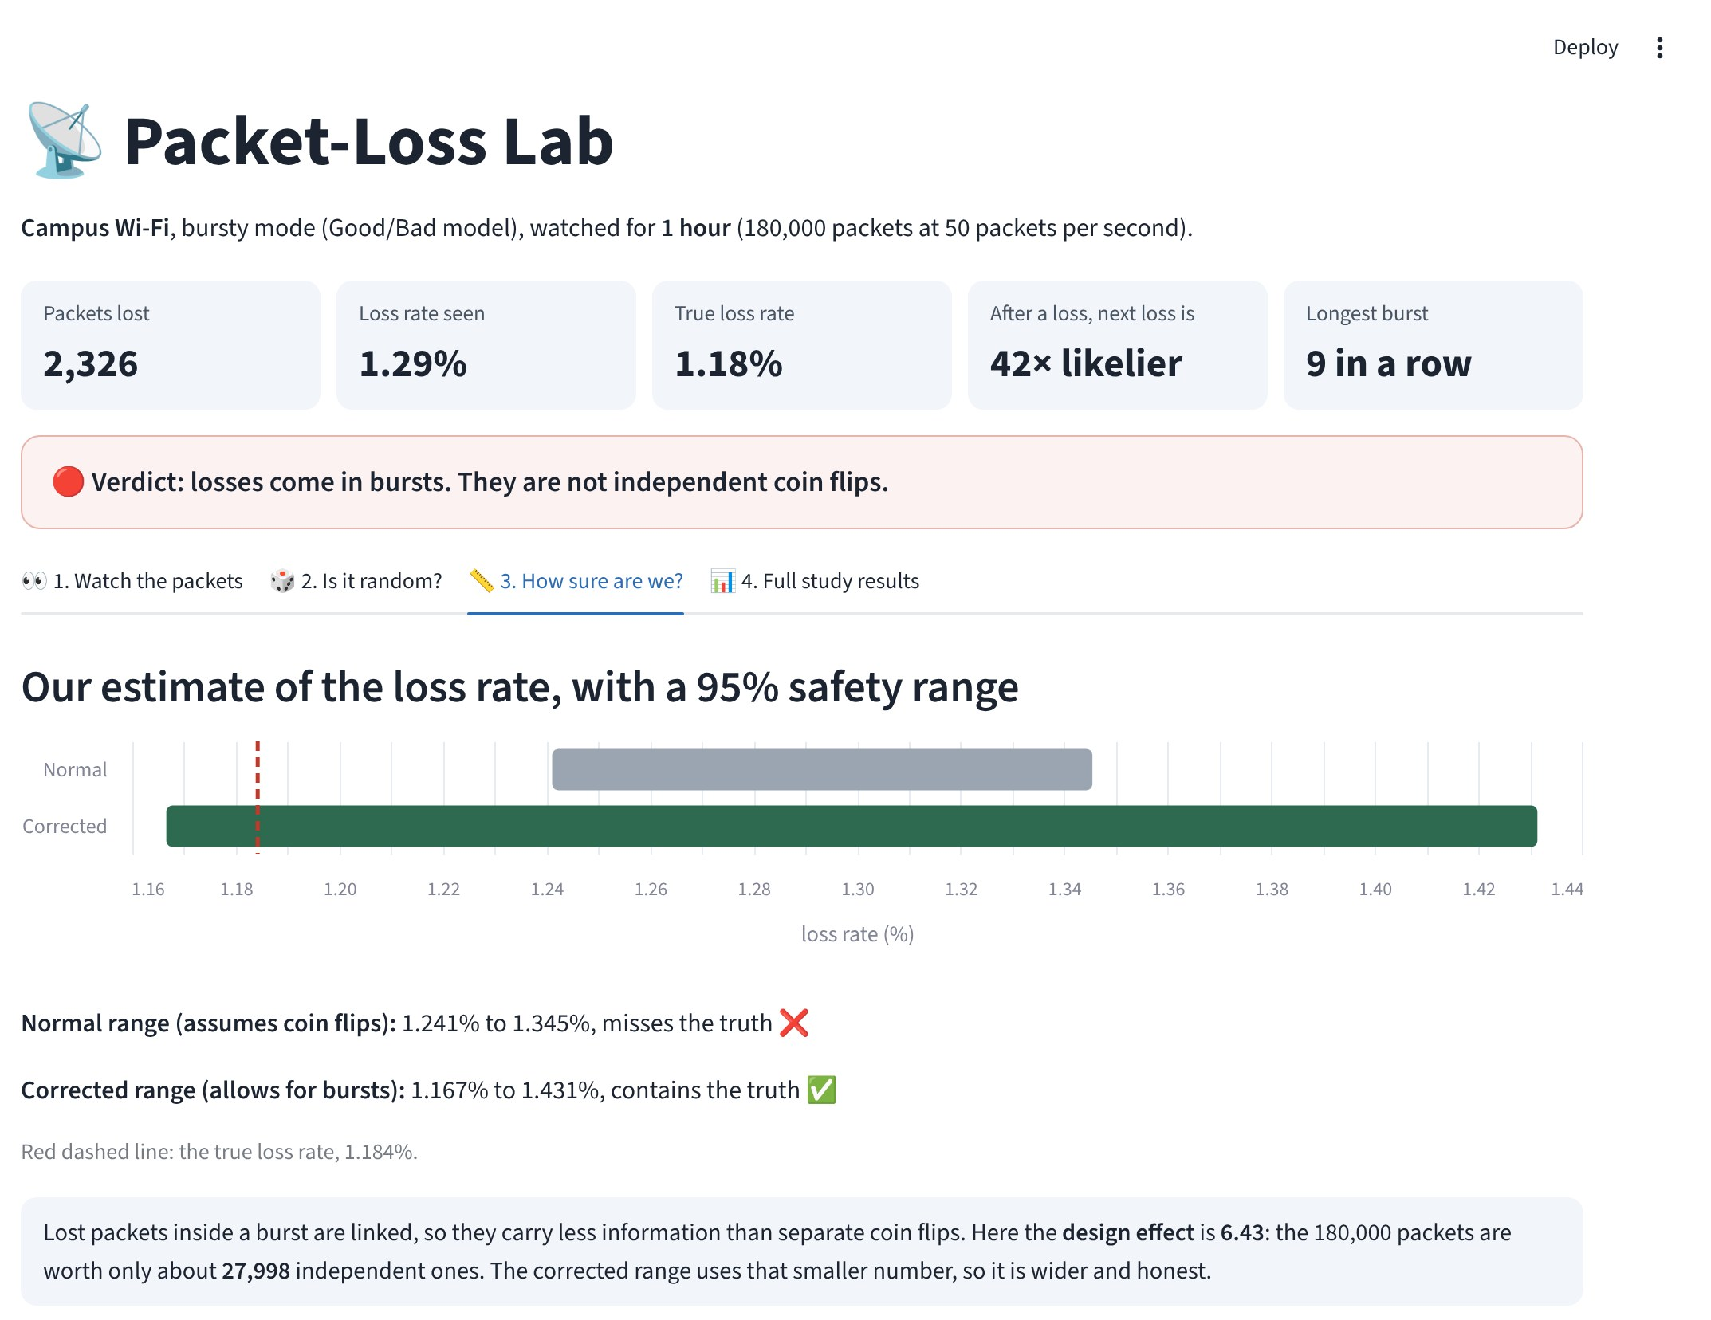
PACKET-LOSS LAB: SIMULATION PAGE
BAMAT207
Final Review
WHAT YOU CAN DO
Pick a network: Wired, Wi-Fi, Mobile.
Coin-flip mode: same loss rate, but every packet independent.
Watch the packets: lost packets shown as red squares.
Is it random? the four tests, passed or failed.
How sure are we? naive and corrected intervals against the truth.
Watch the packets: red squares are losses
How sure are we: naive vs corrected
2,326
Wi-Fi losses, same as the study
42×
likelier after a loss
2026
default seed
ONE-MINUTE DEMO
1. Wi-Fi: losses clump together. 2. Coin-flip mode: all checks pass. 3. Intervals: naive misses, corrected covers.
RUN IT
streamlit run lab.py, then pick Simulation Lab (Phase 1) in the sidebar.
Statistical Modelling of Packet-Loss Patterns
22
Notes:
The app runs the same code as the study. Its default view reproduces our Wi-Fi results exactly. In the demo we show the red loss squares, then switch to coin-flip mode, then compare the two intervals.

Slide 23
CONCLUSIONS AND FUTURE WORK
BAMAT207
Final Review
CONCLUSIONS
FUTURE WORK
Loss counts: the Poisson model is rejected; the Negative Binomial has lower AIC.
Gaps: a fast phase (mean 29 to 33 ms) and a slow phase of seconds.
Dependence: P(L|L) is 31 to 43 times P(L|N).
Networks: mean loss rates of 0.28%, 1.29% and 3.94% differ significantly.
Intervals: naive coverage 40% to 86%; corrected 93% to 94%.
Real runs: 10 minutes each on Wi-Fi, hotspot and wired with the Real Network Lab.
Calibration: estimate the two-state model with the Baum-Welch algorithm.
Tail models: three-phase mixtures or a hidden Markov model.
Hierarchical Bayes: pool across networks, with Phase 1 results as priors.
Time of day: compare peak and off-peak loss rates.
PROPOSED PHASE 2 TIMELINE (WEEKS AFTER THE FINAL REVIEW)
Now
Week 2
Week 4
Week 6
Week 8
Record real runs in the Lab, 10 minutes each
Baum-Welch fit and repeat the analysis
Hierarchical model, time of day, report
Statistical Modelling of Packet-Loss Patterns
23
Notes:
The main result is that losses in all three scenarios are dependent and arrive in bursts. Models that assume independence fit poorly and give intervals that are too narrow. Phase 2 will repeat the analysis on measured traces. The timeline at the bottom is a proposal in weeks after this review.

Slide 24
REFERENCES
BAMAT207
Final Review
SOURCES
USE OF SOURCES
Loss model [1, 2, 3]. EM algorithm [4]. Tests [5 to 9]. AIC [10]. Design effect [11]. Bayesian methods [12]. Software [13 to 15].
[1] E. N. Gilbert, "Capacity of a burst-noise channel," Bell System Technical Journal, vol. 39, no. 5, pp. 1253-1265, 1960.
[2] E. O. Elliott, "Estimates of error rates for codes on burst-noise channels," Bell System Technical Journal, vol. 42, no. 5, pp. 1977-1997, 1963.
[3] M. Yajnik, S. Moon, J. Kurose and D. Towsley, "Measurement and modelling of the temporal dependence in packet loss," Proc. IEEE INFOCOM, 1999, pp. 345-352.
[4] A. P. Dempster, N. M. Laird and D. B. Rubin, "Maximum likelihood from incomplete data via the EM algorithm," J. Royal Statistical Society B, vol. 39, no. 1, pp. 1-38, 1977.
[5] A. Wald and J. Wolfowitz, "On a test whether two samples are from the same population," Annals of Mathematical Statistics, vol. 11, no. 2, pp. 147-162, 1940.
[6] H. W. Lilliefors, "On the Kolmogorov-Smirnov test for the exponential distribution with mean unknown," J. American Statistical Association, vol. 64, pp. 387-389, 1969.
[7] S. S. Wilks, "The large-sample distribution of the likelihood ratio for testing composite hypotheses," Annals of Mathematical Statistics, vol. 9, no. 1, pp. 60-62, 1938.
[8] W. H. Kruskal and W. A. Wallis, "Use of ranks in one-criterion variance analysis," J. American Statistical Association, vol. 47, pp. 583-621, 1952.
[9] H. B. Mann and D. R. Whitney, "On a test of whether one of two random variables is stochastically larger than the other," Annals of Mathematical Statistics, vol. 18, no. 1, pp. 50-60, 1947.
[10] H. Akaike, "A new look at the statistical model identification," IEEE Trans. Automatic Control, vol. 19, no. 6, pp. 716-723, 1974.
[11] L. Kish, Survey Sampling. New York: Wiley, 1965.
[12] A. Gelman, J. B. Carlin, H. S. Stern, D. B. Dunson, A. Vehtari and D. B. Rubin, Bayesian Data Analysis, 3rd ed. CRC Press, 2013.
[13] C. R. Harris et al., "Array programming with NumPy," Nature, vol. 585, pp. 357-362, 2020.
[14] P. Virtanen et al., "SciPy 1.0: fundamental algorithms for scientific computing in Python," Nature Methods, vol. 17, pp. 261-272, 2020.
[15] J. D. Hunter, "Matplotlib: a 2D graphics environment," Computing in Science and Engineering, vol. 9, no. 3, pp. 90-95, 2007.
PAPER AND CODE
IEEE paper in the paper folder. Seed 2026 regenerates every number.
SOURCE CODE
github.com/AashmanBiyani08/Prob_Stats_Project
DATA
Phase 1 traces are simulated. Phase 2 measures real packets; validated on a test server.
Statistical Modelling of Packet-Loss Patterns
24
Notes:
These are the original sources for the loss model and for each statistical method. The code is available on GitHub. Running it with seed 2026 reproduces every number in this presentation.

Slide 25
APPENDIX: ABBREVIATIONS
BAMAT207
Final Review
MODELS AND FITTING
TESTS AND INFERENCE
Short | Full form | Plain meaning
GE | Gilbert-Elliott model | Two-state Good/Bad channel that makes bursts
πB | Stationary Bad probability | Share of time spent in the Bad state
hG, hB | Loss probability in Good, Bad | Chance a packet is lost in each state
MLE | Maximum likelihood estimation | Picks values that make the data most likely
EM | Expectation-Maximisation | Guess, update, repeat: fits the two-phase mixture
AIC | Akaike Information Criterion | Model score; lower is better
NB | Negative Binomial | Count model that allows clumping
χ² | Chi-square test | Compares observed and expected counts
KS | Kolmogorov-Smirnov test | Largest gap between data and model curves
Short | Full form | Plain meaning
LRT, G² | Likelihood-ratio test, its statistic | Does the previous packet matter?
P(L|N), P(L|L) | Loss after delivered, after lost | a and b; b/a is the burst amplification
H0, H1 | Null, alternative hypothesis | No effect vs the effect we test for
α | Significance level | Reject H0 when p < 0.05
CrI | Credible interval | 95% Bayesian range for the loss rate
deff | Design effect | Real spread ÷ spread under independence
n_eff | Effective sample size | n ÷ deff: worth of correlated packets
MC, SE | Monte Carlo, standard error | Repeat by simulation; its accuracy
pp | Percentage points | Difference between two percentages
Statistical Modelling of Packet-Loss Patterns
25
Notes:
This slide lists every short form used in the deck, with its full name and a one-line meaning. Use it to answer panel questions on terms.

Slide 26
APPENDIX: PHASE 2 TERMS
BAMAT207
Final Review
MEASURING
THE LAB
Term | Full form | Plain meaning
ICMP | Internet Control Message Protocol | The protocol behind ping; the router replies
UDP | User Datagram Protocol | Plain packets to our own echo server
RTT | Round-trip time | Time for a reply to come back (ms)
Echo server | Program that sends packets back | Used for UDP mode and the validation test
Timeout | 2 s wait for a reply | No reply in time: the packet counts as lost
Router / gateway | First hop of the network | Probing it measures the Wi-Fi link itself
Term | Meaning | Plain meaning
Probe | probe.py | Sends the packets and records replies
Run / capture | One recording | CSV of packets plus a JSON of settings
Verdict | Bursty or no evidence | Runs test or Markov test at α = 0.05
Live vs study | Side-by-side check | Real run against the matching study network
Same story | Same test outcome | Both reject, or both do not
Saved run | Kept run with results | Stored in realworld/saved_runs
Statistical Modelling of Packet-Loss Patterns
26
Notes:
Short forms and terms used on the Phase 2 slides, with a plain meaning for each.

