Slide 1
Presented By
By
Manikanta
shashikala

Slide 2
Introduction to digital video technology

Slide 3

What is an image? Image is collections of pixel An image can be thought of as a 2D matrix. If we think about colors, we can extrapolate this idea seeing this image as a 3D matrix where the additional dimensions are used to provide color data.
R
G
B
100 | 0 | 0 | 0
100 | 7 | 0 | 0 | 0
100 | 7 | 2 | 0 | 0 | 0
100 | 100 | 2 | 2 | 2 | 2
 | 100 | 100 | 6 | 0 | 0
 |  | 100 | 6 | 6 | 6
2D
3D
color intensity

Slide 4

What is picture element (pixel) ?
Pixel is the small single component of a digital image.
100 | 0 | 0 | 0 | G
100 | 7 | 0 | 0 | 0 | B
100 | 7 | 2 | 0 | 0 | 0
100 | 100 | 2 | 2 | 2 | 2
 | 100 | 100 | 6 | 0 | 0
 |  | 100 | 6 | 6 | 6
R

Slide 5
What is bit (color) depth? The number of bits used to represent each pixel in an image. ... For example, a typical color image using 8 bits per channel is often referred to as a 24-bit color image (8 bits x 3 channels).
100 | 0 | 0 | 0 | G
100 | 7 | 0 | 0 | 0 | B
100 | 7 | 2 | 0 | 0 | 0
100 | 100 | 2 | 2 | 2 | 2
 | 100 | 100 | 6 | 0 | 0
 |  | 100 | 6 | 6 | 6
R
The range
0-255
8R+8G+8B = 24 bits

Slide 6
What is resolution?
Another property of an image is the resolution, which is the number of pixels in one dimension. It is often presented as width × height, for example, the 4×4 image below.
width
height
4
4

Slide 7
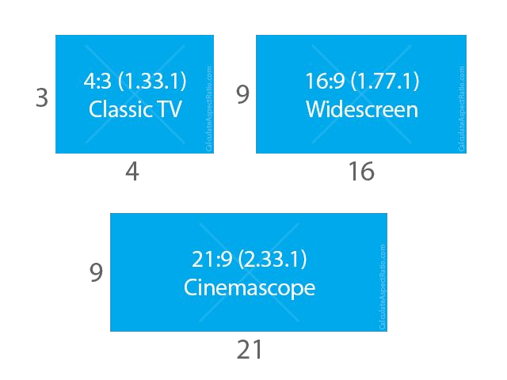
What is aspect ratio (AR)? Aspect ratio which simply describes the proportional relationship between width and height of an image or pixel.
16:9 (1.7777777778) 4:3 (1.3333333333)
1280/720 (1.7777777778) 1024/768 (1.3333333333)
When people says this movie or picture is 16x9 they usually are referring to the Display Aspect Ratio (DAR), however we also can have different shapes of individual pixels, we call this Pixel Aspect Ratio (PAR).

Slide 8
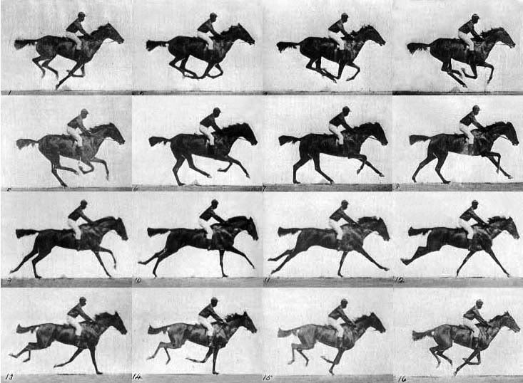
What is a video? we can define a video as a succession of n frames in time which can be seen as another dimension, n is the frame rate or frames per second (FPS).
Fig: Frames in a video of horse riding

Slide 9
Interlaced and progressive In the early days, engineers came up with a technique for doubling the perceived frame rate of a video display without consuming extra bandwidth. This technique is known as interlaced video; it basically sends half of the screen in 1 "frame" and the other half in the next "frame". Today screens render mostly using progressive scan technique. Progressive is a way of displaying, storing, or transmitting moving images in which all the lines of each frame are drawn in sequence.

Slide 10
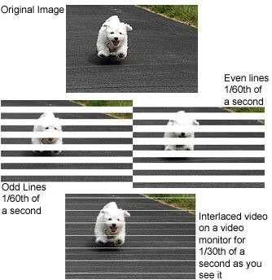
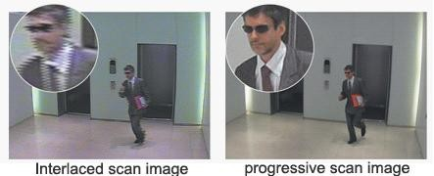

Slide 11
What are 480p, 1080i, 1080p formats?
[number][letter]
number is the resolution's height
letter: p means progressive and
I means interlaced.

Slide 12
What is bitrate?
WIDTH * HEIGHT * BITS_PER_PIXEL * FPS
4 * 4 * 24 * 30
11,520 bits per second
30 FPS

Slide 13
Space needed to store 1h of video at 720p 30fps
WIDTH * HEIGHT * BITS_PER_PIXEL * FPS 1280 * 720 * 24 * 30
663,552,000 (663.552Mb) bits per second
2,388,787,200,000 (278GB)

Slide 14
CODEC - enCOder / DECoder

Slide 15
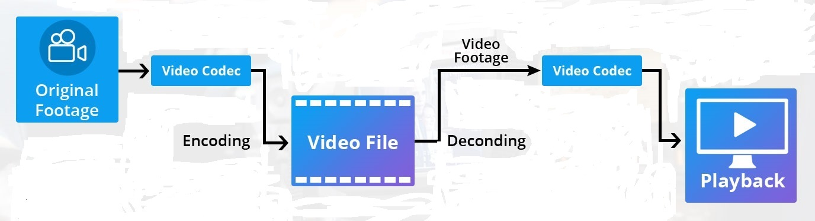
CODEC
“A codec is a device or computer program for encoding or decoding a digital data stream or signal.”
Fig: Encoding and Decoding of video file

Slide 16
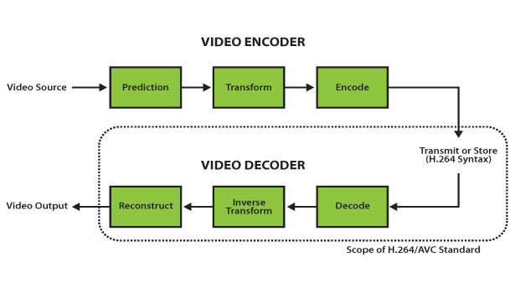
Compression and De-compression
Space needed to store 1h of video at 720p 30fps
WIDTH * HEIGHT * BITS_PER_PIXEL * FPS
1280 * 720 * 24 * 30
663,552,000 (663.552Mb) bits per second
2,388,787,200,000 (278GB)
with chroma sub-sampling YUV420
WIDTH * HEIGHT * BITS_PER_PIXEL * FPS
1280 * 720 * 12 * 30
331,776,000 (331.776Mb) bits per second
1,194,393,600,000 (139GB)

Slide 17
Container and CODEC
Containers
OGG
MP4
WMA
AVI
MKV, WebM
TS
MOV
CODEC
H264 / AVC
H265 / HEVC
MPEG-4
VP9
AV1
Theora
Daala

Slide 18
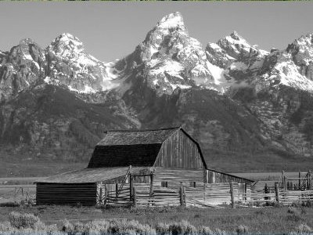
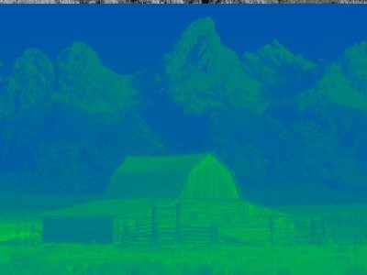




Color space YUV (YCbCr, YpbPr): The Y′UV model defines a color space in terms of one luma component (Y′) and two chrominance components, called U (blue projection) and V (red projection) respectively
Y (luma)
U (chroma blue)
V (chroma red)

Slide 19
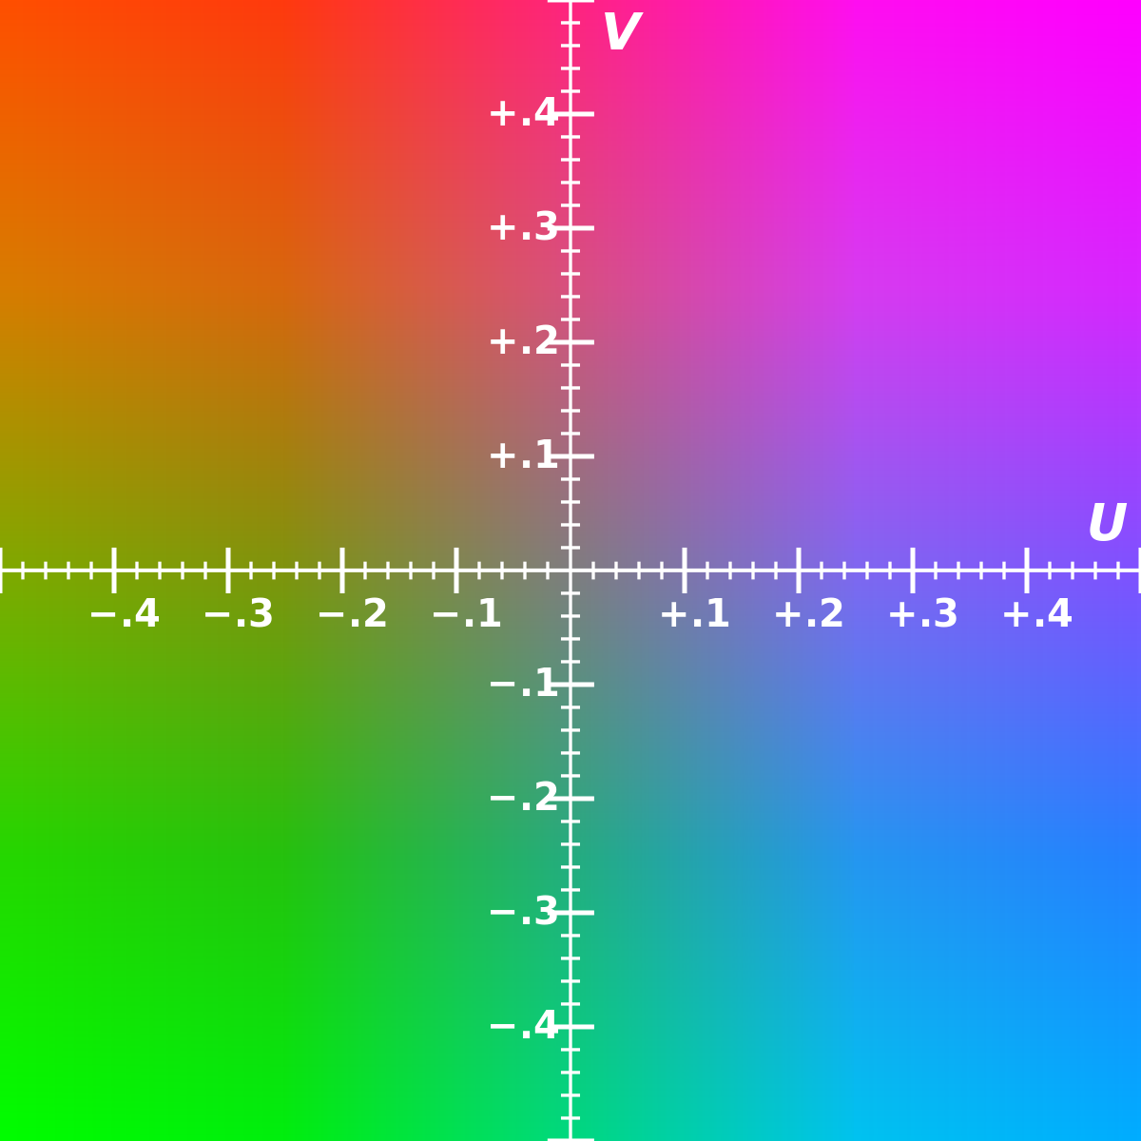
Chroma sub-sampling YUV 4:4:4 4:2:2 4:2:0 The U and V color values are shared between pixels, which frees bandwidth and may increase frame rate. Known as “chroma subsampling,”
Fig:YUV-planes

Slide 20
Conti..
Y (luma)
U (chroma blue)
V (chroma red)

Slide 21
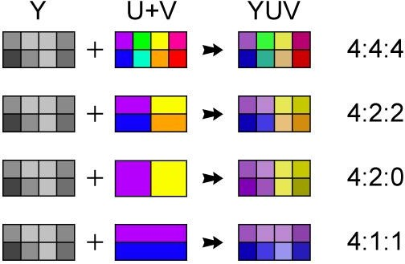
Chroma sub-sampling YUV 4:4:4 4:2:2 4:2:0

Slide 22
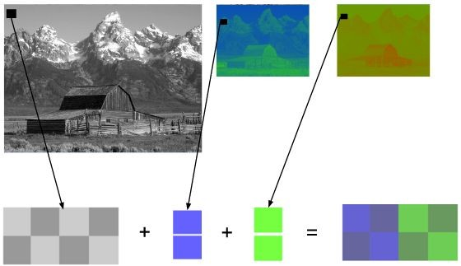
Chroma subsampling 4:2:0

Slide 23
Frame types
What is I frame?Intra coded frame
It constructed from itself only and it is used as a reference for other frames.
It never constructed from other frames.
What is P frame?Predictive frame
It is constructed from previous i and p frames.
It contains previous frame changes.
It can construct from another P-frame.
What is B frame?Bi-directional predictive frame.
It is constructed from past and future frames.
It is not constructed from another B-frame means never used as a reference.

Slide 24
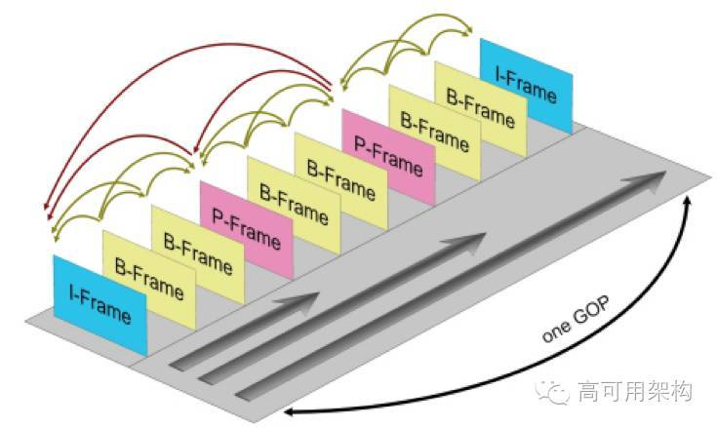
Conti..
In video coding,a group of pictures or GOP structure, specifies the order in which intra-and inter-frames are arranged.
The GOP is a collection of successive pictures within a coded video stream.
Each coded video stream consists of successive GOPs, from which the visible frames are generated.

Slide 25
V4L2
Video4Linux is a collection of device drivers and an API for supporting realtime video capture on Linux systems. It supports many USB webcams, TV tuners, and related devices, standardizing their output, so programmers can easily add video support to their applications that use the V4L framework.

Slide 26
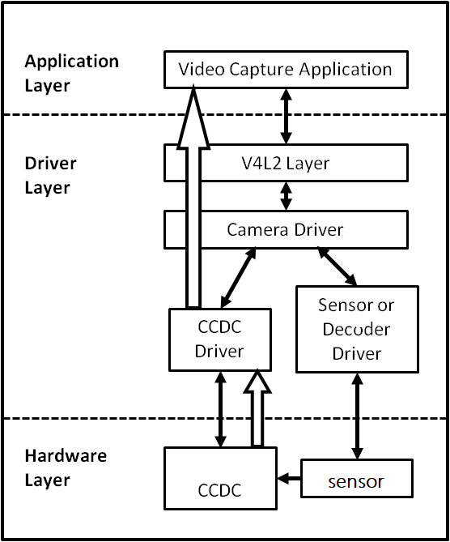
Fig:V4L2

Slide 27
V4L2 framework
What is V4L2 Framework ?
Video for linux or V4L is set of APIs and driver framework for video capture
applications and for O/P devices.
Since we don’t have any common framework, we need to do the setup of device
instance and connecting to sub-devices themselves for all the drivers. And there is also
lot of common code that could never be refactored due to lack of framework.
To avoid this complexity, introduced a framework with common fuctionalities for all
the drivers which is know as V4L2 framework.
Note : The videobuf layer fuctions as a sort of glue layer between V4L2 driver and userspace.

Slide 28
Conti..
Structure of V4L driver ?
Note : All the drivers will follow the same structure.
1. A struct for each device instance containing the device state.
2. A way of initializing and commanding sub-devices (if any).
3. Creating V4L2 device nodes (/dev/videoX, /dev/vbiX and /dev/radioX) and keeping track of device- node specific data.
4. Filehandle-specific structs containing per-filehandle data;
5. video buffer handling.
Important functions provided by V4L2 Framework are:
1.Buffer Management – videobuf2-core.c
2.Controls – v4l2-controls.c
3.Events – V4l2-events.c

Slide 29
Buffer Management
What is buffer mangagment ?
It Handles the allocation and managemet of buffers for the storage of video frames.
There are two set of functions,
One is for standard I/O system calls like read(), poll(), mmap().
Another set of functions used to implement bulk of the V4L2 ioctl() calls related to streaming I/O, including buffer allocation, queueing, dequeueing and streaming controls.
What are different type of buffers ?
Buffers which are scatterd in both the physical and (kernel) virtual.
Buffers which are physically scattered, but which are virtual contigious.
Buffers which are physically contigious.
Note: Based on type of buffers used, need to include the following header files. <media/videobuf-dma-sg.h> /* Physically scattered */
<media/videobuf-vmalloc.h> /* vmalloc() buffers */
<media/videobuf-dma-contig.h> /* Physically contiguous */

Slide 30
Conti..
Memory type for VB2 buffers
This is type of memory module to make buffers visible on userspace.
VB2_MEMORY_UNKNOWN Buffer status is unknow or it is not used yet on userspace.
VB2_MEMORY_MMAP The buffers are allocated by the kernel and its memory mapped via mmap() ioctl call,when the user is using the buffers via read() or write() system calls.
VB2_MEMORY_USERPTR The buffers are allocated in userspace and its memory mapped via mmap() ioctl call.
VB2_MEMORY_DMABUF The buffers are passed to userspace via DMA buffer.

Slide 31
Conti..
int (*buf_setup) (struct videobuf_queue *q, unsigned int *count, unsigned int *size); buf_setup() is called early in the I/O process, when streaming is being instead. Its purpose is to tell videobuf about the I/O streaming.
int (*buf_init)(struct vb2_buffer *vb); Whenever buffer is getting allocated (in MMAP) or after acquiring new USERPTR buffer. Driver may perform initialization, if initialization fails will prevent the queue setup.
int (*buf_prepare)(struct vb2_buffer *vb); This is called everytime when the buffer is queued and from VIDIOC_PREPARE_BUF() ioctl. buf_prepare will set the buffer’s size, width, height, and field.

Slide 32
void (*buf_queue)(struct vb2_buffer *vb); 1. When buffer is queued for I/O, it is passed to buf_queue() for driver to handle it. 2. Which means passes a buffer vb to driver, driver may perform operation on this buffer. 3. Driver should give the buffer back by calling vb2_buffer_done() function. Mostly it is called after VIDIOC_STREAMON(). Note : Sometime buf_queue() can be called before start_streming(), if user pre-queue buffers before calling streamon().
Void (*buf_release)(struct videobuf_queue *q, struct videobuf_buffer *vb); 1. This is called when the buffer is not going to use.
int (*start_streaming)(struct vb2_queue *q, unsigned int count); 1. This is called when the streaming is starts. 2. The driver gets the number of already queued buffers in conunt parameter.
void (*stop_streaming)(struct vb2_queue *q); 1. This is called when streaming stops (stream-off called).

Slide 33
Controls
With respect to controls, the driver developer is intrested in following aspects.
1. How do I add a control?
2. How do I set the control’s value? (i.e. s_ctrl)
3. How do I get the control’s value? (i.e. g_volatile_ctrl)
4. How do I validate the user’s proposed control value? (i.e. try_ctrl)
All the rest is something which can do something centrally. The control framework is was created in order to implement all the rules of the V4L2 specification with respect to controls in central place. And to make life as easy as possible.
v4l2_ctrl describes the control properties and keep track of control’s value.
v4l2_ctrl_handler tracks the controls. It maintaine the list of v4l2_ctrl objects that it owns and another list of references to controls, posibilly to controls owned by other handlers. Note: refer v4l2-ctrl.c file for more on controls.

Slide 34
Conti..
Types of controls : V4L2_CTRL_TYPE_INTEGER V4L2_CTRL_TYPE_BOOLEAN
V4L2_CTRL_TYPE_MENU
V4L2_CTRL_TYPE_BUTTON
V4L2_CTRL_TYPE_INTEGER64
V4L2_CTRL_TYPE_STRING
V4L2_CTRL_TYPE_CTRL_CLASS
V4L2_CTRL_TYPE_BITMASK
V4L2 control flags :
V4L2_CTRL_FLAG_DISABLED – control is permanently disabled.
V4L2_CTRL_FLAG_GRABBED – control is temporarily unchangable, ex other app took ctrl.

Slide 35
Conti..
V4L2_CTRL_FLAG_READ_ONLY – control is permanently is read only. V4L2_CTRL_FLAG_UPDATE – hint change in this control will effect the other controls with in same control class
V4L2_CTRL_FLAG_INACTIVE - control is not applicable for current configuration. V4L2_CTRL_FLAG_SLIDER – control is best represented as slider like element in user interface V4L2_CTRL_FLAG_WRITE_ONLY – control permanently writable. Note: refer v4l2-ctrl.c file for more on controls.

Slide 36
Events
The V4L2 events provide a generic way to pass events to user space.
Events are defined by a type and an optional ID. The ID may refer to a V4L2 object such as a control ID.
Userspace/client has to subscribe to events it wants to listen to.
Following are the important functions related to events: - v4l2_event_queue() Queue events from hardware into v4l2 events queues. - v4l2_events_dequeue() Dequeue events from v4l2 events queue. - v4l2_event_subscribe() Subcribe to a pirticular event - v4l2_event_unsubscribe() Unsubscribe to an event. Client will no longer be reported of these events

Slide 37
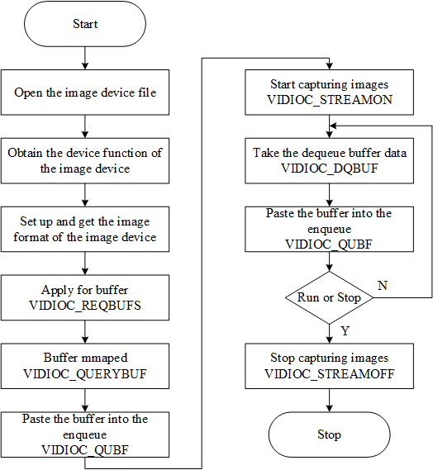
V4l2 test application call flow

Slide 38
Full Log
Below is the log for test application log1.txt file
/* open the video device 0 and query the device capabilities card as : Integrated_Webcam_HD and bus as usb-0000:00:14.0-5 */
shashi:video_open:VIDIOC_QERYCAP
Device /dev/video0 opened: Integrated_Webcam_HD: Integrate (usb-0000:00:14.0-5).
/* video device 0 formats as width=1280, height=720, pixelformat=MJPG */
shashi:video_get_format:VIDIOC_G_FMT
Video format: MJPG (47504a4d) 1280x720
/* it allocated 8 buffers using malloc */
shashi:video_alloc_buffers:VIDIOC_REQBUFS
8 buffers requested.
/*8 buffers are mapping into process address space using mmap length as 1834789 and different offset address*/
shashi:video_alloc_buffers:VIDIOC_QUERYBUF
length: 1843789 offset: 0
Buffer 0 mapped at address 0x7f267834a000.
shashi:video_alloc_buffers:VIDIOC_QUERYBUF
length: 1843789 offset: 1847296
Buffer 1 mapped at address 0x7f2677d76000.
shashi:video_alloc_buffers:VIDIOC_QUERYBUF
length: 1843789 offset: 3694592
Buffer 2 mapped at address 0x7f2677bb3000.
shashi:video_alloc_buffers:VIDIOC_QUERYBUF
length: 1843789 offset: 5541888
Buffer 3 mapped at address 0x7f26779f0000.
shashi:video_alloc_buffers:VIDIOC_QUERYBUF
length: 1843789 offset: 7389184
Buffer 4 mapped at address 0x7f267782d000.
shashi:video_alloc_buffers:VIDIOC_QUERYBUF
length: 1843789 offset: 9236480
Buffer 5 mapped at address 0x7f267766a000.
shashi:video_alloc_buffers:VIDIOC_QUERYBUF
length: 1843789 offset: 11083776

Slide 39
Conti..
length: 1843789 offset: 11083776
Buffer 6 mapped at address 0x7f26774a7000.
shashi:video_alloc_buffers:VIDIOC_QUERYBUF
length: 1843789 offset: 12931072
Buffer 7 mapped at address 0x7f26772e4000.
/* buffers are placing into input queue for capturing */
shashi:video_queue_buffer:VIDIOC_QBUF
shashi:video_queue_buffer:VIDIOC_QBUF
shashi:video_queue_buffer:VIDIOC_QBUF
shashi:video_queue_buffer:VIDIOC_QBUF
shashi:video_queue_buffer:VIDIOC_QBUF
shashi:video_queue_buffer:VIDIOC_QBUF
shashi:video_queue_buffer:VIDIOC_QBUF
shashi:video_queue_buffer:VIDIOC_QBUF
/* video device is capturing 10 frames by stream on */
shashi:video_enable:enable ? VIDIOC_STREAMON : VIDIOC_STREAMOFF
/* retreiving the buffer from capture plane */
shashi:video_do_capture:VIDIOC_DQBUF
0 (0) [-] 0 54824 bytes 5022.898708 1600148240.715216
/* sending an empty buffer to capture plane */
shashi:video_queue_buffer:VIDIOC_QBUF
shashi:video_do_capture:VIDIOC_DQBUF
1 (1) [-] 2 53768 bytes 5024.495000 1600148240.915236
shashi:video_queue_buffer:VIDIOC_QBUF
shashi:video_do_capture:VIDIOC_DQBUF

Slide 40
Conti..
2 (2) [-] 3 55944 bytes 5024.695035 1600148241.115293
shashi:video_do_capture:VIDIOC_DQBUF
3 (3) [-] 4 56136 bytes 5024.895070 1600148241.315301
shashi:video_queue_buffer:VIDIOC_QBUF
shashi:video_do_capture:VIDIOC_DQBUF
4 (4) [-] 5 62432 bytes 5025.095106 1600148241.515341
shashi:video_queue_buffer:VIDIOC_QBUF
shashi:video_do_capture:VIDIOC_DQBUF
5 (5) [-] 6 62152 bytes 5025.295144 1600148241.715378
shashi:video_queue_buffer:VIDIOC_QBUF
shashi:video_do_capture:VIDIOC_DQBUF
6 (6) [-] 7 64360 bytes 5025.495178 1600148241.915410
shashi:video_queue_buffer:VIDIOC_QBUF
shashi:video_do_capture:VIDIOC_DQBUF
7 (7) [-] 8 64672 bytes 5025.695232 1600148242.115478
shashi:video_queue_buffer:VIDIOC_QBUF
shashi:video_do_capture:VIDIOC_DQBUF
8 (0) [-] 9 72200 bytes 5025.895251 1600148242.315512
shashi:video_queue_buffer:VIDIOC_QBUF
shashi:video_do_capture:VIDIOC_DQBUF
9 (1) [-] 10 72296 bytes 5026.095288 1600148242.515516
shashi:video_queue_buffer:VIDIOC_QBUF
/* video device is disabled by stream off */
shashi:video_enable:enable ? VIDIOC_STREAMON : VIDIOC_STREAMOFF
Captured 9 frames in 1.800756 seconds (4.997901 fps, 343624.566571 B/s).
/* allocated buffers released after stream off */
shashi:video_free_buffers:VIDIOC_REQBUFS
8 buffers released.
/* video device 0 is closed */
shashi:video_close

Slide 41
Thank You

