Slide 1
Presented By
By
Manikanta
shashikala

Slide 2
Introduction to digital video technology

Slide 3

What is an image? Image is collections of pixel An image can be thought of as a 2D matrix. If we think about colors, we can extrapolate this idea seeing this image as a 3D matrix where the additional dimensions are used to provide color data.
R
G
B
100 | 0 | 0 | 0
100 | 7 | 0 | 0 | 0
100 | 7 | 2 | 0 | 0 | 0
100 | 100 | 2 | 2 | 2 | 2
 | 100 | 100 | 6 | 0 | 0
 |  | 100 | 6 | 6 | 6
2D
3D
color intensity

Slide 4

What is picture element (pixel) ?
Pixel is the small single component of a digital image.
100 | 0 | 0 | 0 | G
100 | 7 | 0 | 0 | 0 | B
100 | 7 | 2 | 0 | 0 | 0
100 | 100 | 2 | 2 | 2 | 2
 | 100 | 100 | 6 | 0 | 0
 |  | 100 | 6 | 6 | 6
R

Slide 5
What is bit (color) depth? The number of bits used to represent each pixel in an image. ... For example, a typical color image using 8 bits per channel is often referred to as a 24-bit color image (8 bits x 3 channels).
100 | 0 | 0 | 0 | G
100 | 7 | 0 | 0 | 0 | B
100 | 7 | 2 | 0 | 0 | 0
100 | 100 | 2 | 2 | 2 | 2
 | 100 | 100 | 6 | 0 | 0
 |  | 100 | 6 | 6 | 6
R
The range
0-255
8R+8G+8B = 24 bits

Slide 6
What is resolution?
Another property of an image is the resolution, which is the number of pixels in one dimension. It is often presented as width × height, for example, the 4×4 image below.
width
height
4
4

Slide 7
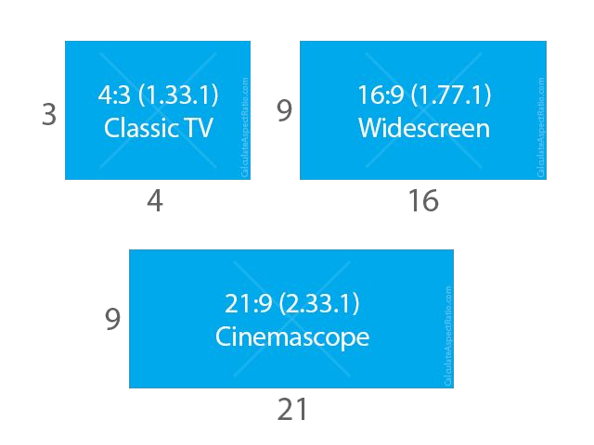
What is aspect ratio (AR)? Aspect ratio which simply describes the proportional relationship between width and height of an image or pixel.
16:9 (1.7777777778) 4:3 (1.3333333333)
1280/720 (1.7777777778) 1024/768 (1.3333333333)
When people says this movie or picture is 16x9 they usually are referring to the Display Aspect Ratio (DAR), however we also can have different shapes of individual pixels, we call this Pixel Aspect Ratio (PAR).

Slide 8
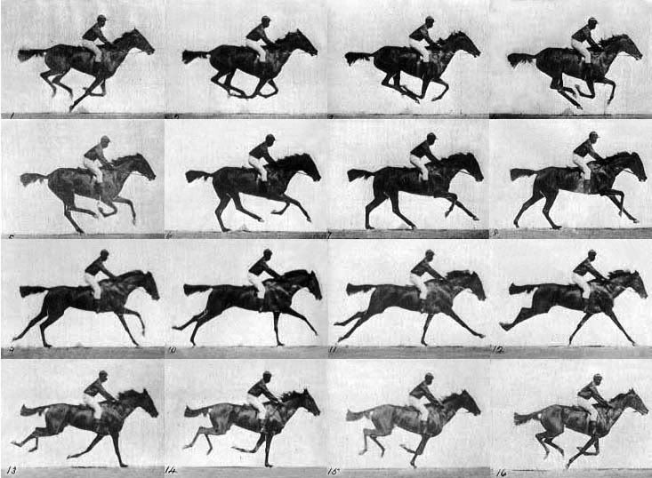
What is a video? we can define a video as a succession of n frames in time which can be seen as another dimension, n is the frame rate or frames per second (FPS).
Fig: Frames in a video of horse riding

Slide 9
Interlaced and progressive In the early days, engineers came up with a technique for doubling the perceived frame rate of a video display without consuming extra bandwidth. This technique is known as interlaced video; it basically sends half of the screen in 1 "frame" and the other half in the next "frame". Today screens render mostly using progressive scan technique. Progressive is a way of displaying, storing, or transmitting moving images in which all the lines of each frame are drawn in sequence.

Slide 10
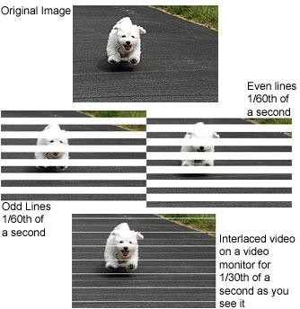
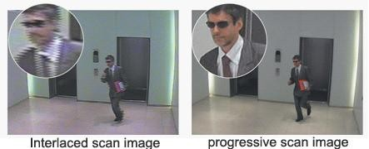

Slide 11
What are 480p, 1080i, 1080p formats?
[number][letter]
number is the resolution's height
letter: p means progressive and
I means interlaced.

Slide 12
What is bitrate?
WIDTH * HEIGHT * BITS_PER_PIXEL * FPS
4 * 4 * 24 * 30
11,520 bits per second
30 FPS

Slide 13
Space needed to store 1h of video at 720p 30fps
WIDTH * HEIGHT * BITS_PER_PIXEL * FPS 1280 * 720 * 24 * 30
663,552,000 (663.552Mb) bits per second
2,388,787,200,000 (278GB)

Slide 14
CODEC - enCOder / DECoder

Slide 15
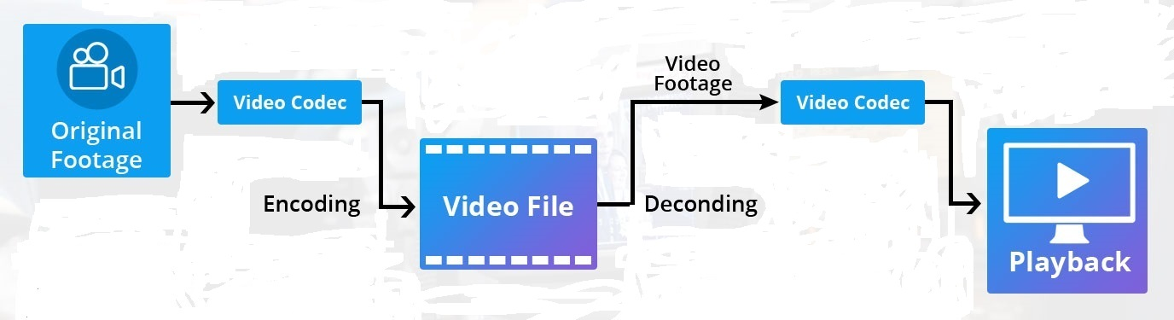
CODEC
“A codec is a device or computer program for encoding or decoding a digital data stream or signal.”
Fig: Encoding and Decoding of video file

Slide 16
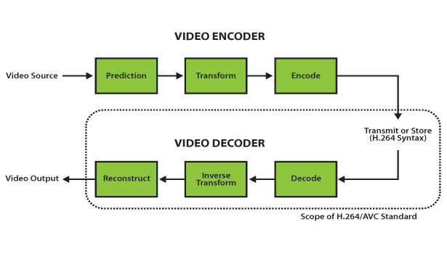
Compression and De-compression
Space needed to store 1h of video at 720p 30fps
WIDTH * HEIGHT * BITS_PER_PIXEL * FPS
1280 * 720 * 24 * 30
663,552,000 (663.552Mb) bits per second
2,388,787,200,000 (278GB)
with chroma sub-sampling YUV420
WIDTH * HEIGHT * BITS_PER_PIXEL * FPS
1280 * 720 * 12 * 30
331,776,000 (331.776Mb) bits per second
1,194,393,600,000 (139GB)

Slide 17
Container and CODEC
Containers
OGG
MP4
WMA
AVI
MKV, WebM
TS
MOV
CODEC
H264 / AVC
H265 / HEVC
MPEG-4
VP9
AV1
Theora
Daala

Slide 18
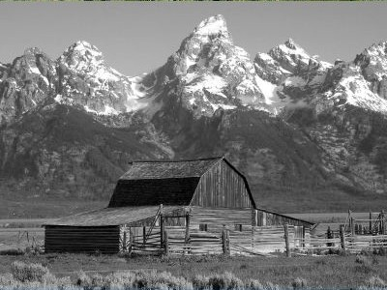
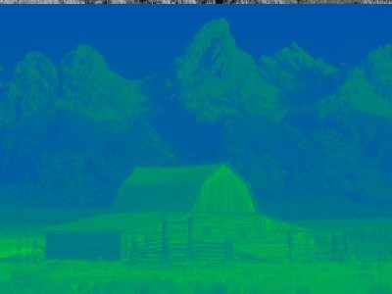

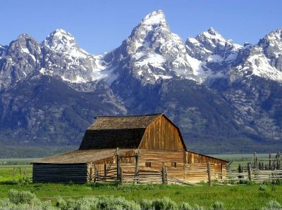


Color space YUV (YCbCr, YpbPr): The Y′UV model defines a color space in terms of one luma component (Y′) and two chrominance components, called U (blue projection) and V (red projection) respectively
Y (luma)
U (chroma blue)
V (chroma red)

Slide 19
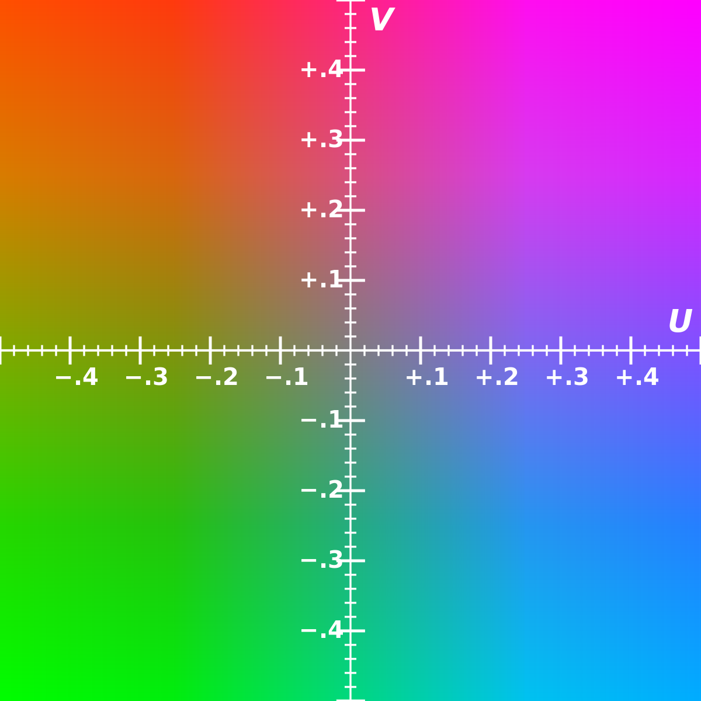
Chroma sub-sampling YUV 4:4:4 4:2:2 4:2:0 The U and V color values are shared between pixels, which frees bandwidth and may increase frame rate. Known as “chroma subsampling,”
Fig:YUV-planes

Slide 20
Conti..
Y (luma)
U (chroma blue)
V (chroma red)

Slide 21
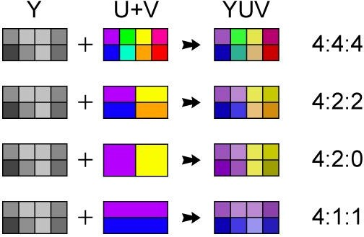
Chroma sub-sampling YUV 4:4:4 4:2:2 4:2:0

Slide 22
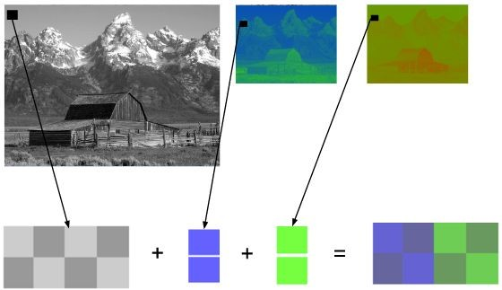
Chroma subsampling 4:2:0

Slide 23
Frame types
What is I frame?Intra coded frame
It constructed from itself only and it is used as a reference for other frames.
It never constructed from other frames.
What is P frame?Predictive frame
It is constructed from previous i and p frames.
It contains previous frame changes.
It can construct from another P-frame.
What is B frame?Bi-directional predictive frame.
It is constructed from past and future frames.
It is not constructed from another B-frame means never used as a reference.

Slide 24
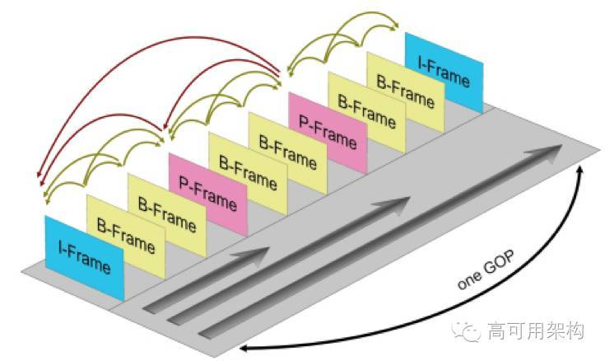
Conti..
In video coding,a group of pictures or GOP structure, specifies the order in which intra-and inter-frames are arranged.
The GOP is a collection of successive pictures within a coded video stream.
Each coded video stream consists of successive GOPs, from which the visible frames are generated.

Slide 25
Open Source vs Proprietary
The term open source refers to software whose source code - the medium in which programmers create and modify software is freely available on the Internet.
It has the peculiarity that its code is open to developers.
It is a software you can modify it and adapt it to your necessities.
The source code for proprietary commercial software is usually a closely guarded secret.

Slide 26
V4L2
Video4Linux is a collection of device drivers and an API for supporting realtime video capture on Linux systems. It supports many USB webcams, TV tuners, and related devices, standardizing their output, so programmers can easily add video support to their applications that use the V4L framework.

Slide 27
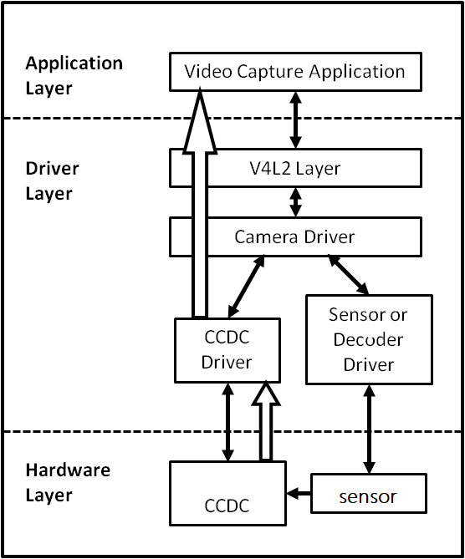
Fig:V4L2

Slide 28
V4L2 framework
What is V4L2 Framework ?
Video for linux or V4L is set of APIs and driver framework for video capture
applications and for O/P devices.
Since we don’t have any common framework, we need to do the setup of device
instance and connecting to sub-devices themselves for all the drivers. And there is also
lot of common code that could never be refactored due to lack of framework.
To avoid this complexity, introduced a framework with common fuctionalities for all
the drivers which is know as V4L2 framework.
Note : The videobuf layer fuctions as a sort of glue layer between V4L2 driver and userspace.

Slide 29
Conti..
Structure of V4L driver ?
Note : All the drivers will follow the same structure.
1. A struct for each device instance containing the device state.
2. A way of initializing and commanding sub-devices (if any).
3. Creating V4L2 device nodes (/dev/videoX, /dev/vbiX and /dev/radioX) and keeping track of device-node specific data.
4. Filehandle-specific structs containing per-filehandle data;
5. video buffer handling.
Important functions provided by V4L2 Framework are:
1.Buffer Management – videobuf2-core.c
2.Controls – v4l2-controls.c
3.Events – V4l2-events.c

Slide 30
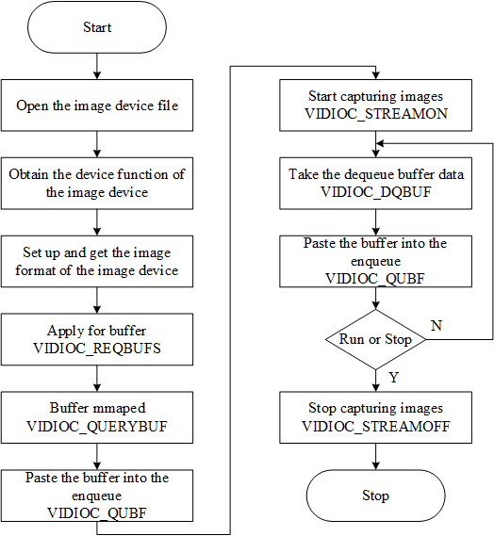
V4l2 test application call flow

Slide 31
Full Log
Below is the log for test application log1.txt file
/* open the video device 0 and query the device capabilities card as : Integrated_Webcam_HD and bus as usb-0000:00:14.0-5 */
shashi:video_open:VIDIOC_QERYCAP
Device /dev/video0 opened: Integrated_Webcam_HD: Integrate (usb-0000:00:14.0-5).
/* video device 0 formats as width=1280, height=720, pixelformat=MJPG */
shashi:video_get_format:VIDIOC_G_FMT
Video format: MJPG (47504a4d) 1280x720
/* it allocated 8 buffers using malloc */
shashi:video_alloc_buffers:VIDIOC_REQBUFS
8 buffers requested.
/*8 buffers are mapping into process address space using mmap length as 1834789 and different offset address*/
shashi:video_alloc_buffers:VIDIOC_QUERYBUF
length: 1843789 offset: 0
Buffer 0 mapped at address 0x7f267834a000.
shashi:video_alloc_buffers:VIDIOC_QUERYBUF
length: 1843789 offset: 1847296
Buffer 1 mapped at address 0x7f2677d76000.
shashi:video_alloc_buffers:VIDIOC_QUERYBUF
length: 1843789 offset: 3694592
Buffer 2 mapped at address 0x7f2677bb3000.
shashi:video_alloc_buffers:VIDIOC_QUERYBUF
length: 1843789 offset: 5541888
Buffer 3 mapped at address 0x7f26779f0000.
shashi:video_alloc_buffers:VIDIOC_QUERYBUF
length: 1843789 offset: 7389184
Buffer 4 mapped at address 0x7f267782d000.
shashi:video_alloc_buffers:VIDIOC_QUERYBUF
length: 1843789 offset: 9236480
Buffer 5 mapped at address 0x7f267766a000.
shashi:video_alloc_buffers:VIDIOC_QUERYBUF
length: 1843789 offset: 11083776

Slide 32
Conti..
length: 1843789 offset: 11083776
Buffer 6 mapped at address 0x7f26774a7000.
shashi:video_alloc_buffers:VIDIOC_QUERYBUF
length: 1843789 offset: 12931072
Buffer 7 mapped at address 0x7f26772e4000.
/* buffers are placing into input queue for capturing */
shashi:video_queue_buffer:VIDIOC_QBUF
shashi:video_queue_buffer:VIDIOC_QBUF
shashi:video_queue_buffer:VIDIOC_QBUF
shashi:video_queue_buffer:VIDIOC_QBUF
shashi:video_queue_buffer:VIDIOC_QBUF
shashi:video_queue_buffer:VIDIOC_QBUF
shashi:video_queue_buffer:VIDIOC_QBUF
shashi:video_queue_buffer:VIDIOC_QBUF
/* video device is capturing 10 frames by stream on */
shashi:video_enable:enable ? VIDIOC_STREAMON : VIDIOC_STREAMOFF
/* retreiving the buffer from capture plane */
shashi:video_do_capture:VIDIOC_DQBUF
0 (0) [-] 0 54824 bytes 5022.898708 1600148240.715216
/* sending an empty buffer to capture plane */
shashi:video_queue_buffer:VIDIOC_QBUF
shashi:video_do_capture:VIDIOC_DQBUF
1 (1) [-] 2 53768 bytes 5024.495000 1600148240.915236
shashi:video_queue_buffer:VIDIOC_QBUF
shashi:video_do_capture:VIDIOC_DQBUF

Slide 33
Conti..
2 (2) [-] 3 55944 bytes 5024.695035 1600148241.115293
shashi:video_do_capture:VIDIOC_DQBUF
3 (3) [-] 4 56136 bytes 5024.895070 1600148241.315301
shashi:video_queue_buffer:VIDIOC_QBUF
shashi:video_do_capture:VIDIOC_DQBUF
4 (4) [-] 5 62432 bytes 5025.095106 1600148241.515341
shashi:video_queue_buffer:VIDIOC_QBUF
shashi:video_do_capture:VIDIOC_DQBUF
5 (5) [-] 6 62152 bytes 5025.295144 1600148241.715378
shashi:video_queue_buffer:VIDIOC_QBUF
shashi:video_do_capture:VIDIOC_DQBUF
6 (6) [-] 7 64360 bytes 5025.495178 1600148241.915410
shashi:video_queue_buffer:VIDIOC_QBUF
shashi:video_do_capture:VIDIOC_DQBUF
7 (7) [-] 8 64672 bytes 5025.695232 1600148242.115478
shashi:video_queue_buffer:VIDIOC_QBUF
shashi:video_do_capture:VIDIOC_DQBUF
8 (0) [-] 9 72200 bytes 5025.895251 1600148242.315512
shashi:video_queue_buffer:VIDIOC_QBUF
shashi:video_do_capture:VIDIOC_DQBUF
9 (1) [-] 10 72296 bytes 5026.095288 1600148242.515516
shashi:video_queue_buffer:VIDIOC_QBUF
/* video device is disabled by stream off */
shashi:video_enable:enable ? VIDIOC_STREAMON : VIDIOC_STREAMOFF
Captured 9 frames in 1.800756 seconds (4.997901 fps, 343624.566571 B/s).
/* allocated buffers released after stream off */
shashi:video_free_buffers:VIDIOC_REQBUFS
8 buffers released.
/* video device 0 is closed */
shashi:video_close

Slide 34
Git-hub links:
https://github.com/shashikala-katthi/TSHtraining/tree/master/Video/V4L2test
https://github.com/manikantapips/TSHtraining/tree/master/video/v4l2testapp

Slide 35
FFmpeg
ffmpeg is a free and open-source software.
ffmpeg is one such software platform especially for multimedia files.
It consisting of a large suite of libraries and programs for handling video, audio, and other multimedia files and streams.
With the help of its expanded libraries we can convert format any video format,edit,repair.
It is basically a command line tool which uses commands to work on audio and video formats.

Slide 36
FFmpeg commands
ffmpeg -i video.mp4 → It will show the details of video file
Converting video files to different formats:
ffmpeg -i video.mp4 out.h264
ffmpeg -i video.mp4 out.yuv
ffmpeg -i out.h264 sample.mp4
ffmpeg -i out.h264 sample.yuv
ffmpeg -i video.mp4 out.h265
ffmpeg -i out.yuv sample.mp4
ffmpeg -i out.yuv out.h264
ffmpeg -i out.yuv out.h265
ffmpeg -i out.h265 out.yuv

Slide 37
REFERENCES
Git hub links:
https://github.com/shashikala-katthi/TSHtraining
https://github.com/manikantapips/TSHtraining

Slide 38
Any questions?

Slide 39
Thank You

