Slide 1
Gstreamer

Slide 2
INTRODUCTION
GStreamer is free and open-source software under subject to the terms of the GNU Lesser General Public License (LGPL)
GStreamer is a pipeline-based multimedia framework
GStreamer supports a wide variety of media-handling components, including simple audio playback, audio and video playback, recording, streaming and editing.
GStreamer is a framework designed to handle multimedia flows. Media travels from the “source” elements (the producers), down to the “sink” elements (the consumers), passing through a series of intermediate elements performing all kinds of tasks. The set of all the interconnected elements is called a “pipeline”.

Slide 3
Gstreamer Architecture
Multimedia Application
gstreamer Core Framework
Encoder
Decoder
Muxer
Demuxer
Sink
source
3rd Party plugins
Goal: create a multimedia application using gstreamer
gstreamer uses 3rd party plugins for processing

Slide 4
How does it work ?
You need to create element for each system modules
Elements are equipped with Pads: source and sink pads
Elements communicate by means of pads and each element is having source and sink pads.
A source pad on one element can be connected to a sink pad on another.
When the pipeline is in the playing state, data buffers flow from the source pad to the sink pad.
Sink
Source
Gstreamer elements
The number of source and sink pad varies depending on the element type.
You can add/create additional sink or source pad.

Slide 5
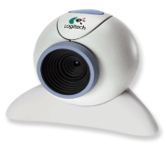



Creating gstreamer elements
example to create an element
Elements element_name = gst_element_factory_make (“plugin name”, “your defined name”)
set property of the element
g_object_set(“property”, “value”);
Src
source
Capture
Filter
Sink
Src
filter
Encode
encoder
Sink
Src
Sink
muxer
Muxer
Src
Sink
Store
sink
Sink

Slide 6
Linking the elements
You need to link the elements
Linking define whom is receiving and sending data to whom
This is similar to linking the system modules
Capture
Filter
Src
Sink
Src
Media Source
Media Filter

Slide 7




Gstreamer pipeline
Webcam
Capture
Filter
Encode
Store
Media Source
Media Filter
Media Encoder
Media Muxer
Media Sink
Src
Sink
Src
Sink
Src
Sink
Src
Sink
example code for creating, and linking a pipeline
pipeline = gst_pipeline_new ("test-pipeline");
source = gst_element_factory_make ("videotestsrc", "source");
gst_bin_add_many (GST_BIN (pipeline), source, filter,encoder, muxer, sink, NULL);
gst_element_link (source, filter,encoder, muxer,sink);

Slide 8
INITIALIZATION
GStreamer is built on top of the GObject (for object orientation) and GLib (for common algorithms) libraries.
The GStreamer framework uses Gobjects.
You can always tell which library you are calling because all GStreamer functions, structures and types have the gst_ prefix, whereas GLib and GObject use g_.
The GStreamer library should be initialized with gst_init before it can be used.
gst_init (&argc, &argv);

Slide 9
BUILDING THE PIPELINE
In GStreamer you usually build the pipeline by manually assembling the individual elements, but, when the pipeline is easy enough, and you do not need any advanced features, you can take the shortcut: gst_parse_launch().
This function takes a textual representation of a pipeline and turns it into an actual pipeline.
pipeline = gst_parse_launch ("playbin uri=https://www.freedesktop.org/software/gstreamer-sdk/data/media/sintel_trailer-480p.webm", NULL);
Here we are building a pipeline composed of a single element called playbin.
playbin is a special element which acts as a source and as a sink, and is a whole pipeline. Internally, it creates and connects all the necessary elements to play your media.
we are only passing one parameter to playbin, which is the URI of the media we want to play.

Slide 10
SETTING PIPELINE STATE
Every GStreamer element has an associated state, which you can more or less think of as the Play/Pause button in your regular DVD player. For now, suffice to say that playback will not start unless you set the pipeline to the PLAYING state.
gst_element_set_state (pipeline, GST_STATE_PLAYING);
gst_element_set_state() is setting pipeline to the PLAYING state, thus initiating playback.
We need to get the pipeline’s bus to know that what happens inside of the pipeline.
bus = gst_element_get_bus (pipeline);
gst_element_get_bus() retrieves the pipeline's bus.
The below lines will block until you receive either an ERROR or an EOS (End-Of-Stream) through that bus.
msg = gst_bus_timed_pop_filtered (bus, GST_CLOCK_TIME_NONE, GST_MESSAGE_ERROR | GST_MESSAGE_EOS);

Slide 11
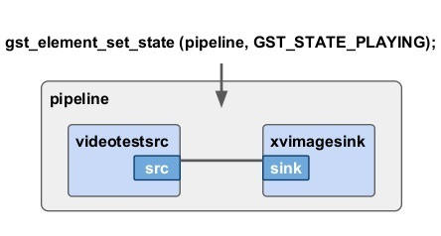
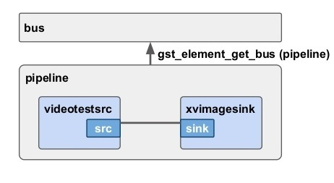
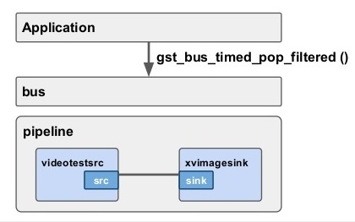
Conti..

Slide 12
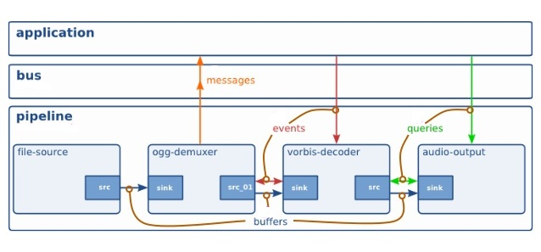
Communication with bus and pipeline

Slide 13
FREE THE OBJECTS AFTER USING THEM
We need to free the msg after returning with error or end-of-stream ,if msg is not NULL.
gst_message_unref (msg);
gst_bus_timed_pop_filtered() returned a message which needs to be freed with
gst_message_unref(msg);
gst_element_get_bus() added a reference to the bus that must be freed with
gst_object_unref(pipeline, GST_STATE_NULL);
Setting the pipeline to the NULL state will make sure it frees any resources it has allocated .
Finally, unreferencing the pipeline will destroy it, and all its contents.
gst_object_unref (pipeline);

Slide 14
ANALYZING THE STREAMS
We are settings the flags to show audio,video,subtitles after creating playbin element and before setting the pipeline as playing state.
flags |= GST_PLAY_FLAG_VIDEO | GST_PLAY_FLAG_AUDIO | GST_PLAY_FLAG_TEXT;
when the pipeline moves to the PLAYING state, we can analyze the streams .
We will know how many audio,video,subtitles streams are available in media.
g_object_get (data->playbin, "n-video", &data->n_video, NULL); g_object_get (data->playbin, "n-audio", &data->n_audio, NULL); g_object_get (data->playbin, "n-text", &data->n_text, NULL);
Now, for each stream, we are retrieving its metadata,Metadata is stored as tags in a GstTagList structure, which is a list of data pieces identified by a name.

Slide 15
Conti..
The GstTagList associated with a stream can be recovered with g_signal_emit_by_name(), and then individual tags are extracted with the by using functions like gst_tag_list_get_string().
playbin defines 3 action signals to retrieve metadata: get-video-tags, get-audio-tags and get-text-tags
g_signal_emit_by_name (data->playbin, "get-video-tags", i, &tags);
gst_tag_list_get_string (tags, GST_TAG_VIDEO_CODEC, &str);
gst_tag_list_get_string (tags, GST_TAG_AUDIO_CODEC, &str);
gst_tag_list_get_string (tags, GST_TAG_LANGUAGE_CODE, &str);
gst_tag_list_get_uint (tags, GST_TAG_BITRATE, &rate);

Slide 16
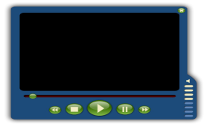
System Modules and Data Flow: Playback
Media File
type
Capture
Decode
Player
Decode
… …
… …
Capture
Demuxer
Decode
… …
Display the video on your GUI and place the audio data to the sound card
Notes:
How to control Frame Rate
<number>

Slide 17
CHANGING THE STREAMS AT RUN TIME
We can set which subtitle URL and font ,we want to play before setting pipeline as playing state.
we set the suburi property, which points playbin to a file containing a subtitle stream.
The subtitle-font-desc property allows specifying the font to render the subtitles
g_object_set (data.playbin, "suburi", "https://www.freedesktop.org/software/gstreamer-sdk/data/media/sintel_trailer_gr.srt", NULL);
g_object_set (data.playbin, "subtitle-font-desc", "Sans, 18", NULL);
We can get user input through keyboard(index),we can set the index to current-audio to play user input audio.
g_object_set (data->playbin, "current-audio", index, NULL);

Slide 18
INSERT THE DATA INTO PIPELINE
An application can manually extract or inject data into a pipeline by using two special elements called appsrc and appsink.
To use an appsrc as the source for the pipeline, simply instantiate a playbin and set its URI to appsrc://
data.pipeline = gst_parse_launch ("playbin uri=appsrc://", NULL);
Playbin will create an internal appsrc element and fire the source-setup signal to allow the application to configure it:
g_signal_connect (data.pipeline, "source-setup", G_CALLBACK (source_setup), &data);
It is important to set the caps property of appsrc, since, once the signal handler returns, playbin will instantiate the next element in the pipeline according to these caps:
gst_audio_info_set_format (&info, GST_AUDIO_FORMAT_S16, SAMPLE_RATE, 1, NULL);
audio_caps = gst_audio_info_to_caps (&info);
g_object_set (source, "caps", audio_caps, "format", GST_FORMAT_TIME, NULL);
Notes:
<number>

Slide 19
Conti..
We then connect to the need-data and enough-data signals. These are fired by appsrc when its internal queue of data is running low or almost full, respectively. We will use these signals to start and stop (respectively) our signal generation process.
g_signal_connect (source, "need-data", G_CALLBACK (start_feed), data);
g_signal_connect (source, "enough-data", G_CALLBACK (stop_feed), data);
gst_caps_unref (audio_caps);
we connect to the new-sample signal, which is emitted every time the sink receives a buffer. Also, the signal emission needs to be enabled through the emit-signals property, because, by default, it is disabled.
g_object_set (data.app_sink, "emit-signals", TRUE, "caps", audio_caps, NULL);
g_signal_connect (data.app_sink, "new-sample", G_CALLBACK (new_sample), &data);
gst_caps_unref (audio_caps);

Slide 20
Conti..
The only thing we do here is register a GLib idle function with g_idle_add() that feeds data to appsrc until it is full again.
when appsrc needs data. Here, we will start pushing data into the appsrc.
data->sourceid = g_idle_add ((GSourceFunc) push_data, data);
when the internal queue of appsrc is full enough so we stop pushing data. Here we simply remove the idle function by using g_source_remove()
g_source_remove (data->sourceid);
data->sourceid = 0;
when the appsink receives a buffer. We use the pull-sample action signal to retrieve the buffer
g_signal_emit_by_name (sink, "pull-sample", &sample);
gst_sample_unref (sample);

Slide 21
Conti..
In push_data function we will create a new buffer with a given size
buffer = gst_buffer_new_and_alloc (CHUNK_SIZE);
We count the number of samples that we have generated so far with the CustomData.num_samples variable, so we can time-stamp this buffer using the GST_BUFFER_TIMESTAMP macro in GstBuffer.
GST_BUFFER_TIMESTAMP (buffer) = gst_util_uint64_scale (data->num_samples, GST_SECOND, SAMPLE_RATE);
Since we are producing buffers of the same size, their duration is the same and is set using the GST_BUFFER_DURATION in GstBuffer.
GST_BUFFER_DURATION (buffer) = gst_util_uint64_scale (num_samples, GST_SECOND, SAMPLE_RATE);
gst_buffer_map (buffer, &map, GST_MAP_WRITE);
raw = (gint16 *)map.data;
gst_buffer_unmap (buffer, &map);
Once we have the buffer ready, we pass it to appsrc with the push-buffer action signal and then gst_buffer_unref() it since we no longer need it.
g_signal_emit_by_name (data->app_source, "push-buffer", buffer, &ret);
gst_buffer_unref (buffer);

Slide 22
PROGRESSIVE STREAMING
When streaming, data is fetched from the network and a small buffer of future-data is kept to ensure smooth playback .
However, data is discarded as soon as it is displayed or rendered (there is no past-data buffer). This means, that if a user wants to jump back and continue playback from a point in the past, data needs to be re-downloaded.
playbin offers similar functionalities through the DOWNLOAD flag which stores the media in a local temporary file for faster playback of already-downloaded chunks.
We need to set the flag after pipeline creation.
flags |= GST_PLAY_FLAG_DOWNLOAD; g_object_set (pipeline, "flags", flags, NULL);
By setting this flag, playbin instructs its internal queue(queue 2) to store all downloaded data.
deep-notify signals are emitted by GstObject elements (like playbin) when the properties of any of their children elements change. In this case we want to know when the temp-location property changes, indicating that the queue2 has decided where to store the downloaded data.
g_signal_connect (pipeline, "deep-notify::temp-location", G_CALLBACK (got_location), NULL);

Slide 23
Conti..
The temp-location property is read from the element that triggered the signal (the queue2) and printed on screen.
When the pipeline state changes from PAUSED to READY, this file is removed. you can keep it by setting the temp-remove property of the queue2 to FALSE.
g_object_get (G_OBJECT (prop_object), "temp-location", &location, NULL);
g_print ("Temporary file: %s\n", location);
g_free (location);
You can keep it by setting the temp-remove property of the queue2 to FALSE.
g_object_set (G_OBJECT (prop_object), "temp-remove", FALSE, NULL);
The refresh_ui method queries the pipeline to find out which parts of the file have been downloaded and what the currently playing position is.
g_timeout_add_seconds (1, (GSourceFunc)refresh_ui, &data);

Slide 24
Conti..
The first thing we do in refresh_ui is construct a new Buffering GstQuery with gst_query_new_buffering() and pass it to the pipeline (playbin) with gst_element_query().
query = gst_query_new_buffering (GST_FORMAT_PERCENT);
result = gst_element_query (data->pipeline, query);
Data does not need to be downloaded in consecutive pieces from the beginning of the file: Seeking, for example, might force to start downloading from a new position and leave a downloaded chunk behind.
Therefore, gst_query_get_n_buffering_ranges() returns the number of chunks, or ranges of downloaded data, and then, the position and size of each range is retrieved with gst_query_parse_nth_buffering_range()
n_ranges = gst_query_get_n_buffering_ranges (query);
gst_query_parse_nth_buffering_range (query, range, &start, &stop);
The format of the returned values (start and stop position for each range) depends on what we requested in the gst_query_new_buffering().

Slide 25
Conti..
Next, we need to get the current position.
we use the TIME format and also query the duration to obtain a percentage.
We will print how much percentage it is downloaded and current position of media stream

Slide 26
REFERENCES
https://github.com/shashikala-katthi/TSHtraining/tree/master/Video/gstreamer
https://github.com/manikantapips/TSHtraining/tree/master/video/gstreamer/playbacktutorial
https://gstreamer.freedesktop.org/documentation/tutorials/playback/index.html?gi-language=c

Slide 27
THANK YOU

