Slide 1
RESUME BUILDER

Slide 2
Department of computer Science Engineering
Team members:
Shashikala munesula
Teena veenavanka
Akash jalli
Gotham kumar kaitha
Vaishnavi yasala

Slide 3
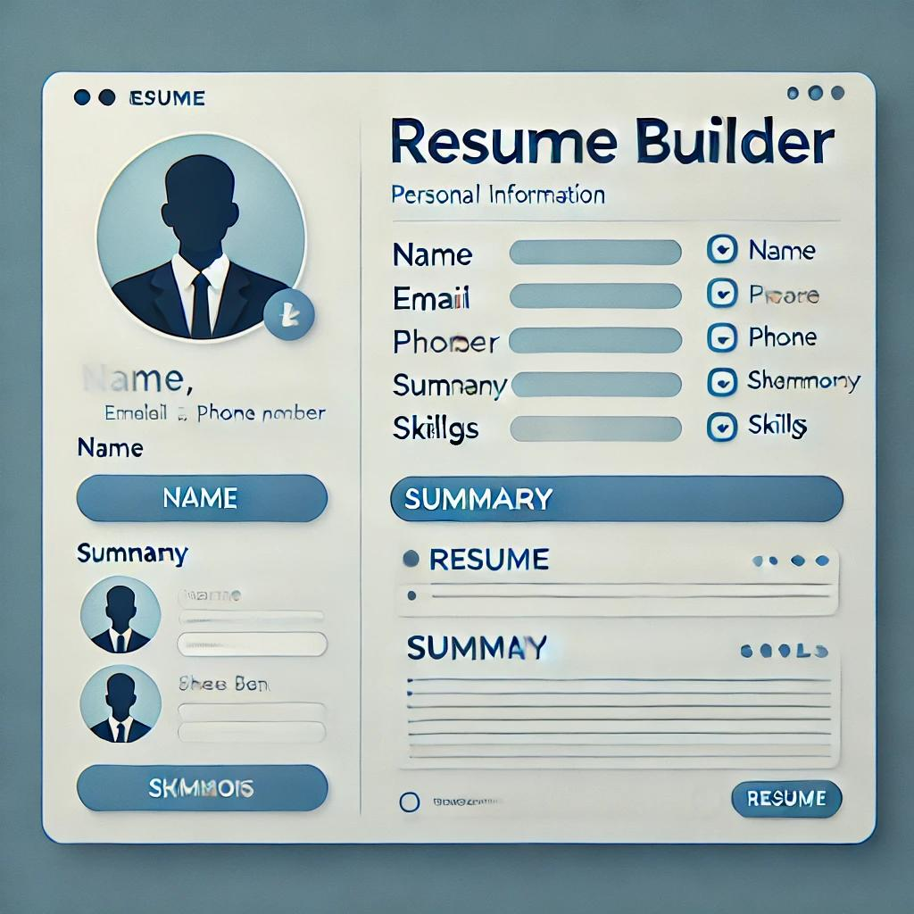
ABSTRACT
A Resume Builder is a web-based application designed to help users create professional resumes efficiently.
This project, built using HTML and CSS, provides a structured form for users to input personal and professional details and a formatted preview of the resume in real-time.
Unlike manual resume creation, this system ensures a consistent layout and design without requiring technical skills.
The project enables users to print or save their resumes as PDFs directly from the browser, making it a simple and effective tool for job seekers.

Slide 4
INTRODUCTION
A resume is a crucial document for job seekers as it summarizes their skills, experience, and qualifications.
Formatting a resume manually can be time-consuming and challenging. This Resume Builder project aims to simplify the resume creation process by offering a structured template where users can input their details.
Using only HTML and CSS, this system provides a user-friendly experience with a real-time preview, allowing users to see their resume take shape as they enter their information.
The primary goal of this project is to provide a responsive, printable resume template without requiring advanced coding knowledge or additional software.

Slide 5
LITERATURE REVIEW
Several online resume builders exist, such as Canva, Zety, and Novoresume, offering advanced features like AI-powered suggestions and multiple templates. However, most of these platforms require login credentials, paid subscriptions, or third-party software integration.
Prior research indicates that job seekers often struggle with:
Formatting issues while using word processors.
Lack of resume design knowledge, leading to poorly structured resumes.
Time-consuming processes, requiring multiple revisions.
By contrast, this HTML & CSS-based Resume Builder provides a free, simple, and efficient way to generate resumes without extra software or login requirements

Slide 6
EXISTING SYSTEM
The traditional methods of resume creation include
1.Manual Resume Writing – Using software like Microsoft Word or Google Docs. Requires formatting skills.
> Time-consuming.
> No real-time preview.
2.Online Resume Builders – Websites offering pre-designed templates. > Often require paid accounts.
>Limited customization in free versions.
> Dependence on third-party services.
These limitations create a need for a free, lightweight, and user-friendly resume builder using only HTML and CSS, eliminating the need for complex tools.

Slide 7
PROPOSED SYSTEM
The proposed system is a simple, static web-based Resume Builder using HTML and CSS, offering:
✅ User Input Form – Allows users to enter their name, contact details, skills, and summary.
✅ Live Resume Preview – Displays the resume format as users fill out the form.
✅ Pre-Designed Resume Template – Ensures professional design without manual formatting.
✅ Print & PDF Option – Users can print or save their resume using the browser’s print feature (Ctrl + P). This solution is free, lightweight, and easy to use, making it accessible for beginners and job seekers without requiring advanced technical knowledge.

Slide 8
SOFTWARE REQUIREMENTS AND SPECIFICATIONS
The project only requires basic front-end technologies, making it highly accessible.
Frontend Technologies: HTML – Used for the resume input form and structured layout. CSS – Used for styling and formatting the resume template.
Software & Tools Required: Text Editor: VS Code, Sublime Text, or Notepad++.
Web Browser: Chrome, Firefox, or Edge (for viewing and printing resumes).
Javascript for update preview

Slide 9
Hardware Requirements
RAM: Minimum 2GB (for smooth development).
Processor: Any modern
CPU.Storage: Minimal, as the project consists of simple HTML & CSS files.

Slide 10
BENIFITS
User-Friendly InterfaceEasy for anyone to use—no design or technical skills required.
Professional LayoutsOffers clean, consistent, and ATS-friendly templates.
CustomizationUsers can input personal details, skills, education, and experience as per their needs.
Time-SavingAutomatically generates resumes without manually formatting each section.
Error ReductionMinimizes formatting mistakes and typos with built-in validations.
AccessibilityCan be accessed online anytime, anywhere.
Data ReusabilitySaves user profiles so resumes can be updated and regenerated quickly.

Slide 11
DIFFERECNCE BETWEEN TRADITIONAL RESUME MAKING
VS RESUME BUILDER
TRADITIONAL SYSTEM | RESUME BUILDER PROJECT
Manual formatting | Auto layout
Time-consuming | Quick and easy
Requires MS Word | Browser-based
Error-prone | Validated input

Slide 12
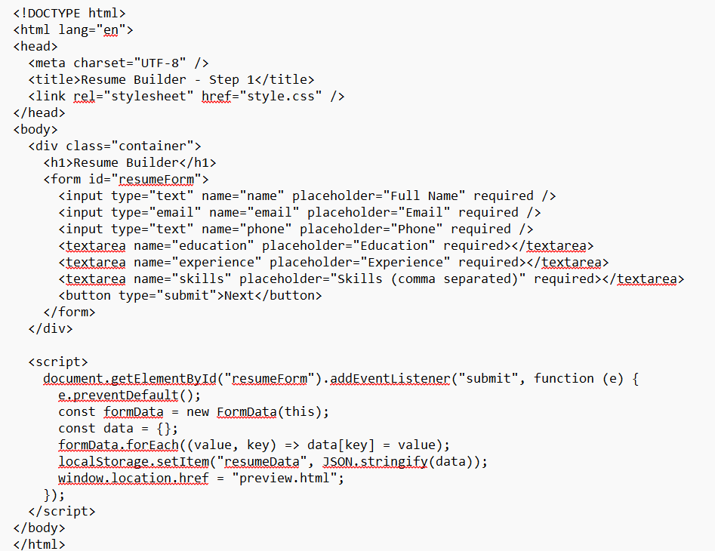

Slide 13
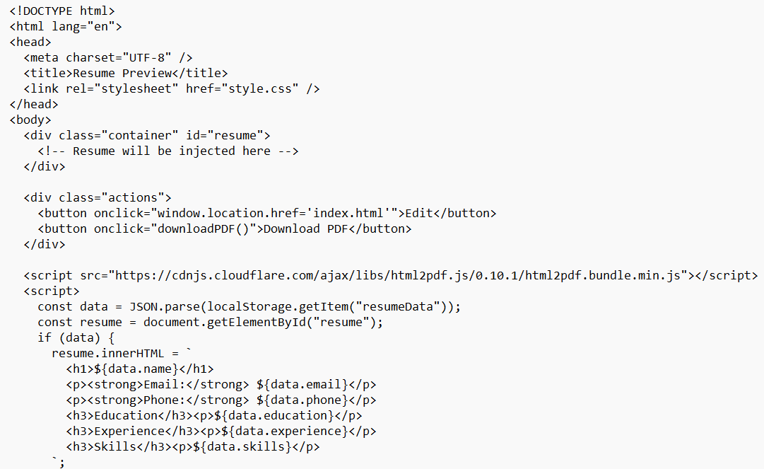

Slide 14
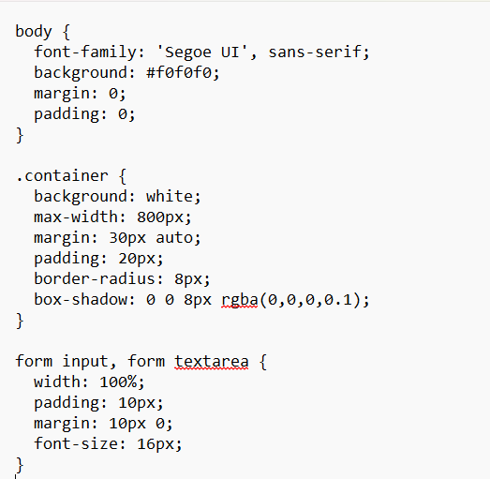
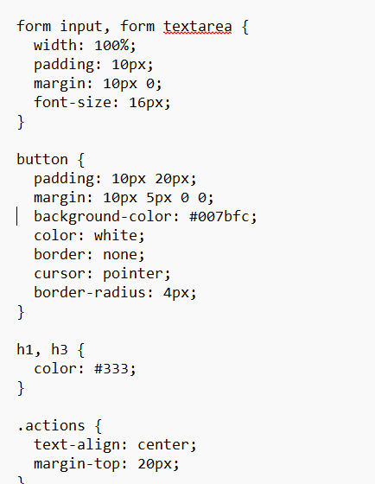

Slide 15
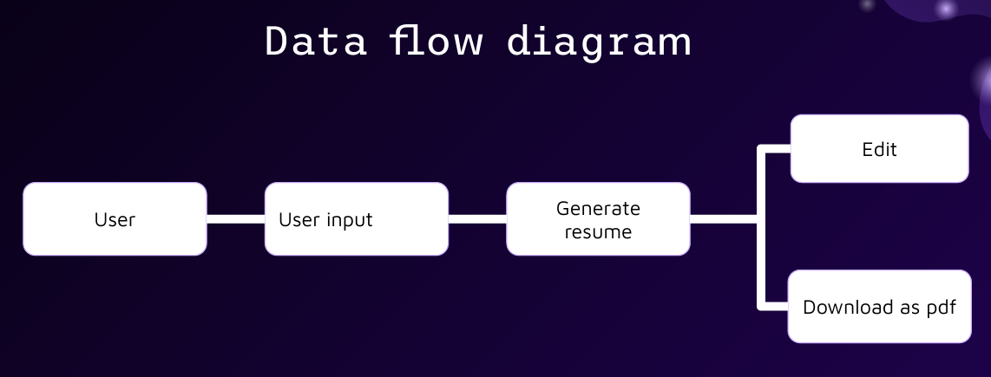

Slide 16
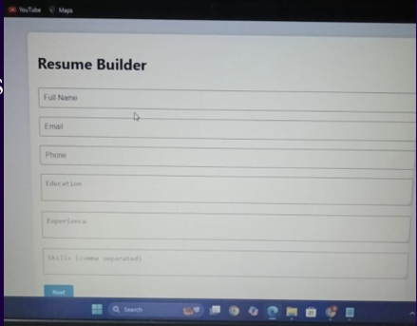
USER INPUT
The user fills out a form with their details such as name ,email ,phone, education , experience and skills ▫User input provides the necessary data to generate a resume

Slide 17
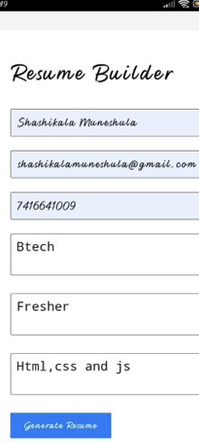
RESUME GENERATOR
Make sure to fill all the details as per the requirements.
Click on generate resume after filling the details.

Slide 18
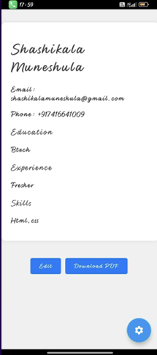
RESUME DISPLAY
The generated resume is displayed on the page.
It will allow the user to edit and download
We can easily download the resume as PDF

Slide 19
SPECIFICATIONS
The Resume Builder project includes the following features:
✅ Form-based Data Entry – Users input personal and professional details.
✅ Real-time Resume Preview – Displays formatted resume instantly.
✅ Print & Save – Users can print or save the resume as a PDF.
✅ Customizable Design – CSS styling allows easy modifications.

Slide 20
CONCLUSION
The Resume Builder project using HTML and CSS is a convenient and user-friendly tool that allows individuals to create professional resumes without requiring login details.
With its simple interface and PDF download feature, users can quickly and easily create and share their resumes.
No login required: Users can create resumes without creating an account or logging in.
Easy to use: The project is designed to be intuitive and easy to navigate.
PDF download: Resumes can be downloaded as PDF documents, making it easy to share and print.

Slide 21
THANK YOU !

