Slide 1
Machine learning with AWS Sagemaker
Shashikant
20/08/2019

Slide 2

Agenda
What is Sagemaker
Need for Sagemaker
Difference between existing and Sagemaker machine learning process and performances.
Storage system in AWS S3 and other system which we can use in sagemaker (Amazon DynamoDB)
How to get started with Sagemaker instances.
Creating the S3 bucket (storage)
Creating the instances for python scripting.
Sagemaker for deep learning.

Slide 3
What is Sagemaker?
Amazon SageMaker is a fully-managed service that covers the entire machine learning build, train, and deploy and workflow to label and prepare your data, choose an algorithm, train the model, tune and optimize it for deployment, make predictions, and take action.
The models get to production faster with much less effort and lower cost

Slide 4
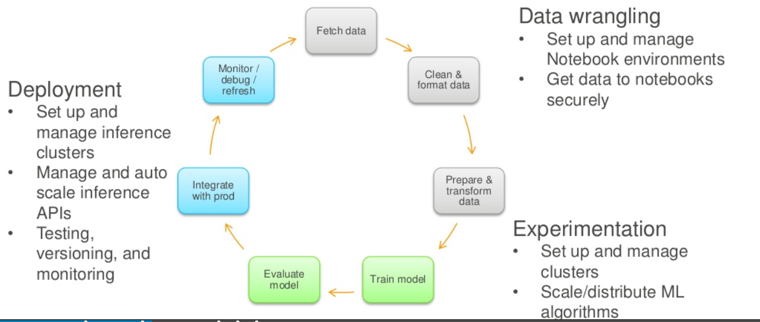
Machine Learning Process

Slide 5
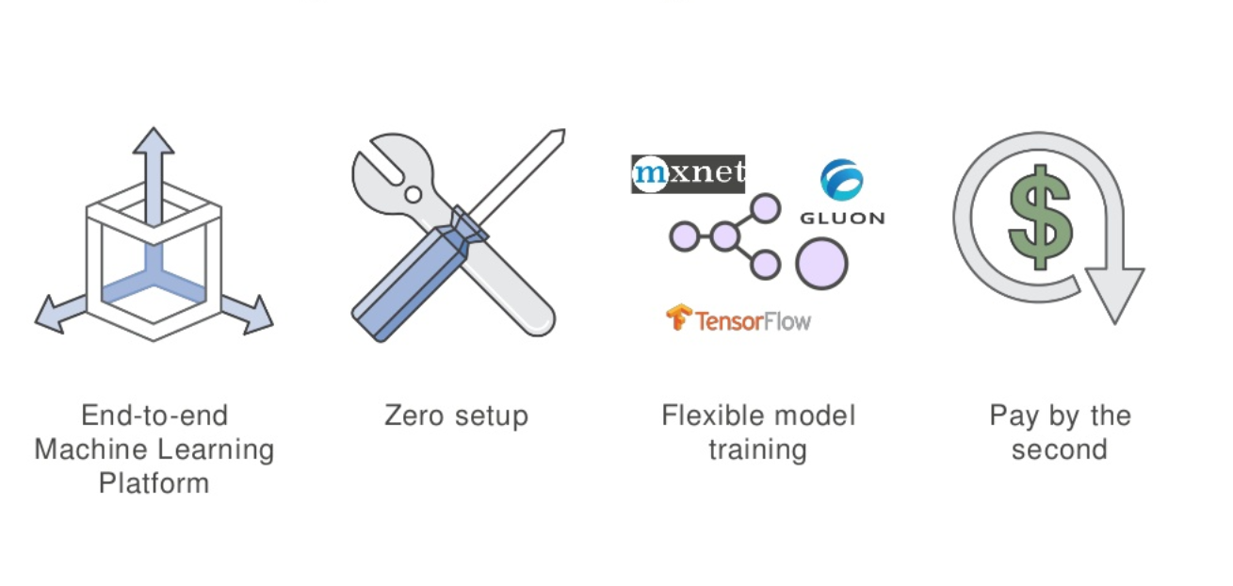
Introduction to Sagemaker

Slide 6
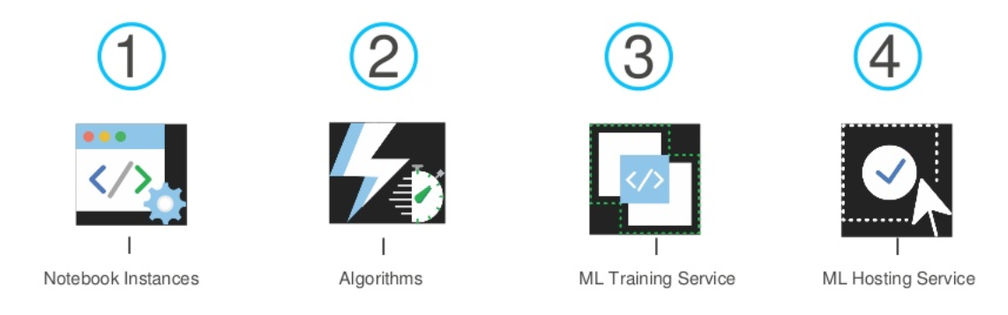
Sagemaker Components

Slide 7
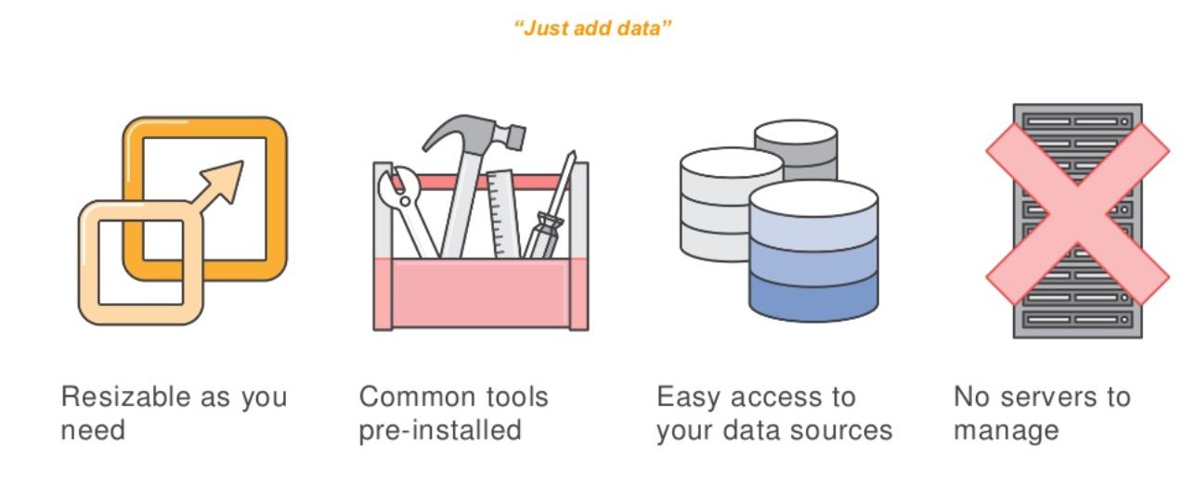
Zero setup required for data exploration

Slide 8
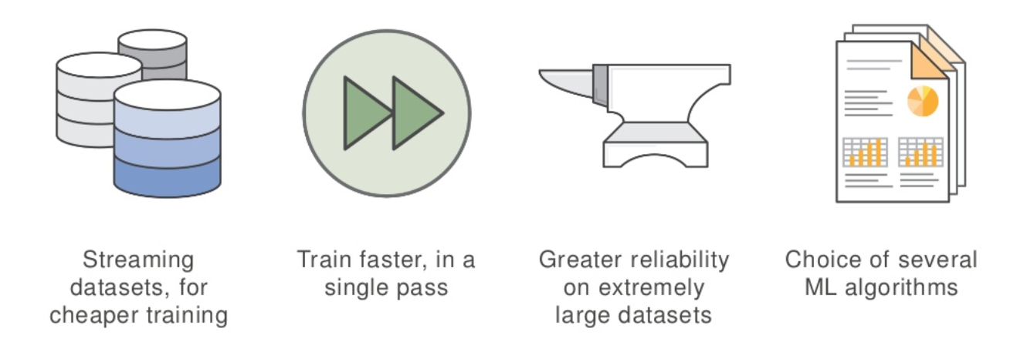
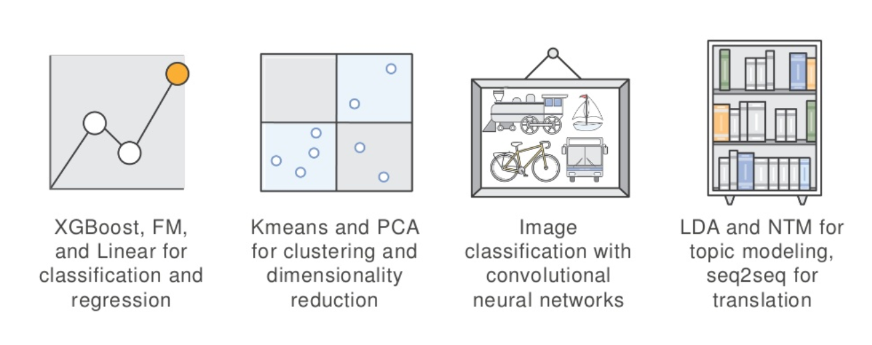
Features

Slide 9
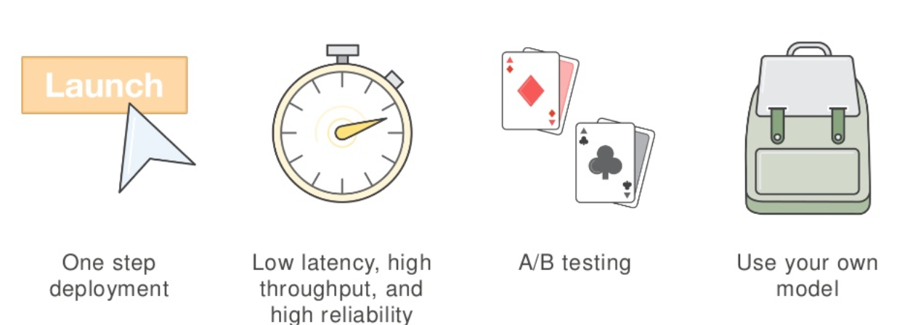
Some more Features…

Slide 10
What is AWS S3 & Need for S3 in Sagemaker
Amazon S3 has simple web services interface that we can use to store and retrieve any amount of data, at any time, from anywhere on the web.
It gives any developer access to the same highly scalable, reliable, fast, inexpensive data storage infrastructure that Amazon uses to run its own global network of web sites
For save these in an Amazon Simple Storage Service (Amazon S3) bucket: You can store datasets that you use as your training data and model artifacts
that are the output of a training job in a single bucket or in two separate buckets.
For small dataset operation one bucket is sufficient.

Slide 11
Creating the S3 Bucket
Sign in to the AWS Management Console and open the Amazon S3 console athttps://console.aws.amazon.com/s3/.
Click Create Bucket.
In the Bucket Name box of the Create a Bucket dialog box, type a bucket name.
Select a region.
Create the bucket in the same region as your cluster. If your cluster is in the Oregon region, click Oregon
Click Create.
When Amazon S3 successfully creates your bucket, the console displays your empty bucket in the Buckets panel.
For using your own / local dataset to S3
Click the name of the data folder.
In the Upload - Select Files wizard, click Add Files.
A file selection dialog box opens.
Select all of the files you downloaded and extracted, and then click Open.
Click Start Upload.

Slide 12
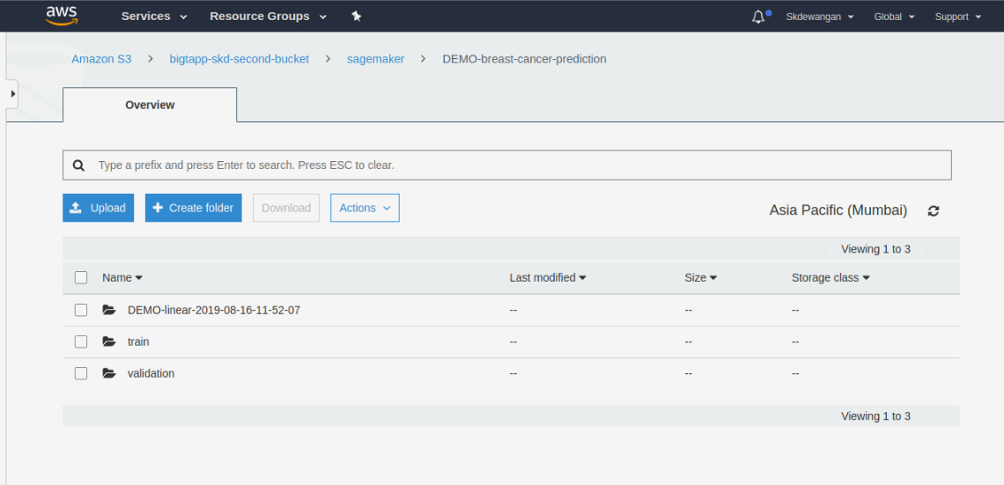
Points to be remember for creating s3 bucket
Amazon SageMaker needs permission to access these buckets.
You grant permission with an IAM role, which you create in the next step when you create an Amazon SageMaker notebook instance.
This IAM role automatically gets permissions to access any bucket that has sagemaker in the name.
It gets these permissions through the AmazonSageMakerFullAccess policy, which Amazon SageMaker attaches to the role.
If you add a policy to the role that grants the SageMaker service principal S3FullAccess permission, the name of the bucket does not need to contain sagemaker.

Slide 13
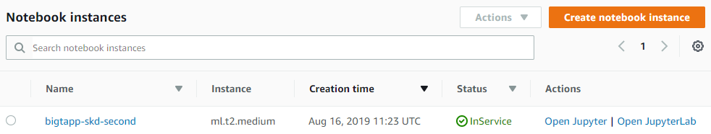
Amazon Sagemaker Steps
To create an Amazon SageMaker notebook instance
1. Open the Amazon SageMaker console at https://console.aws.amazon.com/sagemaker/.
2. Choose Notebook instances, then choose Create notebook instance.
3. On the Create notebook instance page, provide the following information (if a field is not mentioned, leave the default values):
3.1 For Notebook instance name, type a name for your notebook instance.
3.2 For Instance type, choose ml.t2.medium. This is the least expensive instance type that notebook instances support, and it suffices for this exercise.
3.3 For IAM role, choose Create a new role, then choose Create role.
3.4 Choose Create notebook instance.

Slide 14
Train Your Model ,Deploy and Validate your model
For Modeling
from sagemaker import KMeans
num_clusters = 7
kmeans = KMeans(role=role,
train_instance_count=1,
train_instance_type='ml.c4.xlarge',
output_path='s3://'+ bucket_name +'/counties/',
k=num_clusters)
%%time
kmeans.fit(kmeans.record_set(train_data))
Deploy
kmeans_predictor = kmeans.deploy(initial_instance_count=1,
instance_type='ml.t2.medium')
Validate
result=kmeans_predictor.predict(train_data)

Slide 15
Instance Types used in Sagemaker for Building, Model Training and Model Deployment
On-Demand ML Notebook Instances - ml.t2.medium
On-Demand ML Training Instances - ml.c4.2xlarge
On-Demand ML Hosting Instances for Real-Time Inference - ml.m4.xlarge

Slide 16
Type of Instances (Major)
General Purpose
General purpose instances provide a balance of compute, memory and networking resources, and can be used for a variety of diverse workloads. These instances are ideal for applications that use these resources in equal proportions such as web servers and code repositories.
Examples:- A1, T3, T3A, T2, M5, M5a, M4
Compute Optimized
Compute Optimized instances are ideal for compute bound applications that benefit from high performance processors.
Instances belonging to this family are well suited for batch processing workloads, media transcoding, high performance web servers, high performance computing (HPC), scientific modeling, dedicated gaming servers and ad server engines, machine learning inference and other compute intensive applications.
Examples:-C5,C5n,C4
Memory Optimized
Memory optimized instances are designed to deliver fast performance for workloads that process large data sets in memory.
Examples:- R5, R5a, R4, X1e, X1

Slide 17
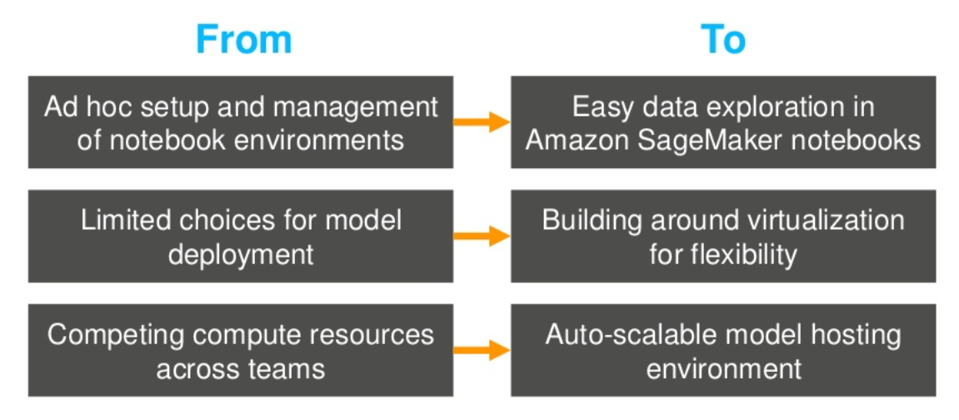
Key benefits of sagemaker

Slide 18
Sagemaker neo
Amazon SageMaker Neo is a new capability that enables machine learning models to train once and run anywhere in the cloud and at the edge.
SageMaker Neo automatically optimizes models built with popular deep learning frameworks that can be used to deploy on multiple hardware platforms.
Optimized models run up to two times faster and consume less than a tenth of the resources of typical machine learning models.

Slide 19
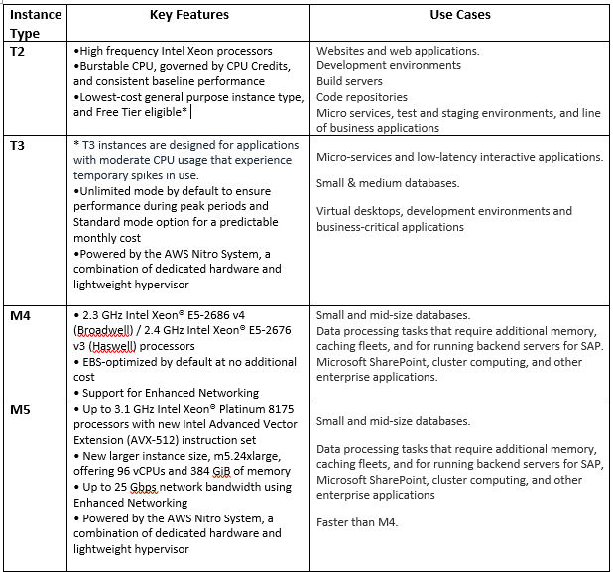

Slide 20
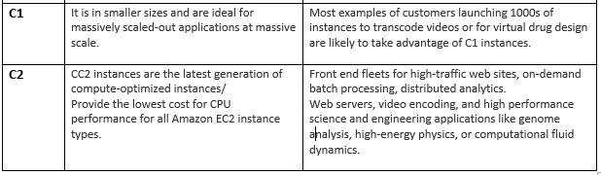
Note:- For choosing the instances is based on application and size of data we can check each instance configurations and price details and use it

Slide 21
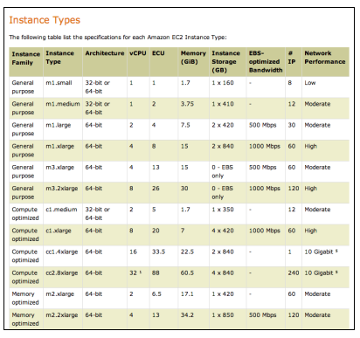
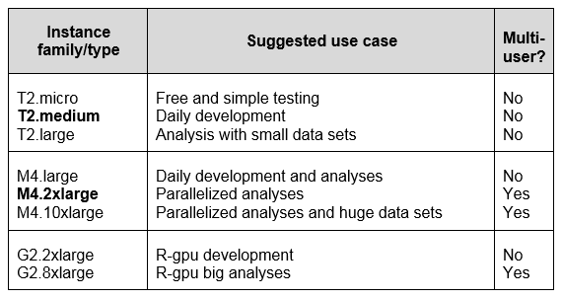
Instance Types
Common Instance Family Types

Slide 22
BigTapp Pte Ltd.

