Slide 1

Indian Bank (Your Own Bank)
Presented By – SHASHIKANT DEWANGAN
(17125760061)

Slide 2
290.25INR 0.50 (0.17%)
Type of bank - Public
Founded- 15 August 1907
Headquartered- Chennai,
Founders:-S. Rm. M. Annamalai Chettiar, V. Krishnaswamy Iyer, S. Rm. M. Ramaswami Chettiar
MD & CEO Kishore Kharat
Executive Directors-M K Bhattacharya & A S Rajeev
Industry-Banking, Financial services
Subsidiaries- Indbank Merchant Banking Svc, Ind Bank Housing, Asset Management Arm, saptagiri grameena bank,Sri Lanka Branch, IndianBank Singapore, Indfund Management Ltd
Stock price- INDIANB (NSE) ₹ 290.25 -0.50 (0.17%) 5 Mar, 11:04 AM IST

Slide 3
Revenue Increase₹7,370.16 crore (US$1.1 billion) (2017 )
Operating income Increase ₹4,000.7 crore (US$610 million) (2017)
Net income- Increase ₹1,405.68 crore (US$220 million) (2017)
Total assets- Increase₹218,233.15 crore (US$33 billion) (2017)
Net Profit- Rs.1405.68 Crore for the year ended 31.03.2017
Branches- 2682 in India.
ATMs- 3358
Owner- Government of India
Number of employees-20,924 (2017)
Capital ratio- 13.20%
Website- www.indianbank.in
International Presence-
Overseas branches in Singapore , Colombo including a Foreign Currency Banking Unit at Colombo and Jaffna
227 Overseas Correspondent banks in 75 countries
Payment Wallet- Indipay

Slide 4
Products
Consumer Banking
Corporate Banking
Finance and Insurance
Mortgage Loans
Investment Banking
Merchant Banking
Private Equity
Private Banking
Savings
wealth management
Credit Cards

Slide 5
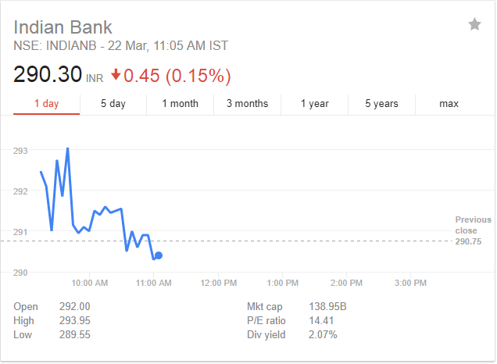
Current Stock Price

Slide 6
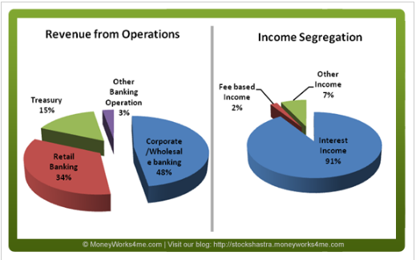
Revenue from Various operations & income Segregation

Slide 7
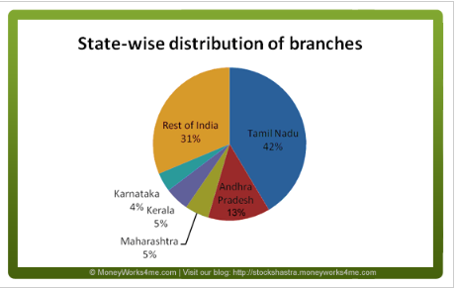
Branch Distribution in India

Slide 8
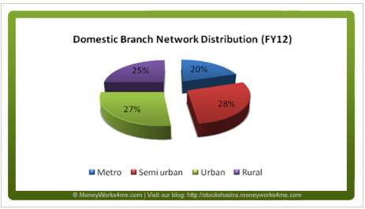
Branch Network Distribution

Slide 9

Positives and Negatives about Indian Bank
*Return on equity (ROE) and return on assets (ROA)

Slide 10
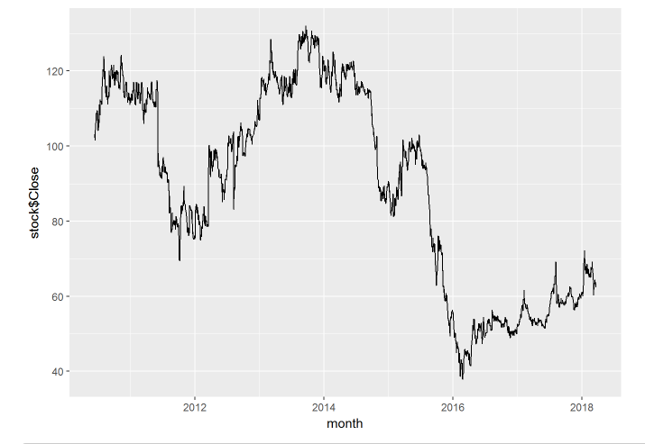
STOCK TREND:

Slide 11
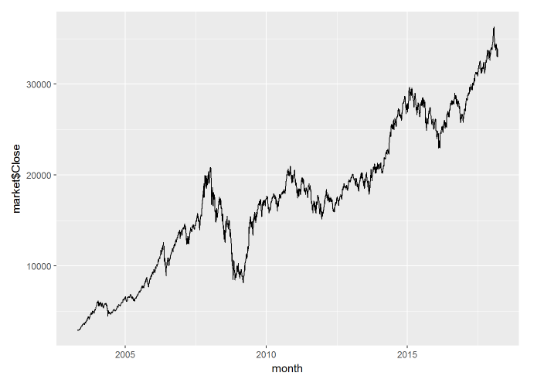
MARKET TREND:

Slide 12
BETA VALUE:
DAILY | WEEKLY | MONTHLY
0.4518833 | 0.5608935 | 0.4613825

Slide 13
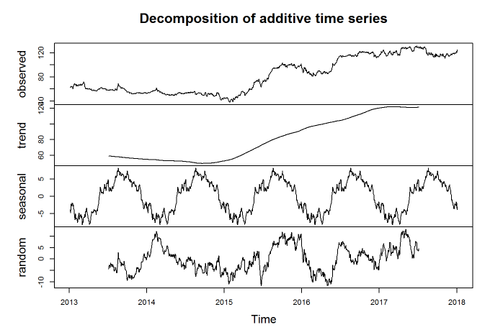
TIME SERIES:

Slide 14
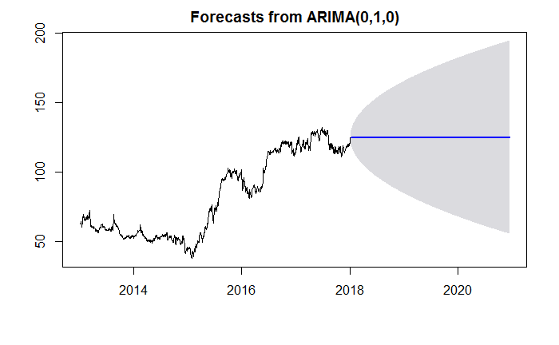
ARIMA MODEL:

Slide 15
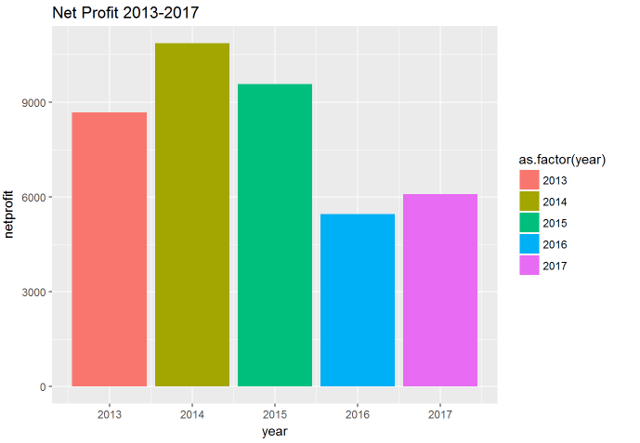
NET PROFIT:

Slide 16


