Slide 1
The Android Journey
The Journey…….
11 yrs back when It started by Andy Rubin, Rich Miner, Nick Sears and Chris White to develop something with a vision :- “smarter mobile devices that are more aware of its owner's location and preferences". Company was Android Inc.
Who are the competitors then:- Symbian and Windows Mobile to name a few. iPhone was not born by that time.
But the founder somehow ran short of money and perhaps waiting for a potential buyer who can fund their much coveted vision.
1

Slide 2
Google’s Entry
In 2005 Google acquired the same making it a wholly owned subsidiary of Google. For the first time, Linux Kernel based operating system for mobile device platform took the shape.
What is Linux Kernel:- The Linux kernel is the operating system kernel used by the Linux family ofUnix-like operating systems. It is a prominent example of free and open source software.
What Google helped:- Marketed the platform to handset makers and carriers on the promise of providing a flexible, upgradable system. Google had lined up a series of hardware component and software partners and signaled to carriers that it was open to various degrees of cooperation on their part.

Slide 3
Drawbacks in other phones
It was by November 2007, the market was already flooded with Mobile Handset makers, like Apple,Microsoft, Nokia (Symbian), HP (formerly Palm), Samsung Electronics / Intel(Tizen, bada), and Blackberry.
What are the Disadvantages of other non-android handsets:-
Fragmented market:- Each brand has its own development environments.
Proprietary Software stacks:- Difficulty in adding a new driver etc.
Closed Networks:- Behaving liked a “walled garden”.

Slide 4
Google’s Help
So what Google planned:- It planned s step forward. It announced the “Open Handset Alliance”, a consortium of 84 firms to develop open standards for mobile devices. Member firms include Google, HTC, Sony, Dell, Intel, Motorola, Qualcomm, Texas Instruments, Samsung Electronics, LG Electronics, T-Mobile, Sprint Corporation, Nvidia, and Wind River Systems. Each member of the Alliance has its own reasons for participations.
For us what it means:-
Free to develop anything what we think of on mobile platform.
Free to market.
Free to get profit.

Slide 5
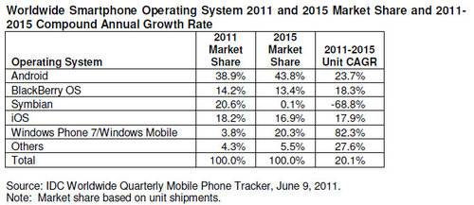
Why Android ?

Slide 6
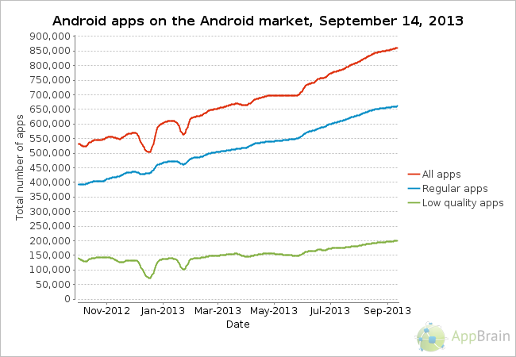
Apps available in Android Market

Slide 7
Android is What ?
Android is a Linux-based mobile OS designed primarily for touchscreen mobile devices such as smartphones and tablet computers.
Initially Android was developed by Android Inc. which Google backed financially and later bought in 2005.
Android is open source and Google releases the code under the Apache License.

Slide 8
Developers Perspective on Android
Android is a free, open source, mobile platform operating system.
Java Oriented (Customized Java)
Low-cost, Customizable, Light weight OS, Easily available of particular hardware devices.
Relaxed Licensing helps “apps” to be developed economically
Extends functionality of devices.
Over 250 million users
Provision of downloading/installation of 3rd party applications helping App Developers to earn lucratively.
Making money every time once someone downloads your creation.

Slide 9
Scope on Mobile App Development
Brands(Samsung, Motorola,HTC, Micromax etc) are rushing ahead with great speed to build their apps on the Android OS, and that trend has opened up enormous job opportunities in the Android domain.
Mobile Application Developer can be named “Best Software Developer For The Future”
Android and iOS app developers claim top spot in a ranking of America’s hottest tech jobs through 2020.
Browse the leading IT job sites,
  www.dice.com
  http://www.linuxforu.com/2013/04/android-apps-development-a-hot-career-option/

Slide 10
Scope on Mobile App Development
Mobile App Developer Employment Projections | 2010 – 2020
  10-Year Growth Pct: 45% (much faster than avg.)†
  10-Year Growth Volume: 292,000 new jobs
  Average Salary: $95,000
  Greater than 700,000 handsets a day(android)
  190,000 handsets a day (iPhone)
  Google Play is the store to sell your creation and marketing.

Slide 11
Users Perspective
Dropping Price point
  Android app in market
  Cheap handset configuration
Mobile Manufactures in Market using Android:
  Acer, Amazon, Archos, Asus,
  Barnes and Noble, HTC, Micromax,
  Motorola ,Samsung, Sony, Toshiba, ViewSonic etc

Slide 12
!!! THANK U !!!!

