Slide 1
Transformers and their application in NLP tasks
Do Transformers pay off on a laptop CPU?
A comparison of 10 sentiment classifiers on SST-2
VILNIUS TECH · Group project
Shashikanth Hosur Ramegowda · Shaeed Khan
Notes:
Speaker: Shashikanth (≈30 s). Introduce the team and the topic: Transformers are the architecture behind BERT, GPT and almost every modern NLP system. Our question: what do they really give, and at what cost, when you only have a normal laptop and limited labelled data?

Slide 2
From reading word by word to reading all at once
Recurrent networks (LSTM)
Transformer (2017)
• Process tokens one after another
• n sequential steps: slow to train
• Distant words interact only through a long chain of states
• Trained from scratch for each task
• Every token attends to every other token
• All positions computed in parallel (GPU or CPU)
• Pre-train once on huge unlabelled text, then fine-tune
• Basis of BERT, GPT, T5 and LitLat BERT
Notes:
Speaker: Shashikanth (≈45 s). Before 2017 NLP models read sentences word by word. The Transformer by Vaswani et al. removed recurrence and kept only attention. That gave parallel training and made huge pre-training possible: BERT, GPT and others. Aim of the project: explain the architecture and measure its benefit experimentally.

Slide 3
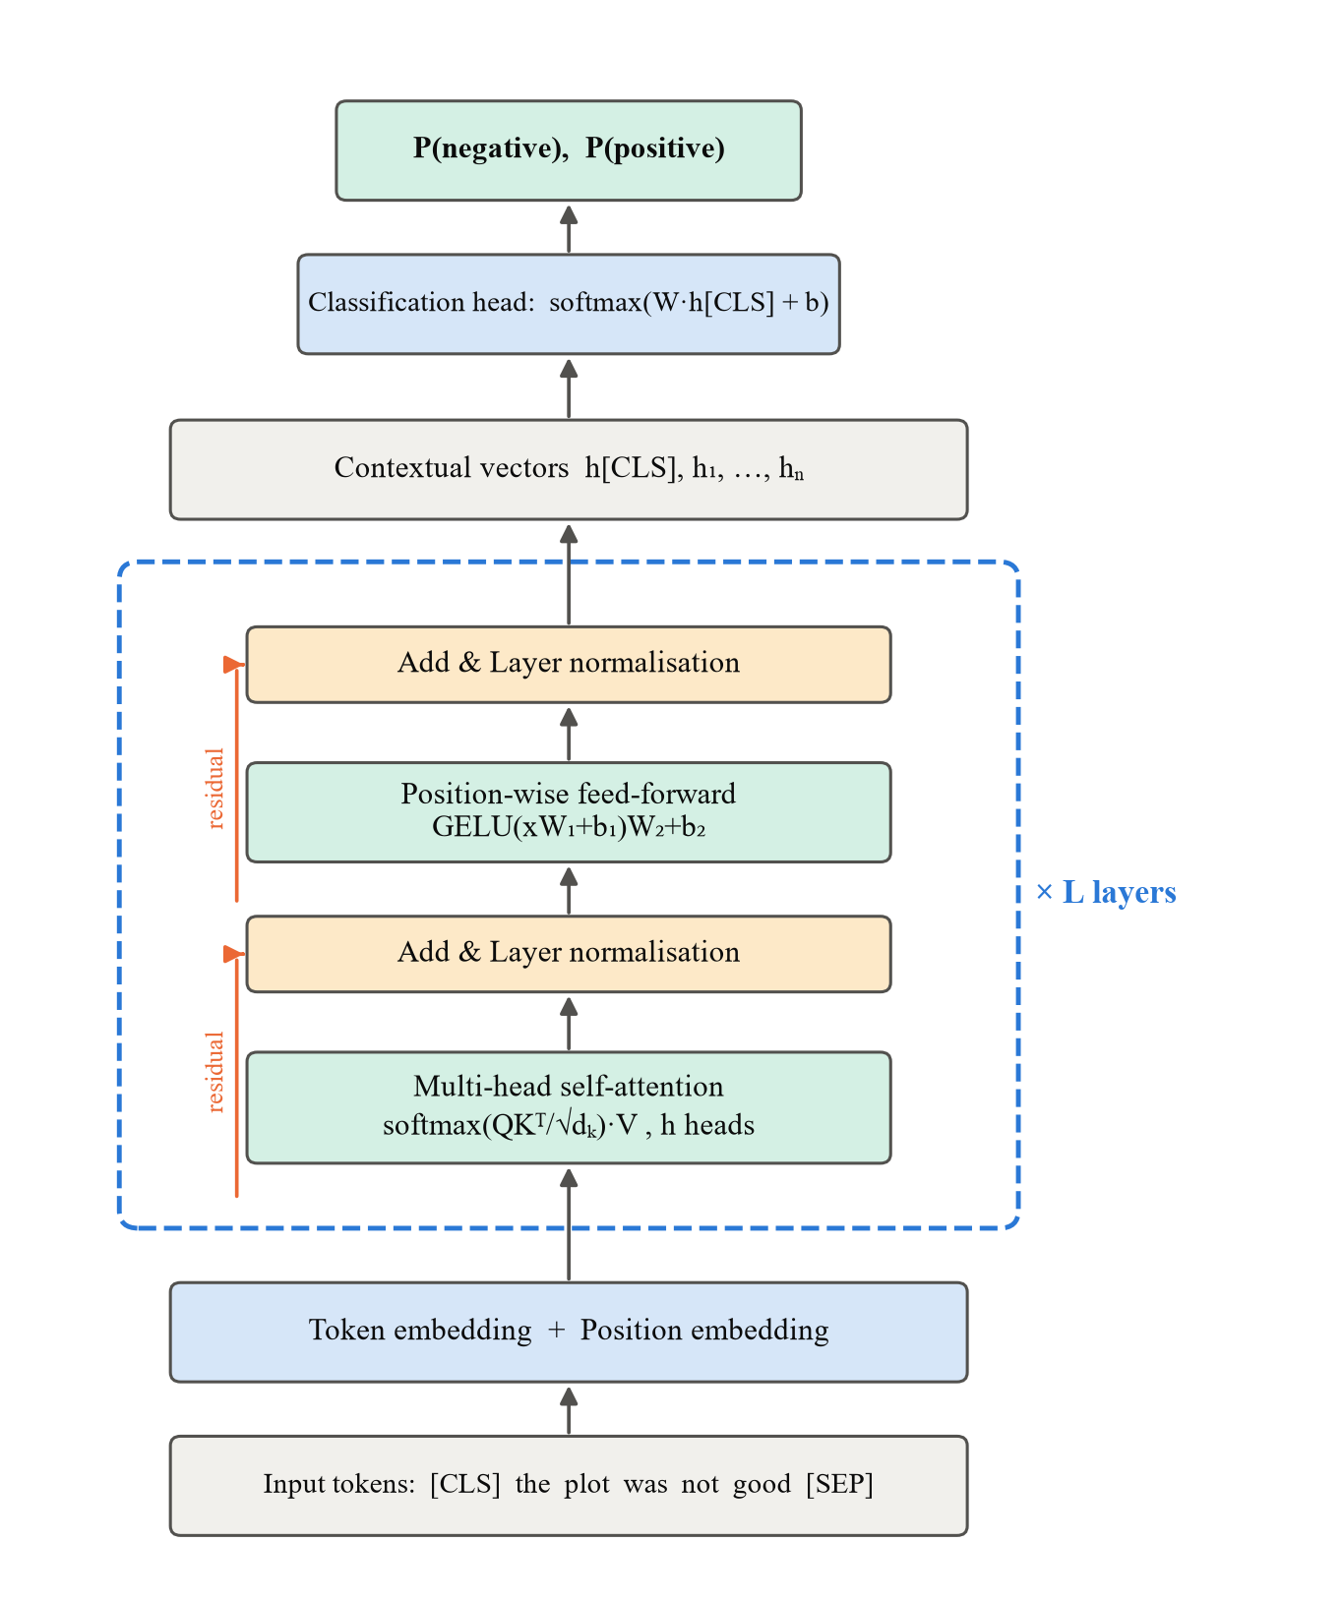
Self-attention: each word looks at the whole sentence
Attention(Q, K, V) = softmax( QKᵀ / √dₖ ) · V
queries · keys → weights → weighted mix of values
1
Sub-word tokens + position embeddings
WordPiece: “unwatchable” → un ##watch ##able
2
Multi-head attention
h heads learn different relations (negation scope, syntax)
3
Feed-forward + residual + LayerNorm
Stacked L times (2, 4 or 6 layers in our models)
4
[CLS] vector → softmax classifier
Whole network fine-tuned with cross-entropy + AdamW
Notes:
Speaker: Shashikanth (≈60 s). Explain Q, K, V: each word asks a question (query), every word offers a key, the softmax of their dot products gives attention weights, and the output is a weighted mix of values. Several heads run in parallel. Layers are stacked with residual connections and layer normalisation. For classification we take the [CLS] vector and add a softmax layer.

Slide 4
Literature: what is known, and what is missing
Encoder-only
Decoder-only
Encoder–decoder
BERT, DistilBERT, RoBERTa
understanding, classification
GPT, Llama
text generation
T5, BART
translation, summaries
What the studies show
What is missing: our gap
1
Transformers are the most accurate. Fine-tuned BERT-type models exceed 90% on SST-2; classical models reach about 79–83%.
These studies report accuracy. They rarely tell a student with a laptop:
• What does the better model cost? (time, speed, size)
• How many labelled sentences does it need?
• Is a ready-made model good enough?
We measure all three, on one laptop CPU.
2
Without pre-training, small data is a problem. In Lithuania a simple naive Bayes (0.735) beat LSTM and CNN networks (0.706), Kapočiūtė-Dzikienė et al. (2019).
3
Lithuanian now has pre-trained models. LitLat BERT (2021), BERT and T5 for reviews (2024), the first open Llama2 models (2024).
Notes:
Speaker: Shaeed (≈60 s). In one sentence: the papers tell us which model is accurate, but not what it costs or how many labels it needs. We searched Google Scholar and Web of Science (transformer OR BERT AND sentiment / text classification, plus Lithuanian). There are three model families; we use encoder-only models for classification. What the studies show: first, Transformers are the most accurate, above 90% on SST-2 against 79 to 83% for classical models. Second, without pre-training small data is a problem: in Lithuania naive Bayes at 0.735 beat LSTM and CNN at 0.706. Third, Lithuanian now has pre-trained models, LitLat BERT and BERT/T5, and open Llama2 models. What is missing, our gap: these studies report accuracy, but a student with a laptop also needs to know the cost, how many labels are needed, and whether a ready-made model is enough. We measure all three on one laptop CPU.

Slide 5
Experiment: 10 competitors, one dataset, one laptop CPU
SST-2
Classical
TF-IDF + Naive Bayes · Logistic Regression · Linear SVM
movie-review sentences, positive or negative
Recurrent
BiLSTM trained from scratch
65k / 2k / 872
Fine-tuned by us (8k labels)
BERT-tiny 4M · BERT-small 29M · DistilBERT 67M
train / development / test sentences
i5-8365U
Ready-made, no training
DistilBERT-SST2 · Twitter-RoBERTa · zero-shot NLI
4-core laptop CPU, 16 GB RAM, no GPU
Criteria: accuracy and macro-F1 · training time · latency per sentence · parameters · negation and contrast subsets · learning curve · bootstrap CI and McNemar test
Notes:
Speaker: Shaeed (≈45 s). Dataset: Stanford Sentiment Treebank, binary. The official validation set is our test set, 2,000 training sentences are the dev set. Ten models in four groups. Everything runs on the same laptop CPU so times are comparable.

Slide 6
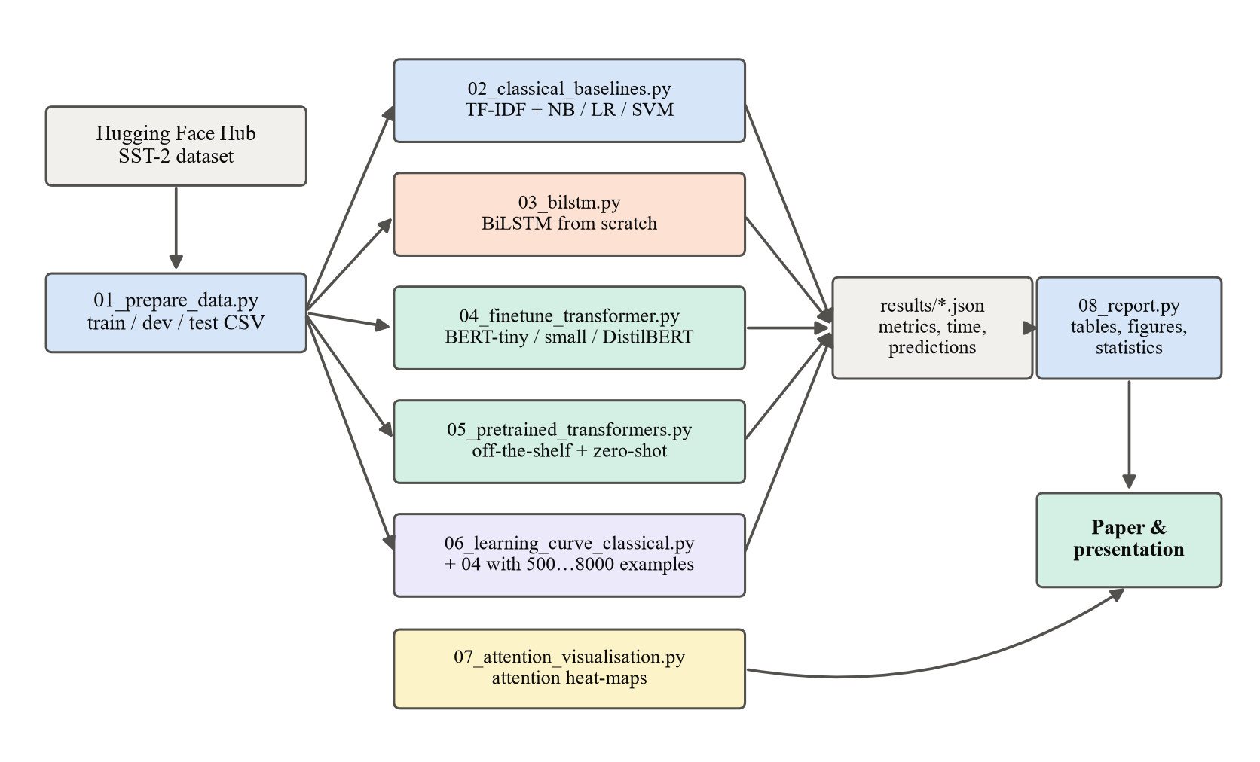
Implementation: a reproducible Python pipeline
PyTorch · Hugging Face Transformers · scikit-learn
• One generic fine-tuning script for any encoder
• AdamW, 10% warm-up, linear decay, best epoch by development accuracy
• Every model saves metrics, timings and predictions as JSON
• run_all.sh reproduces all results (about 2.5 hours on a laptop)
Notes:
Speaker: Shashikanth (≈40 s). The program is a pipeline of nine scripts. The key one is the fine-tuning script: give it any model name from the Hugging Face hub and a number of training examples. All results are stored with predictions, so the report script computes tables, figures and statistical tests.

Slide 7
Fine-tuned DistilBERT: +5.9 points over classical
88.8%
DistilBERT fine-tuned on 8,000 labels
82.9%
best classical: TF-IDF + Linear SVM
81.8%
zero-shot: no labels at all
Bars: classical (cyan), recurrent (orange), transformer (blue). Test set: 872 sentences.
Notes:
Speaker: Shashikanth (≈60 s). Ranking of all ten models. Classical TF-IDF models reach 81.9–82.9%, the BiLSTM 82.8%, our fine-tuned Transformers up to 88.8% with only 8,000 labelled sentences. The ready-made DistilBERT-SST2 reaches 91.1%. Zero-shot, with no labels at all, still gets 81.8%.

Slide 8
The price: slower training and inference, bigger models
Model | Accuracy, % | Train time | Latency, ms | Params
TF-IDF + Linear SVM | 82.9 | 2 s | 0.06 | 73 k
BiLSTM (from scratch) | 82.8 | 6 min | 0.45 | 2.0 M
BERT-tiny fine-tuned (8k) | 76.6 | 2 min | 1.2 | 4.4 M
BERT-small fine-tuned (8k) | 83.7 | 26 min | 14.1 | 28.8 M
DistilBERT fine-tuned (8k) | 88.8 | 2.6 h | 39.1 | 67.0 M
DistilBERT-SST2 (off-the-shelf) | 91.1 | – | 44.6 | 67.0 M
Zero-shot NLI DistilRoBERTa | 81.8 | – | 107.0 | 82.1 M
×710
slower inference of DistilBERT vs TF-IDF, still only about 40 ms per sentence
Fine-tuning is affordable
Training on the laptop CPU took from 2 minutes to 2.6 hours. No GPU is needed for a few thousand examples.
Notes:
Speaker: Shashikanth (≈45 s). The gain is not free: a TF-IDF model trains in seconds and classifies in microseconds; Transformers need minutes to tens of minutes of CPU training and milliseconds per sentence. For most applications that is still perfectly acceptable.

Slide 9
Pre-training is the key: fewer labels, higher accuracy
4,000
labels: BERT-small already matches the best classical model trained on all 65k (82.7% vs 82.9%)
+14 p.p.
advantage with only 500 labels; the gap shrinks as data grows
Notes:
Speaker: Shaeed (≈50 s). Same random subsets for both models. With very few labels TF-IDF cannot learn the vocabulary, while BERT-small already knows English from pre-training. This confirms the Lithuanian finding that pre-training, not the neural network as such, is what makes the difference on small data.

Slide 10
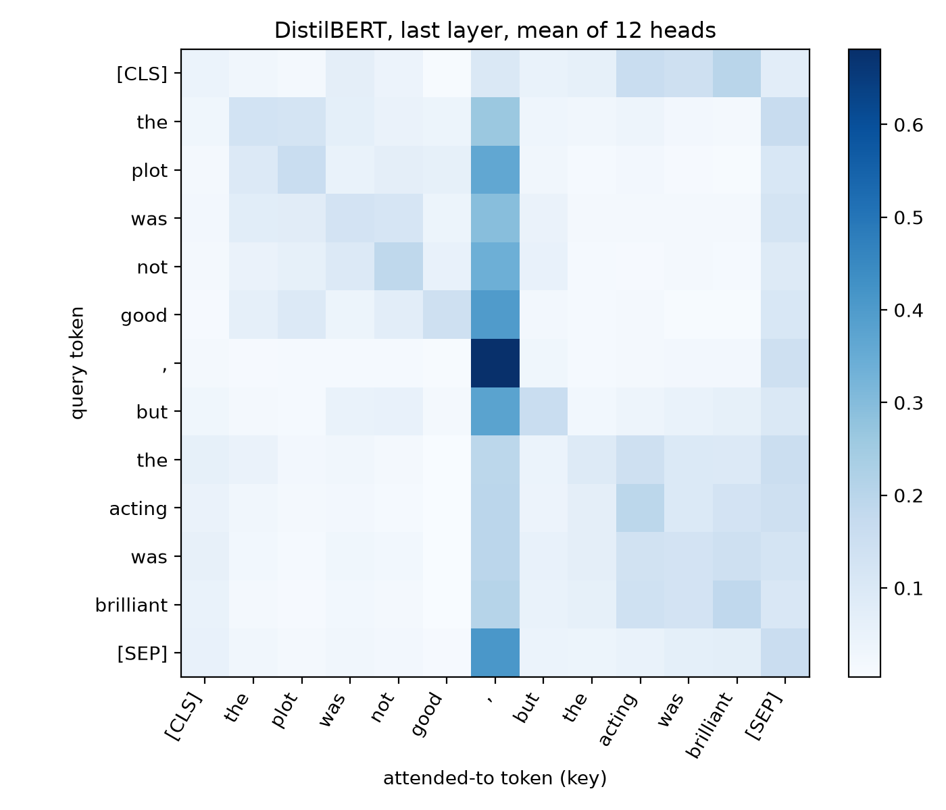
Context matters: negation and contrast sentences
“the plot was not good, but the acting was brilliant”: DistilBERT attention, last layer
Notes:
Speaker: Shaeed (≈45 s). Bag-of-words models lose most on sentences with negation and contrast, because 'not good' contains the word 'good'. Transformers keep their accuracy much better. The heat-map shows how attention links the words in such a sentence – but, as Jain and Wallace warn, attention is an illustration, not a proof of reasoning.

Slide 11
Conclusions and recommendations
1
Fine-tuned Transformers are the most accurate: 88.8% vs 82.9% (classical) and 82.8% (BiLSTM)
2
Pre-training gives data efficiency: BERT-small with 4,000 labels matches classical models trained on 65k; DistilBERT with 8,000 beats them
3
Cost is real but manageable: minutes of CPU fine-tuning, milliseconds per sentence
4
Reuse first: an in-domain public model gives 91.1% with zero training; zero-shot (81.8%) and out-of-domain models are useful but weaker
5
For Lithuanian: fine-tune LitLat BERT or XLM-R on a small labelled set, the next step of this work
Thank you! Questions?
Notes:
Speaker: Shaeed (≈60 s). Summarise the answers to the research questions and give the practical recommendation: first try a public in-domain model, otherwise fine-tune a compact Transformer on a few thousand labels; use TF-IDF only when latency or hardware are extremely limited. Future work: Lithuanian data with LitLat BERT. Invite questions.

