Slide 1
CDACL-003
Supply Chain
Analysis PPT
Diagnostic Report & Power BI Dashboard Analysis
Beauty & Personal Care | 100 SKUs | 5 Cities | 5 Suppliers
₹5,77,600
46,099
₹52,924
2.28%
Total Revenue
Units Sold
Total Supply Cost
Avg Defect Rate

Slide 2
Agenda
01
OVERVIEW
02
REVENUE
Dataset & Dashboard Overview
Revenue by Product Type
100 SKUs, 3 categories, 5 cities, KPI summary from Power BI
Donut chart: Skincare leads at 41.83% of total ₹5,77,600
03
SUPPLIERS
04
LEAD TIME
Supplier Revenue & SKU Count
Lead Time & Products Sold
Supplier 1 tops both revenue (₹158K) and SKU count (27)
Supplier 2 highest total lead time; Suppliers 1 & 2 equal on units
05
GEOGRAPHY
06
COST
Revenue by Product & Location
Costs & Price Analysis
Kolkata dominates skincare; Bangalore leads in haircare
Supplier 1 costliest overall; Skincare commands highest price

Slide 3
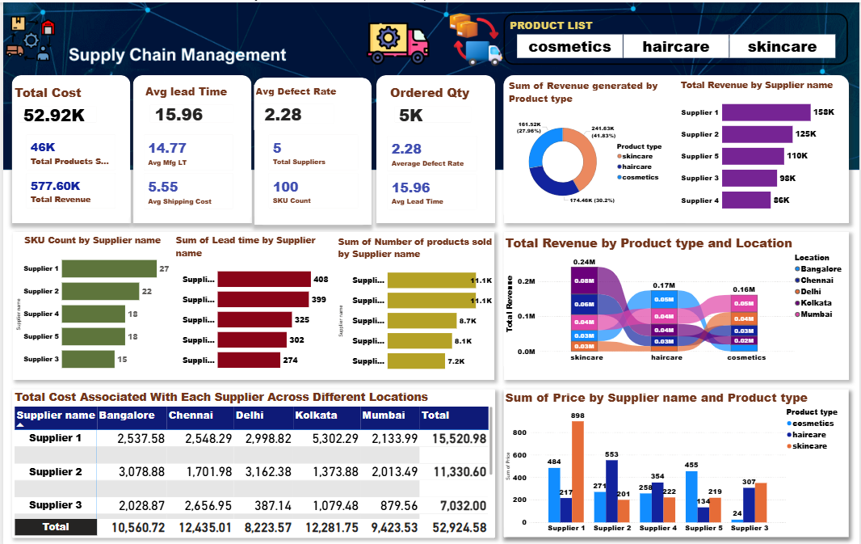
Power BI Dashboard — Full View
Supply Chain Management

Slide 4
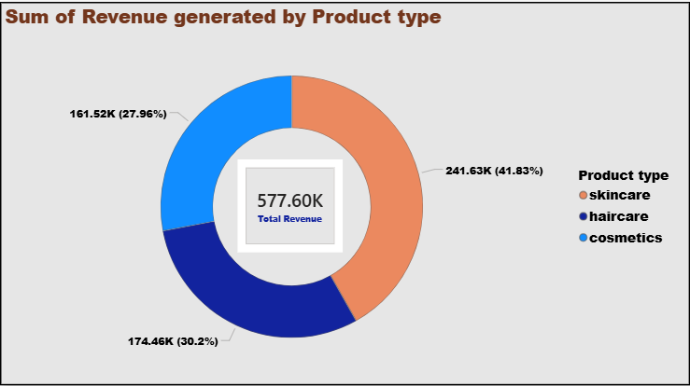
Revenue by Product Type
₹5,77,600
Total Revenue
41.83%
Skincare Share
30.20%
Haircare Share
27.96%
Cosmetics Share
Key Insight: Skincare dominates with ₹2,41,630 — nearly 42% of all revenue. Cosmetics, despite 27.96% share, has the lowest manufacturing cost (₹43.05) offering the best margin opportunity.

Slide 5
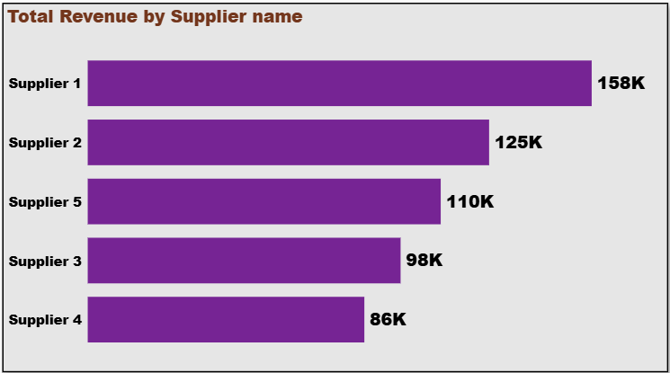
Total Revenue by Supplier
Supplier Revenue Breakdown
🥇
Supplier 1
₹158K
27.4%
🥈
Supplier 2
₹125K
21.7%
🥉
Supplier 5
₹110K
19.1%
4️⃣
Supplier 3
₹98K
17.0%
5️⃣
Supplier 4
₹86K
14.9%
Supplier 1 generates 27.4% of all supplier revenue with only 27 SKUs — highest revenue efficiency.

Slide 6
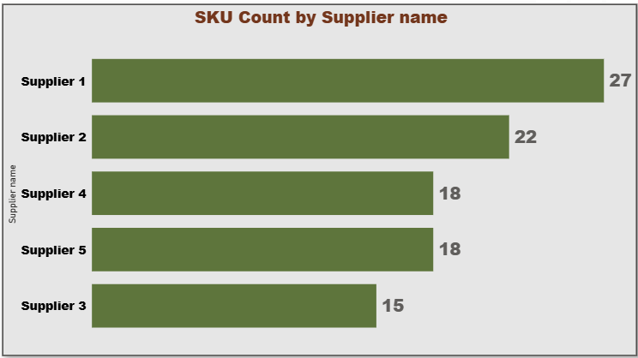
SKU Count by Supplier
SKU Distribution Analysis
Supplier 1
27 SKUs (27%)
Market leader in portfolio breadth
Supplier 2
22 SKUs (22%)
Strong second with broad offering
Supplier 4
18 SKUs (18%)
Tied 3rd — niche specialist
Supplier 5
18 SKUs (18%)
Tied 3rd — equal portfolio size
Supplier 3
15 SKUs (15%)
Smallest portfolio — focused range

Slide 7
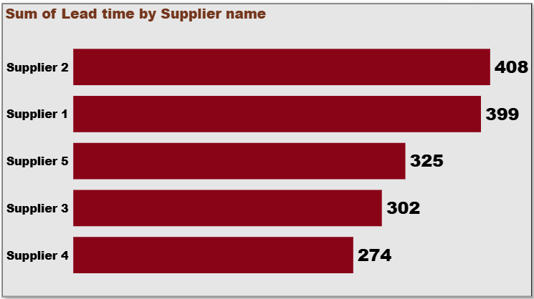
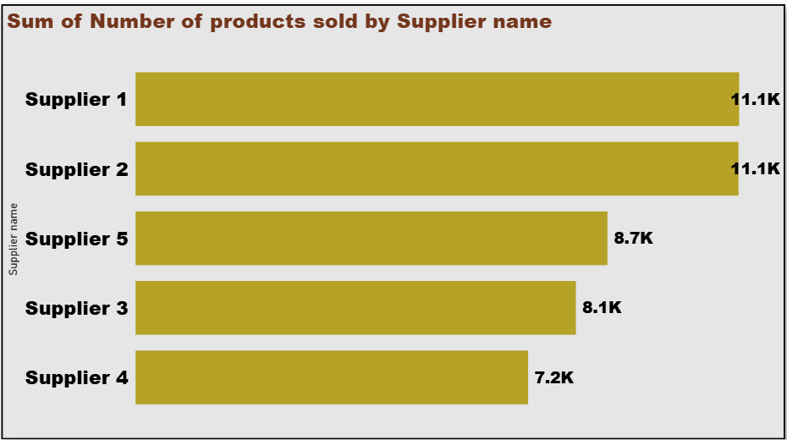
Lead Time & Products Sold by Supplier
Sum of Lead Time by Supplier
Products Sold by Supplier
⚠️
Supplier 2 — Highest Lead Time
✅
Suppliers 1 & 2 — Equal Sales
📊
Supplier 4 — Most Efficient
Total lead time 408 days (most delayed). Despite this, it matches Supplier 1 in units sold (11.1K).
Both sold 11.1K units — top performers in volume. Supplier 1 does it with lower lead time (399).
Lowest lead time (274) with 7.2K units sold. Best lead-time-to-sales efficiency among all.

Slide 8
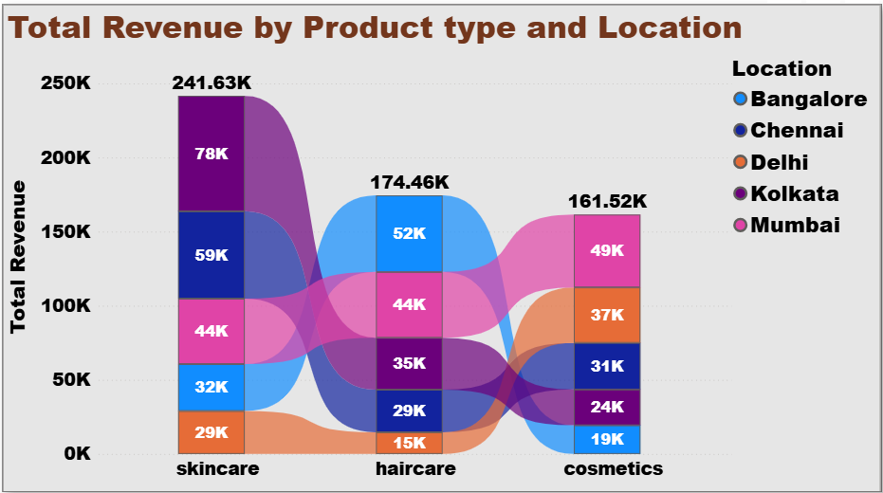
Revenue by Product Type & Location
City-wise Revenue Highlights
Kolkata
Total: 137K
SK: 78K HC: 35K CO: 24K
Mumbai
Total: 137K
SK: 44K HC: 44K CO: 49K
Chennai
Total: 119K
SK: 59K HC: 29K CO: 31K
Bangalore
Total: 103K
SK: 32K HC: 52K CO: 19K
Delhi
Total: 81K
SK: 29K HC: 15K CO: 37K
Bangalore leads in Haircare (52K). Kolkata & Mumbai tied for total revenue (137K each). Delhi needs attention.

Slide 9
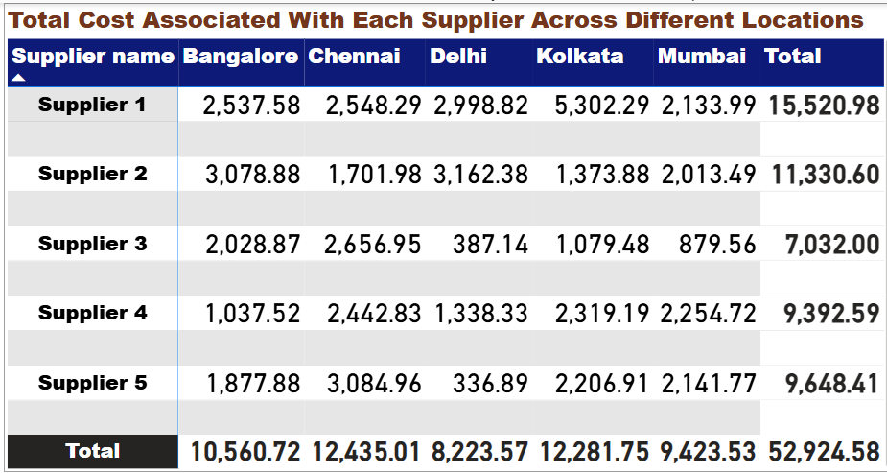
Total Cost by Supplier Across Locations
Cost Analysis
Supplier 1
₹15,521
Highest total cost — Kolkata heavy (₹5,302)
Supplier 2
₹11,331
High cost in Bangalore (₹3,079) & Delhi (₹3,162)
Supplier 5
₹9,648
Chennai is biggest cost centre (₹3,085)
Supplier 4
₹9,393
Even spread across cities
Supplier 3
₹7,032
Lowest cost — most cost-efficient supplier
Total supply chain cost: ₹52,924.58 | Supplier 1 alone accounts for 29.3% of total cost — review procurement strategy.

Slide 10
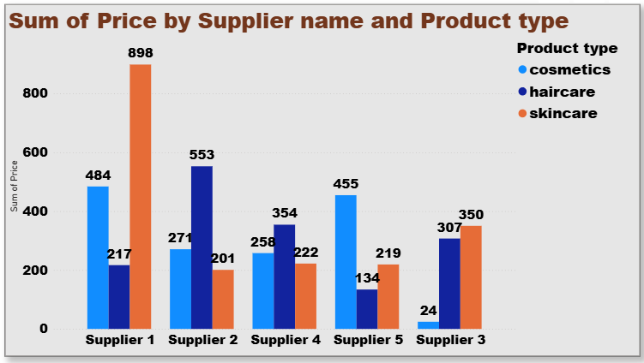
Price by Supplier & Product Type
Key Pricing Insights
👑
Supplier 1 — Skincare King
Highest skincare price sum (₹898) — commands premium positioning in the market.
💆
Supplier 2 — Haircare Leader
Highest haircare price sum (₹553) — dominant in the haircare category.
💄
Supplier 1 — Cosmetics
Also leads cosmetics pricing (₹484), making Supplier 1 the most versatile player.
⚠️
Supplier 3 — Low Cosmetics
Only ₹24 in cosmetics — very limited presence. Risk of category dependency.
Supplier 1 dominates pricing across all 3 categories. Supplier 3 is critically under-represented in cosmetics (₹24 vs avg ₹300+).

Slide 11
Product Comparison Dashboard
Side-by-side: Skincare vs Haircare vs Cosmetics
Metric | 🧴 Skincare | 💆 Haircare | 💄 Cosmetics | Winner
SKU Count | 40 | 34 | 26 | Skincare
Total Revenue (₹) | 2,41,630 | 1,74,460 | 1,61,520 | Skincare
Revenue Share | 41.83% | 30.20% | 27.96% | Skincare
Avg Price (₹) | 49.4 | 50.1 | 48.8 | Haircare
Avg Mfg Cost (₹) | 48.99 | 48.46 | 43.05 | Cosmetics
Avg Defect Rate | 2.34% | 2.48% | 1.92% | Cosmetics
Avg Lead Time (days) | 15.8 | 16.6 | 15.5 | Cosmetics
★ Cosmetics is the efficiency champion (lowest cost + lowest defect). Skincare is the revenue engine. Scale both for maximum profitability.

Slide 12
Key Recommendations
01
REVENUE
02
SUPPLIER
Scale Skincare & Cosmetics
Prioritise Supplier 1 & 3
Skincare = ₹2.41L revenue. Cosmetics = best margins (1.92% defect, ₹43 cost). Double investment in both.
Supplier 1 leads revenue (₹158K) & SKUs (27). Supplier 3 has lowest cost (₹7,032). Balance growth vs cost.
03
LEAD TIME
04
GEOGRAPHY
Fix Supplier 2 Delays
Invest in Delhi Market
Supplier 2 has highest total lead time (408 days). Renegotiate SLAs or introduce penalty clauses immediately.
Delhi has the lowest revenue (₹81K) but strong cosmetics (₹37K). A targeted push can unlock ₹25K+ growth.
05
PRICING
06
QUALITY
Diversify Supplier 3 Portfolio
Reduce Haircare Defect Rate
Supplier 3 has only ₹24 in cosmetics pricing. Expand their product range or bring in a specialist supplier.
Haircare has the worst defect rate (2.48%). Implement tighter QC checkpoints and set a target of <1.5%.

Slide 13
Conclusion
Skincare is the revenue engine — ₹2,41,630 (41.83%) with 40 SKUs. Expand and protect this segment.
Cosmetics is the efficiency champion — lowest defect rate (1.92%) and manufacturing cost (₹43). Ideal for margin improvement.
Haircare needs quality attention — highest defect rate (2.48%) and longest avg lead time (16.6 days).
Supplier 1 is the most valuable partner — top revenue (₹158K), top SKUs (27), highest price realization.
Supplier 3 is the cost champion (₹7,032 total) but has a dangerously thin cosmetics portfolio (₹24 only).
Delhi is the weakest geography (₹81K) — needs targeted expansion strategy.
Total supply chain cost ₹52,924 with Supplier 2 carrying the heaviest lead time burden (408 days).
CDACL-003 | Supply Chain Analytics | Beauty & Personal Care

