Slide 1

1 Skill
Many benefits
Vendor ID: M1O56N2HKYZ0IH
Skill ID: amzn1.ask.skill.c8cbc9da-
37c3-4c44-ae77-aff560919269

Slide 2

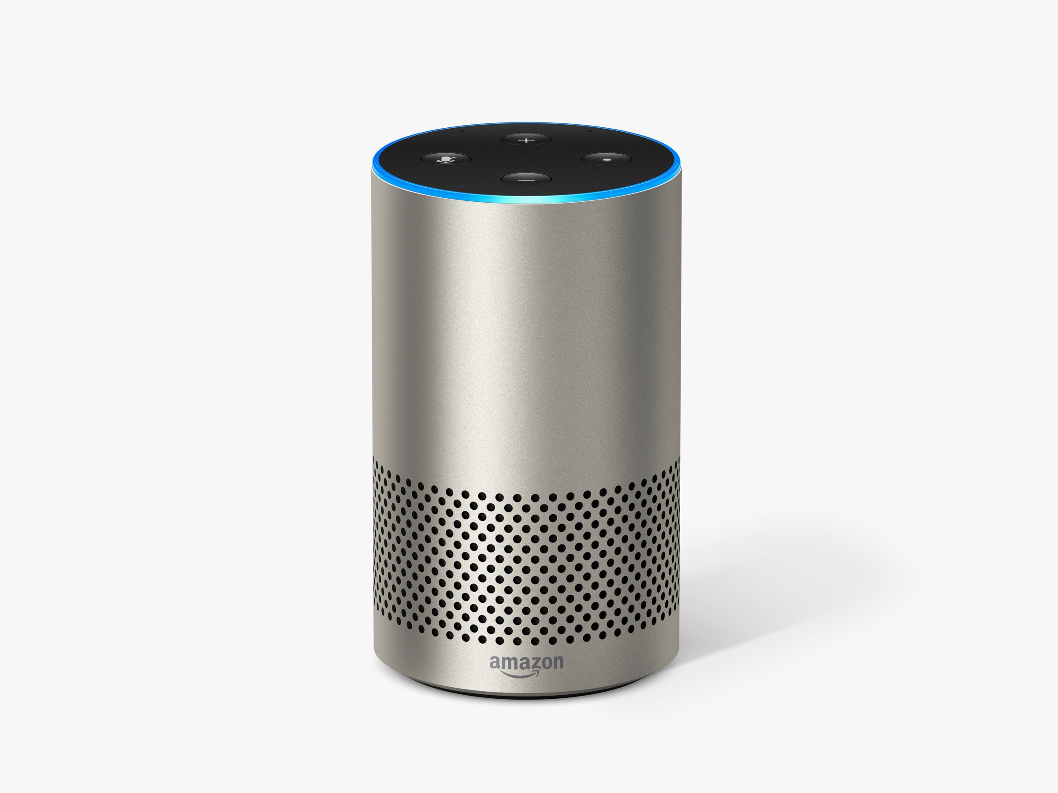
Learning Simple Magic tricks with Alexa.
Use Case - 2
Puzzle drizzle is an engaging Alexa skill, in which you can learn simple magic tricks, Puzzles that blows your mind.
To get both Learn and Fun. Let’s switch to puzzle drizzle.

Slide 3

Overview:
Puzzle Drizzle offers you two features :
Learn some simple magic tricks in your free time.
Learn Aptitude and mathematics in your free time by playing some exciting puzzles.
All you have to do is, Just say simple sentences.
“ Let’s play. ” → To start playing puzzle game
“ Magic world. ” → To enter into magical world
Puzzle Drizzle

Slide 4

Some Sample Utterances :
For puzzle game.
StartingGame
Let’s play
Let’s start
ChoosingLevel
easy Level
medium Level
AnsweringQuestion
My answer is x.
x is my answer
Get started
hard Level
x
Puzzle Drizzle

Slide 5

Some Sample Utterances :
For Magic tricks.
StartMagic
Magic world
PlayingTrick
Start magic
TeachingTrick
Teach me this
Let’s play magic world
magic
Magic trick
Another trick
Start
Teach me again
Teach me
Puzzle Drizzle

Slide 6
Description :
When you play puzzle games, you will be rewarded with 20 points for every question. And for every wrong answer it reduces 5 points from your score. Based on your score, puzzle drizzle will give you remarks (like keep trying, come on, that’s excellent). It makes user to get involved more into the game
We use SSML to give engaging audio experience to the user. There will be some engaging music for every interesting puzzle or magic trick you go through. And also voices like Kendra, Brain, Joey, Justin were used to make the voices more natural.
Puzzle drizzle

Slide 7


Technical Stack used:
Python
(as backend)
Amazon Polly and SSML
(For best voice experience)
Dynamo DB
(For storage)
Puzzle drizzle

Slide 8
Puzzle drizzle, drizzles entertainment and fun wherever you go and whatever you do.
puzzle drizzle

Slide 9





Thank You
Thank You
Shashil Sravan
Puzzle Drizzle
Vendor ID: M1O56N2HKYZ0IH
amzn1.ask.skill.c8cbc9da-37c3-4c4
4-ae77-aff560919269

