Slide 1
An Introduction to Salesforce Integration

Slide 2
Agenda
Salesforce Integration
HTTP & Callout Basics
Authorize an external site with remote site settings
Get Data from a Service
Send Data to a Service
Test Callouts
Test a Callout with HttpCalloutMock

Slide 3
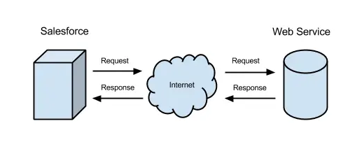
HTTP and Callout Basics
REST callouts are based on HTTP.

Slide 4
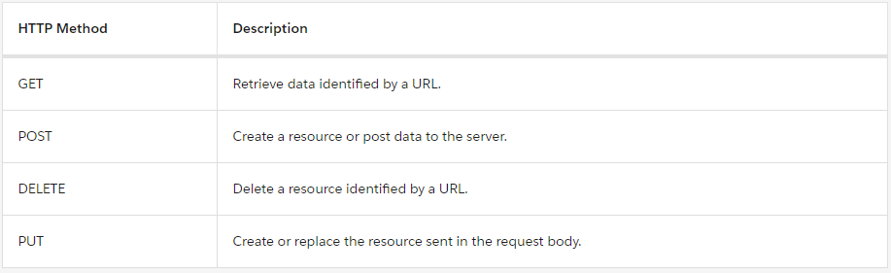
Common HTTP Methods

Slide 5
Authorize Endpoint Addresses
From Setup, enter Remote Site Settings in the Quick Find box, then click Remote Site Settings.
Click New Remote Site.
For the remote site name, enter animals_http.
For the remote site URL, enter https://th-apex-http-callout.herokuapp.com. This URL authorizes all subfolders for the endpoint, like https://th-apex-http-callout.herokuapp.com/path1 and https://th-apex-http-callout.herokuapp.com/path2
Click Save & New.
For the second remote site name, enter animals_soap.
For the remote site URL, enter https://th-apex-soap-service.herokuapp.com
Click Save.

Slide 6
Get Data from a Service
Http http = new Http();
HttpRequest request = new HttpRequest();
request.setEndpoint('https://th-apex-http-callout.herokuapp.com/animals');
request.setMethod('GET');
HttpResponse response = http.send(request);
if (response.getStatusCode() == 200) {
// Deserialize the JSON string into collections of primitive data types.
Map<String, Object> results = (Map<String, Object>) JSON.deserializeUntyped (response.getBody());
List<Object> animals = (List<Object>) results.get('animals');
System.debug('Received the following animals:');
for (Object animal: animals) {
System.debug(animal);
}
}

Slide 7
Send Data to a Service
Http http = new Http();
HttpRequest request = new HttpRequest();
request.setEndpoint('https://th-apex-http-callout.herokuapp.com/animals');
request.setMethod('POST');
request.setHeader('Content-Type', 'application/json;charset=UTF-8’);
// Set the body as a JSON object
request.setBody('{"name":"mighty moose"}');
HttpResponse response = http.send(request);
// Parse the JSON response
if (response.getStatusCode() != 201) {
System.debug('The status code returned was not expected: ' +
response.getStatusCode() + ' ' + response.getStatus());
} else {
System.debug(response.getBody());
}

Slide 8
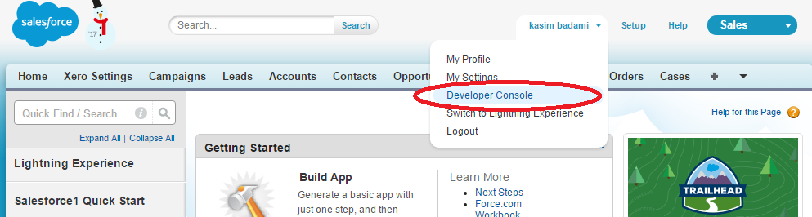
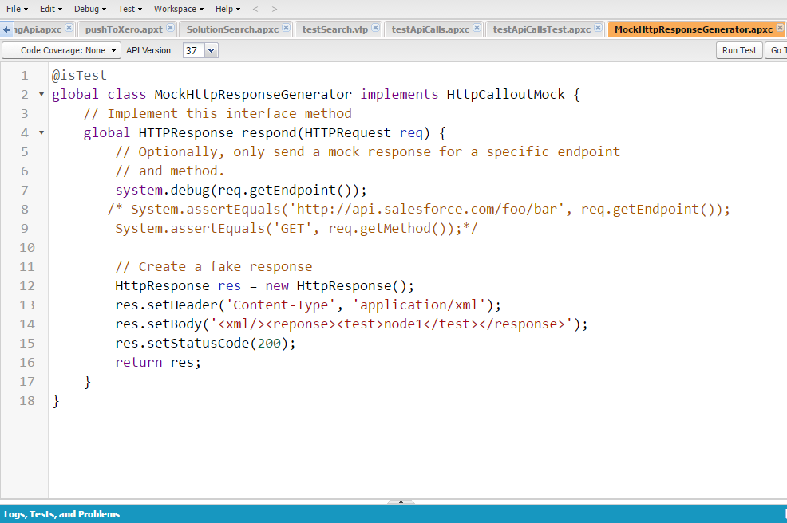
Salesforce Developer Console

Slide 9
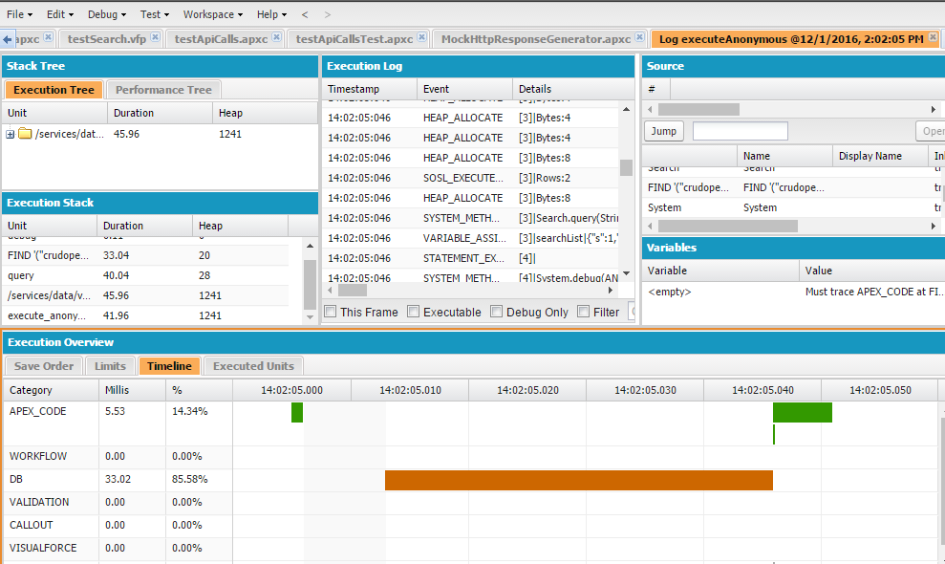
Salesforce Developer Console (Debug Log)

Slide 10
Data Types and Access Modifiers
Data Types:
Primitive (Integer, Double, Long, Date, Datetime, String, ID, or Boolean)
Collections (Lists, Sets and Maps)
sObject
Enums
Access Specifiers:
Global
Public
Private

Slide 11
Apex – SOQL and SOSL
SOQL
SOQL statements evaluate to a list of sObjects, a single sObject, or an Integer for count method queries. We can also used different types of variables in SQOL to fetch records. Types like string, Set, integer
e.g. List<Account> aa = [SELECT Id, Name FROM Account WHERE Name = 'Acme'];
SOSL
SOSL statements evaluate to a list of lists of sObjects, where each list contains the search results for a particular sObject type. The result lists are always returned in the same order as they were specified in the SOSL query. If a SOSL query does not return any records for a specified sObject type, the search results include an empty list for that sObject.
e.g.
List<List<SObject>> searchList = [FIND 'map*' IN ALL FIELDS RETURNING Account (Id, Name), Contact, Opportunity, Lead];

Slide 12
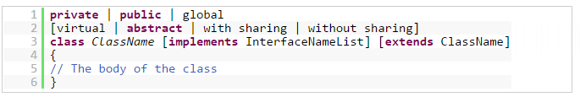
Apex Class
A class can contain variables and methods. Variables are used to specify the state of an object, such as the object's Name or Type. Since these variables are associated with a class and are members of it, they are commonly referred to as member variables. Methods are used to control behavior, such as getOtherQuotes or copyLineItems.
Class Example

Slide 13
Apex Triggers
Apex triggers are like stored procedures which execute when a particular event occurs. It executes before and after an event occurs on record.
insert
update
delete
merge
upsert
undelete
Trigger Variables
Trigger class methods
Trigger.New and Trigger.NewMap
Trigger.Old and Trigger.oldMap

Slide 14
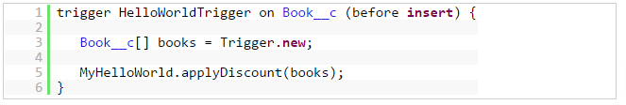
Triggers Example
Trigger Example

Slide 15
Apex Asynchronous Execution
Batch Class
Future Methods
Queueable Classes (Jobs)
Scheduled classes

Slide 16
Apex Test Classes
Testing is an important part of the development process. Before you can deploy Apex or package it for the Force.com AppExchange, the following must be true.
At least 75% of your Apex code must be covered by unit tests, and all of those tests must complete successfully.
Note the following.
When deploying Apex to a production organization, each unit test in your organization namespace is executed by default.
Calls to System.debug are not counted as part of Apex code coverage.
Test methods and test classes are not counted as part of Apex code coverage.
While only 75% of your Apex code must be covered by tests, your focus shouldn't be on the percentage of code that is covered. Instead, you should make sure that every use case of your application is covered, including positive and negative cases, as well as bulk and single records. This should lead to 75% or more of your code being covered by unit tests.
Every trigger must have some test coverage.
All classes and triggers must compile successfully.

Slide 17
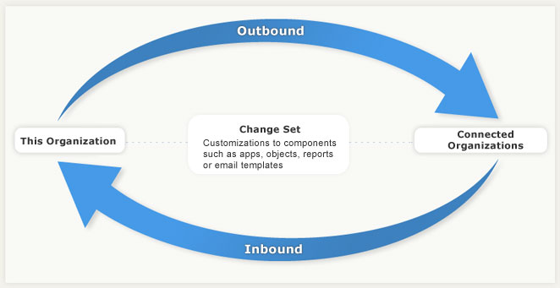
Deployment Process
Inbound Change sets
Outbound Change Sets

Slide 18
Any Questions?

Slide 19
Thank you!

