Slide 1
An Introduction to Salesforce Admin

Slide 2
Agenda
Validation Rule
Workflow Rule
Approval Process
Process Builder
Profiles
Permission Sets
Role Hierarchy

Slide 3
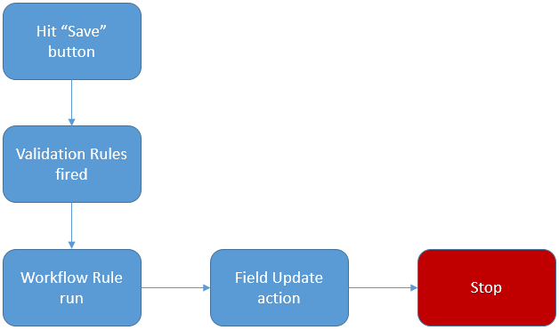
Validation Rule
Validation Rules Fire just after DML

Slide 4
Workflow in Salesforce
What is a Workflow Rule ?
Feature provided by Salesforce to automate certain business processes to save time across your org.
Evaluation Criteria
created
created, and every time it's edited
created, and any time it's edited to subsequently meet criteria
Actions
Tasks - Assign a new task to a user, role, or record owner.
Email Alerts – Send an email to one or more recipients you specify.
Field Updates – Update the value of a field on a record.
Outbound Messages – Send a secure configurable API message (in XML format) to a designated listener.

Slide 5
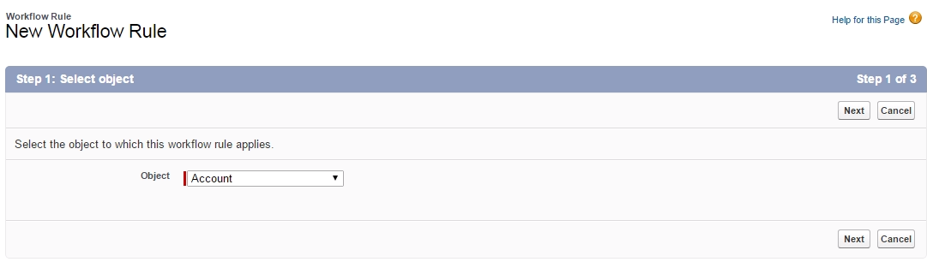
Steps to Create Workflow
Step 1 : Select Object

Slide 6
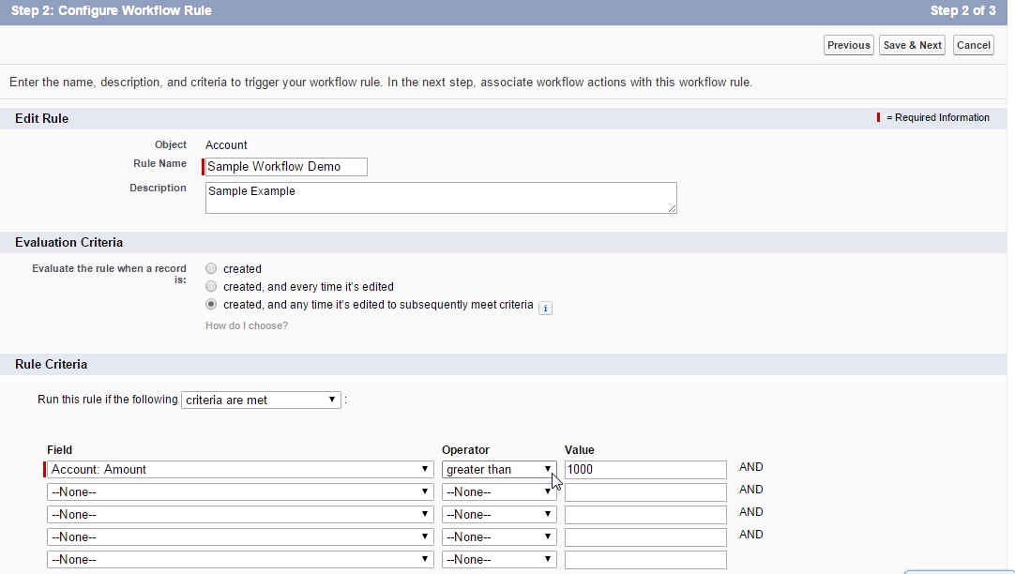
Step 2 : Defining criteria

Slide 7
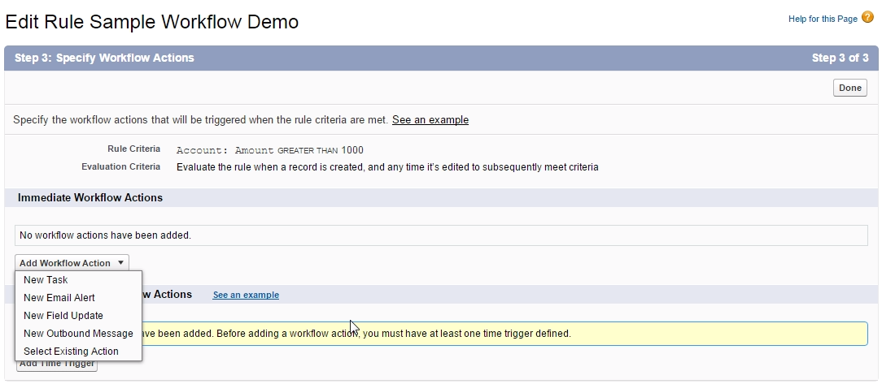
Step 3 : Select action

Slide 8
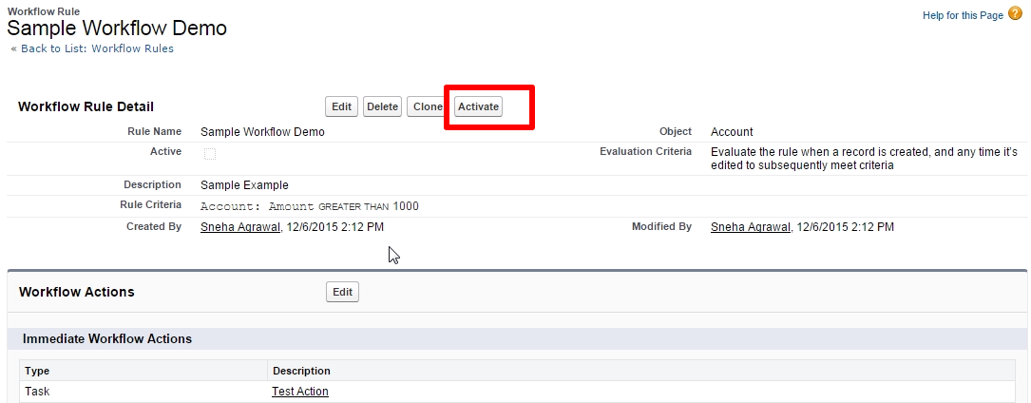
Step 4 : Activate workflow

Slide 9
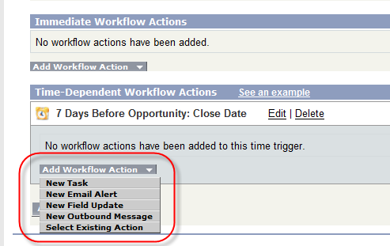
Time Based Workflow

Slide 10
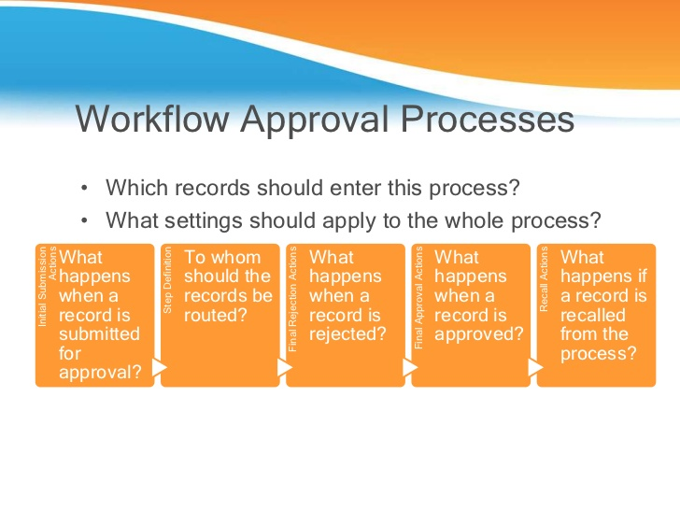

Slide 11
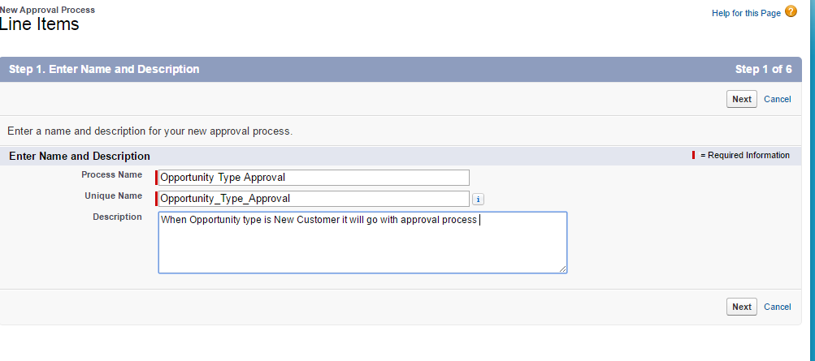
Create Approval Process
Navigate setup->Create ->Workflow & Approval ->Approval Processes
Click on Create New Approval process and choose new standard Setup Wizard From drop down list
Step 1:-Enter Name

Slide 12
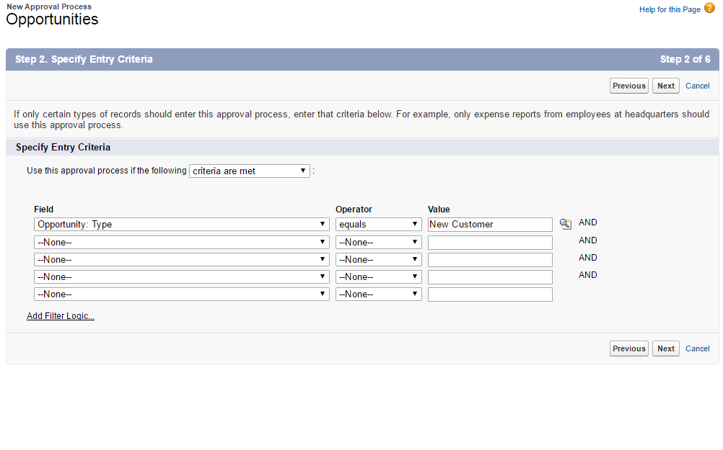
Step 2 : Specify Entry Criteria

Slide 13
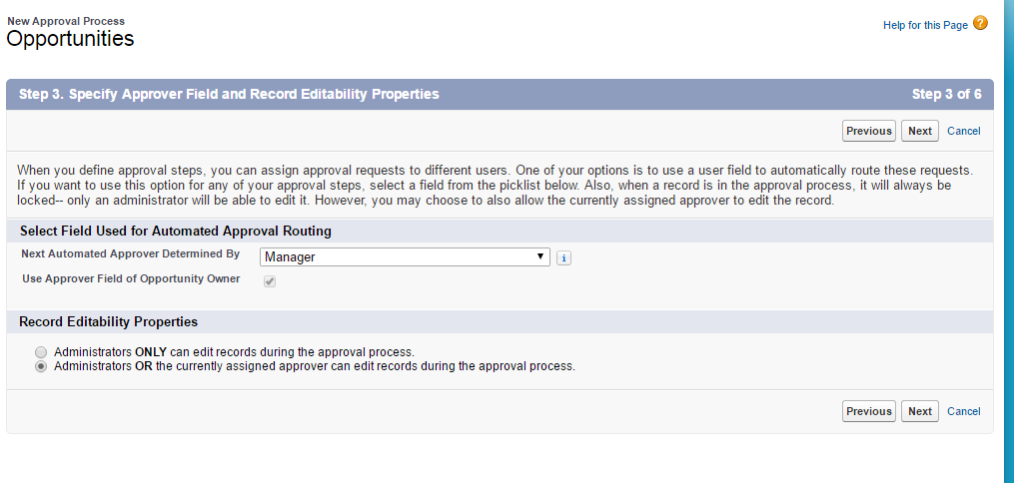
3.Specify Approver Field and Record Editability

Slide 14
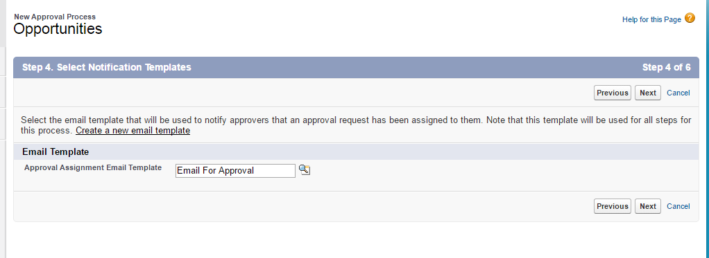
4. Select Notification Template

Slide 15
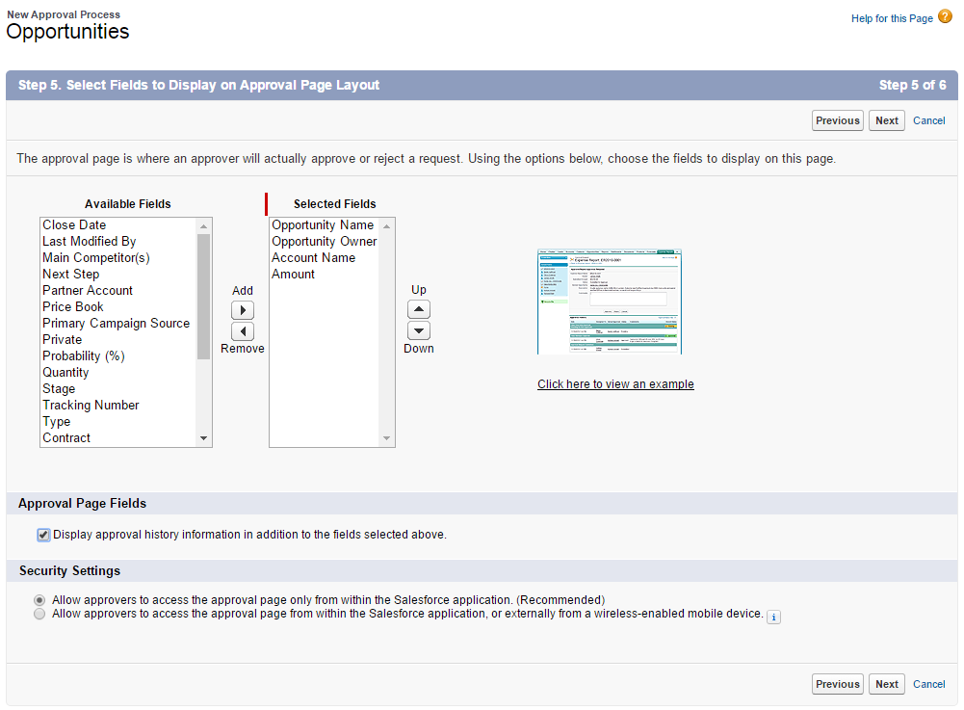
5. Approval Page layout

Slide 16
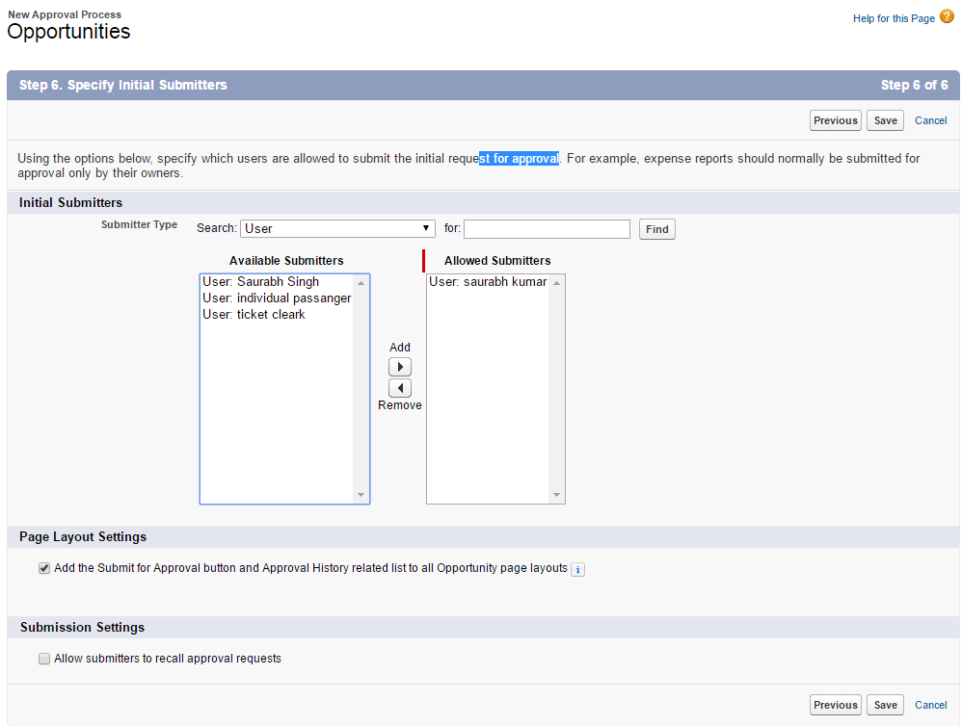
6.Initial Submitters

Slide 17
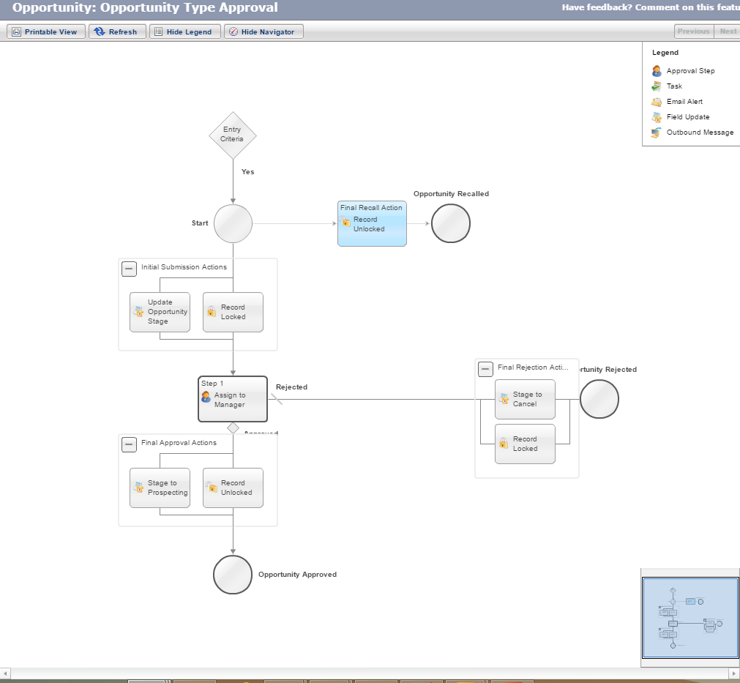
Final Approval Process Diagram

Slide 18
Introduction to Process Builder
The Process Builder is a tool that allows you to easily automate business processes using a convenient graphical representation of your process as you build it.
Automated processes in the Process Builder consist of :
Criteria that determine when to execute action groups
Immediate and scheduled actions to execute when those criteria are met.

Slide 19
With Process Builder, You can:
Create a record
Update any related record—not just the record or its parent
Use a quick action to create a record, update a record, or log a call
Launch a flow—you can’t schedule this action with workflow
Send an email
Post to Chatter
Submit for approval
Call Apex from a process

Slide 20
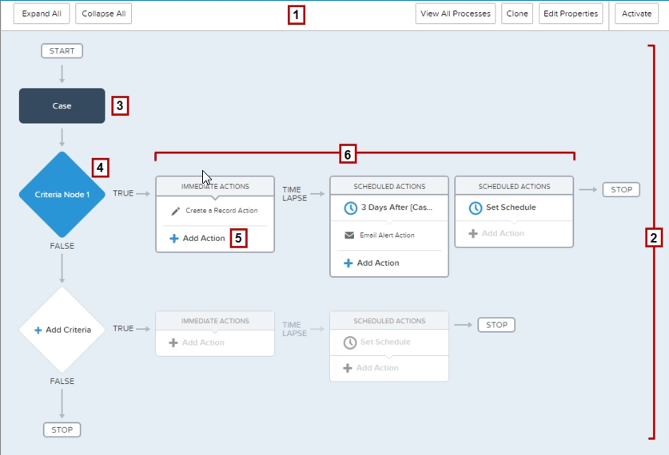
Process Builder

Slide 21
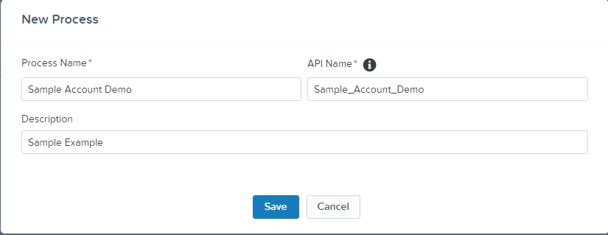
Step 1 : Define the Name

Slide 22
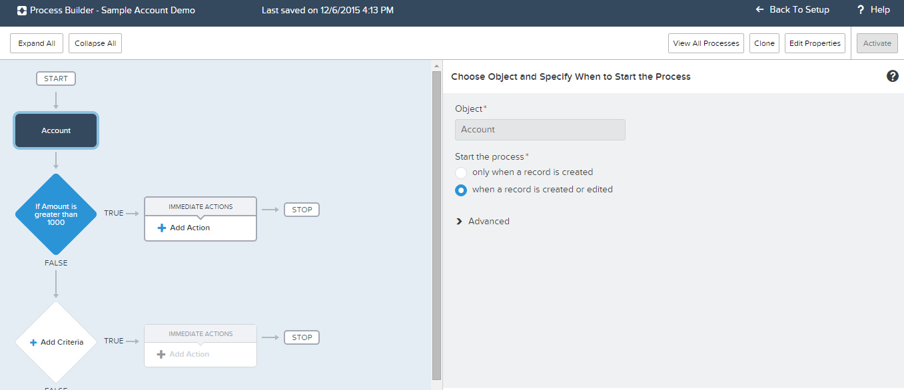
Step 2 : Select Object

Slide 23
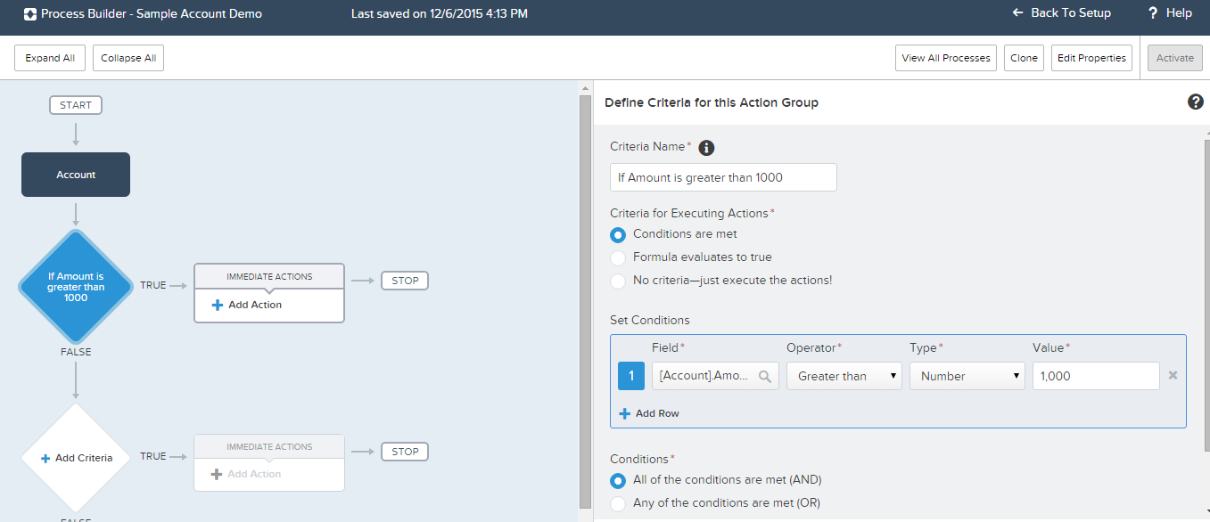
Step 3 : Criteria Node

Slide 24
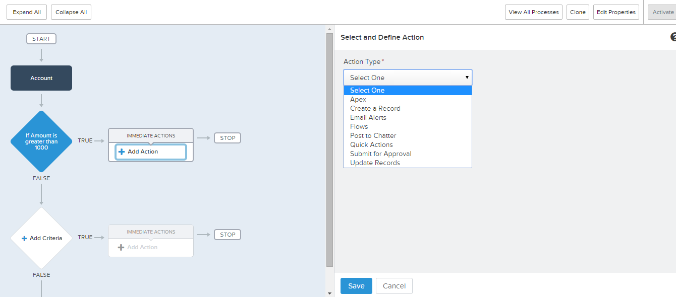
Step 4 : Select Action

Slide 25
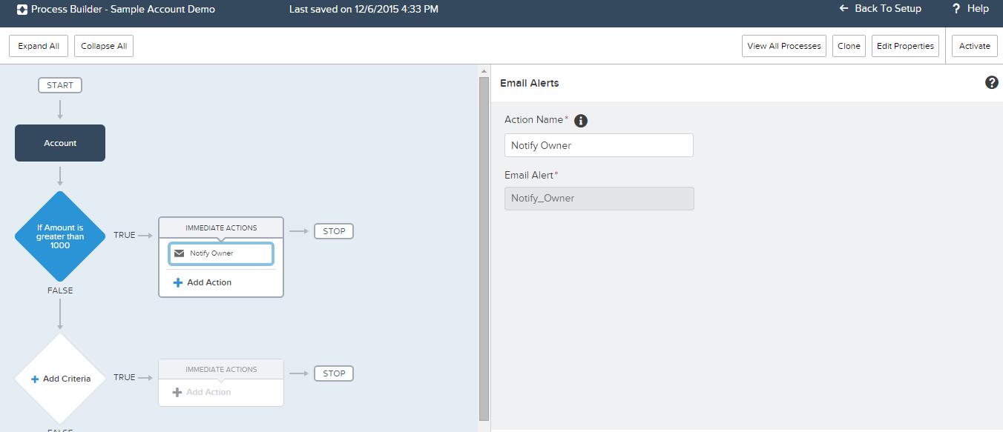
Step 4 : Define action and activate it

Slide 26
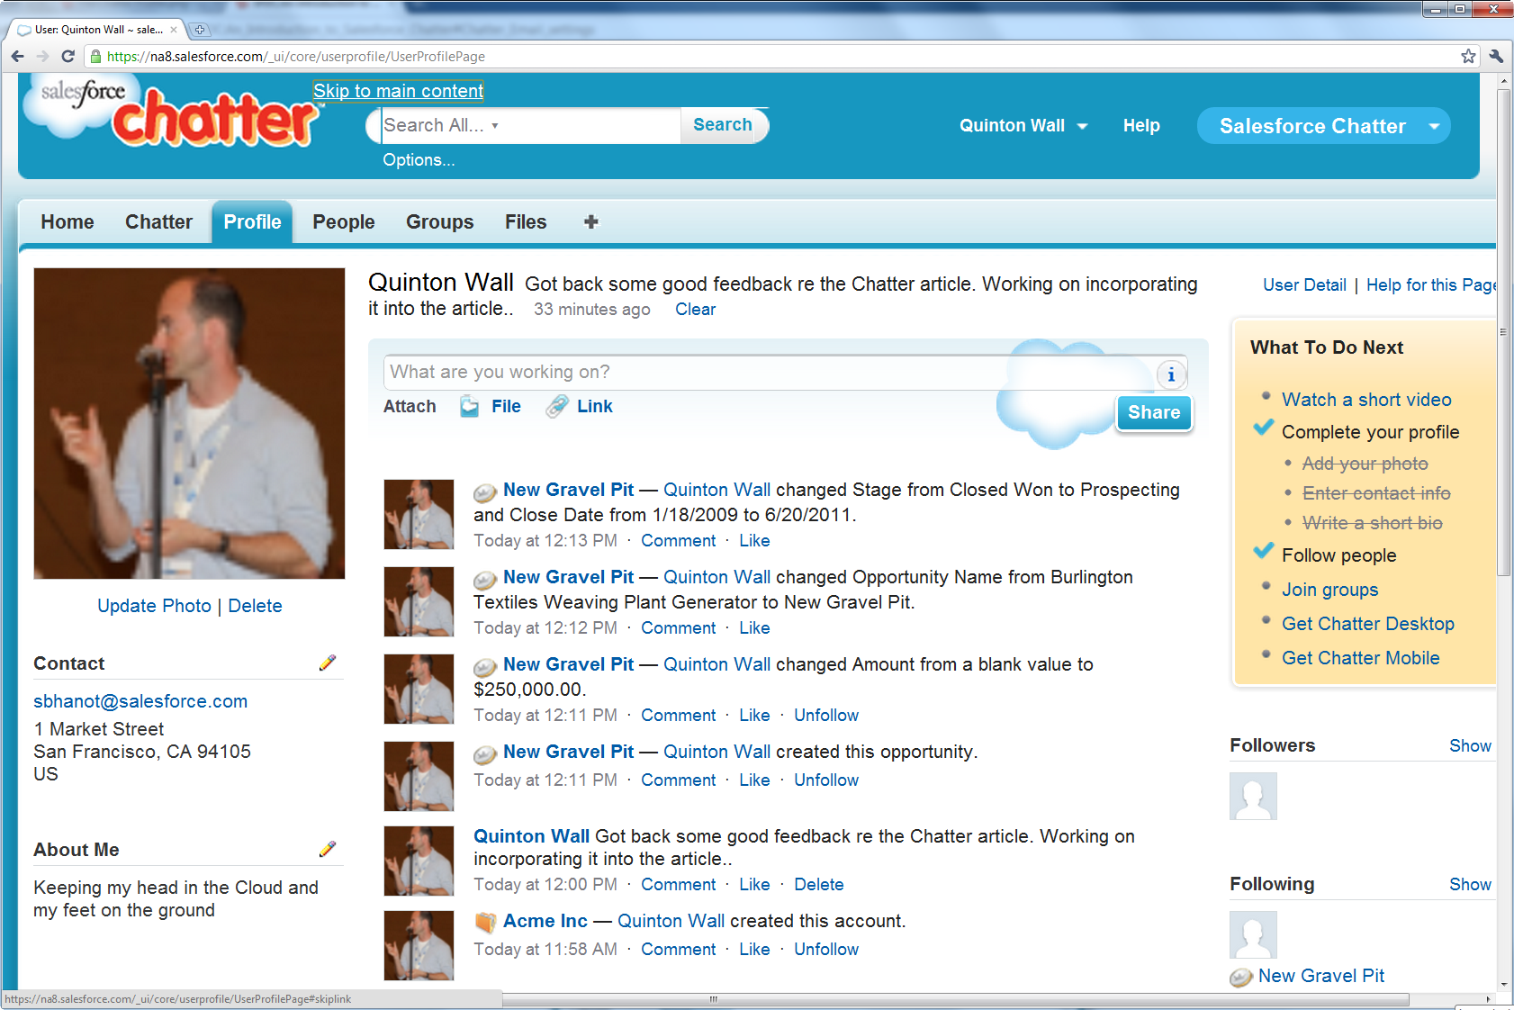
Chatter
Chatter provides collaboration features and capabilities to any application built on the Force.com platform. These collaboration features include real-time feed updates, user profiles, and feeds that allow users to see changes that are important to them. For a developer/Admin this social platform opens up endless possibilities for customization..

Slide 27
Profiles & Permission sets
What is a Profile ?
A profile is a group/collection of settings and permissions that define what a user can do in salesforce.
Object permissions
Field permissions
System permissions
Tab settings
App settings
Apex class access
Visualforce page access
Login hours
Login IP ranges

Slide 28
Profiles & Permission sets
What is a Permission Sets ?
A permission set is a collection of settings and permissions that give users access to various tools and functions.
The settings and permissions in permission sets are also found in profiles, but permission sets extend users' functional access without changing their profiles.

Slide 29
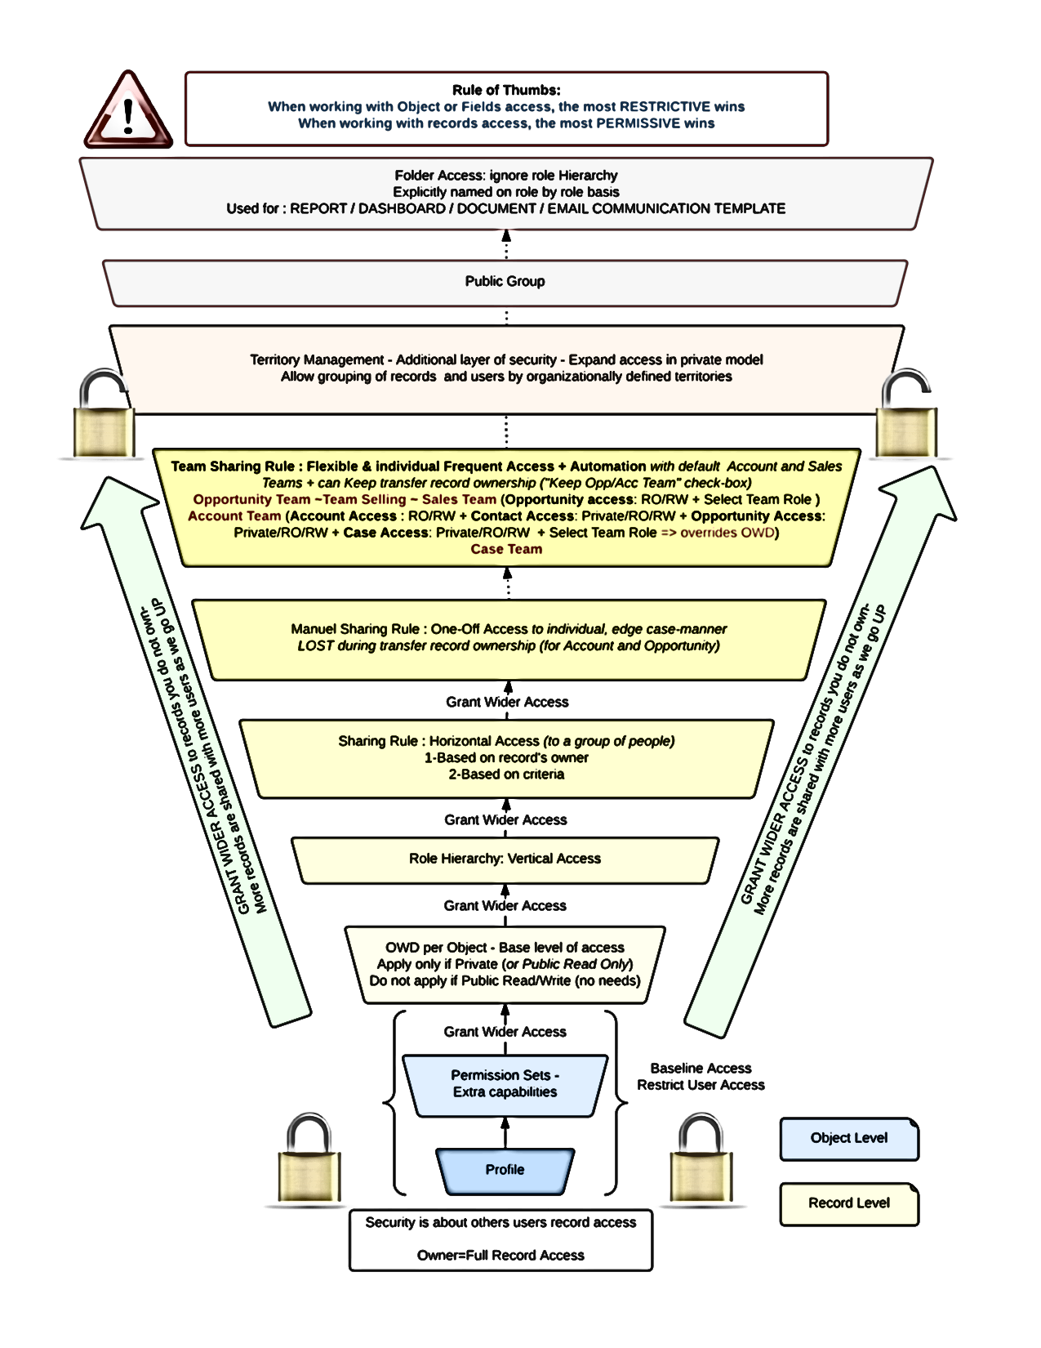
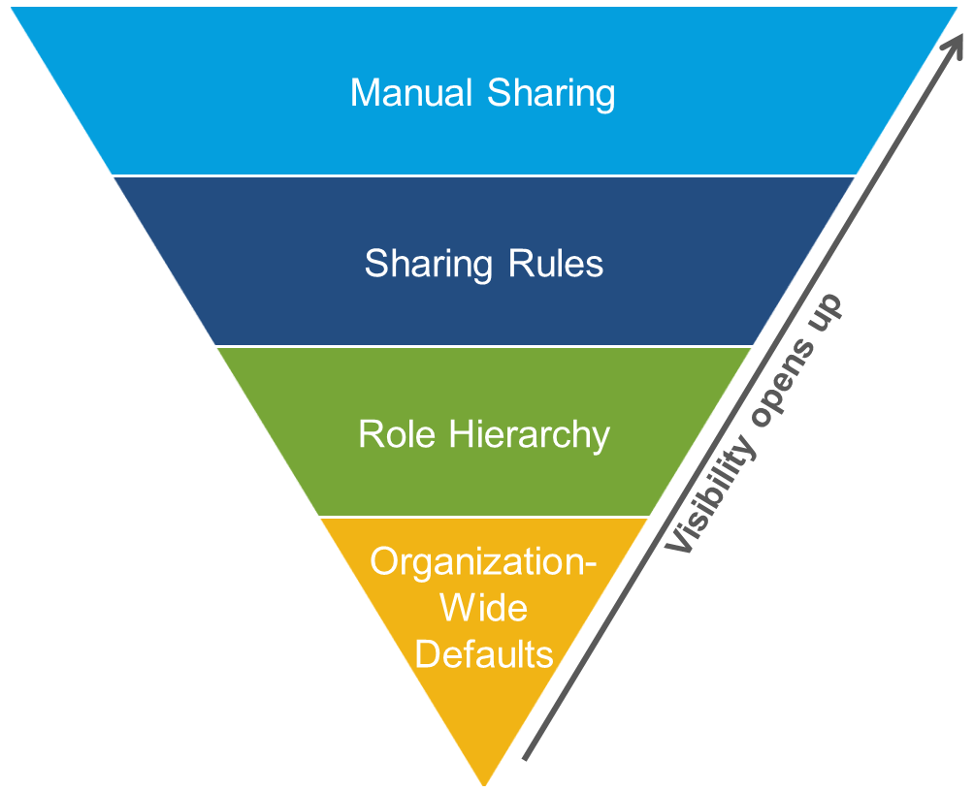
Security and Access

Slide 30
Any Questions?

Slide 31
Thank you!

