Slide 1
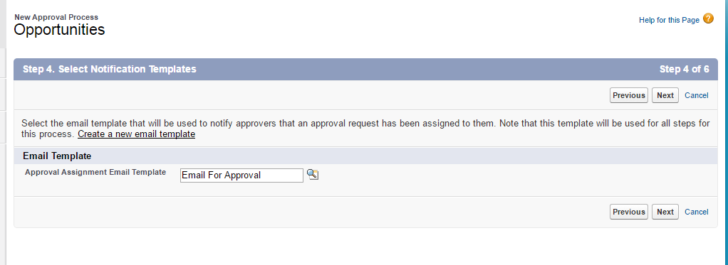
4. Select Notification Template

Slide 2
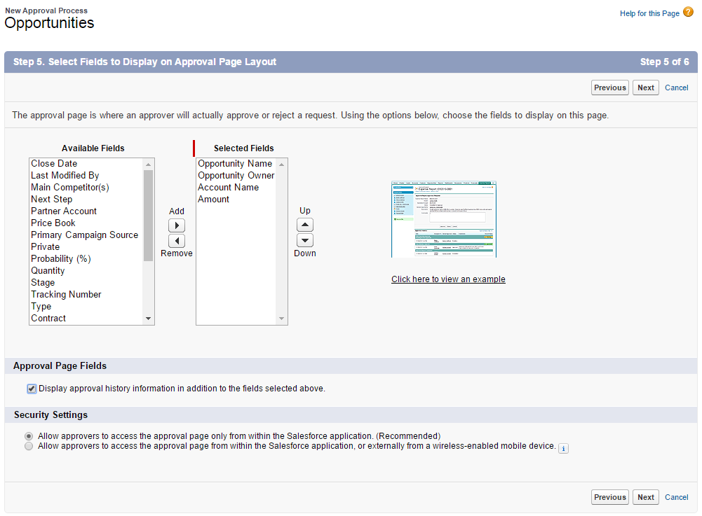
5. Approval Page layout

Slide 3
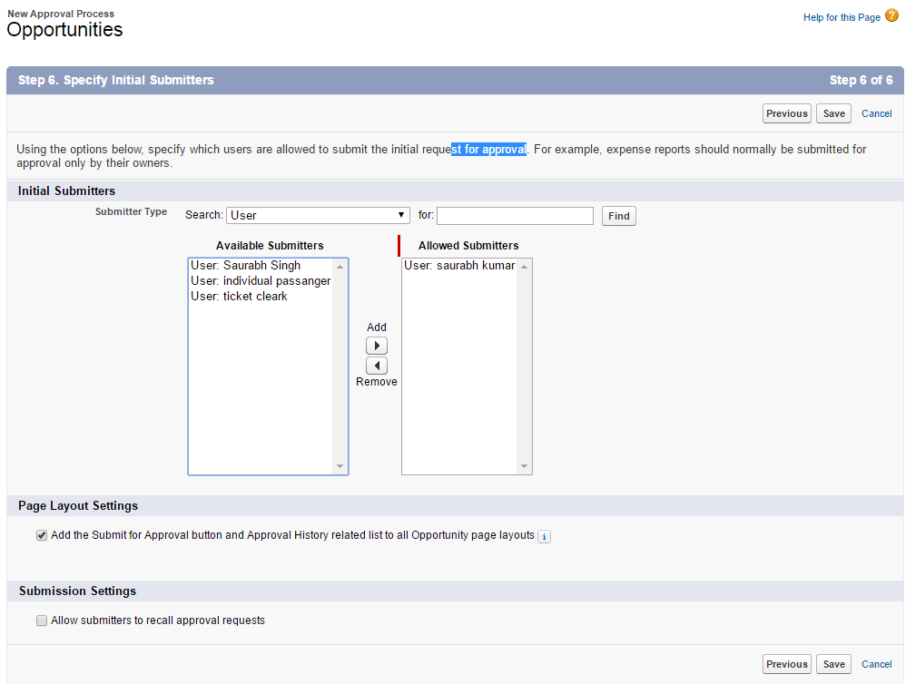
6.Initial Submitters

Slide 4
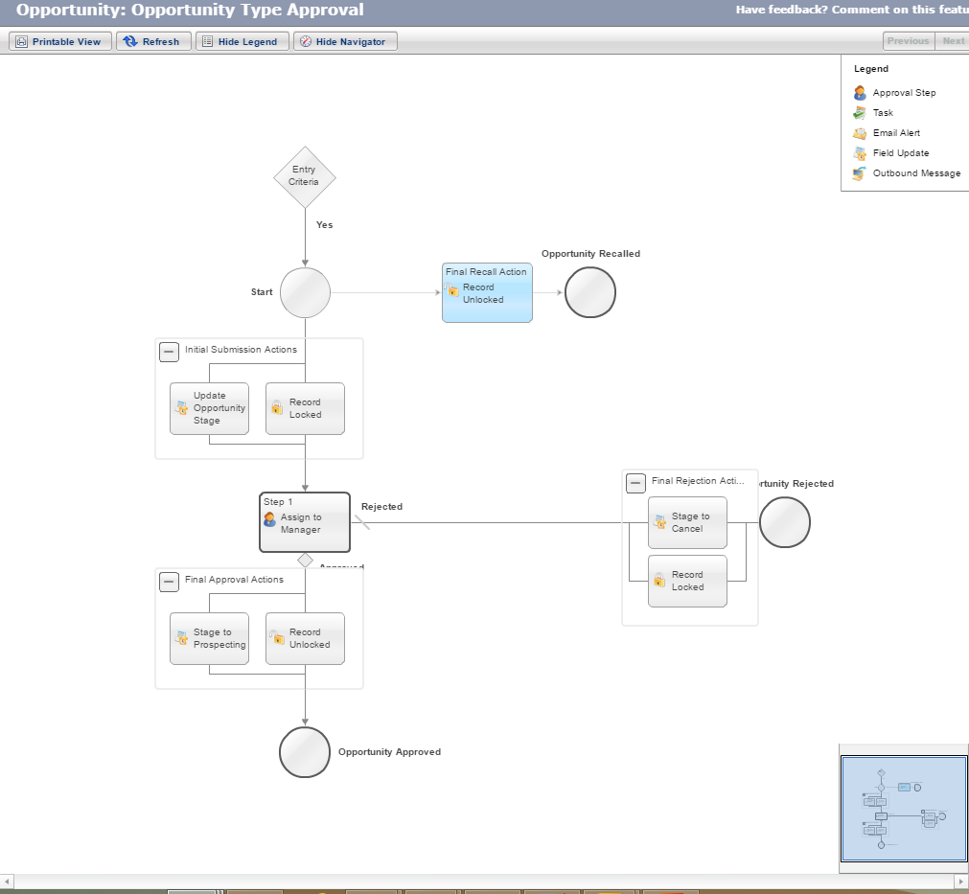
Final Approval Process Diagram

Slide 5
Introduction to Process Builder
The Process Builder is a tool that allows you to easily automate business processes using a convenient graphical representation of your process as you build it.
Automated processes in the Process Builder consist of :
Criteria that determine when to execute action groups
Immediate and scheduled actions to execute when those criteria are met.

Slide 6
With Process Builder, You can:
Create a record
Update any related record—not just the record or its parent
Use a quick action to create a record, update a record, or log a call
Launch a flow—you can’t schedule this action with workflow
Send an email
Post to Chatter
Submit for approval
Call Apex from a process

Slide 7
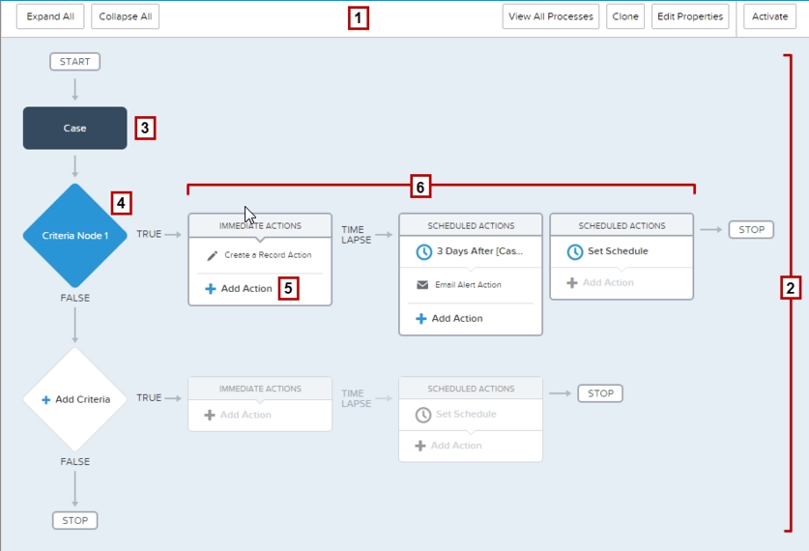
Process Builder

Slide 8
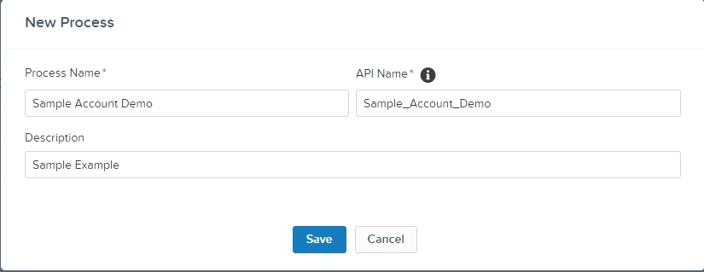
Step 1 : Define the Name

Slide 9
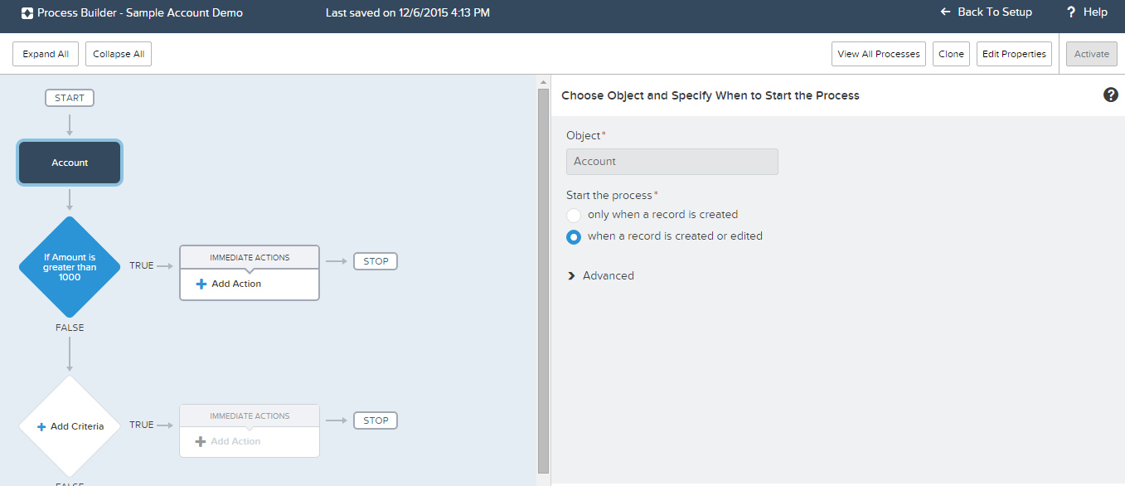
Step 2 : Select Object

Slide 10
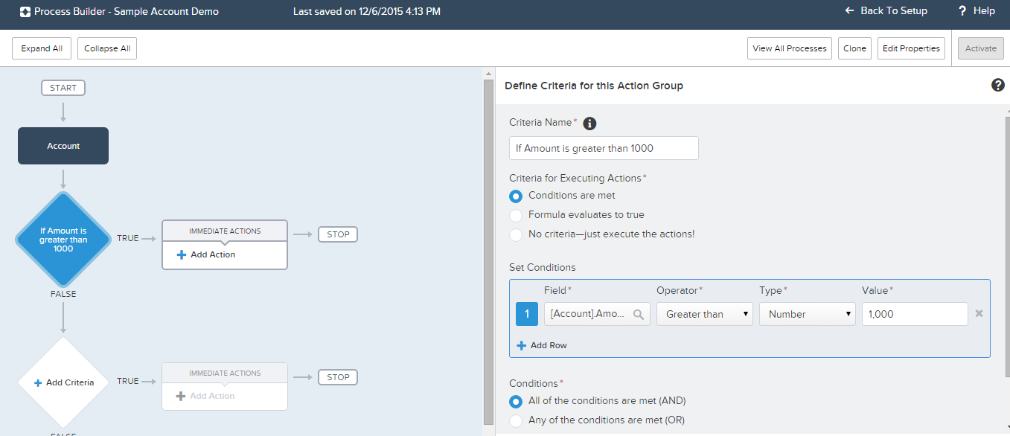
Step 3 : Criteria Node

Slide 11
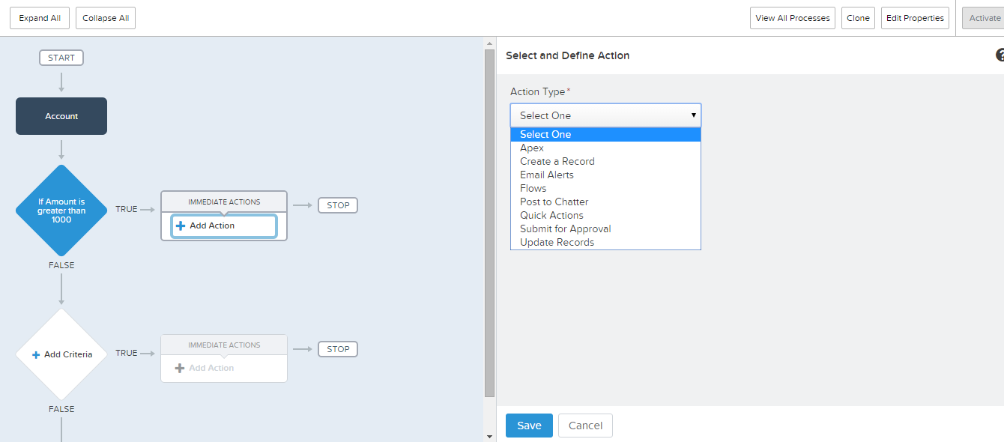
Step 4 : Select Action

Slide 12
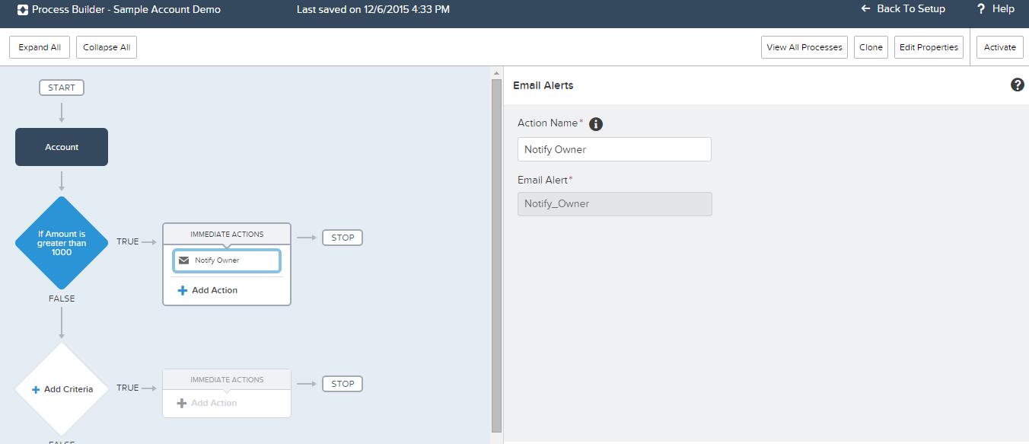
Step 4 : Define action and activate it

Slide 13
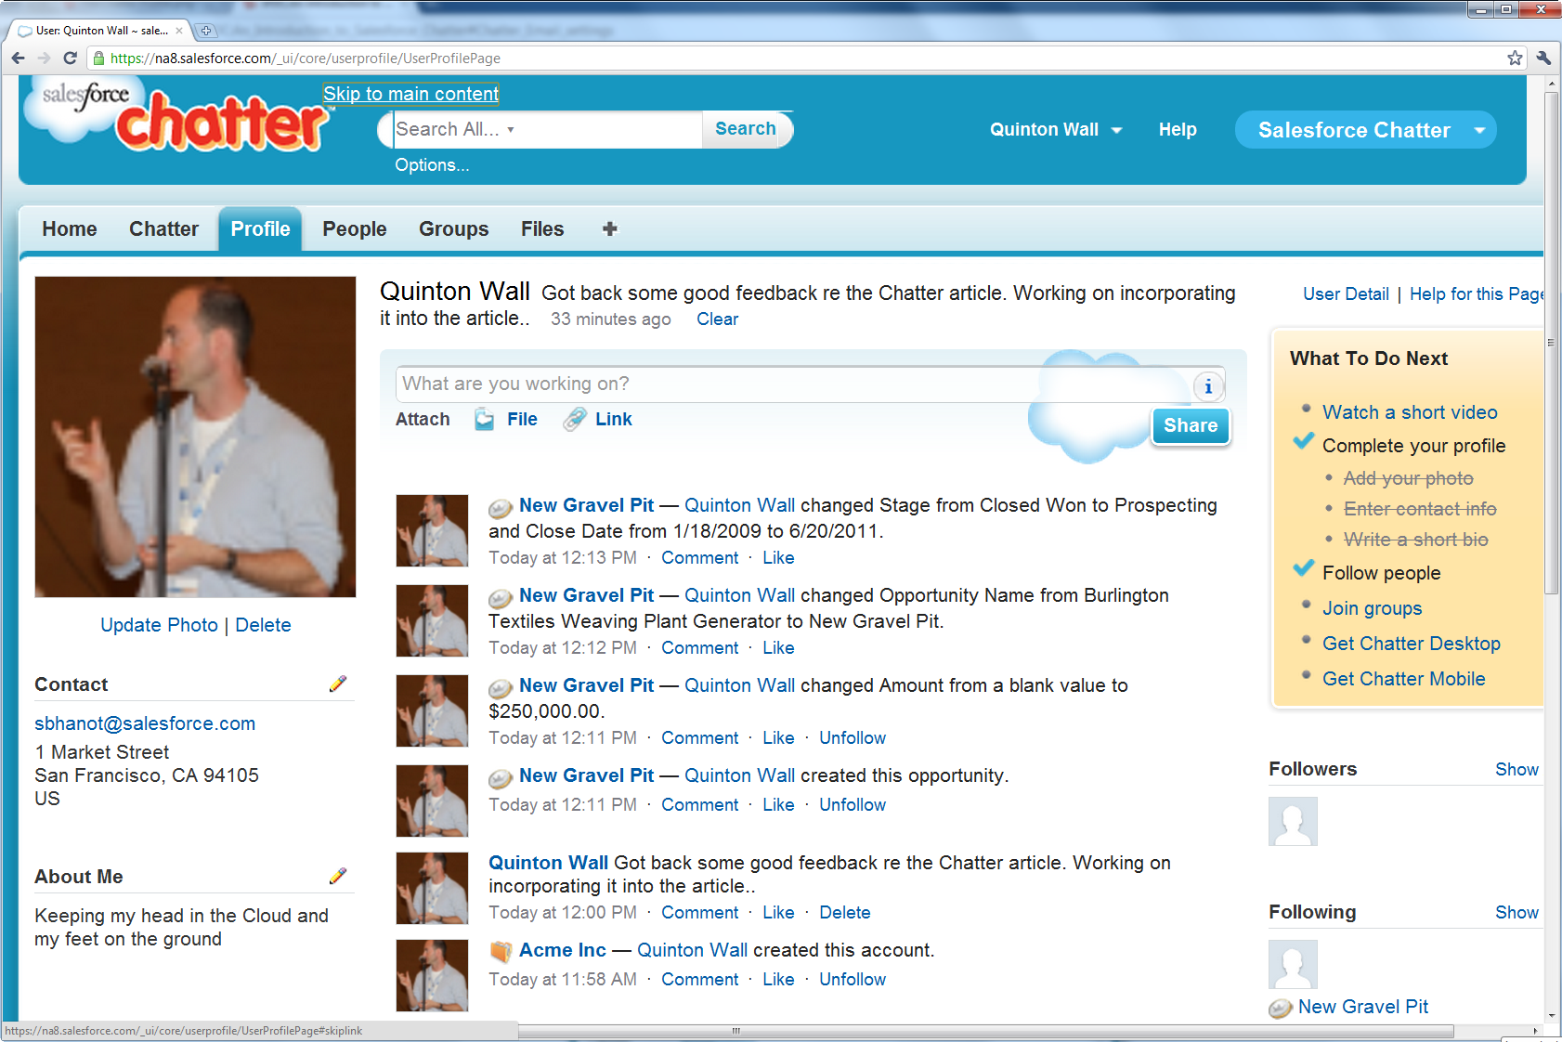
Chatter
Chatter provides collaboration features and capabilities to any application built on the Force.com platform. These collaboration features include real-time feed updates, user profiles, and feeds that allow users to see changes that are important to them. For a developer/Admin this social platform opens up endless possibilities for customization..

Slide 14
Introduction to Visual Flow
Flow—An application that automates a process by collecting, updating, editing, and creating Salesforce data. Flows can execute logic, interact with the Salesforce database, call Apex classes, and guide users through screens for collecting and updating data. Most often, flows are built by using the Cloud Flow Designer.
Cloud Flow Designer—a point-and-click tool that you can use to design flows.
Visual Workflow—the product that encompasses the process of designing, managing, and running flows. If you’re not sure about the difference between Visual Workflow and workflow rules

Slide 15
Creating a Simple Flow
Business need :- End User Should able to directly create a Chatter Post and Case regarding their issue by using a User Friendly Interface .
Step1:- Create a Flow with all required component and logic
Step2:- Associate with the Account object button .

Slide 16
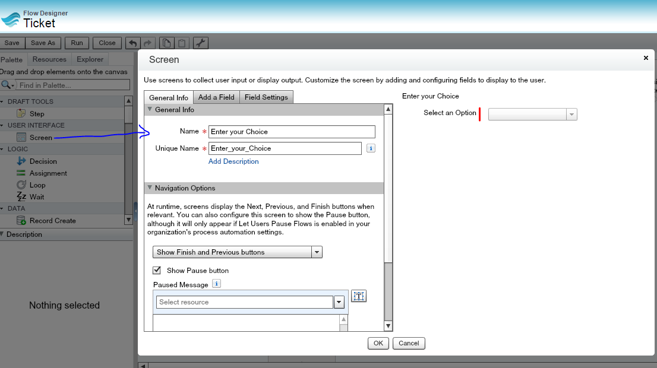
Step1: Put a Starting Screen

Slide 17
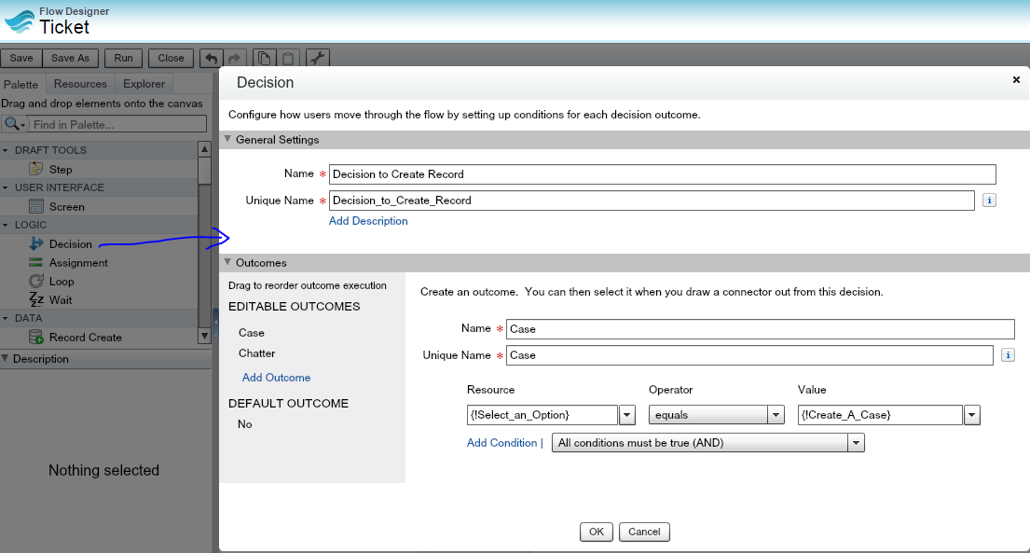
Write Logic in Decision

Slide 18
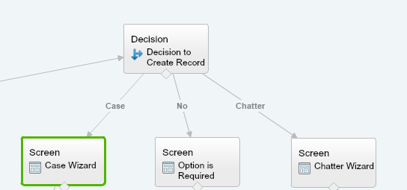
Create Separate route as per Decision result

Slide 19
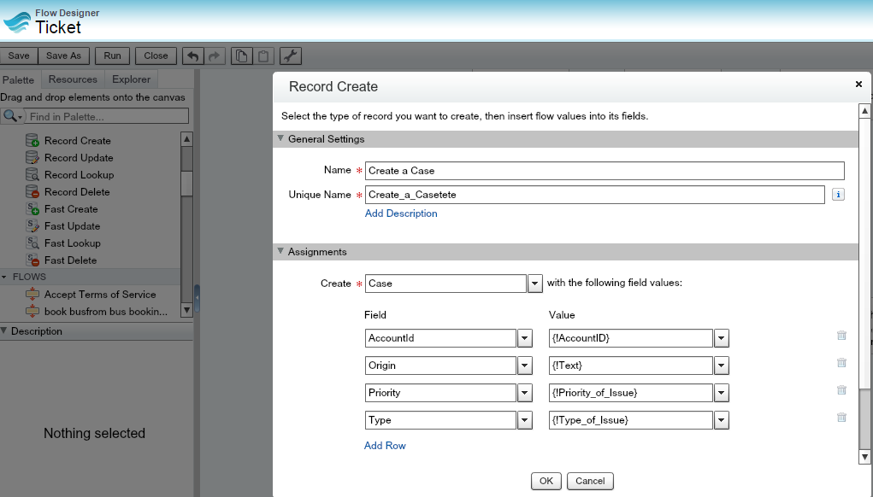
Create Record Create Palettes

Slide 20
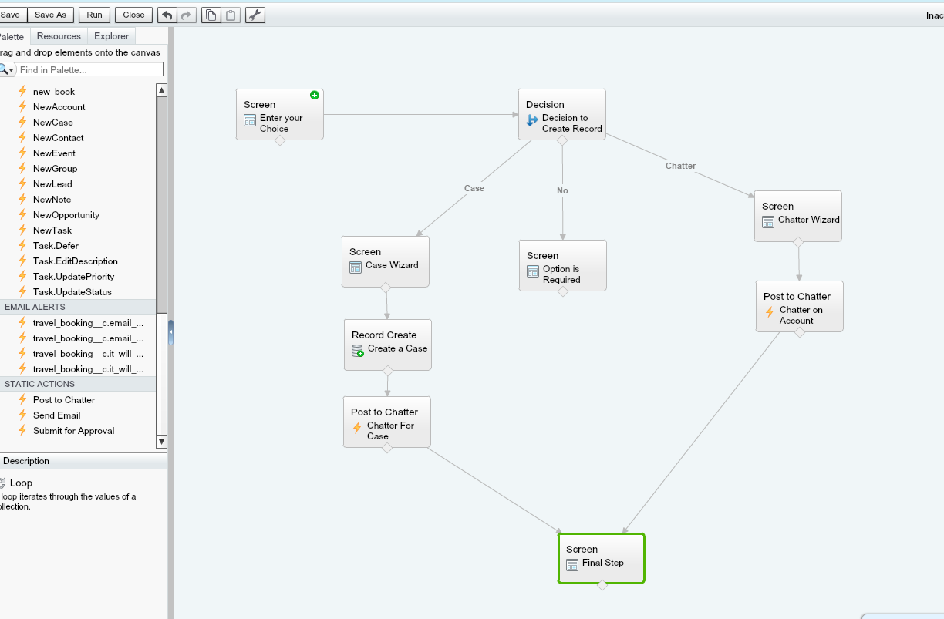

Slide 21
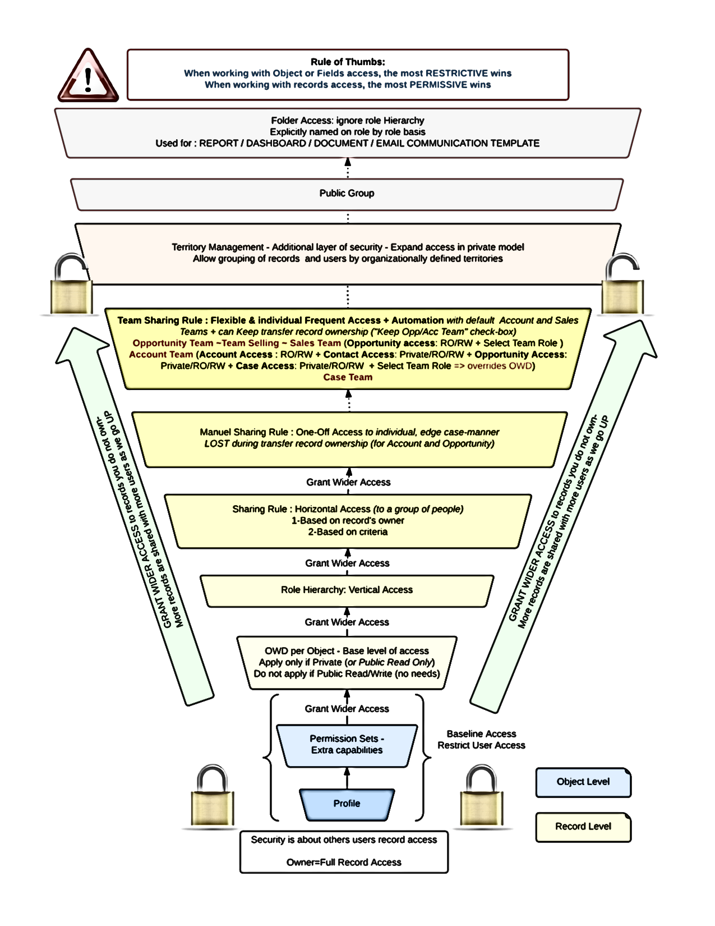
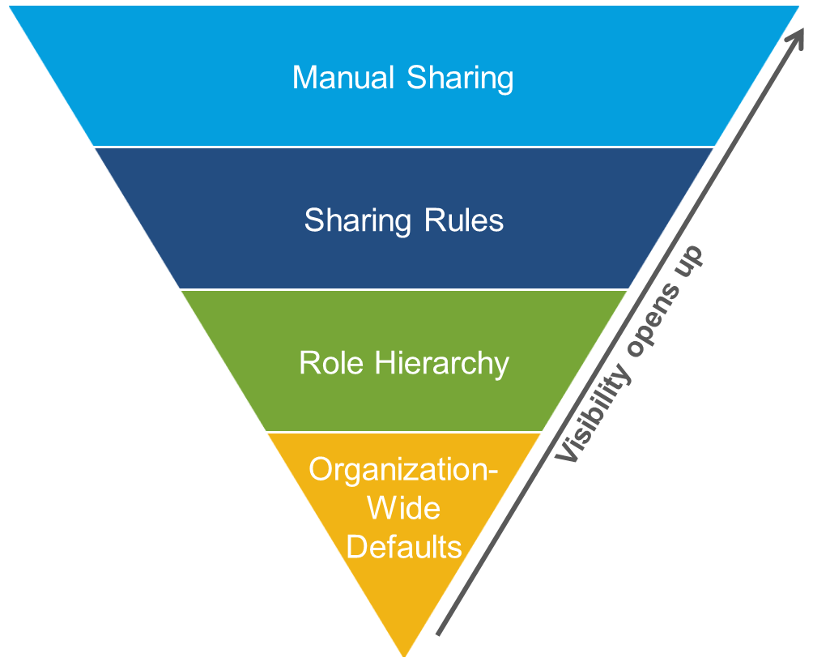
Security and Access

Slide 22
Any Questions?

Slide 23
Thank you!

