Slide 1


Python Crash Course Os Module
Shashikant Pattar
V1.0
Date 09-12-2015
Hour 9

Slide 2
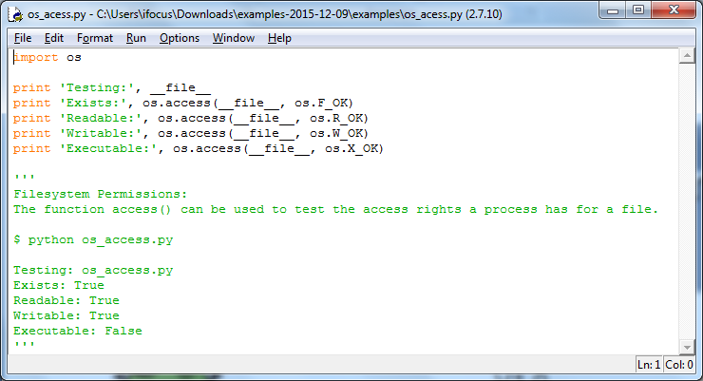
OS Module
Os.access : os.access(path, mode)
specified access to path.It returns True if access is allowed, False if not.

Slide 3
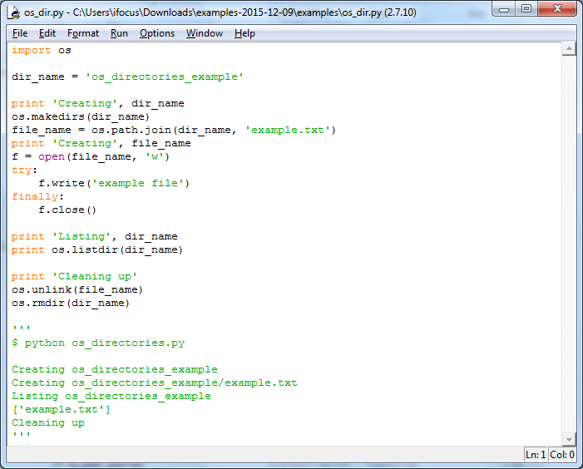
Os.mkdirs
Os.mkdirs

Slide 4
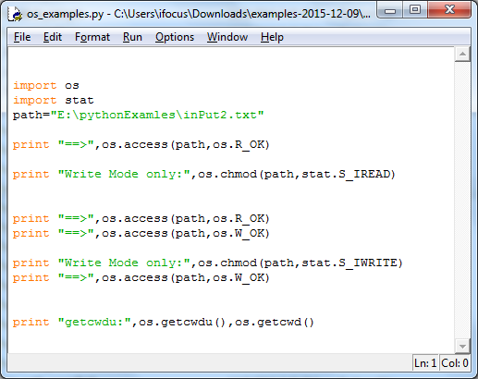
Os.chmod
Os.chmod: Change the mode of the file

Slide 5
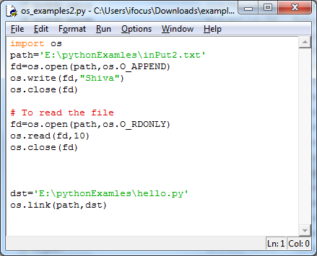
Os.open
Os.open: file operations will be done by os module and its will be using os.open, os.read,os.close

Slide 6
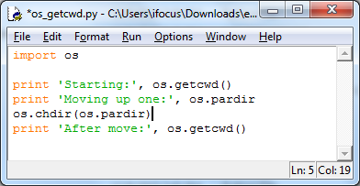
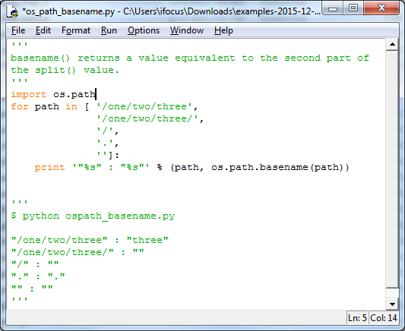
Os.getcwd : get current working directory
Os.path.basename:
returns a value equivalent to the second part of the split value

Slide 7
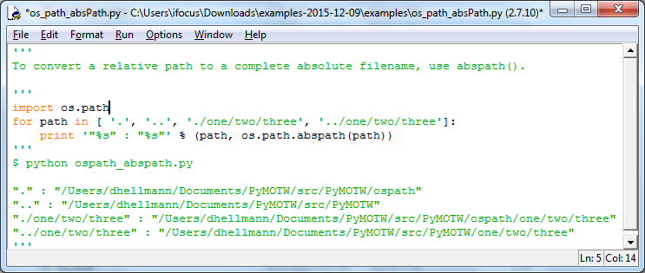
Os.path.abspath: To convert a relative path to a complete absolute filename

Slide 8
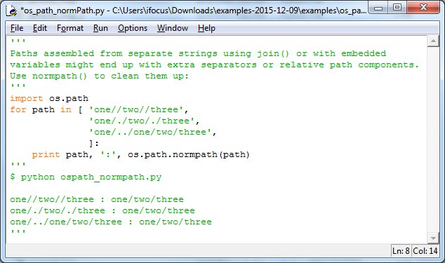
Os.path.normpath
Normalize a pathname by collapsing redundant separators and up-level references so that A//B, A/B/, A/./B and A/foo/../B all become A/B.

Slide 9
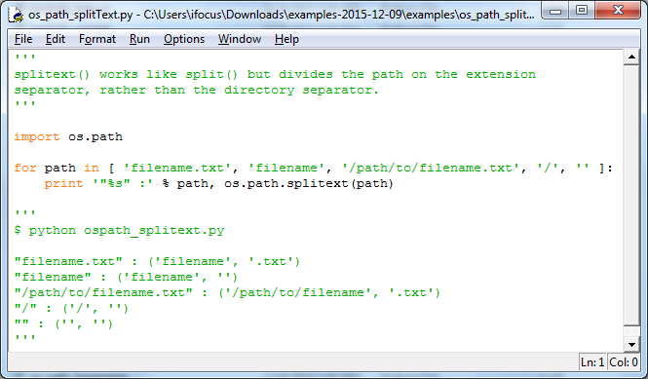
Os.split: works like split , but it divides the path on the extension separator

Slide 10
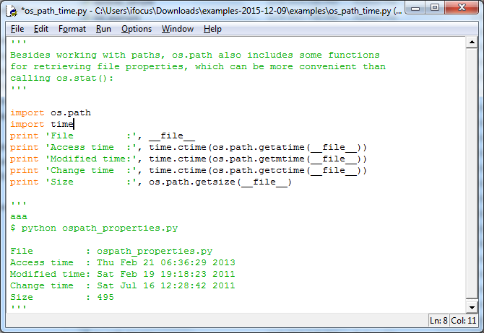
File details from OS module
We can retrieving the details of the file properties

Slide 11
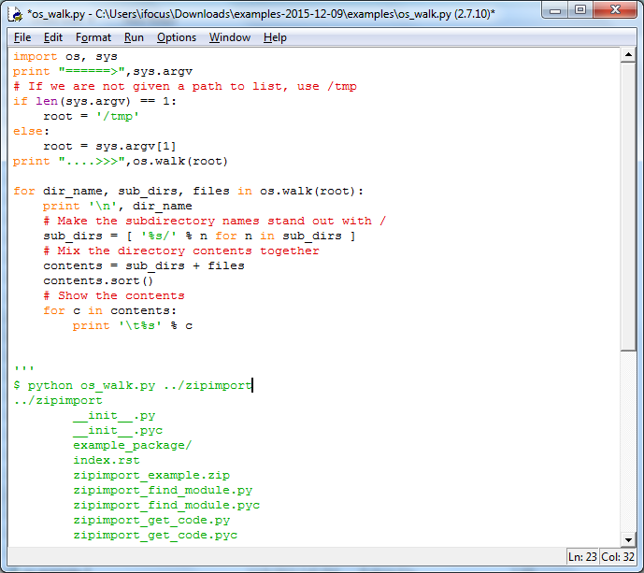
Os.walk: The method walk() generates the file names in a directory tree by walking the tree either top-down or bottom-up.

Slide 12
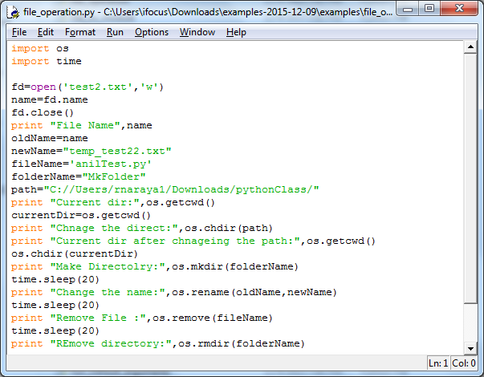
Os.chdir,os.mkdir,os.rename,os.remove,os.rmdir

Slide 13

QA

