Slide 1
Python regular expressions
Shashikant Pattar
V1.0
Date 09-12-2015
Hour 9

Slide 2

Python regular expressions
Regular expressions are a powerful string manipulation tool
All modern languages have similar library packages for regular expressions
Use regular expressions to:
Search a string (search and match)
Replace parts of a string (sub)
Break strings into smaller pieces (split)

Slide 3
Python’s Regular Expression Syntax
Most characters match themselves
The regular expression “test” matches the string ‘test’, and only that string
[x] matches any one of a list of characters
“[abc]” matches ‘a’,‘b’,or ‘c’
[^x] matches any one character that is not included in x
“[^abc]” matches any single character except ‘a’,’b’,or ‘c’

Slide 4
Python’s Regular Expression Syntax
“.” matches any single character
Parentheses can be used for grouping
“(abc)+” matches ’abc’, ‘abcabc’, ‘abcabcabc’, etc.
x|y matches x or y
“this|that” matches ‘this’ and ‘that’, but not ‘thisthat’.

Slide 5
Python’sRegular Expression Syntax
x* matches zero or more x’s
“a*” matches ’’, ’a’, ’aa’, etc.
x+ matches one or more x’s
“a+” matches ’a’,’aa’,’aaa’, etc.
x? matches zero or one x’s
“a?” matches ’’ or ’a’
x{m, n} matches i x‘s, where m<i< n
“a{2,3}” matches ’aa’ or ’aaa’

Slide 6
Regular Expression Syntax
“\d” matches any digit; “\D” any non-digit
“\s” matches any whitespace character; “\S” any non-whitespace character
“\w” matches any alphanumeric character; “\W” any non-alphanumeric character
“^” matches the beginning of the string; “$” the end of the string
“\b” matches a word boundary; “\B” matches a character that is not a word boundary

Slide 7
Search and Match
The two basic functions are re.search and re.match
Search looks for a pattern anywhere in a string
Match looks for a match staring at the beginning
Both return None (logical false) if the pattern isn’t found and a “match object” instance if it is
>>> import re
>>> pat = "a*b”
>>> re.search(pat,"fooaaabcde")
<_sre.SRE_Match object at 0x809c0>
>>> re.match(pat,"fooaaabcde")
>>>

Slide 8
Q: What’s a match object?
A: an instance of the match class with the details of the match result
>>> r1 = re.search("a*b","fooaaabcde")
>>> r1.group() # group returns string matched
'aaab'
>>> r1.start() # index of the match start
3
>>> r1.end() # index of the match end
7
>>> r1.span() # tuple of (start, end)
(3, 7)

Slide 9
What got matched?
Here’s a pattern to match simple email addresses
\w+@(\w+\.)+(com|org|net|edu)
>>> pat1 = "\w+@(\w+\.)+(com|org|net|edu)"
>>> r1 = re.match(pat,"finin@cs.umbc.edu")
>>> r1.group()
'finin@cs.umbc.edu’
We might want to extract the pattern parts, like the email name and host

Slide 10
What got matched?
We can put parentheses around groups we want to be able to reference
>>> pat2 = "(\w+)@((\w+\.)+(com|org|net|edu))"
>>> r2 = re.match(pat2,"finin@cs.umbc.edu")
>>> r2.group(1)
'finin'
>>> r2.group(2)
'cs.umbc.edu'
>>> r2.groups()
r2.groups()
('finin', 'cs.umbc.edu', 'umbc.', 'edu’)
Note that the ‘groups’ are numbered in a preorder traversal of the forest

Slide 11
What got matched?
We can ‘label’ the groups as well…
>>> pat3 ="(?P<name>\w+)@(?P<host>(\w+\.)+(com|org|net|edu))"
>>> r3 = re.match(pat3,"finin@cs.umbc.edu")
>>> r3.group('name')
'finin'
>>> r3.group('host')
'cs.umbc.edu’
And reference the matching parts by the labels

Slide 12
More re functions
re.split() is like split but can use patterns
>>> re.split("\W+", “This... is a test,
short and sweet, of split().”)
['This', 'is', 'a', 'test', 'short’,
'and', 'sweet', 'of', 'split’, ‘’]
re.sub substitutes one string for a pattern
>>> re.sub('(blue|white|red)', 'black', 'blue socks and red shoes')
'black socks and black shoes’
re.findall() finds al matches
>>> re.findall("\d+”,"12 dogs,11 cats, 1 egg")
['12', '11', ’1’]

Slide 13
Compiling regular expressions
If you plan to use a re pattern more than once, compile it to a re object
Python produces a special data structure that speeds up matching
>>> capt3 = re.compile(pat3)
>>> cpat3
<_sre.SRE_Pattern object at 0x2d9c0>
>>> r3 = cpat3.search("finin@cs.umbc.edu")
>>> r3
<_sre.SRE_Match object at 0x895a0>
>>> r3.group()
'finin@cs.umbc.edu'

Slide 14
Pattern object methods
Pattern objects have methods that parallel the re functions (e.g., match, search, split, findall, sub), e.g.:
>>> p1 = re.compile("\w+@\w+\.+com|org|net|edu")
>>> p1.match("steve@apple.com").group(0)
'steve@apple.com'
>>> p1.search(”Email steve@apple.com today.").group(0)
'steve@apple.com’
>>> p1.findall("Email steve@apple.com and bill@msft.com now.")
['steve@apple.com', 'bill@msft.com’]
>>> p2 = re.compile("[.?!]+\s+")
>>> p2.split("Tired? Go to bed! Now!! ")
['Tired', 'Go to bed', 'Now', ’ ']
email address
sentence boundary

Slide 15
Example: pig latin
Rules
If word starts with consonant(s)
Move them to the end, append “ay”
Else word starts with vowel(s)
Keep as is, but add “zay”
How might we do this?
http://cs.umbc.edu/courses/331/current/code/python/pig.py

Slide 16
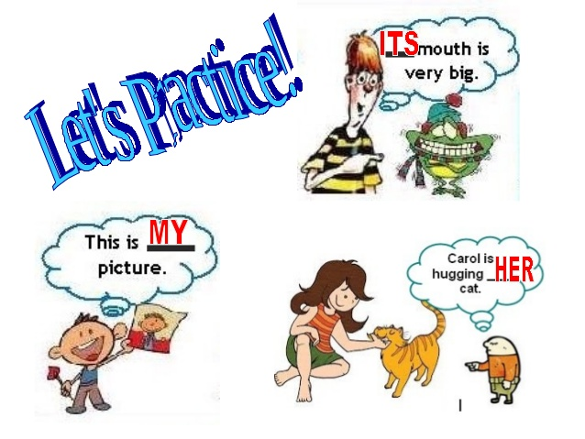

Slide 17

QA

