Slide 1
Python Class and Object
Shashikant Pattar
V1.0
Date 09-12-2015
Hour 9

Slide 2
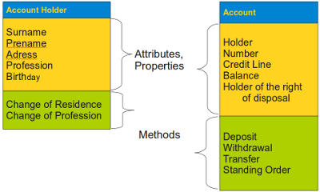
Classes, Objects, Instances
A class defines a data type, which contains variables, properties and methods. A class describes the abstract characteristics of a real-life thing.
There can be instances and objects of classes. An instance is an object of a class created at run-time.

Slide 3
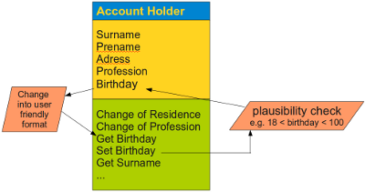
Encapsulation of Data
Important advantage of OOP consists in the encapsulation of data
The terms encapsulation and abstraction (also data hiding) are often used as synonyms
Encapsulation is the mechanism for restricting the access to some of an object's components

Slide 4
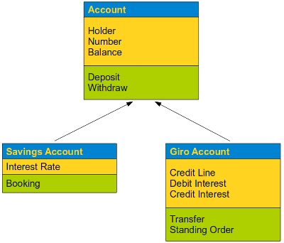
Inheritance
Classes can inherit other classes. A class can inherit attributes and behavior (methods) from other classes, called super-classes. A class which inherits from super-classes is called a Sub-class. Super-classes are sometimes called ancestors as well. There exists a hierarchy relationship between classes.

Slide 5
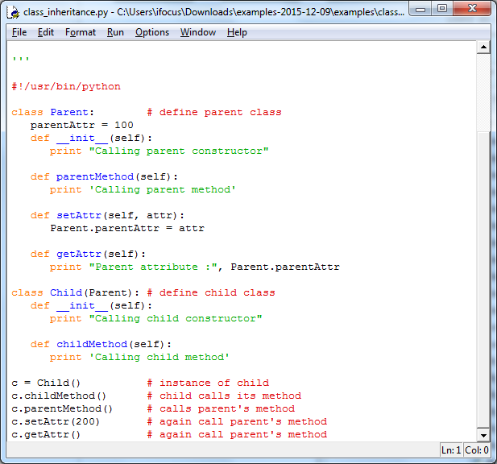
Inheritance

Slide 6
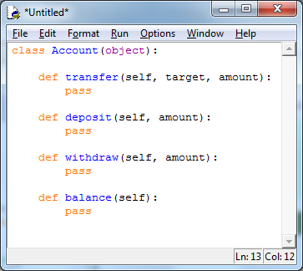
Definition of Methods
A method differs from a function only in two aspects:
it belongs to a class and it is defined within a class
the first parameter in the definition of a method has to be a reference "self" to the instance of the class
a method is called without this parameter "self"

Slide 7
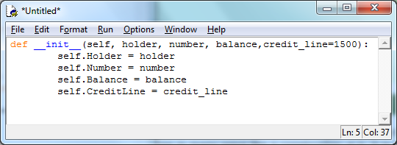
Constructor
Explicit constructors like C++ or Java, but the __init__() method in Python is something similar
It is the first code which is executed, when a new instance of a class is created

Slide 8
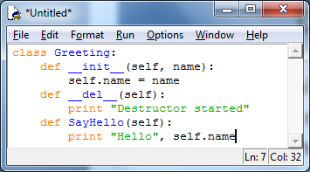
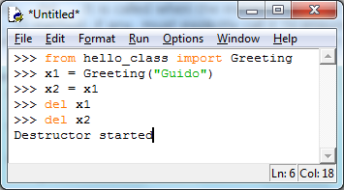
Destructor
There is no "real" destructor, but something similiar, i.e. the method __del__. It is called when the instance is about to be destroyed

Slide 9
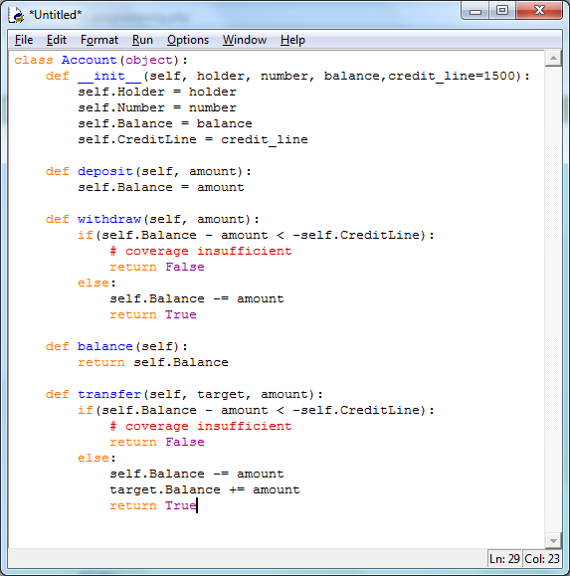
Complete Listing of the Account Class

Slide 10
Data Encapsulation
If an identifier doesn't start with an underscore character "_" it can be accessed from outside, i.e. the value can be read and changed
Data can be protected by making members private or protected.
private data __A can be accessed by the following name construct: instance_name._classname__A.
Name | Notation | Behaviour
name | Public | Can be accessed from inside and outside
_name | Protected | Like a public member, but they shouldn't be directly accessed from outside.
__name | Private | Can't be seen and accessed from outside

Slide 11
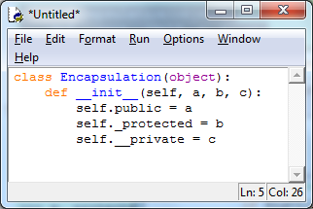
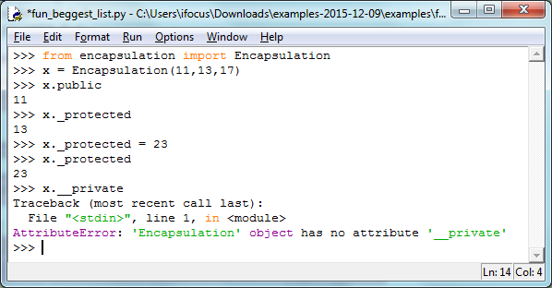

Slide 12
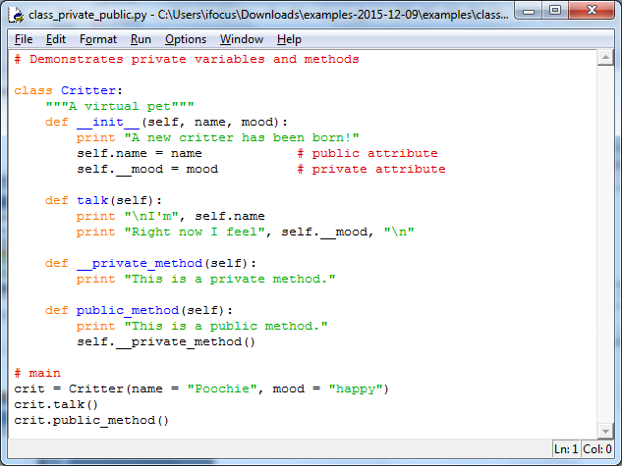
Continue ….

Slide 13
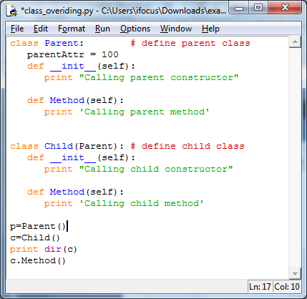
Overriding
What is overriding? Overriding is the ability of a class to change the implementation of a method provided by one of its ancestors.

Slide 14


Slide 15

QA

