Slide 1

Python Crash Course Random Module
Shashikant Pattar
V1.0
Date 12-12-2015
Hour 9

Slide 2
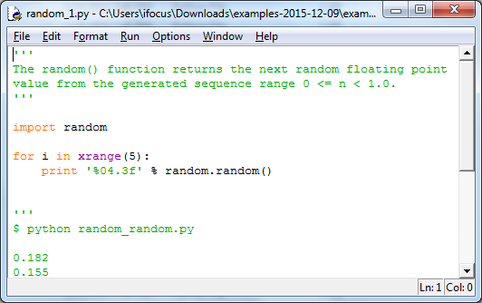
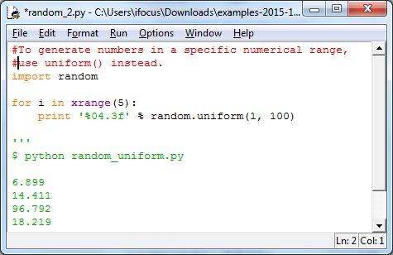
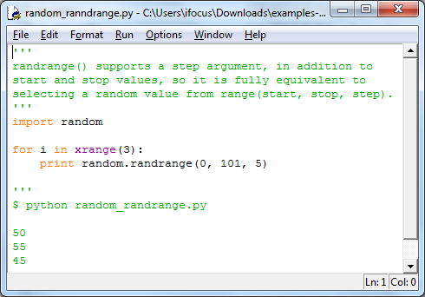
random

Slide 3
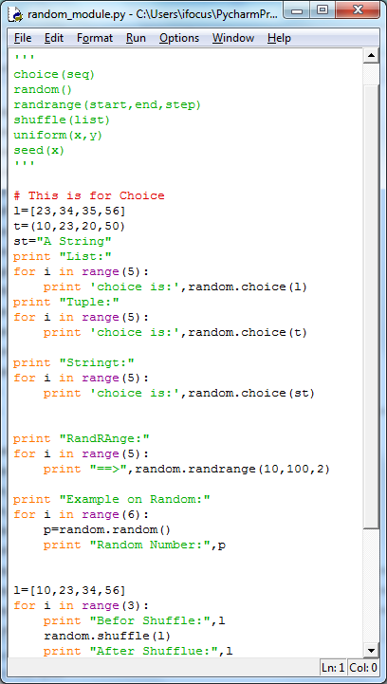
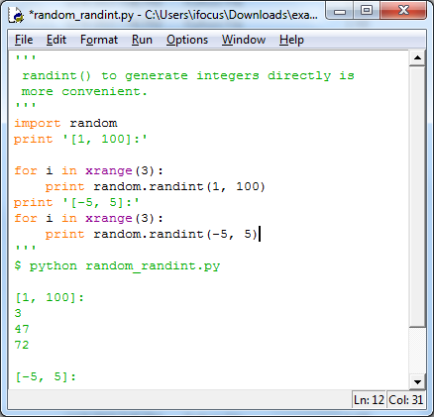
Choice
Random
randint
Randrange
Shuffle
uniform

Slide 4
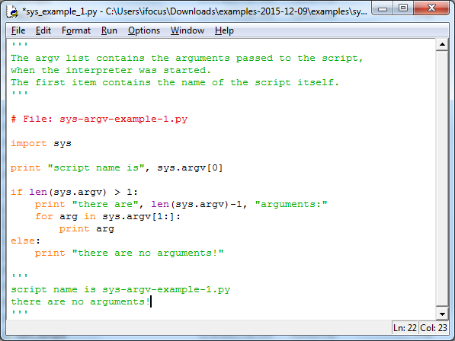
Sys module
The argv list contains the arguments passed to the script,when the interpreter was started.
The first item contains the name of the script itself

Slide 5
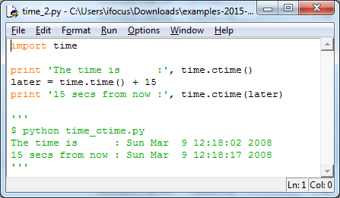
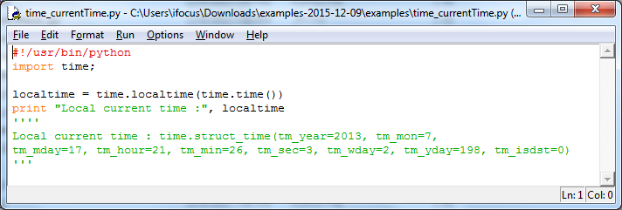
Time Module
Time.ctime()
Time.localtime

Slide 6
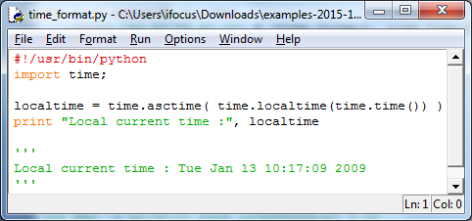
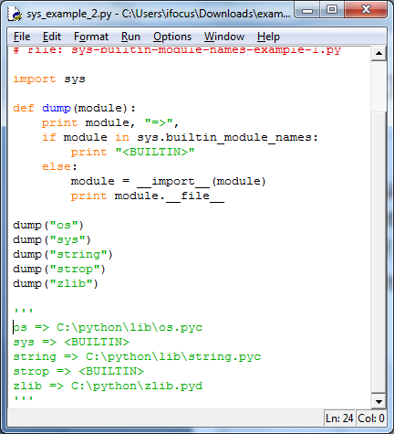
Time continue ..
The builtin_module_names list contains the names of all modules built into the Python interpreter.

Slide 7
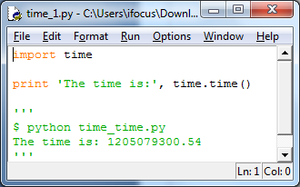
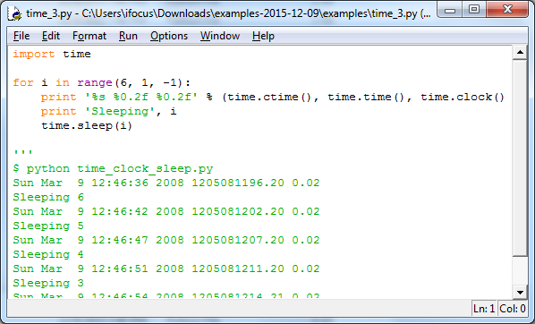
Time continue …
Time.time()
Time.sleep(sec)

