Slide 1
Ph.D. Dissertation Presentation
Federated Learning over Wireless Networks: Incentive Design and Game-theoretic Analysis
Advisor: Choong Seon Hong, Ph.D.
Shashi Raj Pandey
Department of Computer Science and Engineering
Kyung Hee University, Republic of Korea
May 6, 2021

Slide 2
Outline
Introduction
Background
Motivation and Problem Statement
Methodology
Research Contributions
Research Proposal I: Incentive Design to enable participation for Federated Learning
A Crowdsourcing Framework for On-Device Federated Learning
Research Proposal II: Hierarchical Learning Infrastructure to Perform Federated Analytics
Edge-assisted Democratized Learning towards Federated Analytics
Conclusions and Future Research Directions

Slide 3
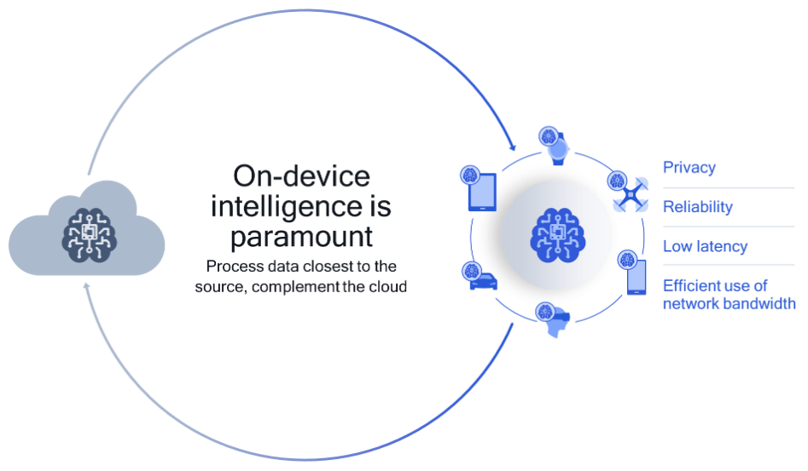
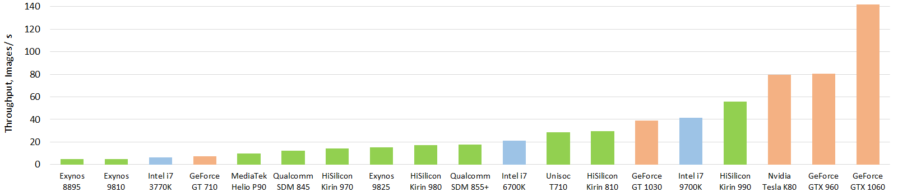
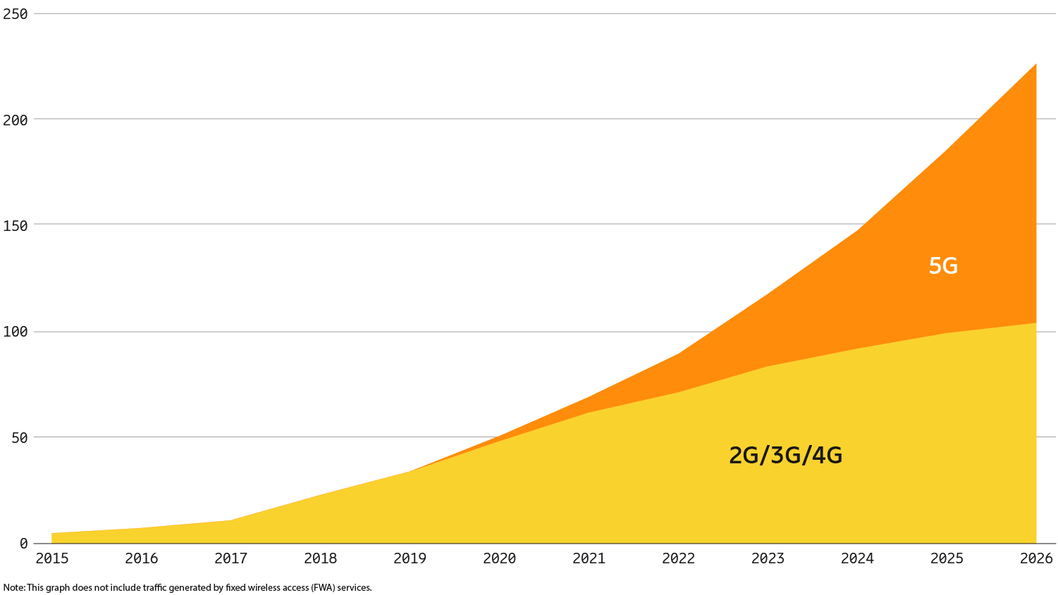




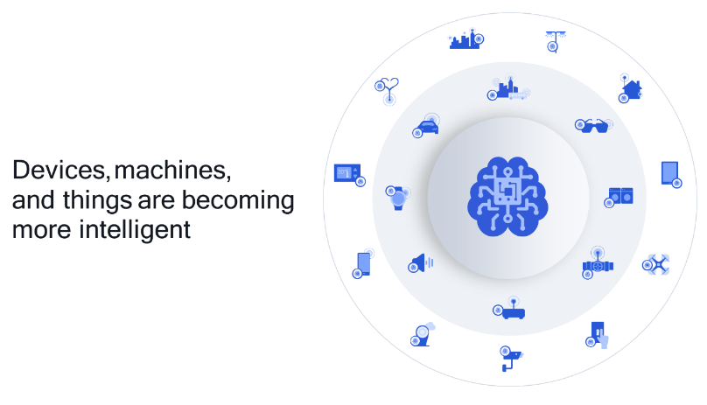






Introduction: Background
Avenues of On-Device Intelligence
Modern powerful processors: System-on-a-Chip (SOCs)
http://ai-benchmark.com/
Source: qualcomm.com/news/
Data Privacy!!!
“analyze and learn from distributed data among devices without exposing that data”
On-Device Intelligence
Massive “distributed” data: private, personalized!!
Large-scale connectivity: hundreds/thousands of online UEs
Source: qualcomm.com/news/

Slide 4
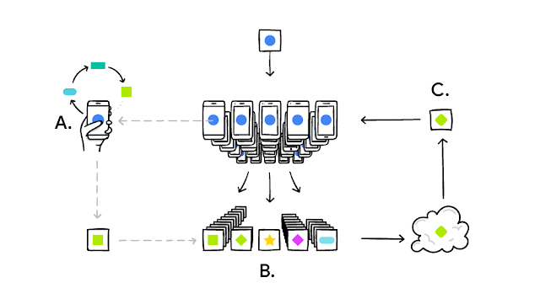
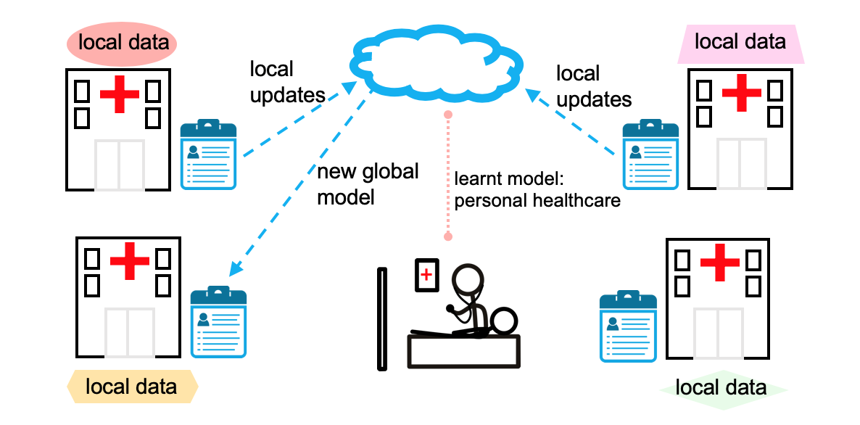
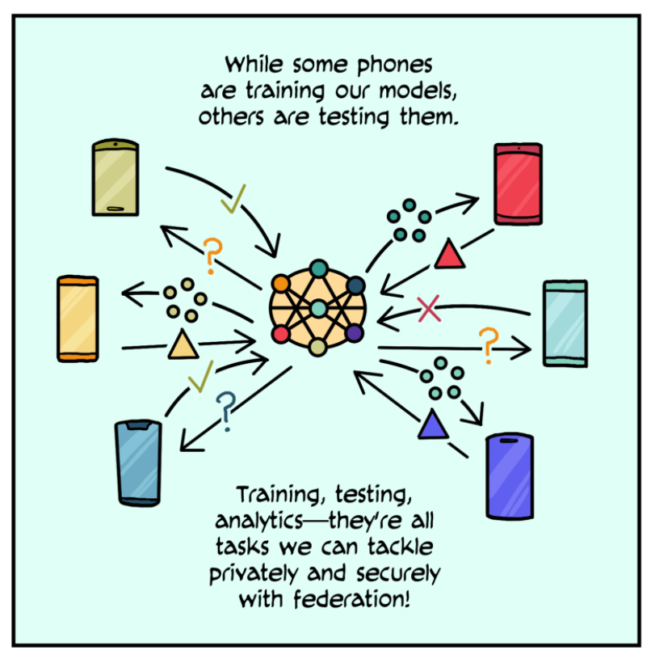
Introduction: Background
Federated Learning (FL)
A privacy-preserving framework for training models in settings where the data is distributed across many clients.
The model training is distributed over mobile users (participating clients; UEs) without actual data transfer to a central server (but only model parameters).
Each mobile contributes to the learning model by independently computing the gradient and local model parameters based on its available training data.
https://ai.googleblog.com/2017/04/federated-learning-collaborative.html
Your phone personalizes the model locally, based on your usage (A). Many users' updates are aggregated (B) to form a consensus change (C) to the shared model, after which the procedure is repeated.
https://www.eetimes.com/federated-learning-demands-more-programmable-hardware/
FL working in a healthcare environment
https://federated.withgoogle.com
Federated Analytics (FA)

Slide 5
Introduction: Background
Challenges of FL over Wireless Networks: poor model quality, resources management, large training time
Challenges of FL over Wireless Networks
[[,[II]]
[[,[I, , II]]
[[,[I, , II]]
Statistical heterogeneity
System-level heterogeneity
Communication bottlenecks
non-i.i.d. data
unbalanced dataset
personalized data
hardware capabilities
computing power
storage/memory
limited wireless resources
intermittent connectivity
dynamic channel conditions
Privacy concerns
[[,[I, , II]]
exposed local parameters
adversary nodes
compromised aggregator
Algorithmic design
[[,[I]]
convergence time
model size
network topology
aggregation methods
computation-communication methods
optimization
Clients selection
stragglers
free-riding problem
adversary nodes
long-term stay
[I] Proposal I: A Crowdsourcing Framework for On-Device Federated Learning (IEEE TWC)
[II] Proposal II: Edge-assisted Democratized Learning Towards Federated Analytics (IEEE IOTJ)

Slide 6
Introduction: Motivation and Problem Statement
Problem Statement: How to train a high-quality, communication-efficient decentralized machine learning model over heterogeneous wireless networks?
Federated Learning over Wireless Networks
How can we motivate a number of participating clients to enable FL?
Communication efficiency: clients perform uncoordinated computation strategy.
Limited data per device; untapped private data.
Hierarchical Learning Infrastructure to Perform Federated Analytics
How to unleash a viable infrastructure for FA other than FL leveraging distributed MEC infrastructures at different regional levels when designing distributed model training architecture?
How to realize a more practical, robust and flexible learning structure towards improving generalization that accommodates heterogeneous learning UEs, results fast knowledge acquisition time, and ensures better FA?
Solution: Self-organizing hierarchical learning structure of Dem-AI [1]
Problem: Users association and network resource allocations for parameters exchange in a HetNet topology
[1] M. N. H. Nguyen, Shashi Raj Pandey, K. Thar, N. H. Tran, M. Chen, W. Saad, and C. S. Hong, “Distributed and democratized learning: Philosophy and research challenges,” IEEE Computational Intelligence Magazine 2021.

Slide 7
Introduction: Methodology
Communication-efficient participatory framework: interactions between clients and the aggregator (MEC)
system-level heterogeneity
MEC’s utility maximization (in terms of model accuracy)
uncoordinated local computation strategies of clients
dynamic wireless channel conditions
incentivize to spur collaboration and align responses
Leader-followers game (Stackelberg game)
larger global iterations to convergence
Participants utility maximization (in terms of offered reward)
clients selection
non-cooperative game
Challenges [information asymmetry]
Incentive Design
Objective
[IEEE TWC, IEEE Communications Magazine, IEEE GLOBECOM 2019]

Slide 8
Introduction: Methodology
Hierarchical learning structure for FA: model aggregations in multiple level and better generalization
statistical heterogeneity
SBSs utility maximization (in terms of overall learning time)
system-level heterogeneity
self-organizing hierarchical structure, knowledge transfer, and optimal UEs-SBSs pairing
two-sided many-to-one matching game
decentralized operations
distributed resource management with stability
self-organized, low-complexity, sub-optimal solutions
dynamic wireless channel conditions
hierarchical aggregation
UEs utility maximization (in terms of latency experience)
fast knowledge acquisition
Challenges
practical edge-assisted hierarchical network architecture
Objective
[IEEE IoTJ, IEEE Computational Intelligence Magazine]

Slide 9
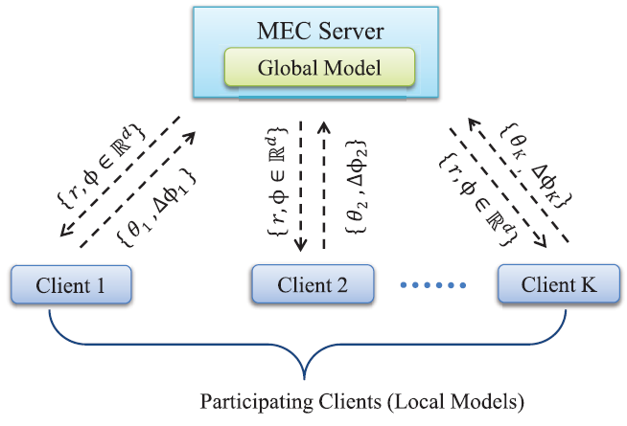
Introduction: Research Contributions
Proposed Solution I
To motivate a number of participating clients to enable a communication-efficient FL.
Proposed the first participatory method as a utility maximization problem to enable computation and communication cost effective FL.
Designed an incentive mechanism to reveal the iteration strategy of mobile clients for improving the global model: a two-stage Stackelberg game.
Developed a linear-complexity algorithm following the best-response dynamics to achieve the equilibrium.
Introduce an admission control strategy to determine threshold accuracy for participation.
r : reward rate ($/accuracy level)
Փ : global change in model
θ : local relative accuracy (duality gap)
∆Փ : local model parameters

Slide 10
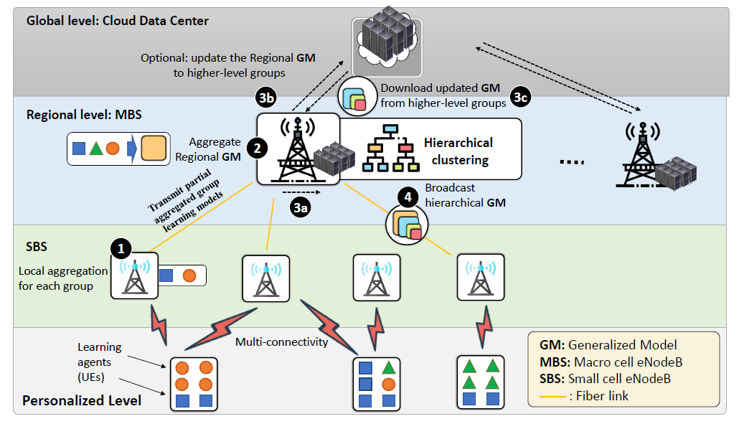
Introduction: Research Contributions
Proposed Solution II
To develop a more robust and flexible model training mechanism that results in a hierarchical architecture, which is the “best-suited” for meeting both the FA and learning objectives.
Proposed an edge-assisted hierarchical learning structure, namely Edge-DemLearn, which acts as a practical framework to empower generalization capability in support of FA with distributed control and aggregation.
Developed an optimization problem to handle joint decision on users association and network resource allocations, i.e., communication and computing resources, for exchanging learning models
Developed a workflow to derive a low-complexity solution to the optimization problem.
Exploited a sub-optimal two-sided many-to-one matching algorithm to handle combinatorial constraints in Edge-DemLearn.

Slide 11
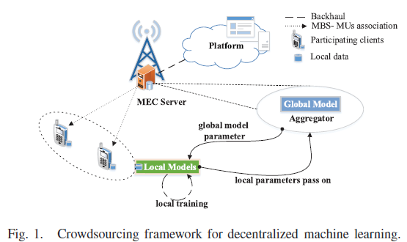
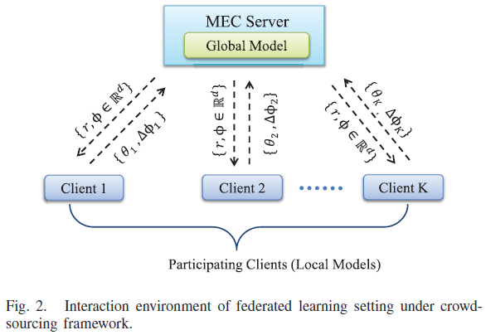
Research Proposals I (1/6)
System Model
r : reward rate ($/accuracy level)
Փ : global change in model
θ : local relative accuracy (duality gap)
∆Փ : local model parameters
Set of participating clients in the crowdsourcing framework aims to solve a learning problem in a distributed manner (FL scheme): [primal-dual solution]
Local computations at the devices and their communication with the centralized coordinating server are interleaved in a complex manner to build a global learning model.
Clients are strategic, perform uncoordinated computations (local iterations); and thus hurting communication-efficient FL: how to align their responses? -> incentivize!

Slide 12

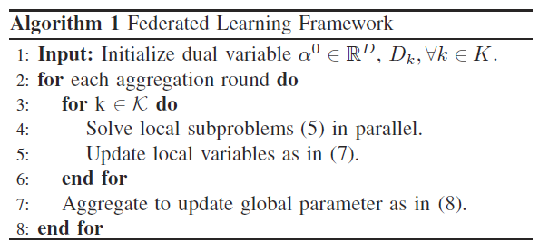


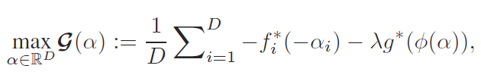







Research Proposals I (2/6)
Global learning problem:
local loss
Corresponding dual optimization problem:
convex conjugates of f and g
dual variable
global relative accuracy
Approximate solution to local problem:
local relative accuracy

Slide 13
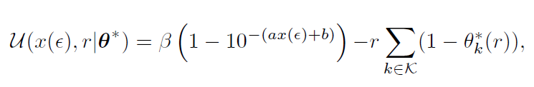

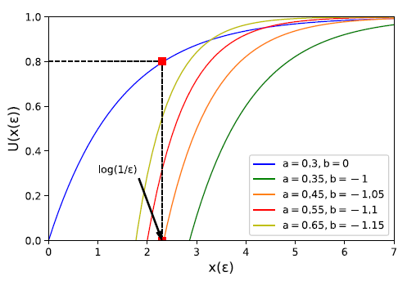
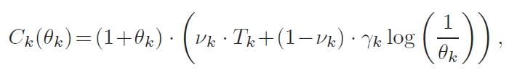
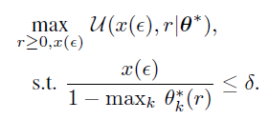


Research Proposals I (3/6)
Incentive mechanism for client’s participation
Stackelberg game!!
Leader
Follower
MEC Server Utility Model
(Rational) Client’s Utility Model
system parameter
reward rate
time required per communication
normalized monetary weight
cost to incentivize
trade-off!
For a given $ε,$ larger $θ_{k}$ exerts more global iterations.
total cost of participation
computation cost per global iteration
convex function!
worst case response

Slide 14

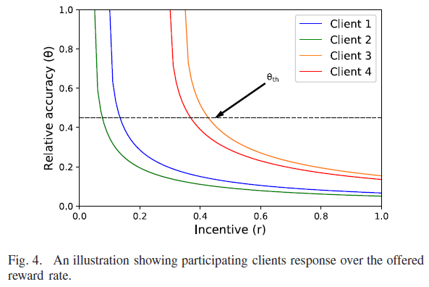

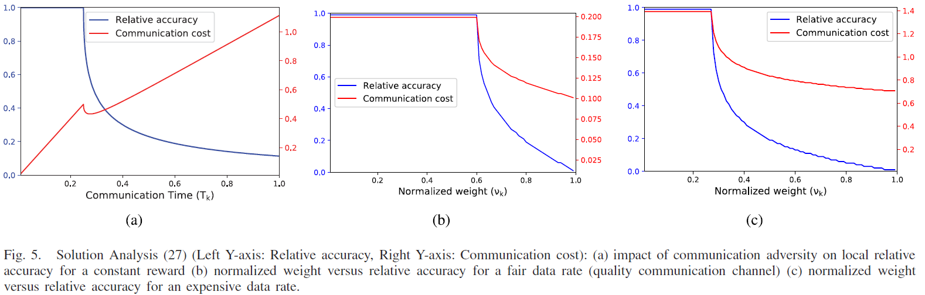
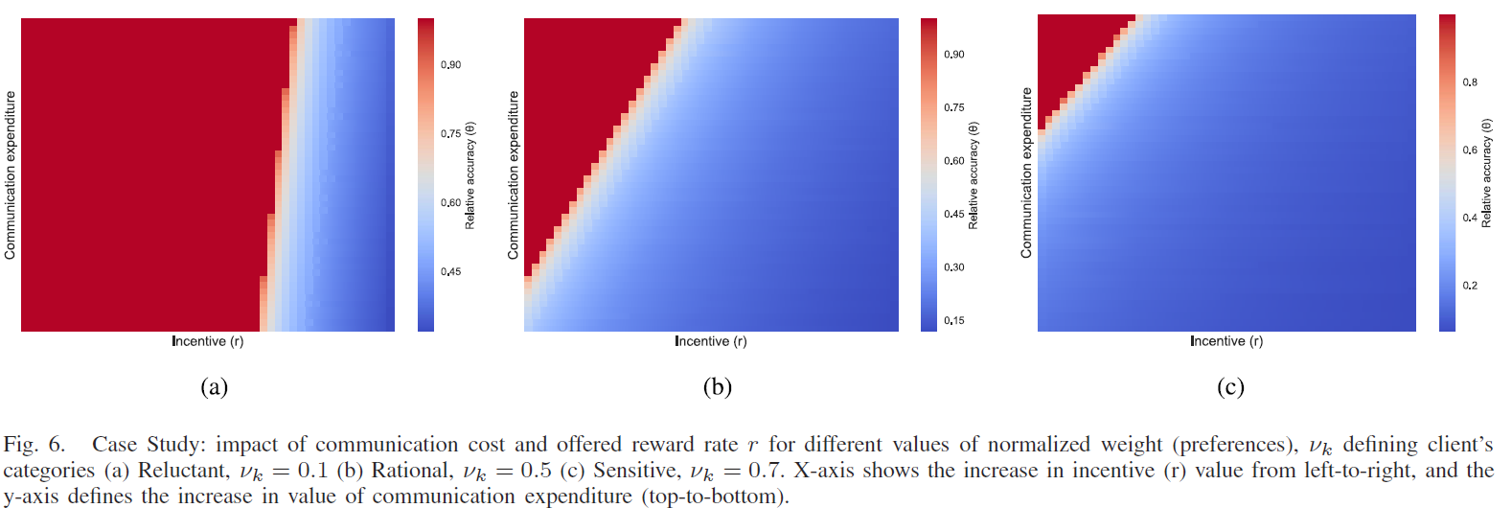
Research Proposals I (4/6)
Best response of client k:
client selection criteria [Remark 1.]
[Lemma 2.]
heterogeneity in clients’ response

Slide 15

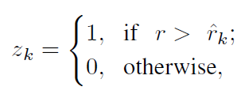
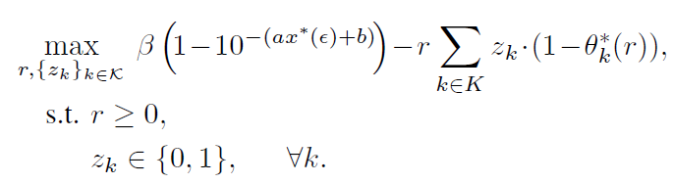
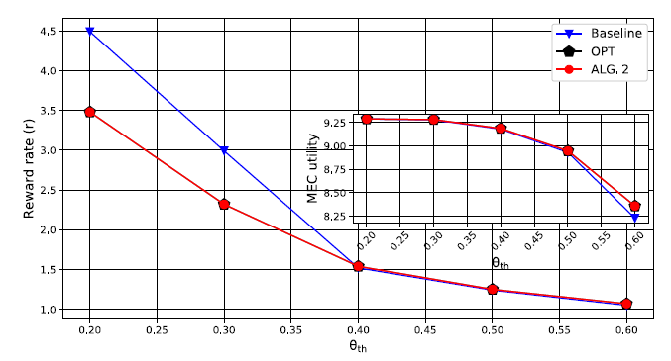
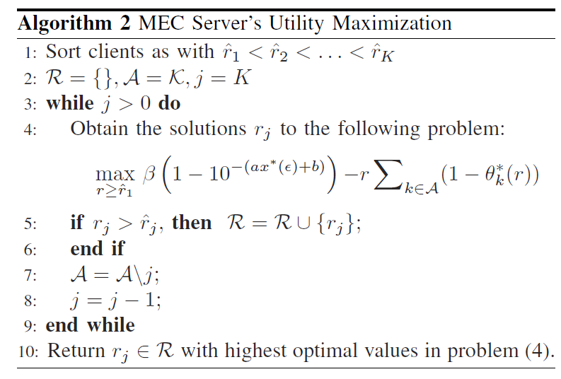
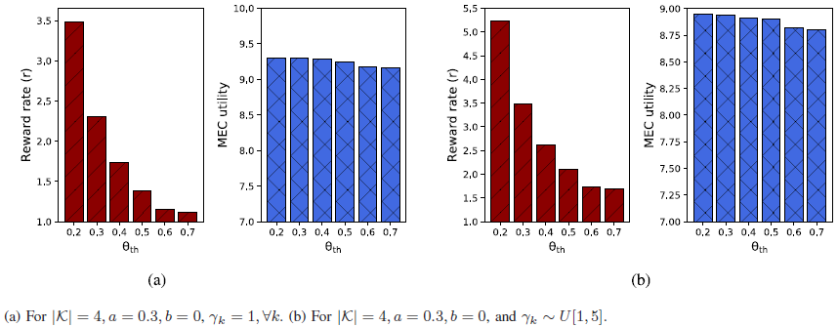
Research Proposals I (5/6)
Equivalent utility maximization problem
22% gain in the offered reward to attain a level of target accuracy!
client selection criteria
mixed-boolean programing (exponential-complexity!)
Reward rate: comparison result for different level of local accuracy.
linear-complexity [Proposition 1]
maintains consensus accuracy [Remark 1]
Impact of γ on reward rate and utility

Slide 16
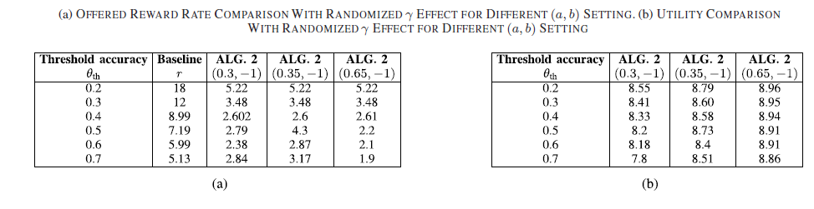

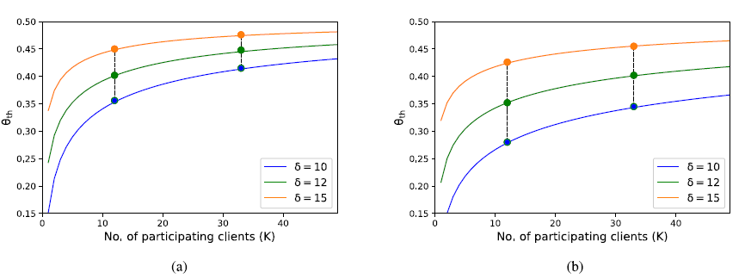


Research Proposals I (6/6)
Comparative study on randomization of γ on reward rate and utility
Threshold accuracy estimation: an admission control strategy
Impact of δ for a = 0.35, b =-1, and a = 0.45, b= -1.05: Smaller threshold captures the efficacy of our proposed framework

Slide 17
Research Proposals II (1/9)
System Model
A two-layer heterogeneous network (HetNet) topology with a single macrocell eNodeB (MBS) at layer 2 and a set of overlaid small cell eNodeBs (SBSs). [multi-connectivity scenario]
Set of UEs associated with SBSs and logical learning groups based on the similarities in learning characteristics. [model weights, gradients]
Problem: Network resources are shared, and needs to be optimized, to get UEs execute self-organizing, hierarchical, distributed model training paradigm of Dem-AI[1] for training high-quality model with better generalization abilities.
The objective: (between UEs and SBSs) joint association and resource allocation design in HetNet towards FA: minimize overall learning time. [fast knowledge acquisition]
[1] M. N. H. Nguyen, Shashi Raj Pandey, K. Thar, N. H. Tran, M. Chen, W. Saad, and C. S. Hong, “Distributed and democratized learning: Philosophy and research challenges,” IEEE Computational Intelligence Magazine 2021.

Slide 18





Research Proposals II (2/9)
Learning problem at UE n associated with logical group g :
hierarchical clustering
Group learning problem:
personalized learning objective in the hierarchical learning structure
Hierarchical Model aggregation:
levels
2-level aggregation (SBSs: partial, MBS: in-group and intra-group)
The subgroups which have more number of UEs have higher impact to the generalized model at level-2.

Slide 19






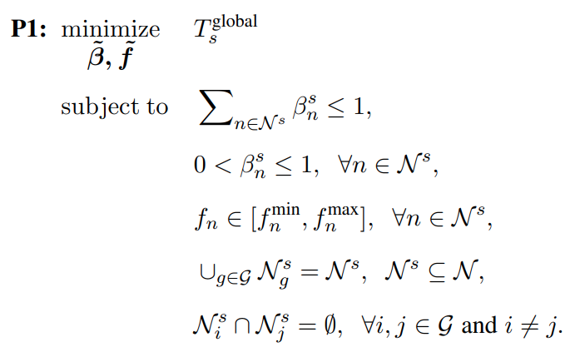
Research Proposals II (3/9)
General optimization framework to minimize overall latency at layer-1 of SBS s :
resource budget
resource allocation
local computation capacity
all UEs participation
one UE in one logical learning group

Slide 20



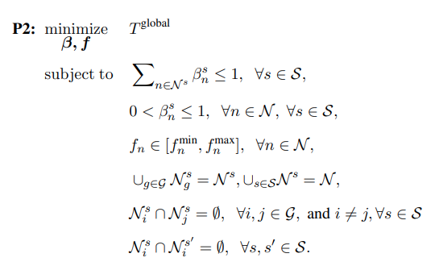
Research Proposals II (4/9)
Edge-assisted Democratized Learning: minimize overall all-group global learning time in 2-layer HetNet architecture:
resource budget
resource allocation
local computation capacity
all UEs participation
one UE in one logical learning group
single association of UE with the SBS
Combinatorial: NP-hard!

Slide 21
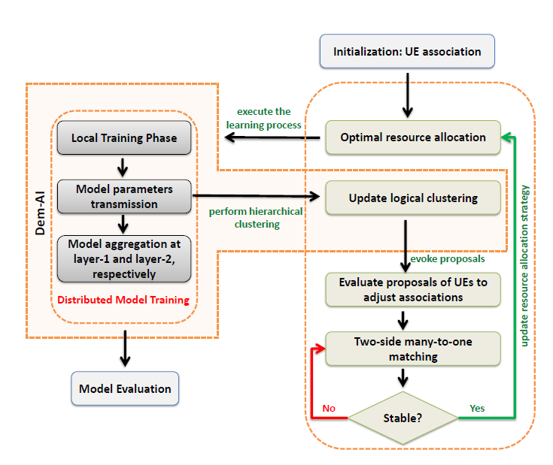



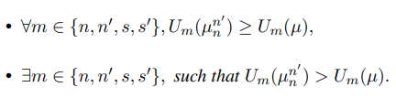
Research Proposals II (5/9)
Proposed Solution: two-sided many-to-one matching game with externalities
Utilities of UEs:
SBSs utility for UE n :
Preference relation for any SBS s over set of UEs:
Swap matching: [Definitions 3 and 4]
Overview of Edge-DemLearn
Near-optimal solution: low-complexity!

Slide 22
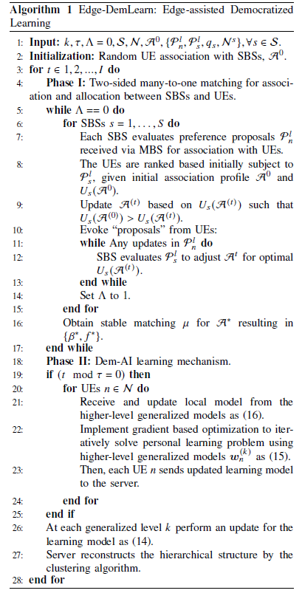
Research Proposals II (6/9)
initial profiling based of RSRP
proposals for swapping
association adjustments between UEs and SBSs
2-level aggregation
updates in the logical groups following hierarchical clustering

Slide 23
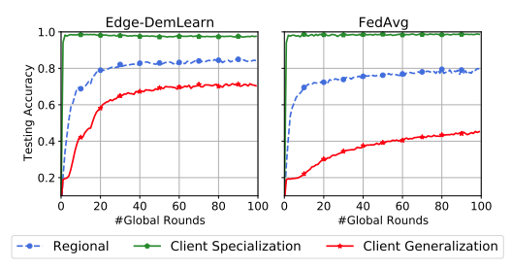
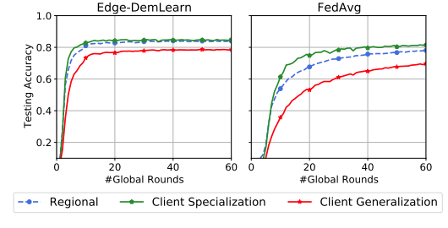
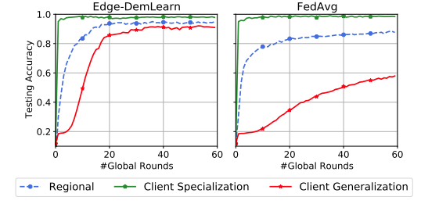
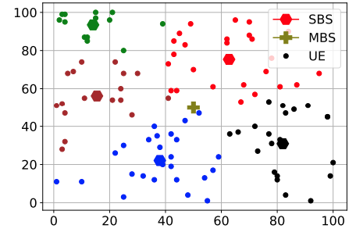
Research Proposals II (7/9)
Learning performance comparision of Edge-DemLearn and FedAvg for N= 50 on (i) FEMNIST, (ii) Fashion-MNIST and (iii) MNIST.
Snapshot of the network model.

Slide 24
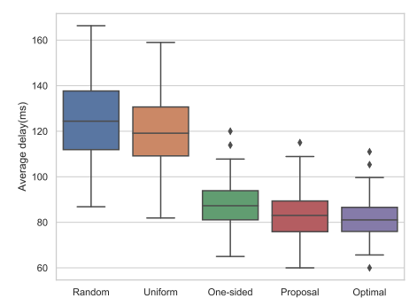
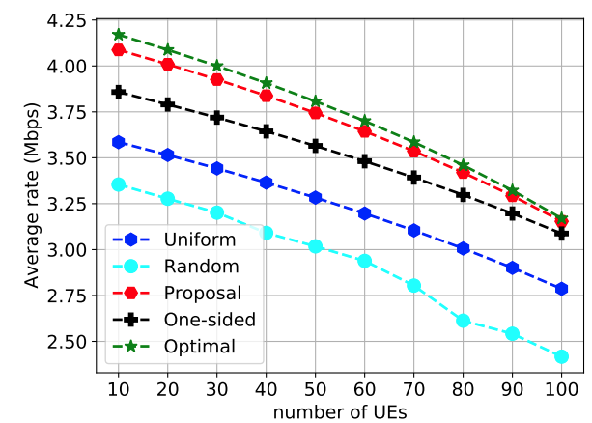
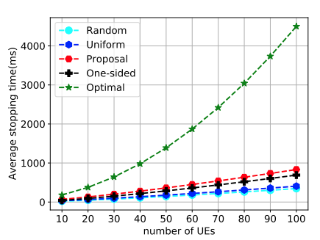
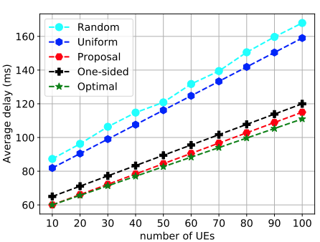
Research Proposals II (8/9)
2.46%
1.8%
45.1%
47.2%
Comparative study on total delay analysis (S= 5, N = 100)
Comparative study on average rate
Comparative study on average delay
Comparative study on average stopping time

Slide 25
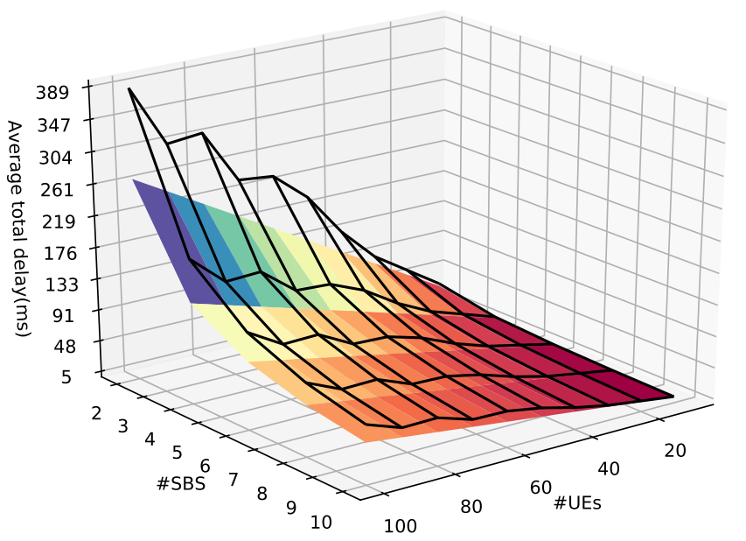
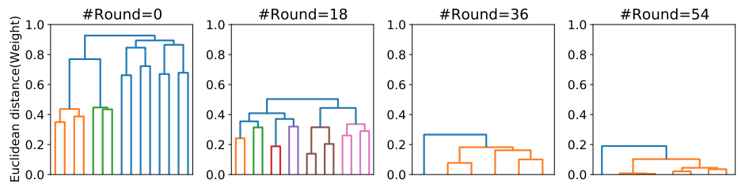
Research Proposals II (9/9)
Snapshot of the logical clustering mechanism at different rounds during model training
Qualitative analysis of average total delay vs. the number of SBS vs. the number of UEs.

Slide 26
Conclusion and Future Direction
 | To address the challenge of clients participation in building a high-quality global model with communication efficiency in FL, we propose an incentive mechanism and admission control strategy applying two-stage Stackelberg game. In future work, we aim to evaluate clients personalization with differentiated pricing mechanism.
 | To realize a more practical, robust and flexible learning structure towards improving generalization that accommodates heterogeneous learning UEs, results fast knowledge acquisition time, and ensures better FA, we propose a novel edge-assisted hierarchical learning structure, namely Edge-DemLearn, in which we apply two-sided matching game for jointly optimizing users association and network resource allocations. In future work, we aim to apply Edge-DemLearn as a distributed learning tool to solve various persisting challenges in wireless networks, such as regional intelligence for database management.
 | With extensive simulation and analysis, the result show that our proposals can resolve challenges related to decentralized machine learning over wireless networks.
Federated Learning over Wireless Networks: Incentive Design and Game-theoretic Analysis

Slide 27
List of Publications
No. | Journals | IF | Section
1 | Shashi Raj Pandey, Nguyen H. Tran, Mehdi Bennis, Yan Kyaw Tun, Aunas Manzoor, and Choong Seon Hong. "A crowdsourcing framework for on-device federated learning." IEEE Transactions on Wireless Communications 19, no. 5 (2020): 3241-3256. | 6.799 | SCIE
2 | Shashi Raj Pandey*, Latif U. Khan*, (co-first author, equal contribution), Nguyen H. Tran, Walid Saad, Zhu Han, Minh NH Nguyen, and Choong Seon Hong. "Federated learning for edge networks: Resource optimization and incentive mechanism." IEEE Communications Magazine 58, no. 10 (2020): 88-93. | 11.052 | SCIE
3 | Shashi Raj Pandey, Kitae Kim, Madyan Alsenwi, Yan Kyaw Tun, Zhu Han, and Choong Seon Hong. "Latency-sensitive Service Delivery with UAV-Assisted 5G Networks." IEEE Wireless Communications Letters (in press) | 4.66 | SCIE
4 | Shashi Raj Pandey, Minh NH Nguyen, Tri Nguyen Dang, Nguyen H. Tran, Kyi Thar, Zhu Han, and Choong Seon Hong. "Edge-assisted Democratized Learning Towards Federated Analytics." IEEE Internet of Things Journal (Under Revision) | 9.936 | SCIE
5 | Shashi Raj Pandey, Sabah Suhail, Seung Il Moon, Choong Seon Hong, ”Q-Learning Supplemented Response Based Crowdsensing Framework for Resource Constrained Devices”KIISE Transactions on Computing Practices, pp.345-351, 2018.07. | -
6 | Nguyen, Minh NH, Shashi Raj Pandey, Kyi Thar, Nguyen H. Tran, Mingzhe Chen, Walid Saad, and Choong Seon Hong. "Distributed and democratized learning: Philosophy and research challenges." IEEE Computational Intelligence Magazine 16, no. 1 (2021): 49-62. | 9.083 | SCIE
7 | Zaw, Chit Wutyee, Shashi Raj Pandey, Kitae Kim, and Choong Seon Hong. "Energy-Aware Resource Management for Federated Learning in Multi-Access Edge Computing Systems." IEEE Access 9 (2021): 34938-34950. | 3.745 | SCIE
8 | Le, Tra Huong Thi, Nguyen H. Tran, Yan Kyaw Tun, Minh NH Nguyen, Shashi Raj Pandey, Zhu Han, and Choong Seon Hong. "An Incentive Mechanism for Federated Learning in Wireless Cellular network: An Auction Approach." IEEE Transactions on Wireless Communications (2021). | 6.799 | SCIE
9 | Alsenwi, Madyan, Nguyen H. Tran, Mehdi Bennis, Shashi Raj Pandey, Anupam Kumar Bairagi, and Choong Seon Hong. "Intelligent resource slicing for eMBB and URLLC coexistence in 5G and beyond: A deep reinforcement learning based approach." IEEE Transactions on Wireless Communications (2021). | 6.799 | SCIE

Slide 28
List of Publications
No. | Journals | IF | Section
10 | Manzoor, Aunas, Kitae Kim, Shashi Raj Pandey, S. M. Kazmi, Nguyen H. Tran, Walid Saad, and Choong Seon Hong. "Ruin theory for energy-efficient resource allocation in uav-assisted cellular networks." IEEE Transactions on Communications (2021). | 5.646 | SCIE
11 | Tun, Yan Kyaw, Yu Min Park, Nguyen H. Tran, Walid Saad, Shashi Raj Pandey, and Choong Seon Hong. "Energy-Efficient Resource Management in UAV-Assisted Mobile Edge Computing." IEEE Communications Letters (2020). | 3.419 | SCIE
12 | Manzoor, Aunas, SM Ahsan Kazmi, Shashi Raj Pandey, and Choong Seon Hong. "Contract-based scheduling of urllc packets in incumbent embb traffic." IEEE Access 8 (2020): 167516-167526. | 3.745 | SCIE
13 | Tun, Yan Kyaw, Anselme Ndikumana, Shashi Raj Pandey, Zhu Han, and Choong Seon Hong. "Joint Radio Resource Allocation and Content Caching in Heterogeneous Virtualized Wireless Networks." IEEE Access 8 (2020): 36764-36775. | 3.745 | SCIE
14 | Alsenwi, Madyan, Ibrar Yaqoob, Shashi Raj Pandey, Yan Kyaw Tun, Anupam Kumar Bairagi, Lok-won Kim, and Choong Seon Hong. "Towards coexistence of cellular and WiFi networks in unlicensed spectrum: A neural networks based approach." IEEE Access 7 (2019): 110023-110034. | 3.745 | SCIE
15 | Tun, Yan Kyaw, Nguyen H. Tran, Duy Trong Ngo, Shashi Raj Pandey, Zhu Han, and Choong Seon Hong. "Wireless network slicing: Generalized kelly mechanism-based resource allocation." IEEE Journal on Selected Areas in Communications 37, no. 8 (2019): 1794-1807. | 11.42 | SCIE
16 | Manzoor, Aunas, Nguyen H. Tran, Walid Saad, SM Ahsan Kazmi, Shashi Raj Pandey, and Choong Seon Hong. "Ruin theory for dynamic spectrum allocation in lte-u networks." IEEE Communications Letters 23, no. 2 (2018): 366-369. | 3.419 | SCIE
No. | International Conferences | Section
1 | Shashi Raj Pandey, Kitae Kim, Madyan Alsenwi, Yan Kyaw Tun, and Choong Seon Hong. "A Crowd-enabled Task Execution Approach in UAV Networks Towards Fog Computing." In 2021 IEEE International Conference on Big Data and Smart Computing (BigComp), pp. 246-251. IEEE, 2021.
2 | Shashi Raj Pandey, Nguyen H. Tran, Mehdi Bennis, Yan Kyaw Tun, Zhu Han, and Choong Seon Hong. "Incentivize to build: A crowdsourcing framework for federated learning." In 2019 IEEE Global Communications Conference (GLOBECOM), pp. 1-6. IEEE, 2019.

Slide 29
List of Publications
No. | International Conferences | Section
3 | Shashi Raj Pandey, Madyan Alsenwi, Yan Kyaw Tun, and Choong Seon Hong. "A downlink resource scheduling strategy for URLLC traffic." In 2019 IEEE International Conference on Big Data and Smart Computing (BigComp), pp. 1-6. IEEE, 2019.
4 | Shashi Raj Pandey, and Choong Seon Hong. "Response driven efficient task load assignment in mobile crowdsourcing." In 2018 International Conference on Information Networking (ICOIN), pp. 442-446. IEEE, 2018.
5 | Madyan Alsenwi, Yan Kyaw Tun, Shashi Raj Pandey, Nway Nway Ei, and Choong Seon Hong. ”Uav-assisted multi-access edge computing system: An energy-efficient resourcemanagement framework.” In 2020 International Conference on Information Networking(ICOIN), pp. 214-219. IEEE, 2020.
6 | Madyan Alsenwi, Yan Kyaw Tun, Shashi Raj Pandey, and Choong Seon Hong. ”A hopfield neural networks based mechanism for coexistence of lte-u and WiFi networks in unlicensed spectrum.” In 2019 20th Asia-Pacific Network Operations and Management Symposium (APNOMS), pp. 1-6. IEEE, 2019. (Student Best Paper Award)
7 | Yan Kyaw Tun, Madyan Alsenwi, Shashi Rai Pandey, Chit Wutyee Zaw, and Choong SeonHong. ”Energy efficient multi-tenant resource slicing in virtualized multi-access edge computing.” In 2019 20th Asia-Pacific Network Operations and Management Symposium (APNOMS), pp. 1-4. IEEE, 2019.
8 | Madyan Alsenwi, Shashi Raj Pandey, Yan Kyaw Tun, Ki Tae Kim, and Choong Seon Hong.”A chance constrained based formulation for dynamic multiplexing of embb-urllc traffics in5g new radio.” In 2019 International Conference on Information Networking (ICOIN), pp.108-113. IEEE, 2019.
9 | Yan Kyaw Tun, Shashi Raj Pandey, Madyan Alsenwi, Chit Wutyee Zaw, and Choong SeonHong. ”Weighted proportional allocation based power allocation in wireless network virtualization for future wireless networks.” In 2019 International Conference on Information Networking (ICOIN), pp. 284-289. IEEE, 2019.
No. | Patents | Remarks
1 | Shashi Raj Pandey, Do Hyeon Kim, and Choong Seon Hong, “Smart Contract-based Method and System for Purchasing Resources for Seamless Media Streaming at Mobile Edge”. Filed. (10-2019-0157099). KIPO. 2019. November. | In progress
2 | Sabah Suhail, Shashi Raj Pandey, Young-ki Kim, and Choong Seon Hong, “Method for Estimating Integrity of Packet in Sensor Network”. Granted. (10-1948214). KIPO. 2019.February. | Granted

Slide 30





Questions & Comments

