Slide 1
Object-Oriented Software Design
Dr. RAJIB MALL
Professor
Department Of Computer Science & Engineering
IIT Kharagpur.

Slide 2

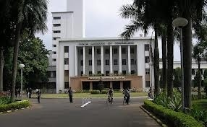
About The Instructor
RAJIB MALL
B.E. , M.E., Ph.D from Indian Institute of Science, Bangalore
Worked with Motorola (India)
  Senior engineer and later project manager
Shifted to IIT, Kharagpur in 1994
  Currently Professor

Slide 3
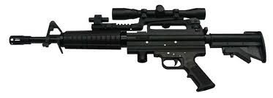


Motivation
You got a sophisticated gun
You were the proud owner of the nice gun!
Wanted to use it…
Opportunity came …
You claimed you are good at using your gun!

Slide 4
Motivation cont…
You learnt Java…
You know the syntax and semantics.
You have written small programs that work.
You claimed you are an expert object-oriented software developer!!
This syndrome is not restricted to students alone…

Slide 5
Plan of The Course
Basic concepts
UML
Object-oriented software development process
Designing using UML
Testing OO programs
Object-oriented principles
Patterns
≈ 50%
≈ 10%
≈ 40%

Slide 6
Introduction
Object-oriented design (OOD) techniques are now extremely popular:
  Inception in early 1980’s and nearing maturity.
  Widespread acceptance in industry and academics.
  Unified Modelling Language (UML) became an ISO standard (ISO/IEC 19501) in 2004.

Slide 7

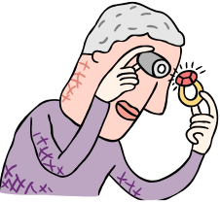


Schematic Object-Oriented Solution for LIS
reference-books
issue-books
members
register

Slide 8
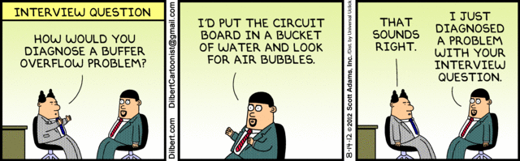

Slide 9

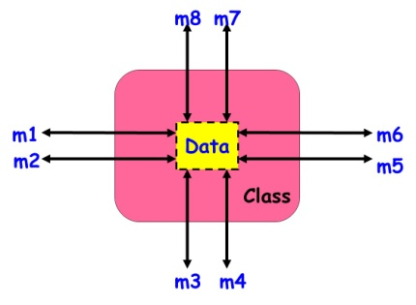
Objects
A system is designed as a set of interacting objects.
Objects are often real-world entities:
    Examples: an employee, a book etc.
  Can also be conceptual objects :
    Controller, manager, etc.
An object consists of data (attributes) and functions (methods) that operate on data.
  Encapsulation.

Slide 10
What is a Data Type?
A data type (or simply type) determines:
  Representation: The way values of variables of that type can be stored.
  Value Space: The possible values for a variable of that type;
  Behavior: The operations that can be applied on variables of that type;

Slide 11
What is a Type System?
A type system associates types with each computed value.
  Seeks to guarantee that operations expecting a certain kind of value are not supplied values which do not make sense.

Slide 12
Strongly vs. Weakly Typed Languages
Liskov and Zilles (1974):
  A strong-typed language is one in which whenever an object is passed from a calling function to a called function, its type must be compatible with the type declared in the called function.
Symptom of Weakly Typed Language:
  A variable may be assigned float, int, string, etc. values: Absence of static type checking
  But, Is there any problem with weakly typed languages?
  Unpredictable result: x = "5" + 6 may be 56 or 11
Dynamic type checking:
  Prevents runtime type error using a type system.

Slide 13
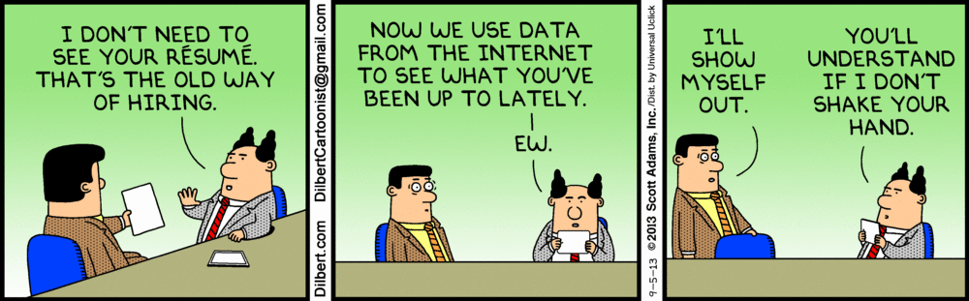

Slide 14
Class Diagram

Slide 15


Class
Template for object creation:
  Instantiated into objects
Examples: Employees, Books, etc.
Sometimes not intended to produce instances:
  Abstract classes

Slide 16
UML Class Representation
A class represents a set of objects having similar attributes, operations, relationships and behavior.
Class Name
Can it have any attributes not explicitly declared?
Window
size: Size
visibility: boolean
Attributes
A class can implicitly have a few association attributes
display()
hide()
Operations

Slide 17
Example UML Classes
LibraryMember
LibraryMember
LibraryMember
Member Name
Membership Number
Address
Phone Number
E-Mail Address
Membership Admission Date
Membership Expiry Date
Books Issued
issueBook( );
findPendingBooks( );
findOverdueBooks( );
returnBook( );
findMembershipDetails( );
issueBook( );
findPendingBooks( );
findOverdueBooks( );
returnBook( );
findMembershipDetails( );
Different representations of the LibraryMember class

Slide 18
Class Attribute Examples
Java Syntax | UML Syntax
Date birthday | Birthday:Date
Public int duration = 100 | +duration:int = 100
Private Student students[0..MAX_Size] | -Students[0..MAX_Size]:Student

Slide 19
Visibility Syntax in UML
Visibilty | Java Syntax | UML Syntax
public | public | +
protected | protected | #
package |  | ~
private | private | -

Slide 20
Methods vs. Messages?
Methods are the operations supported by an object:
  Means for manipulating the data of an object.
  Invoked by sending a message (method call).
  Examples: calculate_salary(), issue-book(), getMemberDetails(), etc.

Slide 21
Method Examples
Java Syntax | UML Syntax
void move(int dx, int dy) | ~move(int dx,int dy)
public int getSize() | +int getSize()

Slide 22
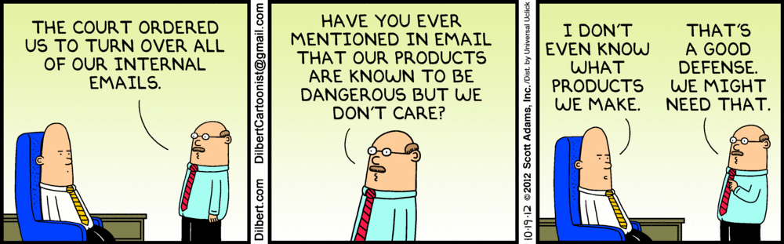

Slide 23
Are Methods and Messages Synonyms?
No
Message was the original concept in object-orientation…
Methods are the later simplifications…
Sometimes used as synonyms

Slide 24
Are Methods and Operations Synonyms?
No
An operation can be implemented by multiple methods.
  Known as polymorphism
  In the absence of polymorphism-–the two terms are used as synonyms.

Slide 25
What are the Different Types of Relationships Among Classes?
Four types of relationships:
  Inheritance
  Association
  Aggregation/Composition
  Dependency

Slide 26
Inheritance
Allows to define a new class (derived class) by extending an existing class (base class).
  Represents generalization-specialization relationship.
  Allows redefinition of the existing methods (method overriding).
LibraryMember
Base Class
Faculty
Students
Staff
Derived
Classes
UnderGrad
PostGrad
Research

Slide 27
Inheritance Example
Animal
“A Dog ISA Animal”
Dog

Slide 28
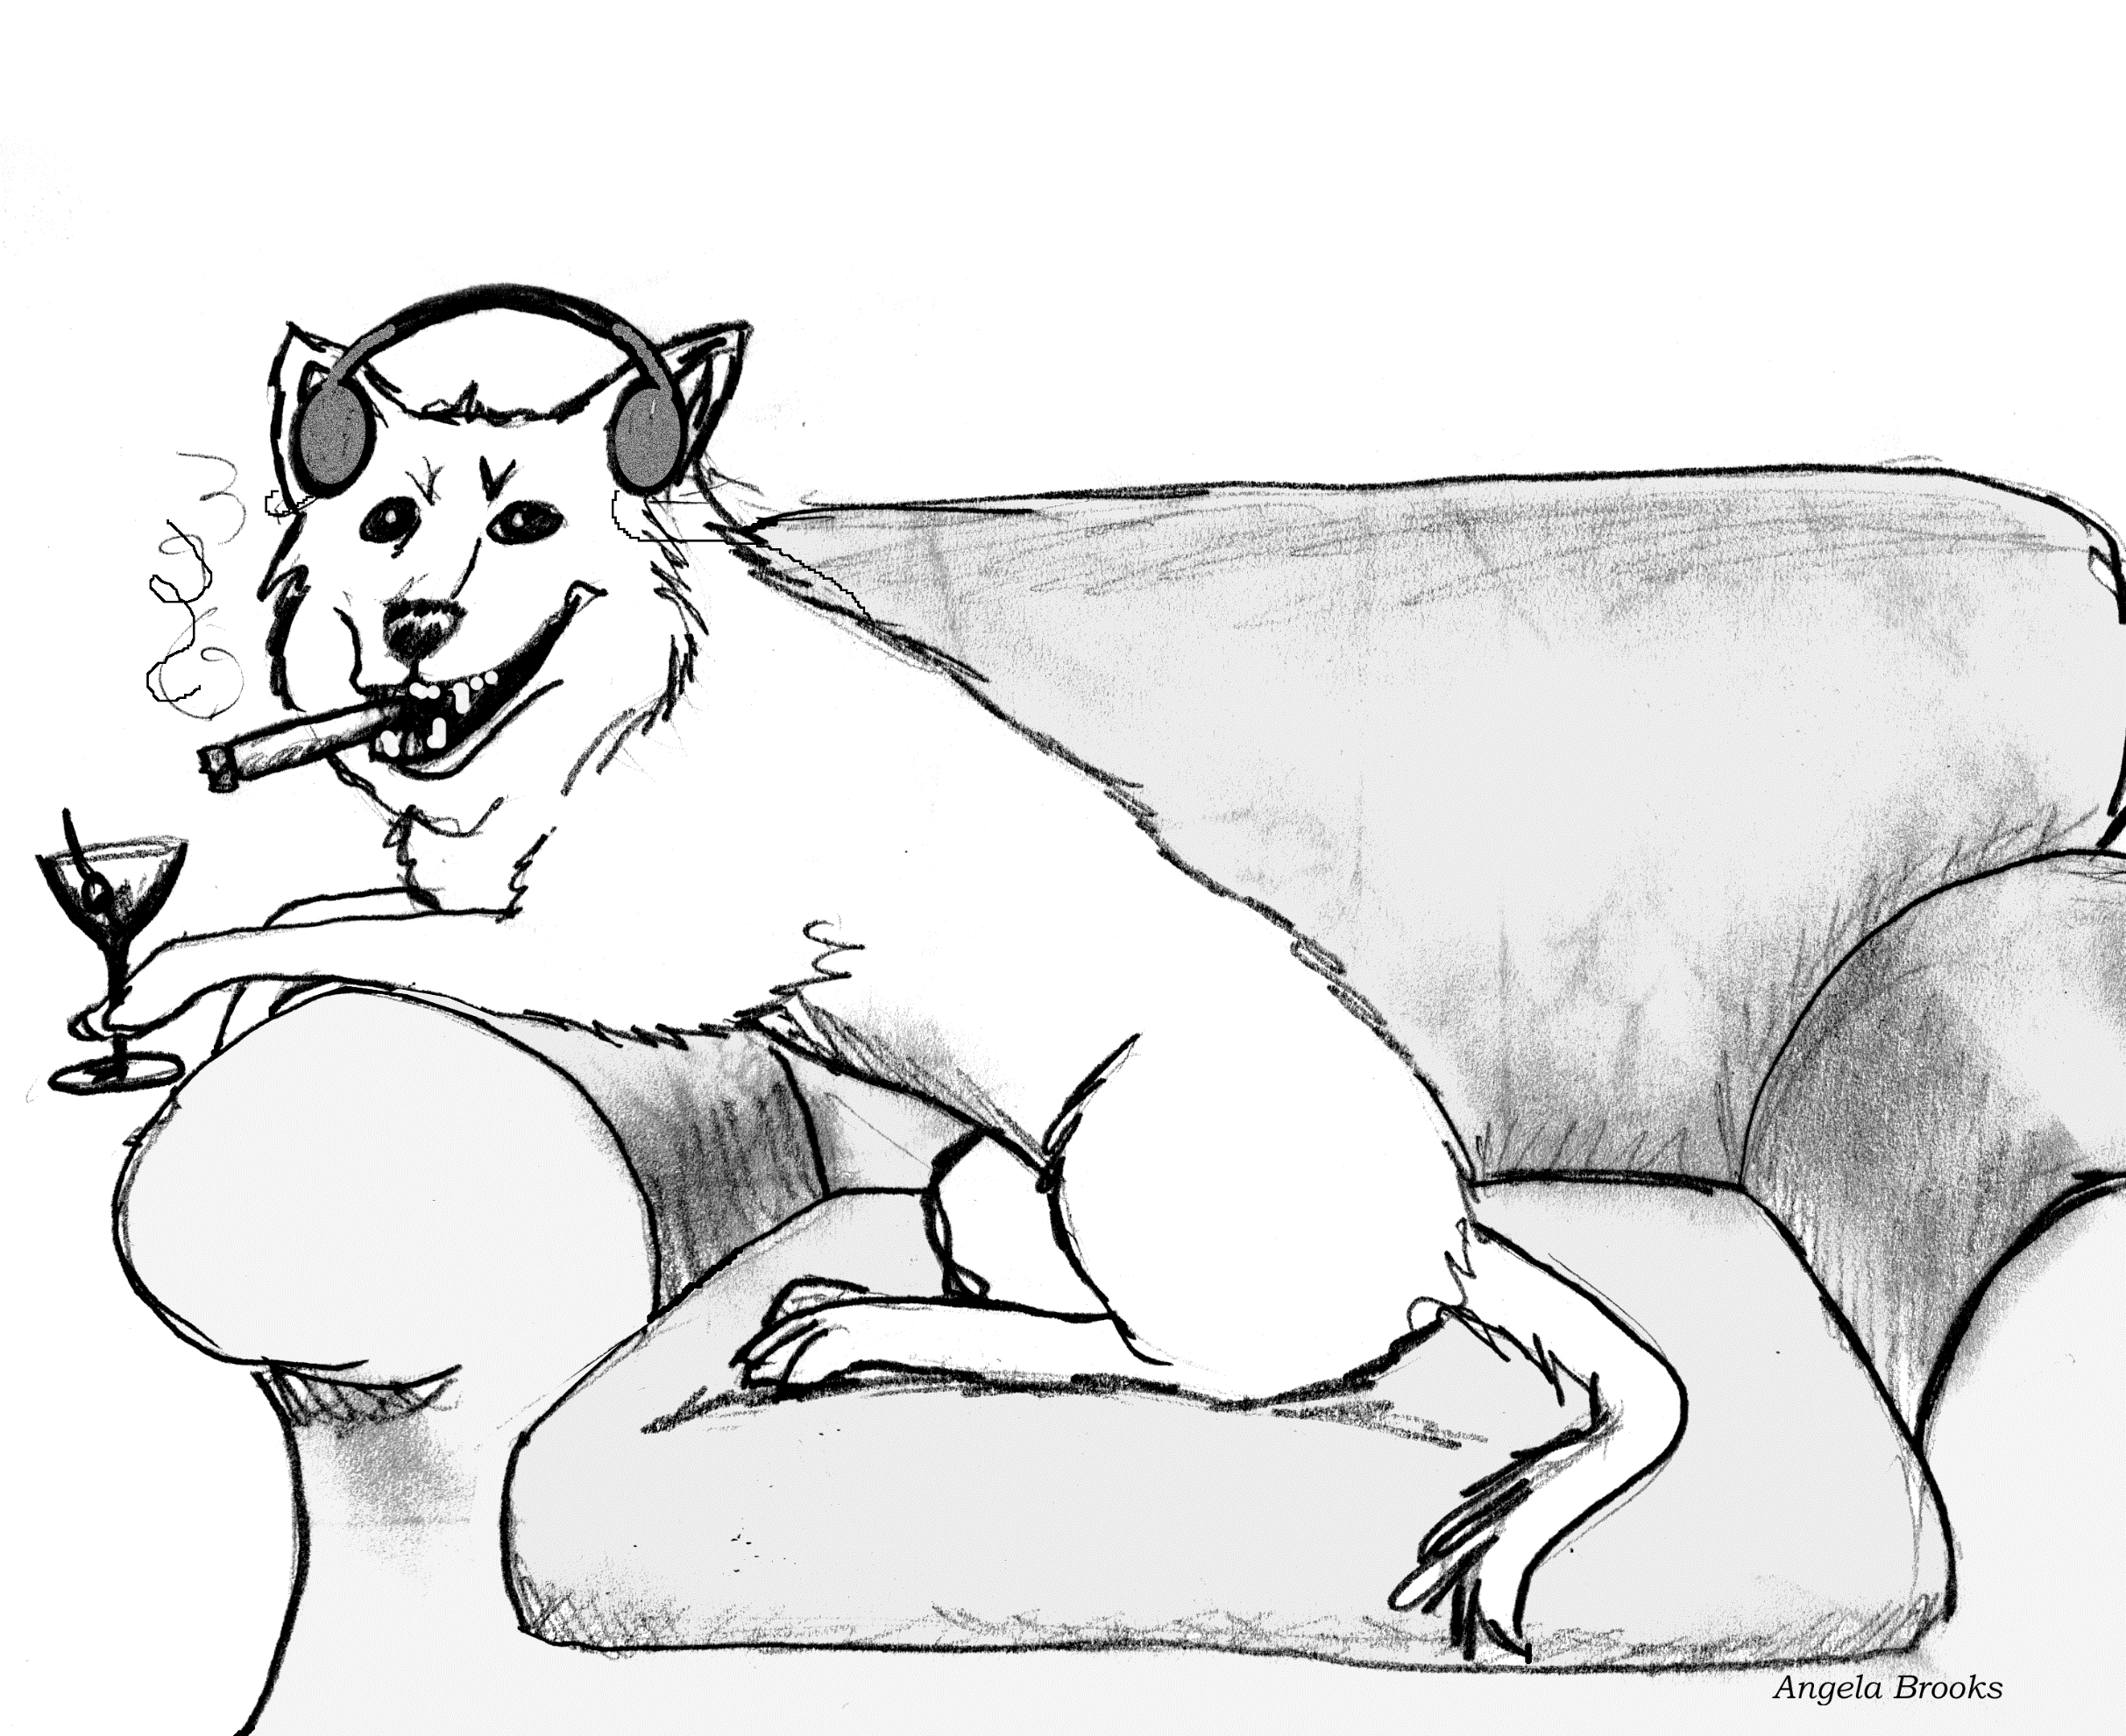
Hmmm… not really…

Slide 29
Inheritance
Lets a subclass inherit attributes and methods from a base class.
LibraryMember
Base Class
Faculty
Students
Staff
Derived
Classes
UnderGrad
PostGrad
Research

Slide 30
Multiple Inheritance cont…
LibraryMember
Base Class
LibraryMember
Base Class
Faculty
Students
Staff
Derived
Classes
Faculty
Students
Staff
Multiple
Inheritance
UnderGrad
PostGrad
Research
UnderGrad
PostGrad
Research

