Slide 1
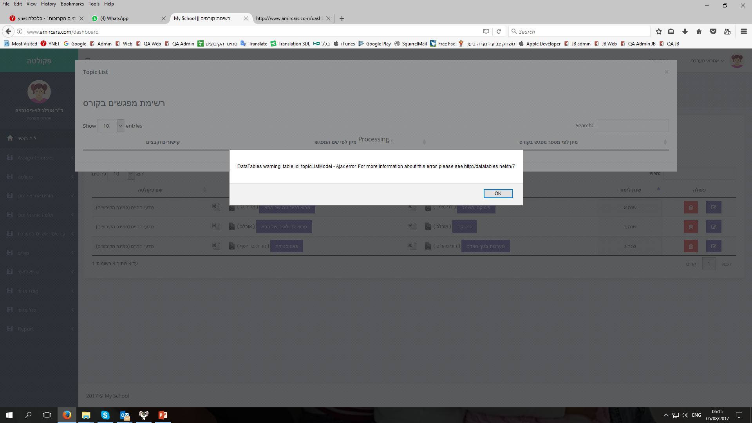
An error that I am getting (NOT all the time)

Slide 2
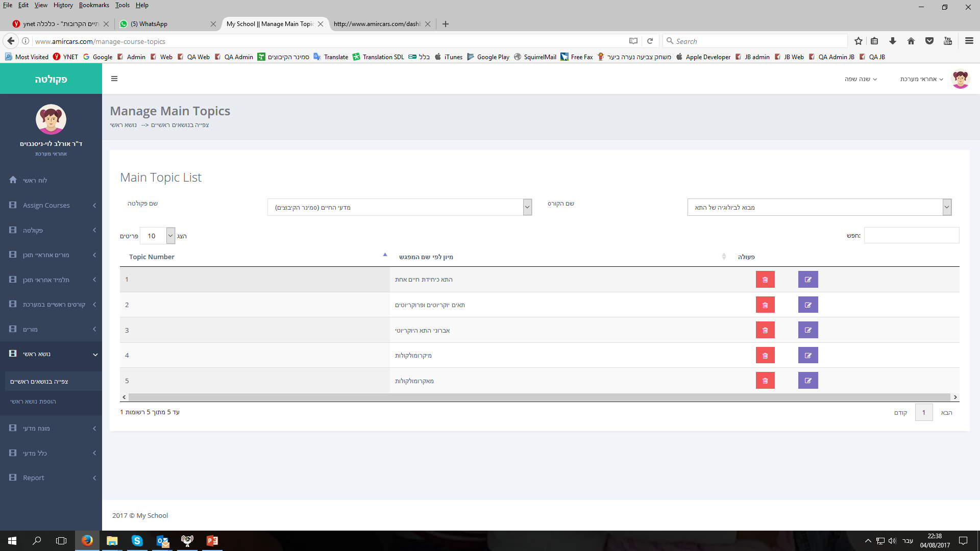
Please see that this course has 5 topics
(see next slides)

Slide 3
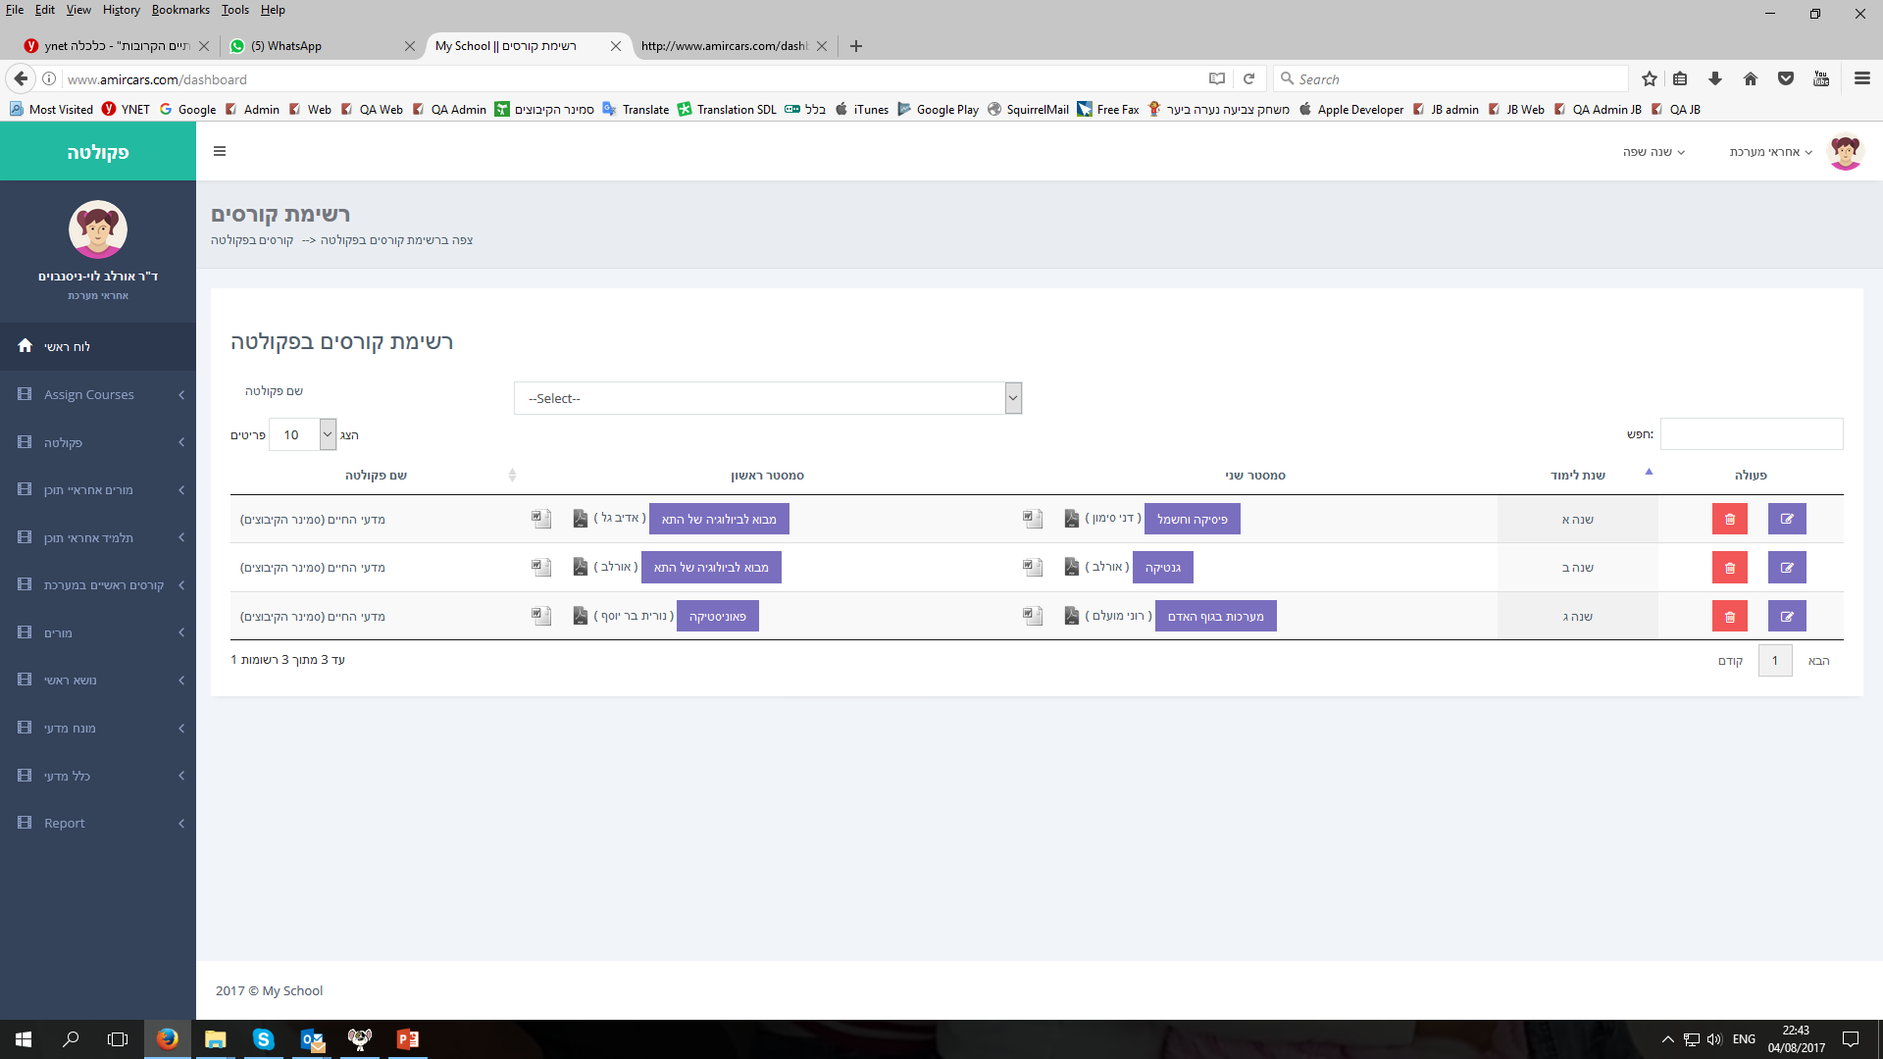
But, when I click on:
(see next slides)

Slide 4
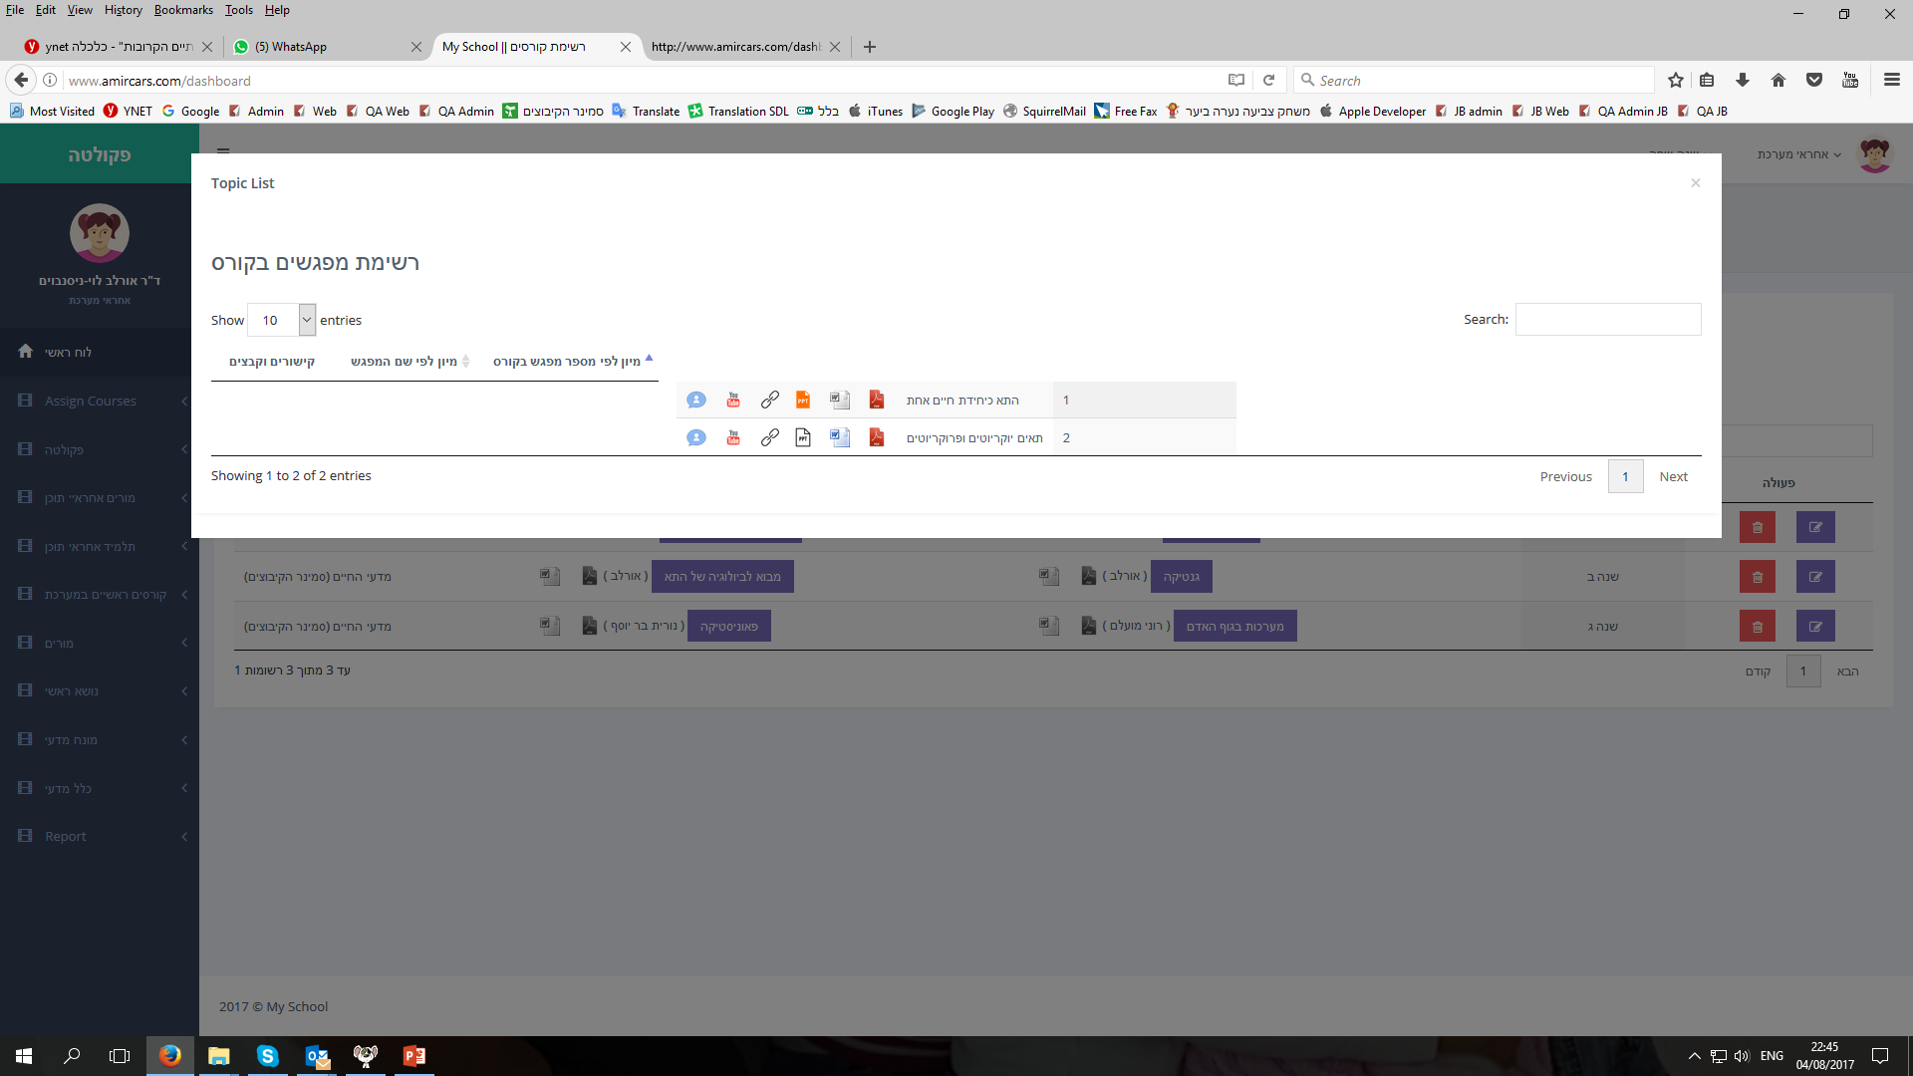
I am getting only 2 topics
Please show all topics referring to the same course

Slide 5
Please fix the design distortion in this screen

Slide 6
Please to the design mor narrow (so the other sub-screen would be aside)
First sub screen
Second sub screen

Slide 7
Please add the course name in this sub-screen

Slide 8
Please add some border (frame) to this sub-screen

Slide 9
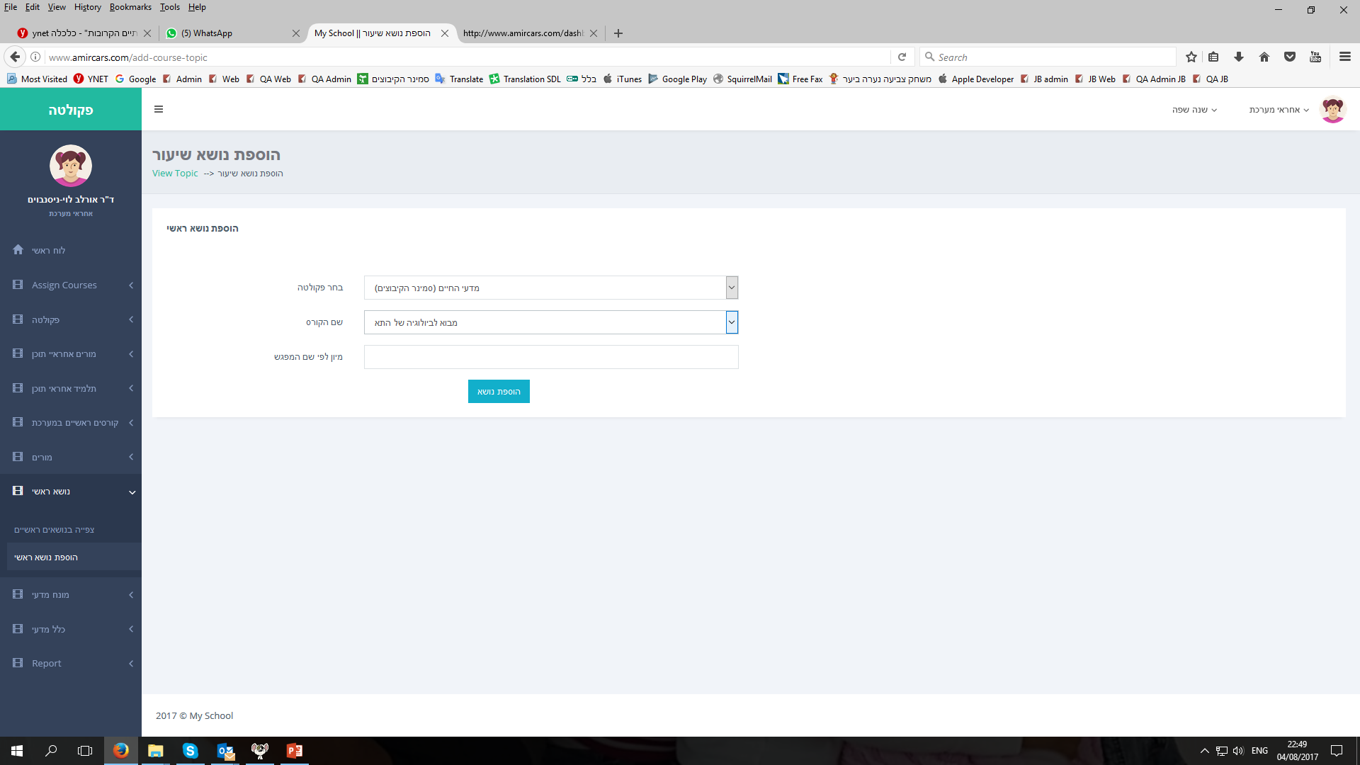
Please add a button to link to “add topics”
Add topics
By clicking the “add topics” button, please open this screen
Can you open it please as a sub-screen?
While open it, please automatically insert school name and course name

Slide 10
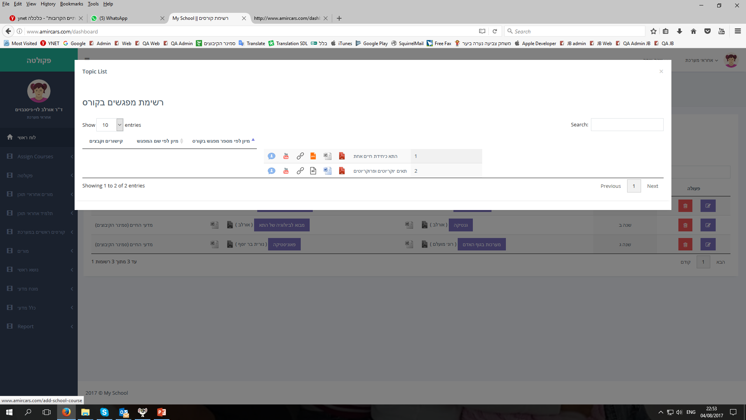
On mouse over (when mouse moves on top of these icons):
Please change it’s appearance (from an ‘arrow’ to a ‘hand’)
Please add captions to each icon (from the list below):
Captions from left to right:
Scientific terms and rules
Add YouTube link
Add an Internet link
Add PowerPoint presentation
Add Word document
Add a PDF

Slide 11
Very very important (!)
The whole idea of this system is to be a database of courses. Yet, at current state, user can not see contents at all! neither of the files (and contents) he upload to web-system.
In case of an existing links or existing files, user must be able to click on icon and to see those. So, In case links or files are already exist, please give the user 2 buttons: Watch or EDIT.
If user choose Watch - he wish to see the file / link he clicked on - please show PPT, PDF or Word, and/or link to the internet or link to YouTube
In case user choose EDIT – Please allow user to upload files… or to edit existing URT (for internet or YouTube)

Slide 12
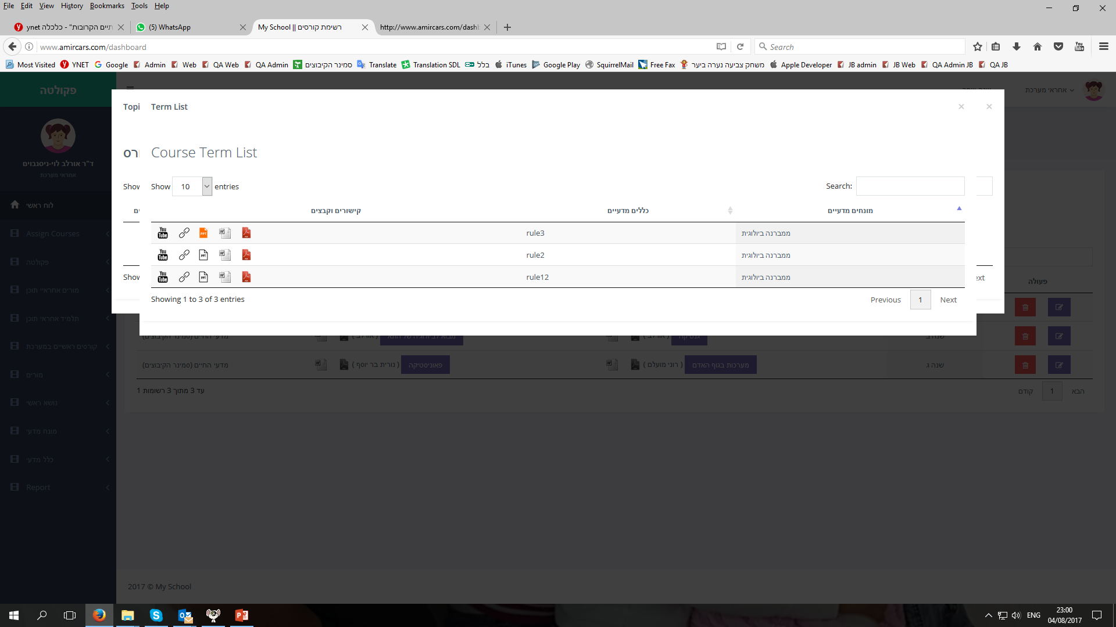
Please add (1) the name of the course and (2) the name of the topic, in this sub-screen

Slide 13
Please locate this sub-screen in some other place
(maybe down a bit), so it will not cover the first one
(see slide #6 above)

Slide 14
Please add some border (frame) to this sub-screen

Slide 15
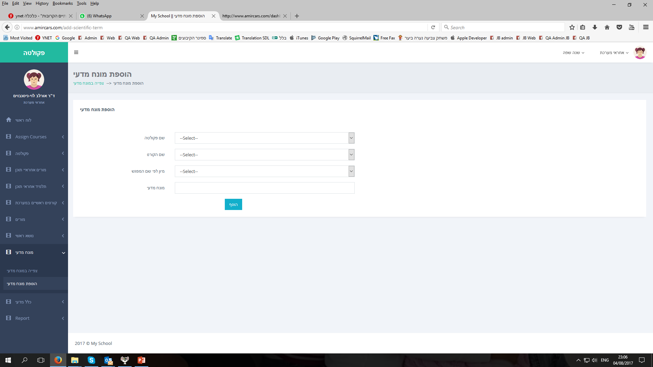
Please add a button to link to “add terms”
Add terms
By clicking the “add terms” button, please open this screen
Can you open it please as a sub-screen?
While open it, please automatically insert school name, course name etc…

Slide 16
On mouse over (when mouse moves on top of these icons):
Please change it’s appearance (from an ‘arrow’ to a ‘hand’)
Please add captions to each icon (from the list below):
Captions from left to right:
Add YouTube link
Add an Internet link
Add PowerPoint presentation
Add Word document
Add a PDF

Slide 17
Very very important (!)
The whole idea of this system is to be a database of courses. Yet, at current state, user can not see contents at all! neither of the files (and contents) he upload to web-system.
In case of an existing links or existing files, user must be able to click on icon and to see those. So, In case links or files are already exist, please give the user 2 buttons: Watch or EDIT.
If user choose Watch - he wish to see the file / link he clicked on - please show PPT, PDF or Word, and/or link to the internet or link to YouTube
In case user choose EDIT – Please allow user to upload files… or to edit existing URT (for internet or YouTube)

Slide 18
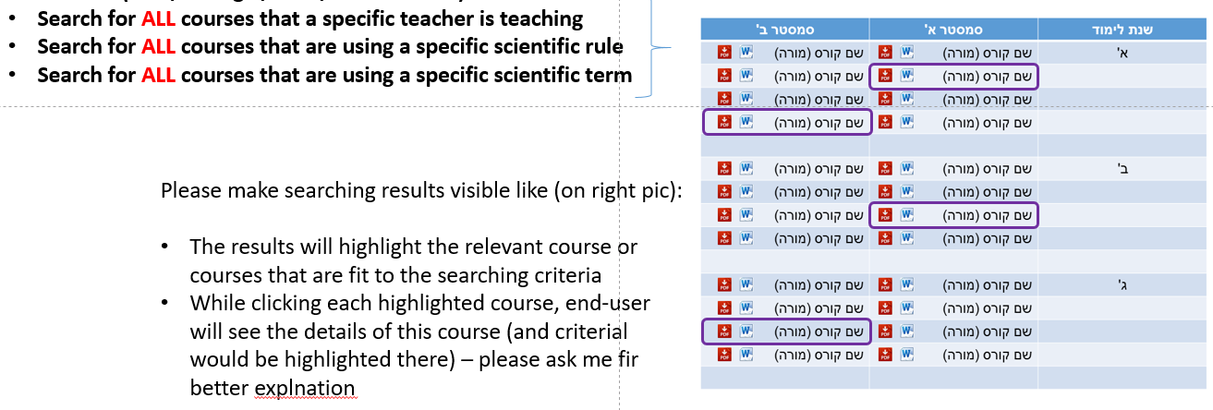
This is a screenshot from the original document. This search is missing (see next slide):
Please see next slide for an elegant way to do that

Slide 19

I think it can be done in the same main screen, by add the following 3 search text-boxes:
Search by a topic
Search by a scientific term
Search by a scientific rule
Search a scientific rule
Search a terms
Search a topic
Free text

Slide 20
There is an issue with terms and rules … I think that they are opposite.
I will explain it soon

Slide 21
There is an issue with the reports
I will explain it soon

