Slide 1
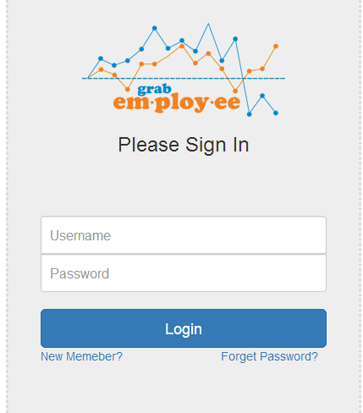
1.Login Module
Employer can login -→
DB authentication Table→Employeers
. Code→ Route::resource('/employer/login', 'EmployerController@company_login'); Route::resource('/employer/login/authenticate', 'EmployerController@company_login
authenticate');

Slide 2
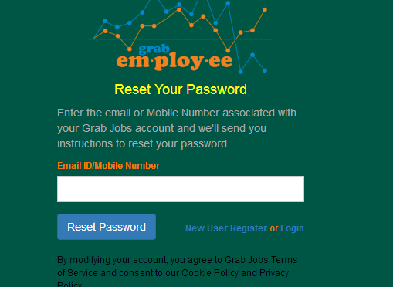
2.Forget Password module
Employer can recover their password using registerd email,they will get a link …using that link
Employer can reset their password.
//For View Route::resource('/eforget_password', 'EmployerController@eforget_password'); //For Controller Action Route::resource('/e_forgetpassword','EmployerController@e_forgetpassword'); // For View of Employer Set password after click on LINK Route::resource('/employer/reset/password/{token}','EmployerController@e_recoverpassword'); Route::resource('/myrecoverpassword','EmployerController@recoverpassword');

Slide 3
3.Employer Registration
Employer can register in two steps-→
1.Basic Information
2.Advanced Info
DB:: employeers
Code::
//for display employee registration Route::resource('/employer/register', 'EmployerController@register'); //Employee registration form1 Route::resource('/emp_register', 'EmployerController@emp_register'); Route::resource('/com_registration', 'EmployerController@com_registration'); //Employer registration complete Route::resource('/employer_registration', 'EmployerController@employer_registration');

Slide 4
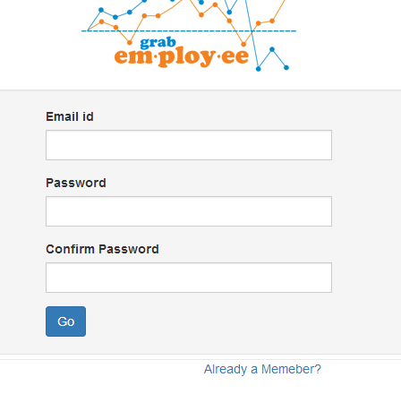
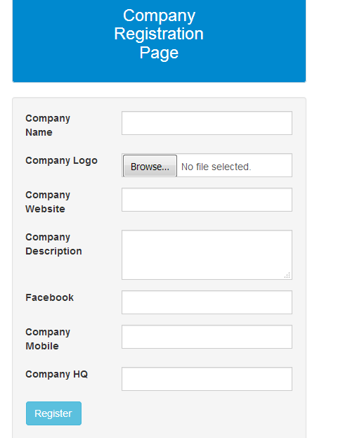
Employer can complete registration in two process
form1
Form2

Slide 5
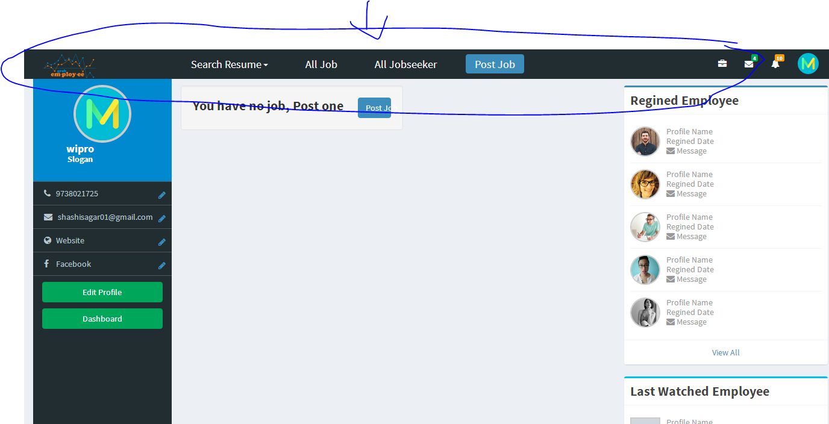
5. Dashboard Module
employer can go to the dashboard as particular enters correct credential.
. Employer can get details in dashboard like logo,mobile,facebook page ,website from registration page.
Code::Route::resource('/employer/dashboard', 'EmployerController@employer_dashboard');

Slide 6
Dashboard contents following parts::
Search Resume
a. Search resume
b. Saved search
Post Jobs
All Job
All Jobseeker

Slide 7
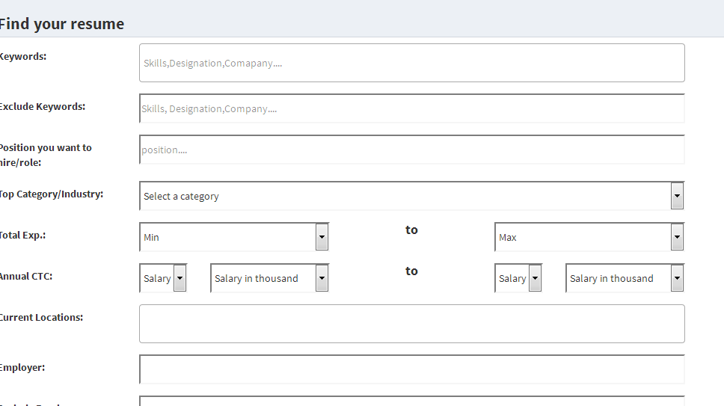
5.Search module 1.(a) search resume
Employer can search resume using their choices given by search form fields.
. DB used :: users, work_histories, skillendorsment, educations, personal_infoes
Code::: Route::resource('/search-resume','EmployerController@search_jobseeker'); Route::resource('/searchresult','EmployerController@searchresult');
For auto suggestion in different field →select2.js from bootstrap api.

Slide 8
Search result page
Search result page As employer will search the reume then →search result page should come→It should look like below:::→Mentioned in design document(Also).
Mobile Number should display on click→ can see below pages.
Modify search -→should go to search form→with previous enter data
New Search→should go to search form
It should display already viewed(if visited),cv status(attacked),total views,active and modify date of each jobseeker dynamically→can viewed in below page.

Slide 9
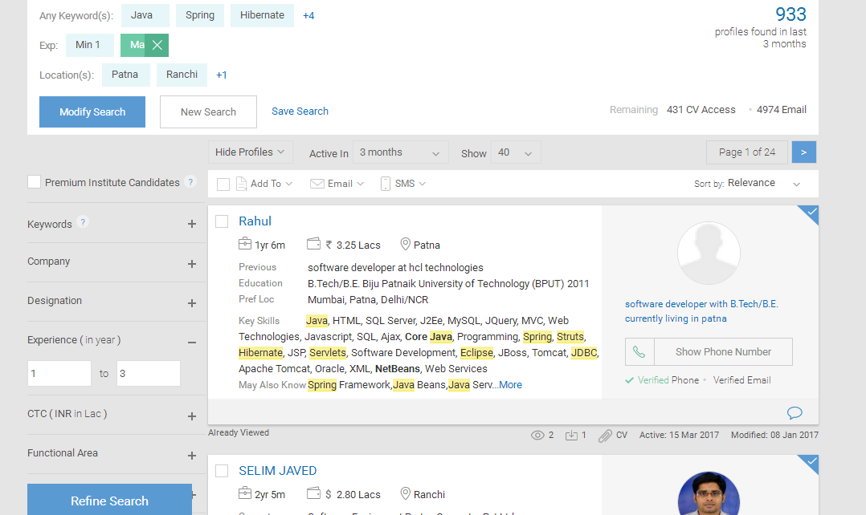
Search result page

Slide 10
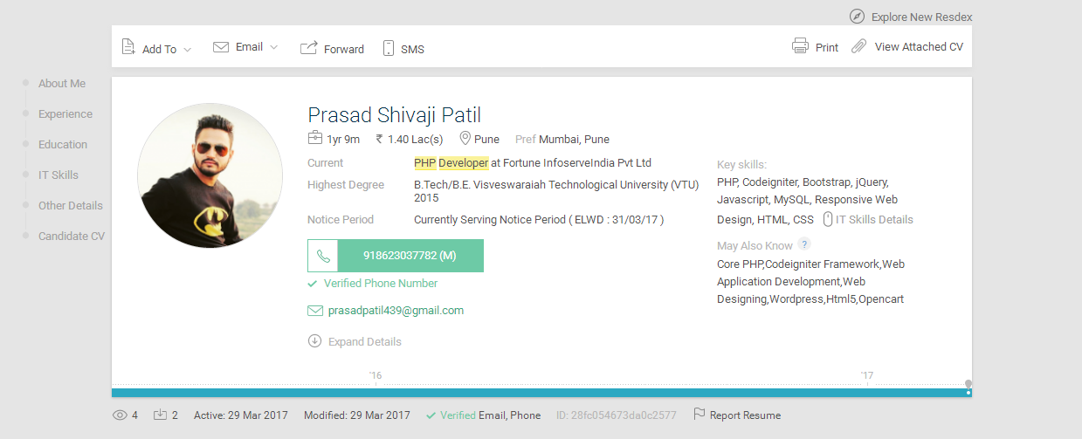
Search result page(continue..)
On click of particular jobseeker ---→It should display all-information of particular jobseeker in separate page-→like below page→There must be option of download the resume--→

Slide 11
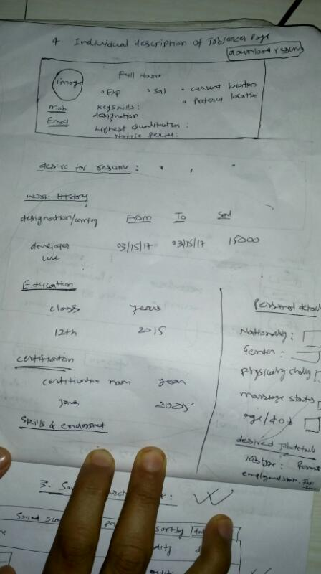
Search result page(continue…)

Slide 12
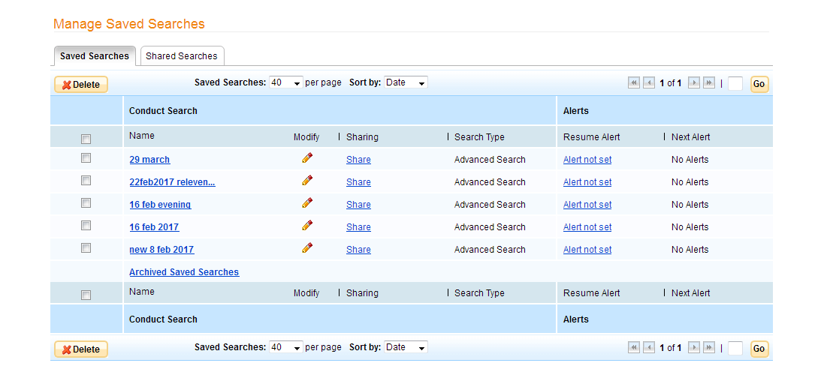
1 (b)save search page
AS employer want to save their search result ------→as particular click the save search button on above page---→It will appear a pop-up→where one need to give their search name for save.→same name should display on save search page →

Slide 13
Save search page(continue…)
on click of particular filename →It should display the same search page that→ employer has get at the time →when he search at the first time.

Slide 14
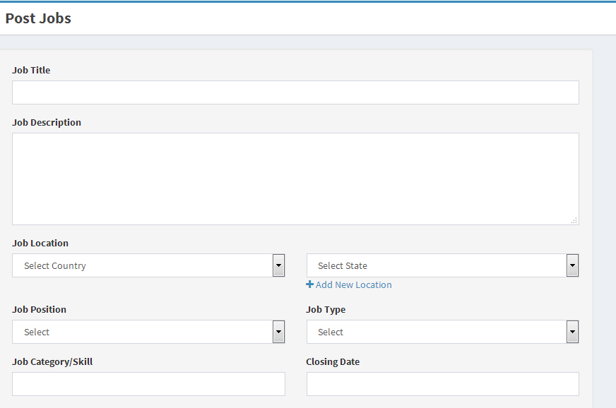
2.Post Jobs
Employer can post jobs if they want using below form fields:::

Slide 15
Post -jobs
on click of preview and submit button on below the post-jobs form →
Employer can preview their job-post for correction needed.
Preview Page will same as text field →but it should display in text only.
. There will be option of edit in preview page→If employer want to edit→then it will go to the post-jobs form page with all-previously fields data.

Slide 16
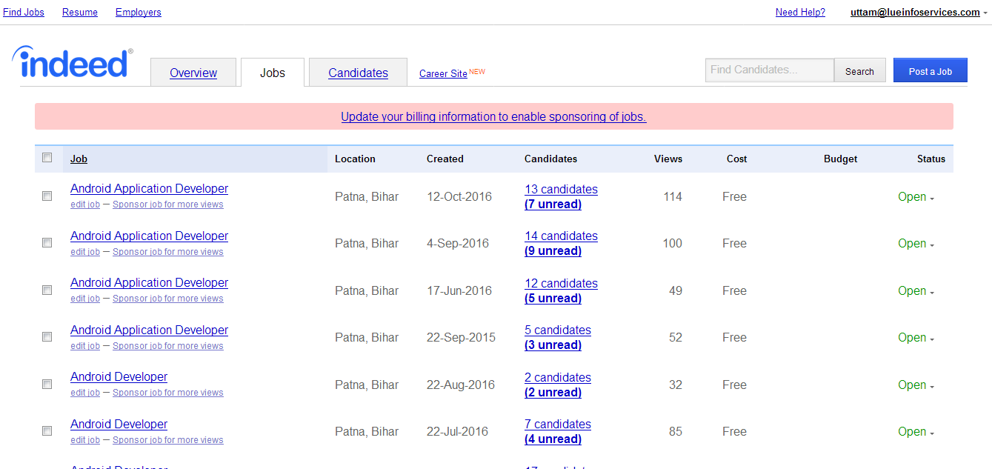
3. All Jobs
Using this Employer can see all-jobs →

Slide 17
All –jobs(continue…)
In the above image there is important point is that --→There should be read/un-read option→how much resume employer has seen or not→when any jobseeker applied on particular jobs.
On click of read it should go→to all read pages→that employer has already seen that resume.
On click of un-read it should go→to all unread pages→New resume that employer has not seen.

Slide 18
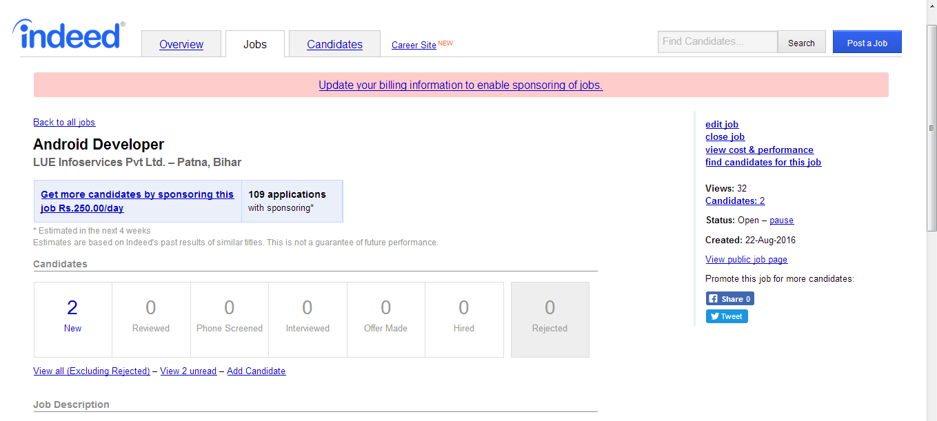
All-jobs(continue)
On click of particular jobs -→it should display like this::

Slide 19
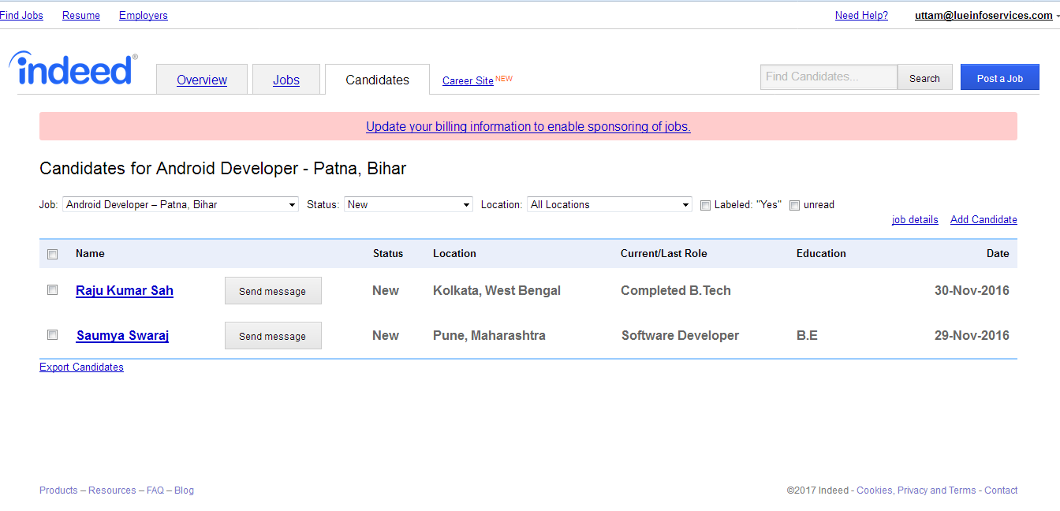
4. All-jobseeker

Slide 20
All-jobseeker(continue…)
There is a list of jobseeker applied on particular jobs above.
There should be filter on basis of 1.jobs 2.status 3. location
. There should come →full description with resume of particular jobseeker-→(see next image)

Slide 21
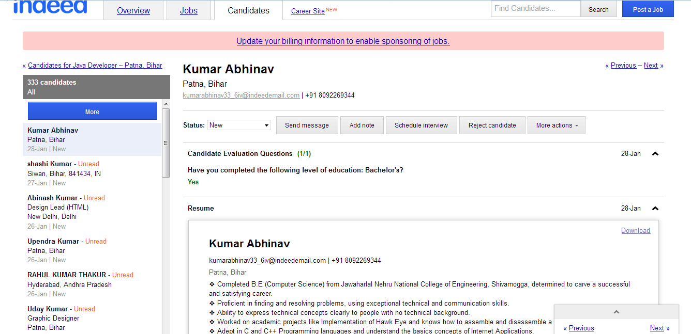
All-jobseeker(continue…)

Slide 22
Last page
Apart from this→follow 1. design document for design pages--→2. and employer Module document
I will make more clear on voice message.

