Slide 1
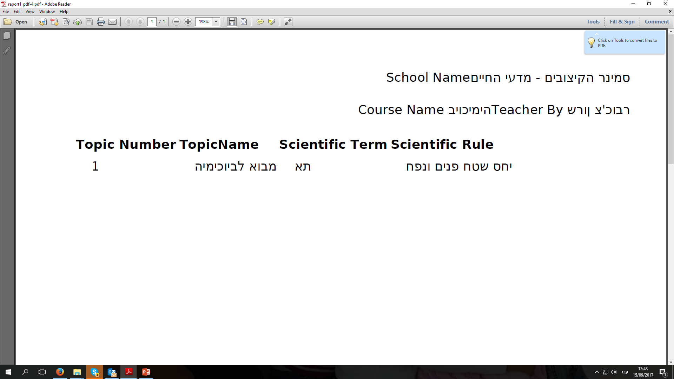
This is the report (from few min ago):
Blue frame are fine Hebrew words… Red frames are flipped Hebrew words
Since, art the same report both OK and flipped Hebrew words, I assume that the text was kept wrongly in Db for those flipped words.
Should be:
ביוכימיה

Slide 2
The right order of this report should be:
First line
Second line
Table part

