Slide 1
DEVELOPMENT OF FAULT DETECTION IN DRONE FLIGHT CONTROL SYSTEM
Using STM32 Microcontroller and Proteus Simulation
TEAM MEMBERS:
SHASHTHIKA R – 9925005153
NAVANEETHAN S– 9925005154
SRINIVASAN – 9925005147
SRIRAM - 9925005150

Slide 2
Abstract
Drone flight-control systems depend on reliable sensor information.
This project demonstrates a basic fault-monitoring concept using an STM32 microcontroller.
Three potentiometers act as simulated sensor inputs and are read through the ADC.
The controller checks each reading against a predefined range and indicates abnormal values using LEDs and a buzzer.
Proteus is used to build and test the circuit virtually before hardware implementation.
2

Slide 3
Problem Statement & Objectives
Problem statement
Objectives
A faulty or out-of-range sensor signal can affect the reliability of a drone flight-control system. A monitoring mechanism is needed to identify abnormal input values and alert the operator.
• Read multiple sensor-like inputs
• Monitor input values continuously
• Detect values outside a safe demonstration range
• Provide visual and audible fault indication
• Validate the logic using Proteus simulation
3

Slide 4
System Architecture
Sensor Inputs
Signal Reading
Fault Checking
Alert Output
3 potentiometers
STM32 ADC1
Range comparison
LEDs + buzzer
The controller repeats the sensing and checking process in a continuous loop.
4

Slide 5
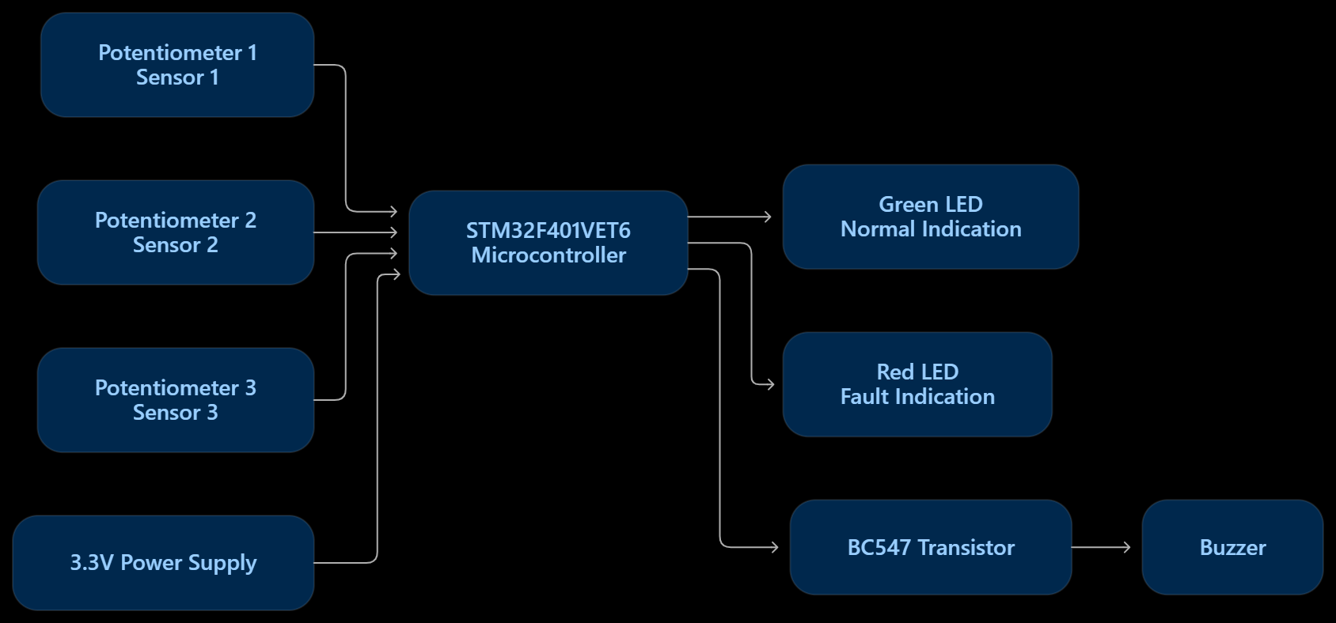
BLOCK DIAGRAM

Slide 6
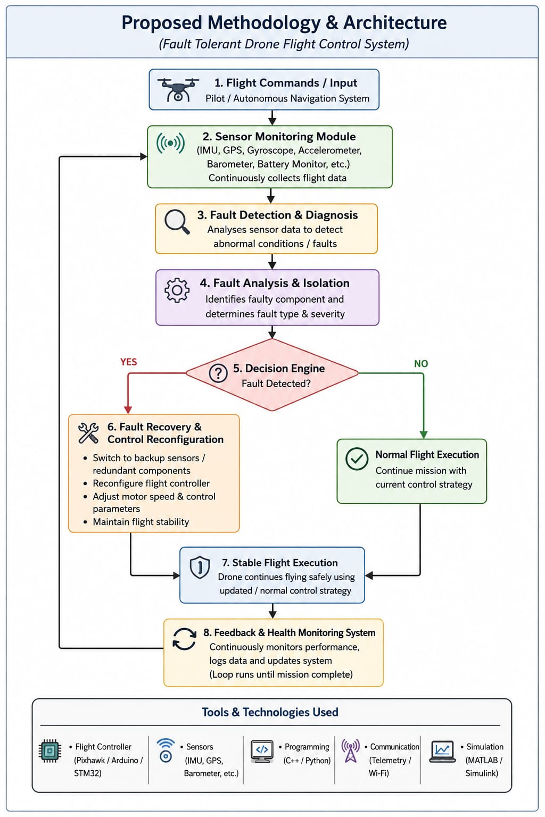

Slide 7
Hardware & Software Requirements
Hardware / simulation components
Software tools
• STM32F401VET6 microcontroller model
• Three 10 kΩ potentiometers
• Green LED – normal indication
• Red LED – fault indication
• BC547 NPN transistor and buzzer
• Current-limiting and base resistors
• 3.3 V supply and common ground
• STM32CubeMX – pin and peripheral configuration
• STM32CubeIDE – Embedded C development
• Proteus – schematic design and simulation
• HEX output – firmware file loaded into Proteus
Note: Exact simulation support depends on the installed Proteus MCU model/library.
5

Slide 8
STM32 Pin Configuration
Prototype signal mapping
STM32 pin | Configuration | Function
PA0 | ADC1_IN0 | Sensor input 1
PA1 | ADC1_IN1 | Sensor input 2
PA4 | ADC1_IN4 | Sensor input 3
PD12 | GPIO Output | Green LED
PD13 | GPIO Output | Red LED
PD14 | GPIO Output | Buzzer driver control
6

Slide 9
Working Methodology
Initialize GPIO and ADC peripherals.
Read three analog input channels: PA0, PA1 and PA4.
Convert the ADC readings into digital values (12-bit range: 0 to 4095).
Compare each reading with the demonstration normal range of 1000 to 3000.
If any reading is outside the range, set the fault status.
Drive the red LED and buzzer during a detected fault; otherwise drive the green LED.
Repeat the process continuously.
7

Slide 10
Fault Detection Logic
Normal condition
Fault condition
All three ADC readings are between 1000 and 3000.
Green LED: ON
Red LED: OFF
Buzzer: OFF
At least one ADC reading is below 1000 or above 3000.
Green LED: OFF
Red LED: ON
Buzzer: ON
8

Slide 11
Proteus Circuit Design
Simulation connections
Place the STM32F401VET6 model and three potentiometers in the schematic.
Connect potentiometer wipers to PA0, PA1 and PA4; connect outer terminals to 3.3 V and GND.
Connect PD12 and PD13 to green and red LEDs through series resistors.
Use PD14 to drive a BC547 transistor through a base resistor; connect the buzzer in the collector circuit.
Provide correct MCU supply connections and a common ground.
Load the HEX file generated for the STM32F401VETx target into the Proteus MCU properties.
9

Slide 12
Testing & Current Results
Test | Procedure | Observed / expected result
GPIO green test | Force PD12 HIGH | Green LED glows – verified
GPIO red test | Force PD13 HIGH | Red LED glows – verified
Normal sensor test | All potentiometers at midpoint | Green ON expected; full test pending
Fault sensor test | Move one input outside range | Red + buzzer expected; verify after ADC validation
Current status: Individual LED GPIO tests have passed. The complete ADC normal/fault test is still being debugged.
10

Slide 13
Challenges & Future Enhancements
Current challenges
Future enhancements
• Confirming ADC scan sequence and EOC configuration
• Verifying potentiometer wiring and ADC readings
• Checking buzzer driver polarity and supply
• Validating normal and fault output states
• Integrate a real IMU sensor (gyroscope and accelerometer)
• Add battery-voltage and temperature monitoring
• Display fault details on an LCD or UART terminal
• Add sensor plausibility checks and fault logging
• Validate safe-state behavior on a real test bench
11

Slide 14
CONCLUSION
This project demonstrates the basic design of a sensor fault-monitoring system using an STM32 microcontroller. Analog inputs are monitored through ADC channels, and abnormal readings are intended to trigger visual and audible alerts. Proteus provides a virtual platform to develop and validate the prototype before further hardware testing.
THANK YOU
12

