Slide 1

Machine LEARNING- PROJECT
Problem Statement Chosen - Allstate Purchase Prediction Challenge

Slide 2
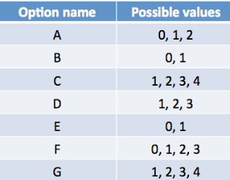
1. Problem & Data Explained
Using Can you forecast which policy a customer would choose based on their shopping history?
The task is to forecast customers' purchased coverage options using a constrained portion of the whole interaction history. The quoting process is shortened, and the issuer is less likely to lose the customer's business, if the ultimate purchase can be forecast earlier in the buying window.
Possible Options
Challenges:
Only Partial Quote History is available in the test data. So, our Predicted plan combination could be out of what’s shown in the test.
A 7 X 1 Vector showing the purchased option needs to be Predicted. Hence It is a very tough Problem. The Kaggle Topmost score is 53% Accuracy only.
Response variables are Multicategory, and they don’t have uniform number of levels.

Slide 3
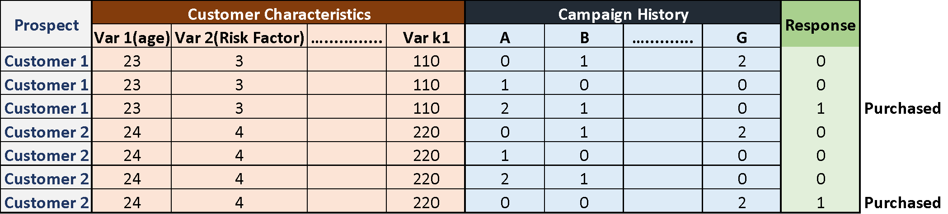
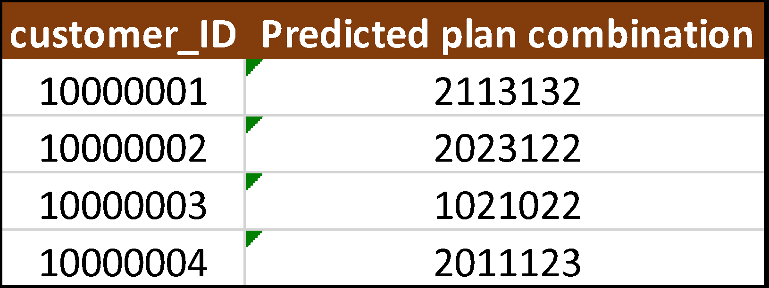
2. Variable Descriptions
Training Data Illustration
customer_ID - A unique identifier for the customer
shopping_pt - Unique identifier for the shopping point of a given customer
record_type - 0=shopping point, 1=purchase point
day - Day of the week (0-6, 0=Monday)
time - Time of day (HH:MM)
state - State where shopping point occurred
location - Location ID where shopping point occurred
group_size - How many people will be covered under the policy (1, 2, 3 or 4)
homeowner - Whether the customer owns a home or not (0=no, 1=yes)
car_age - Age of the customer’s car
car_value - How valuable was the customer’s car when new
risk_factor - An ordinal assessment of how risky the customer is (1, 2, 3, 4)
age_oldest - Age of the oldest person in customer's group
age_youngest - Age of the youngest person in customer’s group
married_couple - Does the customer group contain a married couple (0=no, 1=yes)
C_previous - What the customer formerly had or currently has for product option C (0=nothing, 1, 2, 3,4)
duration_previous - how long (in years) the customer was covered by their previous issuer
A,B,C,D,E,F,G - the coverage options
cost - cost of the quoted coverage options
Prediction on Test - Illustration

Slide 4
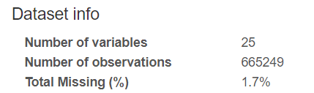
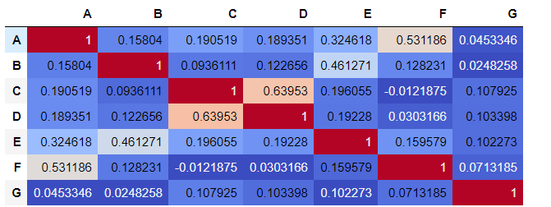
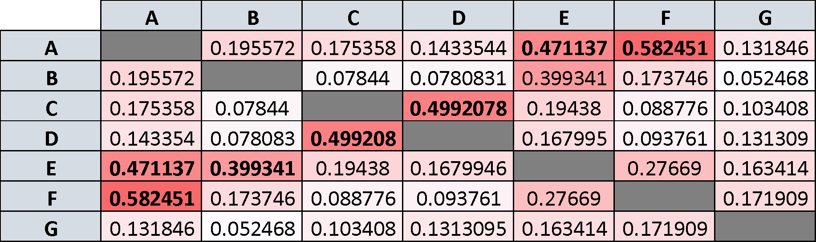
3. Exploratory Data Analysis
An EDA was done to understand the data – The variable Risk Factor has a lot of Missing values.
Correlation between Options: Understanding this is important since our approach involves multiple models to predict everyone. Below given is the correlation matrix for the Policy variables. But since the variables are Multi-class categorical variables, Pearson’s coefficient doesn’t make sense.
Cramér’s V was used to find the correlation/association between the policy option variables: To obtain the below matrix, first filter for responder’s data alone and do an ANOVA . Higher the value of Cramer’s V higher is the association.
The above combinations are decided based on the values in the adjacent matrix. Higher the value of Cramer’s V higher is the association

Slide 5
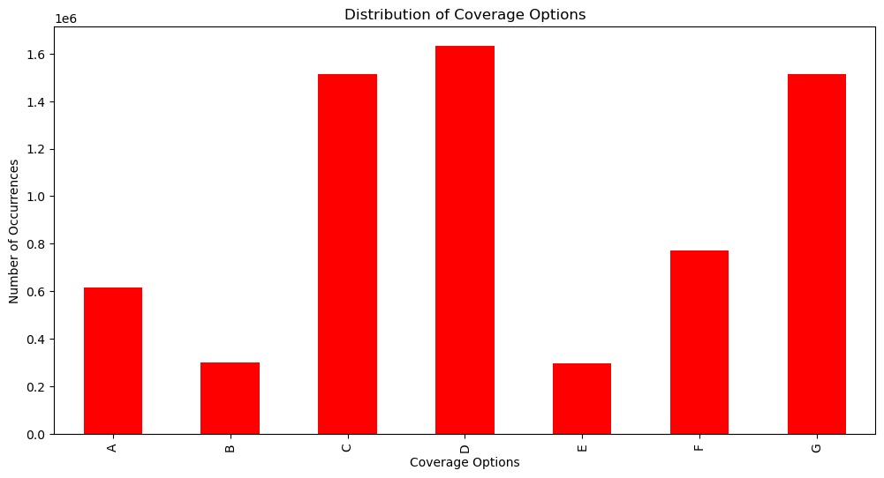
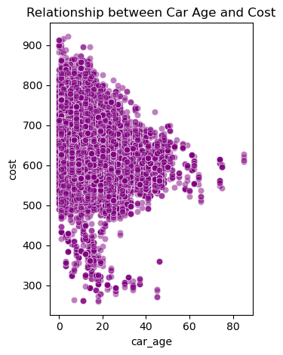
From the EDA, we can derive:
The most popular coverage option among A to G
Relationship between car age(number of years owned) and cost
We can see that the policy D has the highest number of occurrence. Therefore, we can say that D is the most popular plan amongst the customers followed by C,G,F,A,B and E
As the Age of the customer’s car increases, the mean cost of the quoted coverage options is around 600.Also, if the car’s age is between 0-40 years, we can see fluctuations in the cost of the quoted coverage options

Slide 6
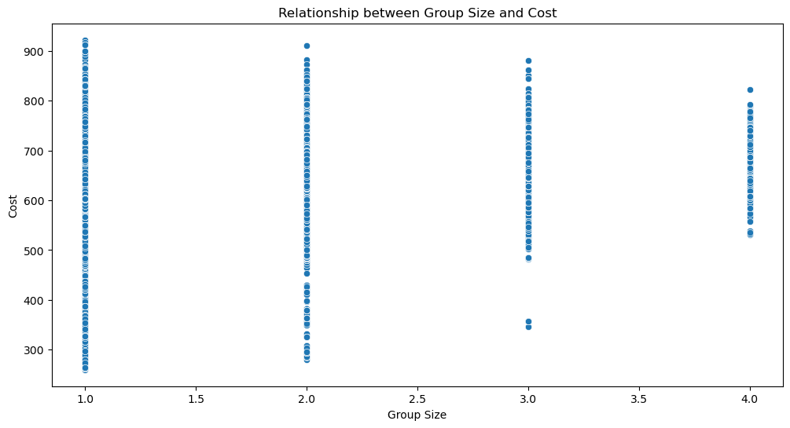
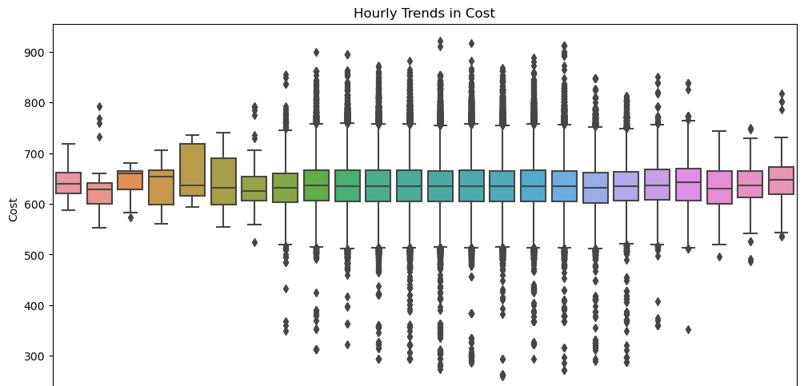
From the EDA, we can derive:
Relationship between group size(How many people will be covered under the policy (1, 2, 3 or 4)) and cost(cost of the quoted coverage options)
Relationship between hourly trends in cost and the cost of the quoted coverage options.
We can see that as the group size (number of people:1,2,3,4) increases, the cost of the quoted coverage options is increasing steadily.
As the hourly trends in cost increases, the mean cost of the quoted coverage options is around 600.

Slide 7
4. Initial Approach With The Data
Model | Algorithm | Kaggle Score(public score)
Initial Approach | Logistic Regression | 0
Base line Submission | naïve approach | 0.409
Strategy Used:
1)Logistic Regression – Initial Approach
Retaining every row(quote history) for all the customers and modelling the response (yes/no) for a particular combination.
Train Data- Model was trained in such a way that every row was treated as a unique entity and the response of the individual(yes/no) was the categorical variable to be predicted.
Test Data – For every quote combination(even though the quote history in test data was partial), the response of the individual(yes/no) was predicted. The quote combination which has the highest probability of Yes was chosen as the final prediction.
2)Naïve Approach - Baseline Submission
Submitted the last shown quote combination as prediction for each customer.
This gave a really decent score of 0.4 as compared to the previous approach. So, we can infer that the last row-quote combination is very important in predicting the final purchase.

Slide 8
5. Initial Approach - Takeaway
Key takeaways:
Due to the poor performance, we need to structure the problem is a different manner to get better results.
The fact that just pasting the last row (last quote shown to customer) gives a baseline model with 0.4 accuracy indicates that quote history plays a lot of role in prediction as compared to the customer characteristics.
Also generating all the possible policy grid is not computationally feasible.
Hence, we need to make use of the correlation information among the options and come up with individual models. Based on the correlation values, we need to decide on the order in which we need to model and predict the individual policy preferences.

Slide 9
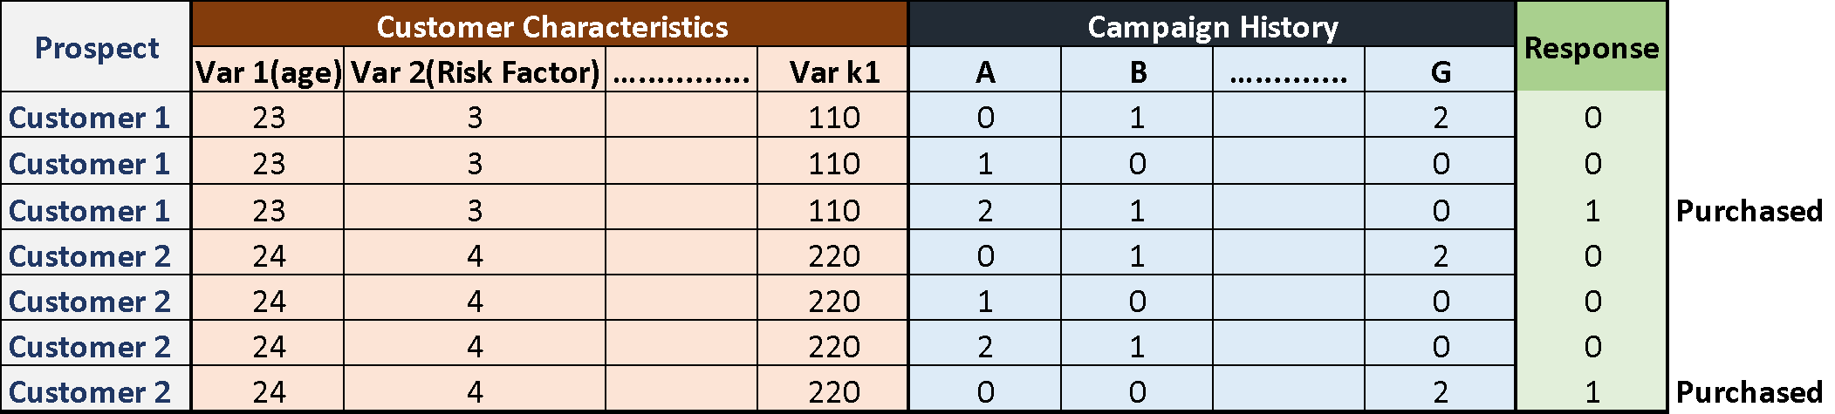
6. Feature Engineering:
Data Transformation to capture information from Previous K-quotes:
Keep only the Responded rows in the new training data.
Include elements that depict the previous K- Policy Quotes displayed to the consumer. In our case, when K=2, we have added two new columns reflecting the option of A, B...G which will be shown to the customer.
Apply the same logic to the test data.
The response column should be removed from the training data.
We must solve a multi-class classification problem by forecasting each policy choice independently.
For K=2, our training dataset would look like the below:

Slide 10
5. Order of Prediction of Policies:
The above combinations are decided based on Cramer’s V(Slide 4)
G being the Most independent, build a classification model initially to predict G.
Build a classification model to predict C. Use the predicted value of C as one of the features to predict D.
Build a classification model to predict A. Use the predicted value of A as one of the features to predict E and F using 2 separate models.
Build a classification model to predict B using the predicted value of E in the previous step as one of the features.
Combine the individual predictions to give the policy combination for each customer.

Slide 11
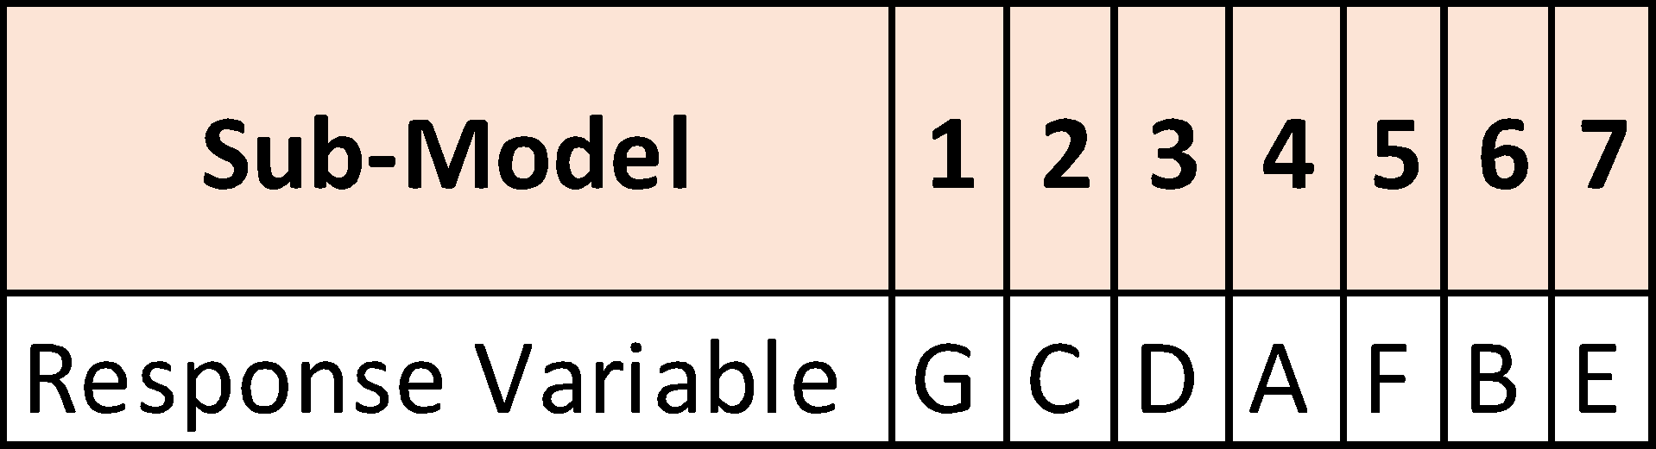
7. Hyperparameter Tuning:
We did hyperparameter tuning to each of these models and found out the best hyperparameter for each of the models(xgboost and random forest) respectively.
After finding the best hyperparameters, we have used these hyperparameters as inputs in our model(xgboost and random forest).
Model 1 Hyper paprameter tuning results- Prediction of G
Best hyperparameters for XGboost: {'max_depth': 6, 'min_child_weight': 4, 'n_estimators': 72}
Best hyperparameters for random forest: {'max_depth': 9, 'n_estimators': 90}
Model 2 Hyper paprameter tuning results- Prediction of C
Best hyperparameters for XGboost: {'max_depth': 4, 'min_child_weight': 2, 'n_estimators': 70}
Best hyperparameters for random forest: {'max_depth': 8, 'n_estimators': 154}
Model 3 Hyper paprameter tuning results- Prediction of D
Best hyperparameters for XGboost: {'max_depth': 3, 'min_child_weight': 3, 'n_estimators': 107}
Best hyperparameters for random forest: {'max_depth': 9, 'n_estimators': 223}
Model 4 Hyper paprameter tuning results- Prediction of A
Best hyperparameters for XGboost: {'max_depth': 5, 'min_child_weight': 1, 'n_estimators': 87}
Best hyperparameters for random forest: {'max_depth': 7, 'n_estimators': 197}
Model 5 Hyper paprameter tuning results- Prediction of F
Best hyperparameters for XGboost: {'max_depth': 4, 'min_child_weight': 3, 'n_estimators': 115}
Best hyperparameters for random forest: {'max_depth': 9, 'n_estimators': 247}
Model 6 Hyper paprameter tuning results- Prediction of B
Best hyperparameters for XGboost: {'max_depth': 3, 'min_child_weight': 2, 'n_estimators': 274}
Best hyperparameters for random forest: {'max_depth': 4, 'n_estimators': 277}
Model 7 Hyper paprameter tuning results- Prediction of E
Best hyperparameters for XGboost: {'max_depth': 3, 'min_child_weight': 3, 'n_estimators': 262}
Best hyperparameters for random forest: {'max_depth': 9, 'n_estimators': 256}

Slide 12
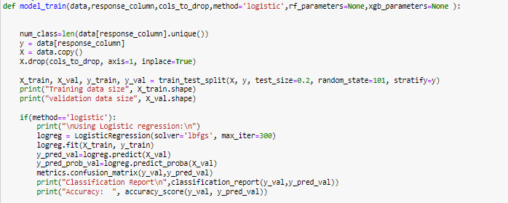
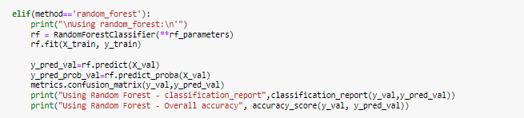
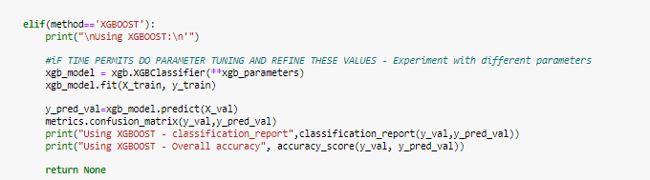
8. Models Used:
LOGISTIC REGRESSION
RANDOM FOREST
XGBOOST

Slide 13
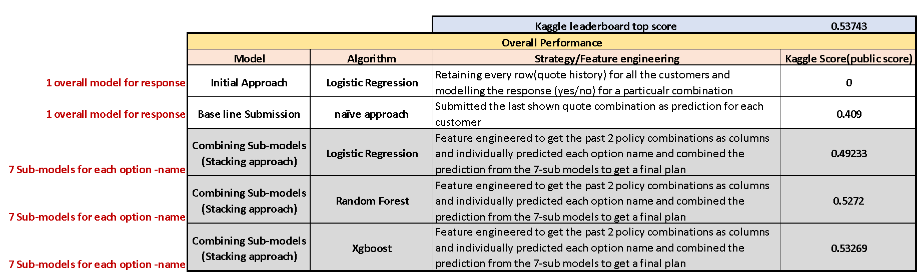
9. Benchmarking of Kaggle Scores on various methodologies tried

Slide 14
10. Conclusion:
Key Takeaways:
Not only can experimenting with other model could give us a high score, but structuring the problem in another way could also give us a good result.
This is a recommendation problem. It can be modelled as a combination of Prediction and Weight optimization.
Multivariate Approach: Instead of predicting the individual options, we can try to formulate this as a Multi-variate problem so that we can capture the interaction effect between the policies better(Covariances).

Slide 15


