Slide 1
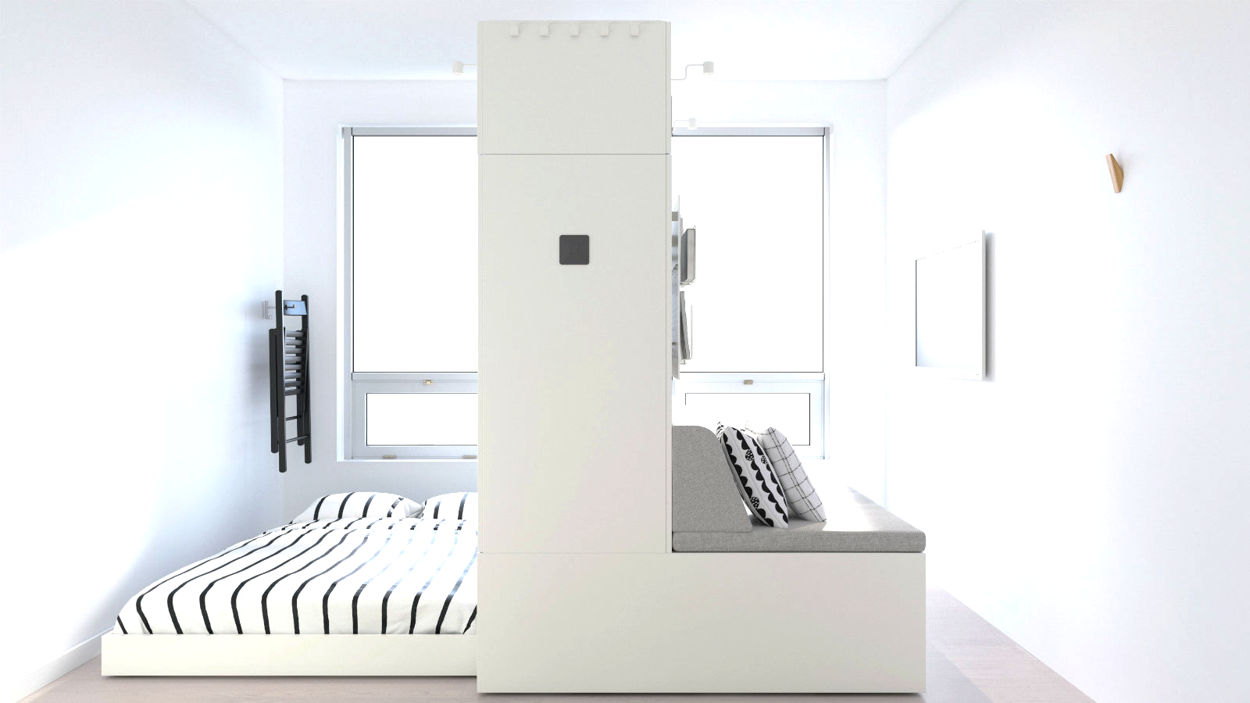

Denh Tlai
A Front-Runner of E-commerce in Cambodia
Mini project Team2
Yoon Sang Joon
Lee Jae Seong
Park Sang Hun
Roh Seong Hyun

Slide 2





Index
A Front-Runner of E-commerce in Cambodia
Current Problem
Improvement Plan
Comparison& Demonstration
Limit & Conclusion

Slide 3

Current Problem

Slide 4
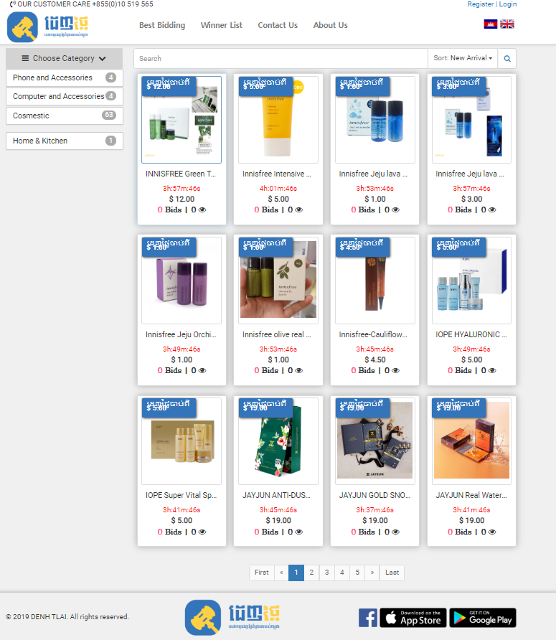
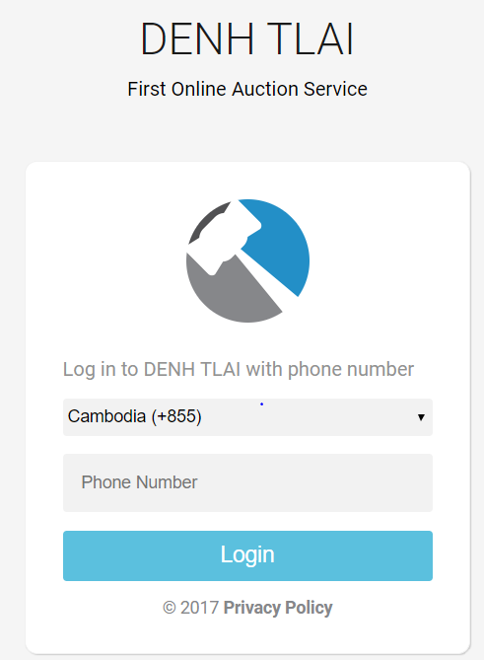
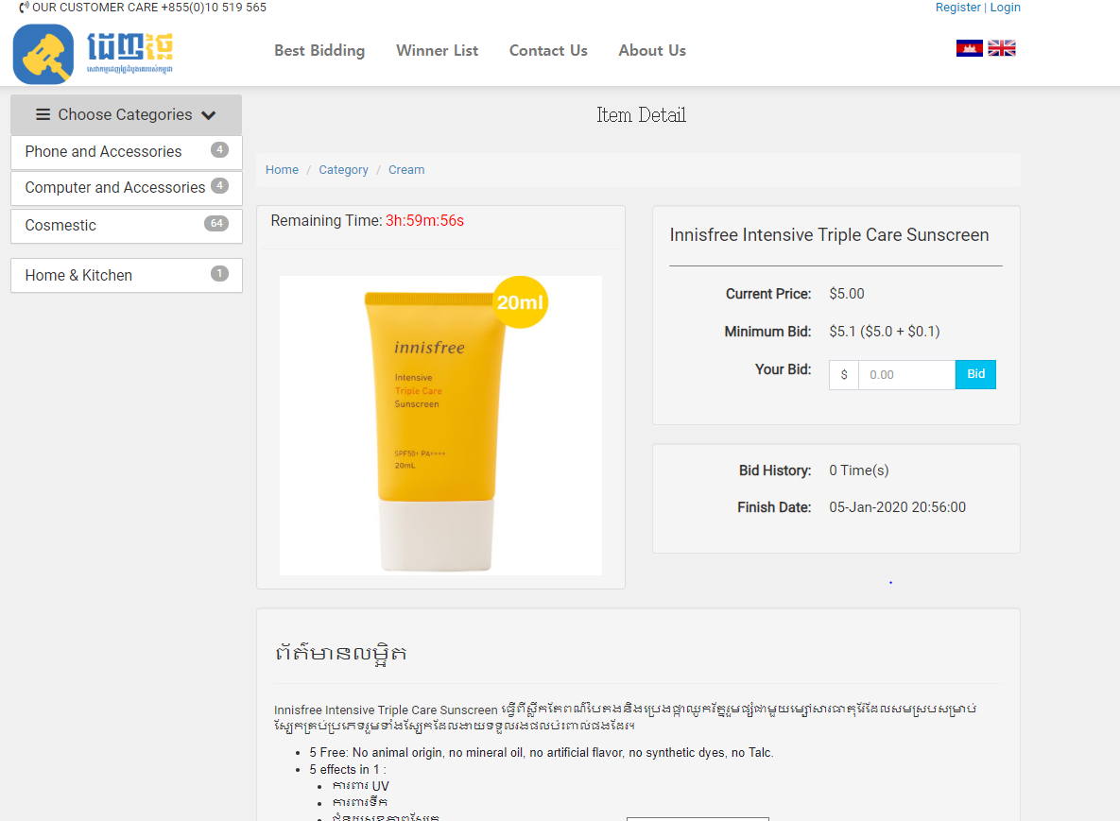
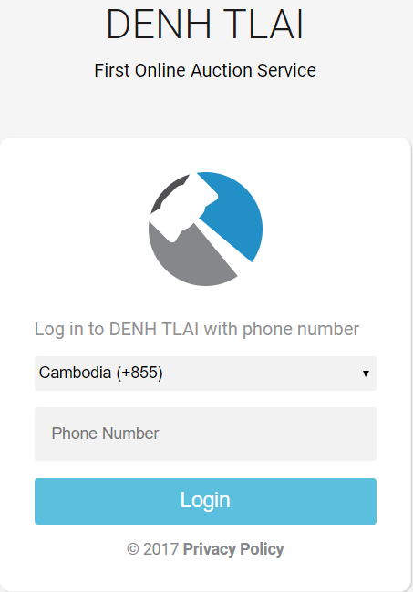
Current problem
Login page
Main page
Detail page
Limited login method.
Low legibility
Complicated User Iterface

Slide 5
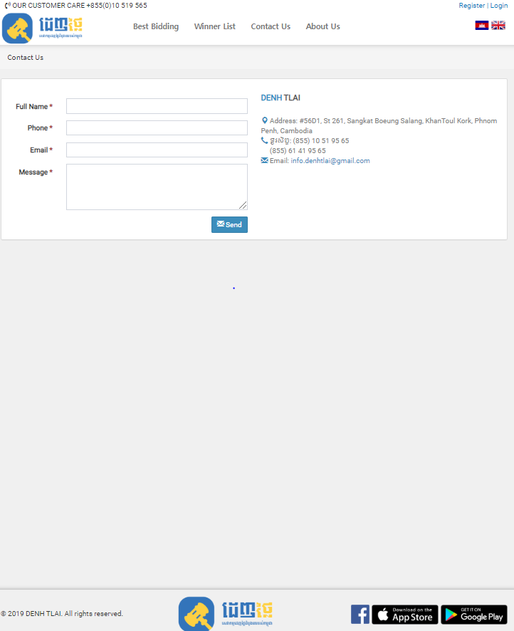
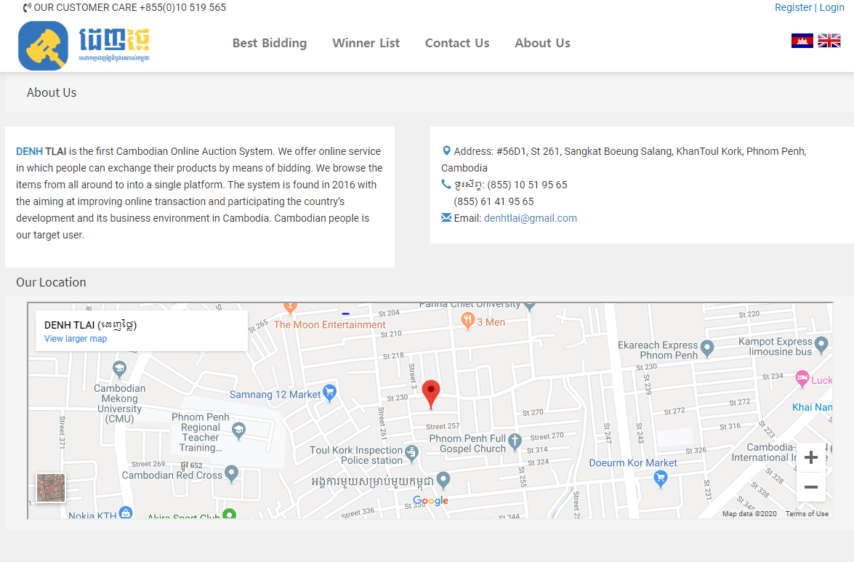
Current problem
About us
Contact us
Lack of information
Improvement of customer service

Slide 6
Improvement Plan

Slide 7
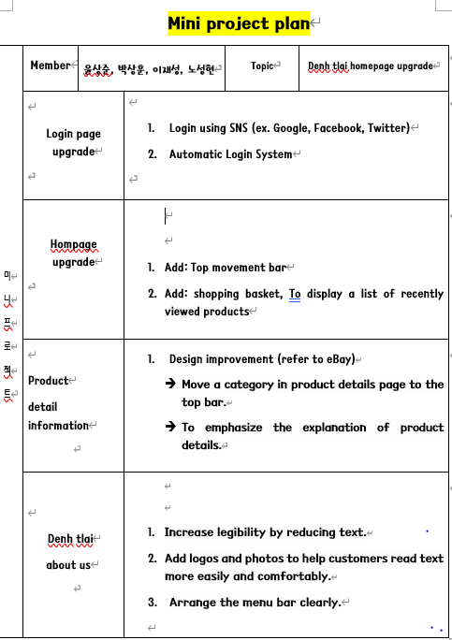
Improvement Plan
Before we started the mini-project, we prepared a plan and got confirmation from Mr. Ly Pichonary and Ms. Eath Manith.

Slide 8
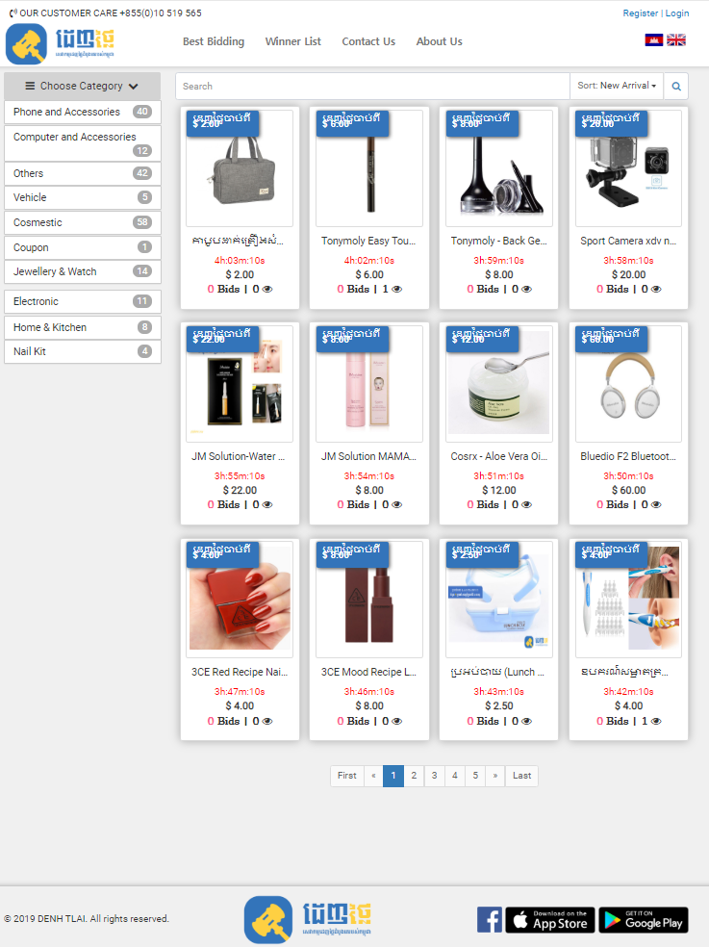
Improvement Plan
Create New main homepage
Add Top movement bar
Move category to top
Recategorize contents
Main Homepage

Slide 9
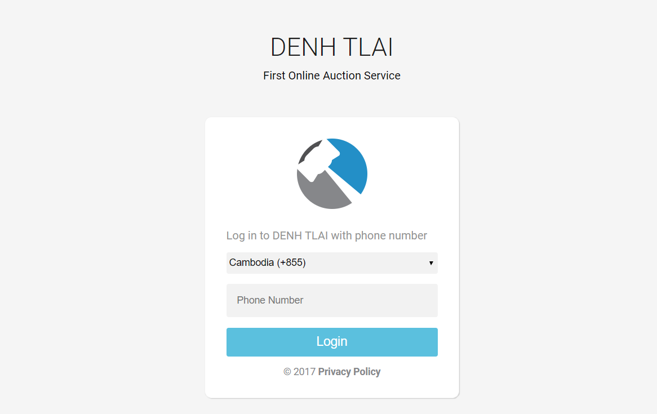
Improvement Plan
Create New Sign in page
Add SNS sign in function
Add New Sign up page
Sign in Page

Slide 10
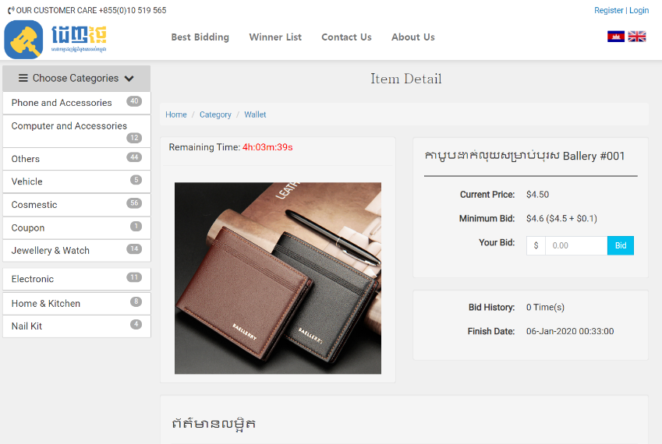
Improvement Plan
Move category to top
Add direct bidding box
Emphasize item detail
Item Detail Page

Slide 11
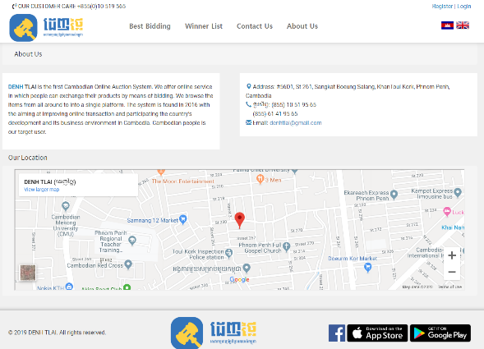
Improvement Plan
Add multiple logos
Relocate whole contents
About Us Page

Slide 12
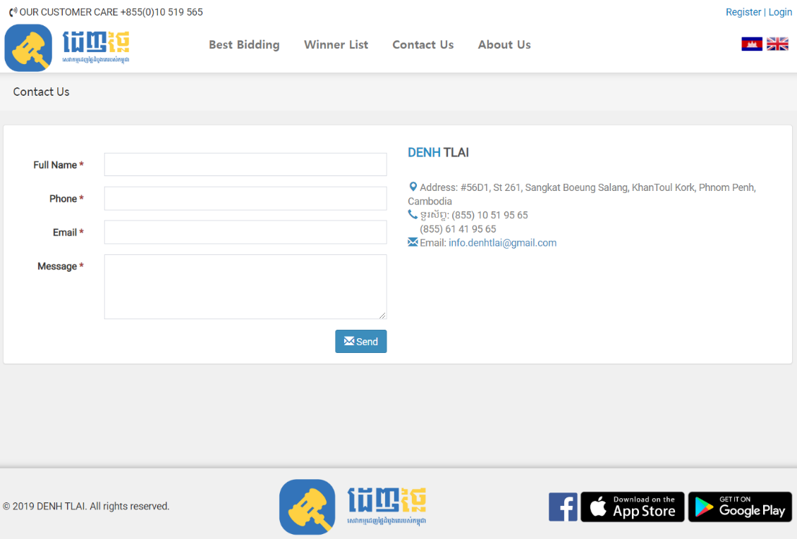
Improvement Plan
Add Top movement bar
Rename : Customer Service
Add FAQ (Frequently Asked Questions)
Contact Us Page

Slide 13
Comparison& Demonstration

Slide 14
Limit & Conclusion

Slide 15
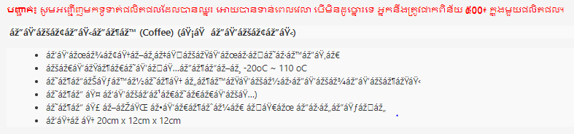
Limit & Conclusion
Some Khmer language are broken after being edited with html.

Slide 16
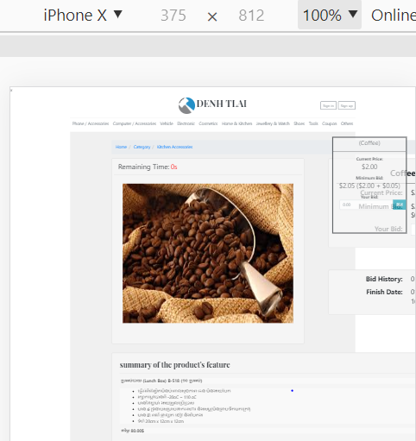
Limit & Conclusion
The layouts are not flexible.

Slide 17

Limit & Conclusion
Next Time…
✓
Apply the Khmerian font well so that it won't break..
✓
Make Denh Tlai homepage kept flexible, When It is opened on mobile.
✓
Review detailed design and connection, and make up for deficiencies.
✓
Create a structure that makes people access to Denh Tlai more easily.

Slide 18

Q & A

