Slide 1

Stock Analysis
Group – 6
• NAYAN PRAKASH SELOKAR - 0790439
• UPASANA DINESH JOSHI - 0789954
• SHASHVAT SACHDEVA - 0768857

Slide 2
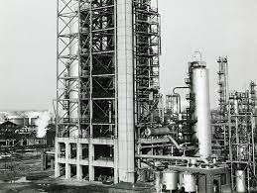
History of organization:
ExxonMobil Corporation is an American multinational oil and gas corporation formed in 1999 through the merger of Exxon Corporation and Mobil Corporation.
After the merger in 1999, ExxonMobil became the world's largest publicly traded oil and gas company, with a market capitalization of over $400 billion. The company operates in over 200 countries and territories, with significant operations in the United States, Canada, Europe, Africa, Asia, and Australia.
ExxonMobil's current operations include exploration, production, transportation, and marketing of oil and gas, as well as the manufacture and sale of chemicals and plastics.

Slide 3
1. Monte Carlo Simulation
A mathematical technique that predicts possible outcomes of an uncertain event

Slide 4
MCS
Developed a Monte Carlo simulation (MCS) model to forecast the stock price for 15 days
Conducted 50 simulations to generate a range of possible future outcomes for the stock price.
The average of the average stock prices for 50 simulations was 103.81 for next 15 days versus the current stock price of 101.62.
Since the expected return is positive and the probability of the stock price increasing is high, we recommend buying the stock.

Slide 5
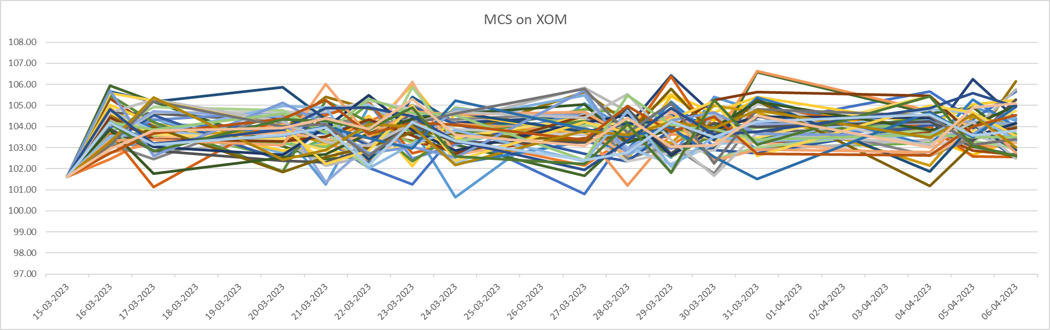

Slide 6
2. Capital Pricing Asset Model
Financial model used to calculate the expected return and risk of an investment by considering the risk-free rate of return, the expected market return, and the asset's beta.

Slide 7
Beta (β) - Volatility in relation to the overall market.
Beta (Yahoo Finance)
β = 1.08
5y Monthly
Beta of 1.08 indicates stock is 8% more volatile than market.
Beta (Calculated)
β = 1.76
5y Monthly
Beta of 1.76 indicates stock is 76% more volatile than market.
Beta is an estimation of volatility, and there is always some error associated with any estimation method

Slide 8
CAPM Model
​Ra​=Rf​+βi(Rm​−Rf​)
where:
Ra​=expected return of investment
Rm = S&P500 Return
Rf​=risk-free rate (Treasury Yield 5 Years)
βi​=beta of the investment
-> 3.53%+1.76*(9.12%-3.53%) = 13.36%
*It means that the expected return of the investment, on the EXXON MOBIL stocks, is 13.36% per year.

Slide 9
3. RATIO ANALYSIS
Used to evaluate a company's financial health and performance across different areas.

Slide 10
1. Liquidity Ratios
Current Ratio (1.41) - The company has 1.41 times more current assets than current liabilities, indicating good short-term solvency.
Quick Ratio(1.06) - The company can cover its short-term liabilities using its quick assets, with some room for additional liquidity.
Cash Ratio(0.43) - The company has less cash and cash equivalents to cover its short-term obligations, indicating lower liquidity.

Slide 11
2. Profitability Ratios
Gross Profit Margin (25.85%) - The company earns 25.85 cents of gross profit for every dollar of revenue, indicating a moderate profitability.
Net Profit Margin (13.98%) - The company earns 13.98 cents of net profit for every dollar of revenue, indicating a moderate profitability after expenses.
Return on Assets (15.10%) - The company earns 15.10 cents of profit for every dollar of assets invested, indicating good asset utilization.
Return on Equity(28.58%) - The company generates 25.58 cents of profit for every dollar of shareholder equity, indicating a good return on investment.

Slide 12
2. Profitability Ratios (Contd)
Operating Profit Margin (15.94%) - The company earns 15.94 cents of operating profit for every dollar of revenue, indicating a moderate profitability from operations.
Earnings per Share (13.54) - The company earns $0.1354 of operating profit for every $1 of revenue, indicating a moderate profitability from operations.

Slide 13
3. Other Ratios:
P/E Ratio (8.10) - The market values the company's stock at 8.10 times its earnings per share, indicating a relatively low valuation.
Dividend Payout Ratio (0.03%) - The company pays out 0.03 cents of dividends for every dollar of earnings, indicating a low payout ratio.
Debt to Equity Ratio (85.41%) - The company has 85.41 cents of debt for every dollar of shareholder equity, indicating higher leverage.
Overall Growth Rate (7.37%) - The company's total revenue has grown at an annual rate of 7.37% over the past five years.

Slide 14
4. Time Series Analysis (Using SMA)
We used 50&100 periods to calculate average value of the adjusted closing price to identify buy or sell signals.

Slide 15
4. Time Series Analysis (Using SMA)
We used 50&100 periods to calculate average value of the adjusted closing price to identify buy or sell signals.
When the short-term moving average crosses above the long-term moving average, this indicates a buy signal.
Contrary, when the short-term moving average crosses below the long-term moving average, it may be a good moment to sell.

Slide 16
4. Time Series Analysis (Using SMA)
We used 50&100 periods to calculate average value of the adjusted closing price to identify buy or sell signals.

Slide 17
5. Forecasting Using FB Prophet
Time series modeling technique that uses a decomposable additive model to predict future values of a time series.

Slide 18
FB Prophet Prediction for XOM
The output of the above model is a predicted time series of future stock prices for ExxonMobil (ticker: XOM).
The model uses the historical data of XOM stock prices from January 1st, 2020
To make predictions for the next 365 days using the Prophet library.
The predicted stock prices gradually increase over time with occasional dips, and the uncertainty of the predicted stock prices increases over time as well, as indicated by the increasing width between 'yhat_lower' and 'yhat_upper' columns.

Slide 19
The model takes into account the trend, seasonality, and daily components of the time series data to make predictions.
Additionally, the predictions are subject to changes in the market and other external factors that may not be captured by the model.

Slide 20
6. Relationship between Predicted values through MCS and FBProphet
The FB Prophet predicts the values by breaking the time series data into trend and seasonality. However, the MCS predicts the value by plotting the random values on a normal distribution using Drift and Standard Deviation.
The average value using MCS for 30 days is 103.54 whereas using FB Prophet is 103.29

Slide 21
THANK YOU!
Any Questions?

