Slide 1
Amazon Alexa Review - Sentiment Analysis
Shashwat Srivastava
PES1PG23CA126
Section: C

Slide 2
Problem Statement
Analyzing the Amazon Alexa dataset and building classification models to predict if the sentiment of a given input sentence is positive or negative.

Slide 3
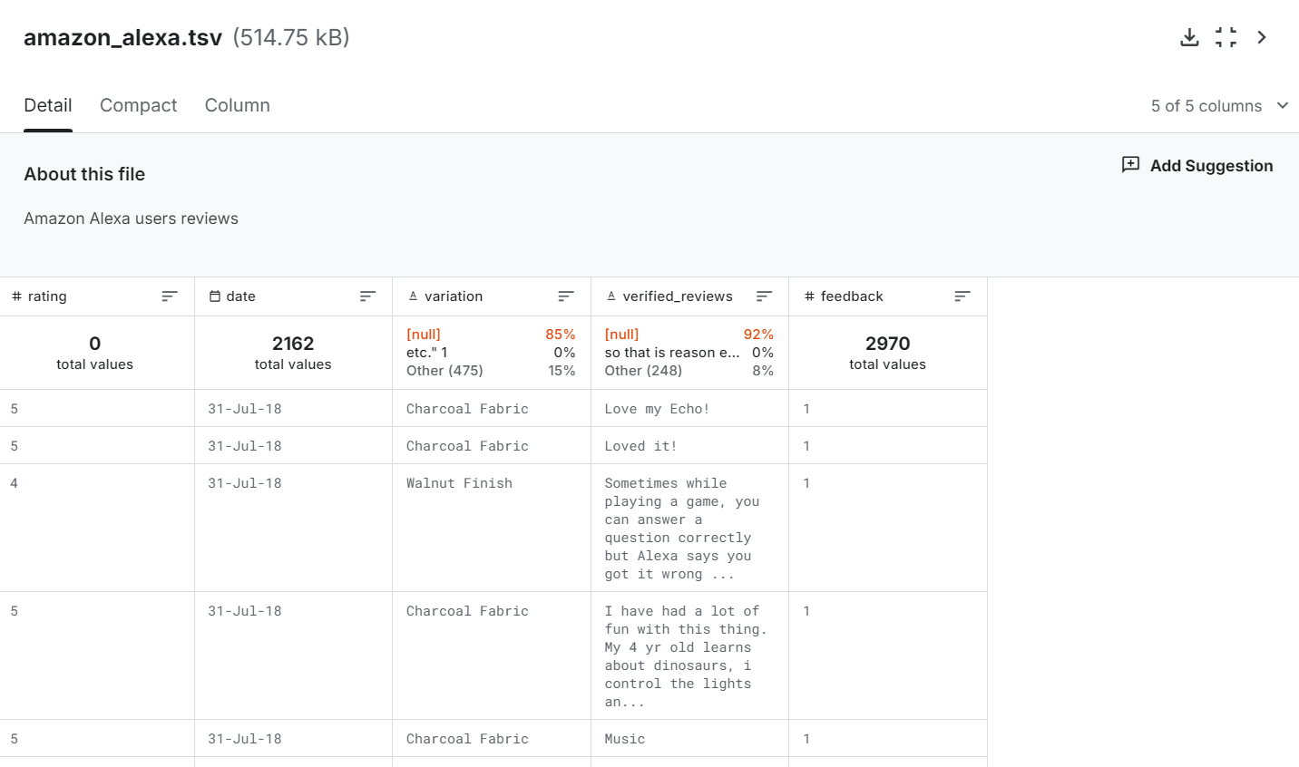
URL:
https://www.kaggle.com/datasets/sid321axn/amazon-alexa-reviews/data
Few records of Data

Slide 4
Description of each attribute
Rating: rating out of 5
Date: date of purchase
Variation: which model they’ve purchased
Verified Reviews: Feedback from the customer
Feedback: 0 (negative) or 1 (positive)

Slide 5
Learning Methodology/Algorithm
Random Forest
K fold cross-validation
XGBoost
Decision Tree Classifier

