Slide 1


PLEDGE TO PROGRESS
Sustainability Hackathon
Sponsored By
Your Team Name: MECH-X4
Your Team Bio: Freshers on Run
Date:

Slide 2
PROBLEM STATEMENT ?
Why we need IoT based Smart Waste Management System?
ENVIRONMENTAL POLLUTION
HEALTH RISK
CLIMATE CHANGE
IoT based Smart Waste Management System will segregate the waste automatically before it reaches to those landfills and dumping grounds so that they can be recycled easily. As we all know that each type of garbage has different recycling process. So, it is very difficult to separate the different kinds of waste from those landfills and dumping ground. It helps us to separate the different types of waste and collect them so that they can be recycled accordingly.
Improper waste disposal can lead to pollution of soil, water, and air. When waste is dumped in open spaces or landfills, it can contaminate soil and water sources. Burning waste in open fires can release harmful gases leading to air pollution.
Improper waste disposal can pose health risks to humans and animals. Dumping hazardous waste in open spaces leads to health problems. Improper disposal of medical waste can also lead to the spread of infectious diseases.
Improper waste disposal can contribute to climate change by releasing methane gas, a potent greenhouse gas, from landfills. Burning waste in open fires can also release carbon dioxide, carbon monoxide and other greenhouse gases into the atmosphere.

Slide 3
Individual users and households can use waste management systems to properly dispose of their waste, such as segregating recyclable materials, composting organic waste, and disposing of hazardous waste at designated facilities.
Businesses can use waste management systems to reduce their waste generation, increase their recycling rates, and ensure proper disposal of hazardous waste. They can also implement sustainable practices, such as reducing packaging waste and using eco-friendly materials.
Governments can use waste management systems to provide waste collection and disposal services to their citizens. They can also implement policies and regulations to promote proper waste management practices, such as mandatory recycling programs and landfill regulations.
USER SEGMENT AND PAIN POINTS ?
Waste management systems can be used by various user segments, including individuals, households, businesses, and governments. Here are some examples of each user segment:

Slide 4
PRE-REQUISITE
Alternatives/competitive products for the IoT Based Smart Waste Management System.
Alternative products that already exist for waste disposal are Manual Wet and Dry
Waste Dustbins. Manual dustbins are traditional dustbins that require manual handling and disposal of waste.
They are usually made of plastic or metal and come in different sizes and shapes.
Users have to manually open the lid and deposit waste into the appropriate bin.

Slide 5
Tools or resources ?
Azure tools or resources which are likely to be used in IoT Based Smart Waste Management System.

Slide 6
WORKING
Firstly, we will put the waste on the top, the sensor present in the waste management system will sense the moisture present in the waste.
If moisture is present in the waste, then it will trigger the servo motor in the direction where the waste collector of wet category is present. If there is no moisture present in the waste, then it will fall into the category of dry waste.
A 16*2 I2C interfaced LCD display is used which will display whether the waste which we have thrown is dry or wet. It will also show a message “Dustbin is full” when the bin gets filled with the waste.
An additional feature is added in which the user will receive a message that your dustbin is full, so that you can emptied it on time to avoid the overflow of garbage.

Slide 7
RESULT
Based on some trials keys, tin lid, Aluminum sheet etc are detected as metallic waste. Paper, dry cloth, plastic waste, wood pieces etc are detected as dry waste whereas banana peel, wet cloth, lemon etc are detected as wet waste.
Waste management is all those activities, actions and works required to manage waste from its production to its final disposal. This project is designed such a way that a system which collects from different positions and segregates the wastes.

Slide 8
KEY DIFFERENTIATORS
Convenience
Hygiene
With IoT Based Smart Waste Management System, you don't need to touch or handle the bin to dispose of your waste. You can just put the waste on the top, and it will automatically segregate the waste based on its type.
Efficiency
Durability
IoT Based Smart Waste Management System help to maintain a high level of hygiene and cleanliness. Since you don't need to touch the bin to open it, there is less chance of spreading germs and bacteria.
IoT Based Smart Waste Management System are more efficient than manual ones. They are time saving as they work automatically. Dry and wet waste can be separated without any fuss.
IoT Based Smart Waste Management System are typically made from high-quality materials that are built to last. They can be designed to withstand heavy use and are less likely to break or malfunction than manual bins.
How IoT based Smart Waste Management System is better than other alternatives?

Slide 9
ADOPTION PLAN
ASSESS THE NEED
Conduct a survey to determine the number of households, offices, or public places that require IoT Based Smart Waste Management System. This will help to determine the quantity and size of the bins needed.
IDENTIFY THE BUDGET
Determine the cost of purchasing and installing the bins, and identify sources of funding. This could include government grants, corporate social responsibility funding, or community fundraising.
MANUFACTURING
Manufacture the bins with upto the mark quality, durability, and features of the bins to ensure they meet the requirements of the community.
INSTALLATION
EDUCATION AND AWARENESS
Develop a plan for installing the bins in strategic locations, such as public parks, commercial areas, or residential areas. Consider the logistics of transportation, installation, and maintenance.
Develop an education and awareness campaign to inform the community about the benefits of automatic wet and dry dustbins and how to use them effectively. This could include flyers, posters, and community events.
MAINTANENCE AND MONITORING
Establish a system for monitoring the use of the bins, collecting feedback from the community, and conducting regular maintenance and repairs.

Slide 10
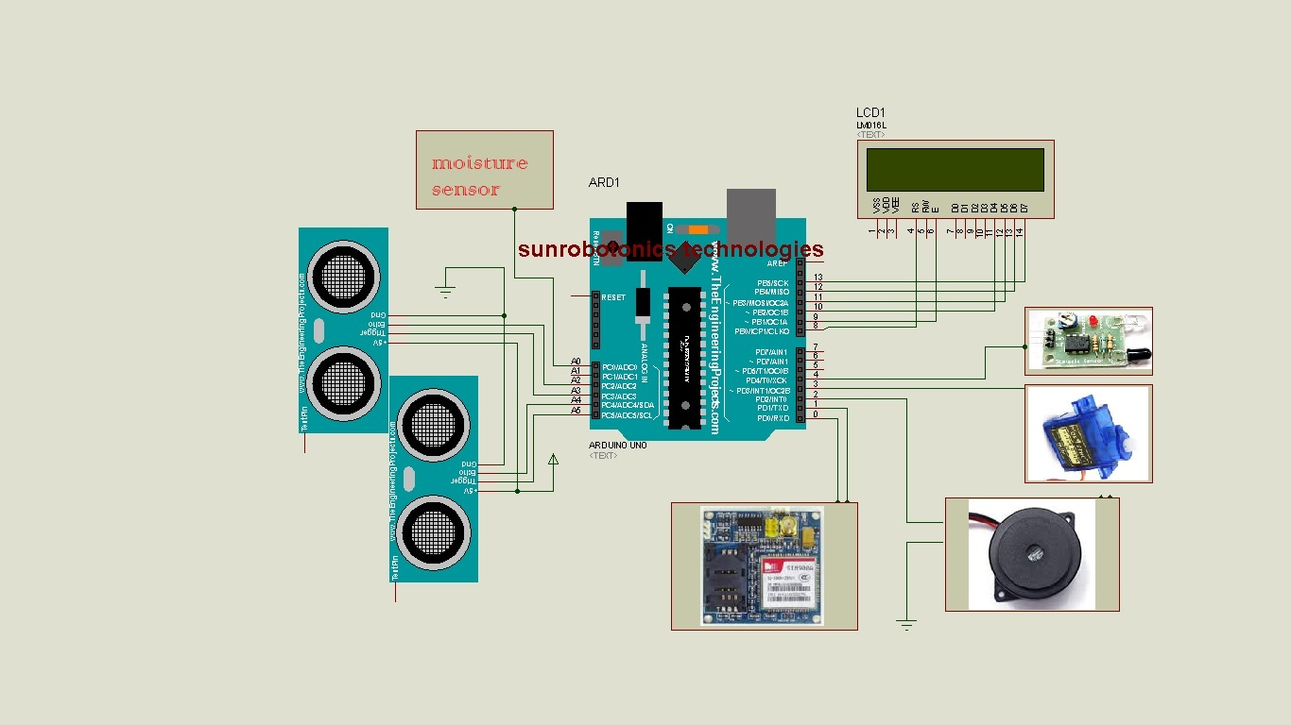
CIRCUIT DIAGRAM OF IoT BASED SMART WASTE MANAGEMENT SYSTEM

Slide 11
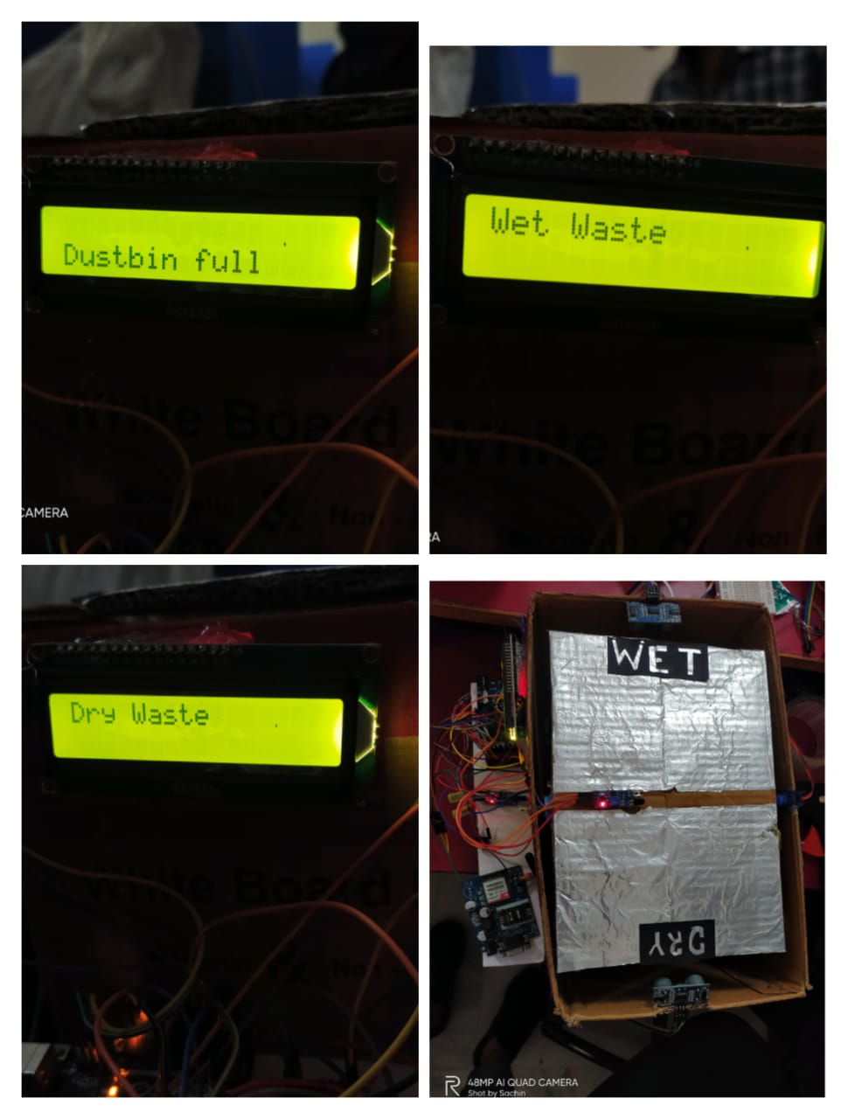

Slide 12
GitHub REPOSITORY LINK

Slide 13
TECHGIG
Thank You
Shashwat Shinghal
Somya Kaushik
Vasu Agarwal
Ashish Rana

