Slide 3





Slide 4
L

Slide 5


Slide 6
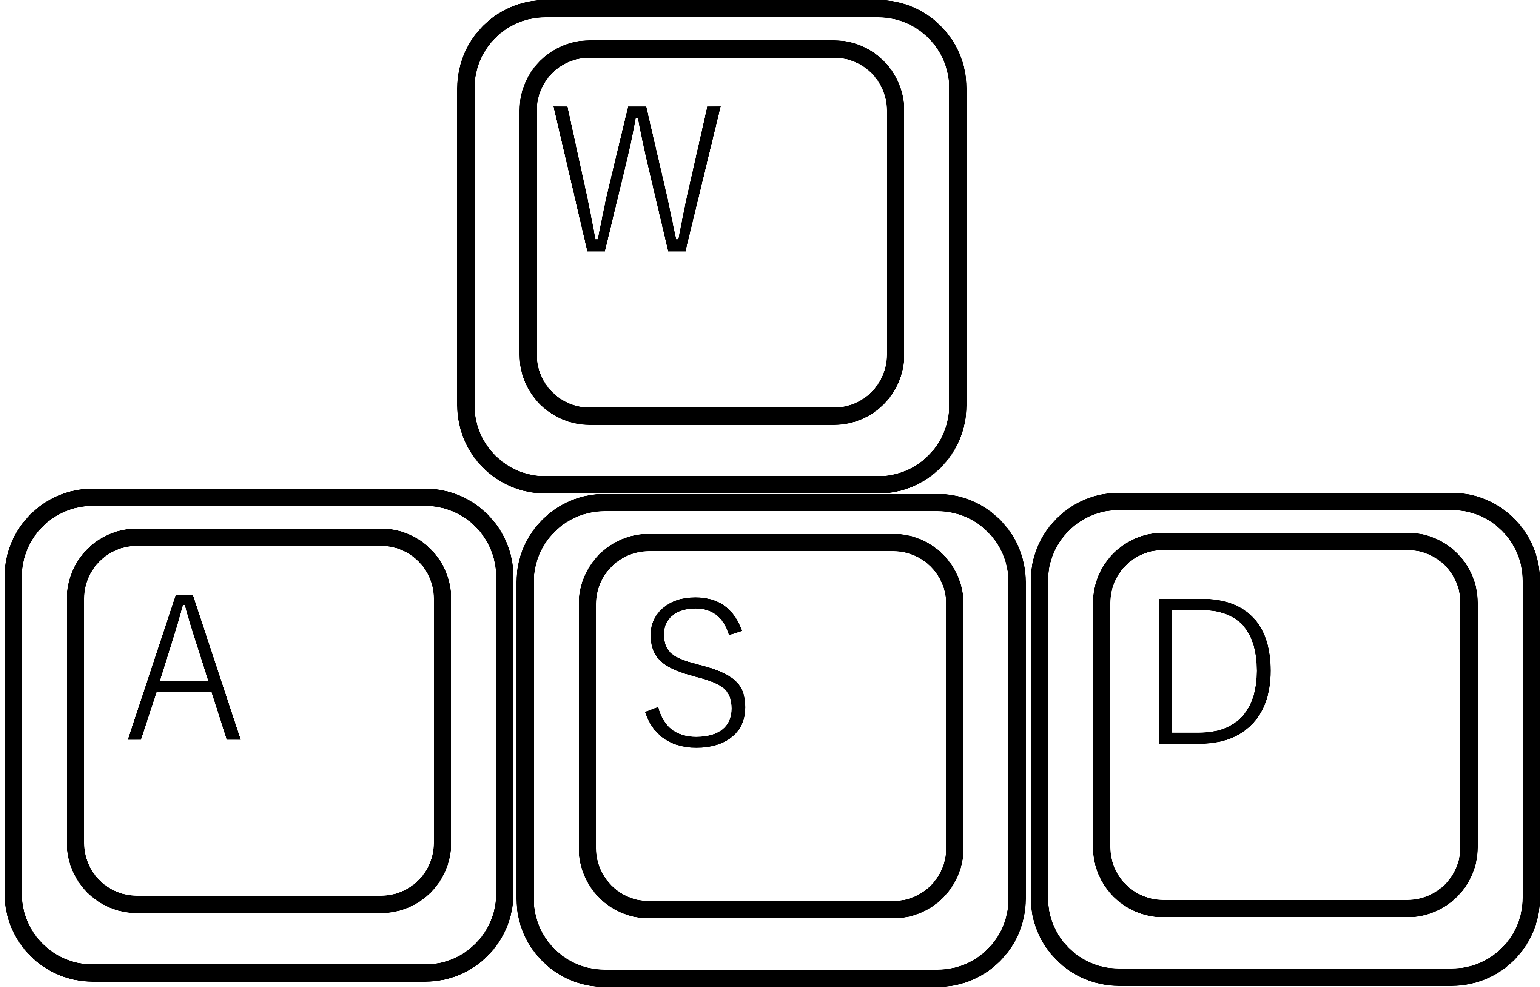
W
Move
A
S
D
J
Left Punch
K
Right Punch
L
Guard/Parry
I
Dash
Pause
SPACE

Slide 7




Slide 8
