Slide 1
Departmental Engineering Project CP301
Siddhartha Arora 2021eeb1213
Shashwat Srivastava 2021eeb1210

Slide 2
Table of contents
01
02
03
04
05
06
Statement
Hypothesis
Need for spectrum sensing? What is it?
Spectrum sensing as a binary hypothesis problem
Objectives
Methodology
Discussing the objectives of this project
Deep learning spectrum sensing methodology
Analysis
Conclusions
In-depth analysis and results here
You can describe the topic of the section here

Slide 3
01
Problem Statement
ML implementation in Spectrum Sensing

Slide 4
Purpose statement
What is Spectrum Sensing? Need for it?
1. Cognitive Radios (CR) utilize spectrum-sensing to differentiate between noise-only and signal-plus-noise bands, necessitating advanced techniques like machine learning for accurate detection.
2. Cognitive radio networks (CRNs) enhance spectrum efficiency by enabling secondary users to access unused spectrum, relying on spectrum sensing to detect available bands amidst various challenges, including the need to vacate bands for critical signals like military communications.

Slide 5
Literature review
C. Szegedy et al., "Going deeper with convolutions," 2015 IEEE Conference on Computer Vision and Pattern Recognition (CVPR), Boston, MA, USA, 2015, pp. 1-9, doi: 10.1109/CVPR.2015.7298594.
S. Zheng, S. Chen, P. Qi, H. Zhou and X. Yang, "Spectrum sensing based on deep learning classification for cognitive radios," in China Communications, vol. 17, no. 2, pp. 138-148, Feb. 2020, doi: 10.23919/JCC.2020.02.012.
W. M. Lees, A. Wunderlich, P. J. Jeavons, P. D. Hale and M. R. Souryal, "Deep Learning Classification of 3.5-GHz Band Spectrograms With Applications to Spectrum Sensing," in IEEE Transactions on Cognitive Communications and Networking, vol. 5, no. 2, pp. 224-236, June 2019, doi: 10.1109/TCCN.2019.2899871.

Slide 6
02
Binary Hypothesis

Slide 7
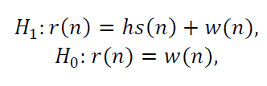
Problem Formulation
Spectrum sensing can be expressed as a binary hypothesis test problem as follows:
where 𝑟(𝑛) represents the received signal, 𝑠(𝑛) represents the transmitted signal, 𝑤(𝑛) represents the noise, and ℎ represents the channel gain.
We have considered spectrum sensing as a classification problem with two categories and proposed a spectrum sensing method based on deep learning.
The method also has the ability of generalization and can adapt to detecting a variety of
untrained signals.

Slide 8
03
Objectives

Slide 9
The objectives are:
Presenting spectrum sensing as a classification problem and proposing a spectrum sensing method based on deep learning classification.
Demonstrating the adaptability of the proposed method to detect unknown signals, showcasing strong generalization ability.
Conducting transfer learning experiments to fine-tune the model with real-world signal samples, leading to further performance improvements.

Slide 10
04
Methodology

Slide 11
Methodology
Type of data
We worked on two types of data, both of which were simulated on matlab using a MATLAB script.
Motives
We propose using deep learning for spectrum sensing, treating it as a classification task.
SpecSense
Image Processing
Finally we used two approaches in this - one was our own CNN model and other was using Inception module
Results
We got really good results for both our own CNN model as well as Inception module, which is 27 layers deep.

Slide 12
05
Analysis

Slide 13
Traditional methods:
Various traditional spectrum sensing techniques: Energy detection, Cyclostationary feature-based detection, Eigenvalue-based detection, Frequency domain entropy-based approach
Machine Learning (ML) in spectrum sensing: Support Vector Machine (SVM), weighted K-nearest neighbor, K-means clustering, Gaussian mixture model, Use of CNNs & RNNs.

Slide 14
How was data collected?

Slide 15
Data Generation/ Simulated Data
4-FSK modulated signal with specifications
In this project, data generation plays a crucial role in simulating real-world scenarios for signal processing tasks. Through random number generation within defined ranges, binary symbols are created to represent signal presence or absence. Parameters such as modulation order, sample rate, and signal-to-noise ratio are carefully set to mimic various communication environments.
2) FSK with different modulation order
Here, we change the modulation schemes to 2, 4, 8 for signals and decrease the fs range by around 7 MHz to avoid any syntax errors. We then generate spectrograms corresponding to this and save them in one of the directory which is also made by the MATLAB code itself.

Slide 16
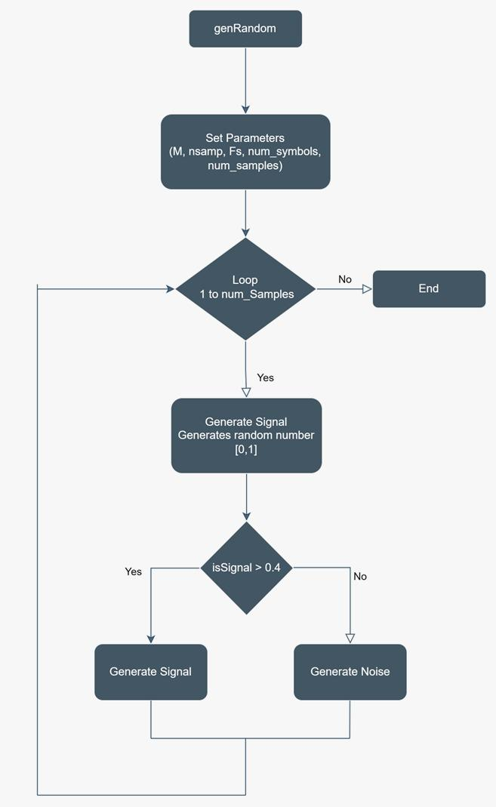
Flowchart for Data Generation:
It sets various parameters for the simulation.
A loop iterates num_samples times.
Inside the loop, a random number is generated to determine if a signal or noise spectrogram is created.
If a signal is generated:
Random symbols, frequency separation, and SNR are generated.
FSK modulation and noise are applied.
The spectrogram is plotted, saved, and the figure is closed.
If noise is generated:
White Gaussian noise is created.
The spectrogram is plotted, saved, and the figure is closed.

Slide 17
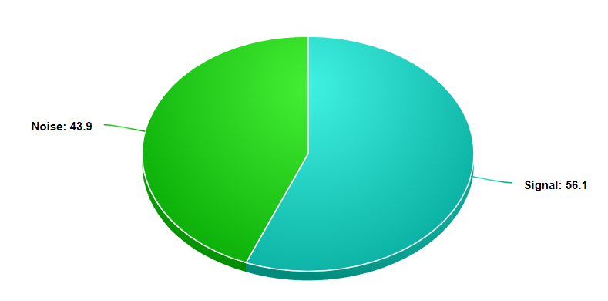
Class Distribution

Slide 18
Spectrograms:
Three dimensional display of signals
X-axis is time, like in a waveform
Y-axis is frequency, like in a spectrum
Darkness is a third dimension, showing amplitude on a dB-scale, like in a spectrum

Slide 19
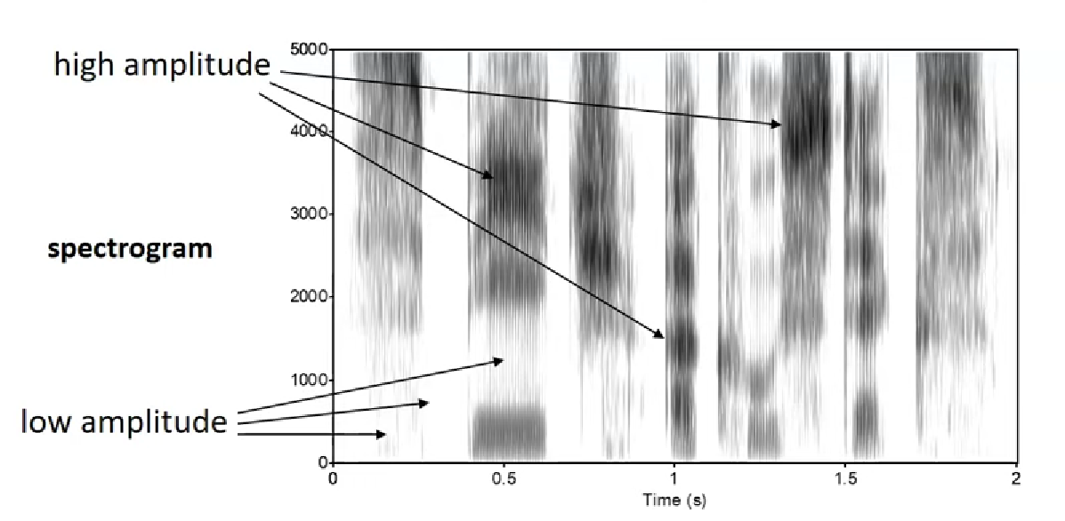

Slide 20
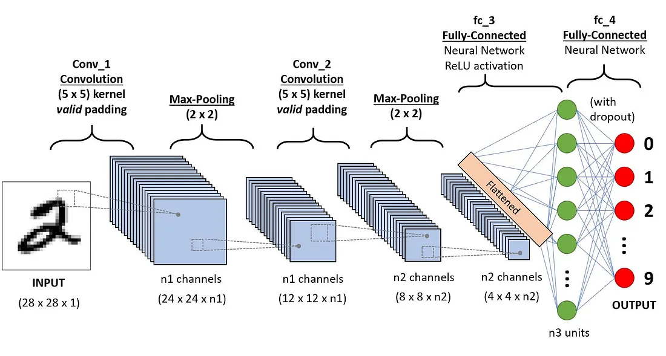
CNN or ConvNets
It’s all about -
sparse interactions,
parameter sharing, and
equivariant representations.

Slide 21
Basic Principle followed-
“Keep the feature space wide and shallow in the initial stages of the network, and the make it narrower and deeper towards the end.”

Slide 22


Technologies-
Python and Tensorflow are industry standards
TensorFlow uses Keras as a simple interface
TensorFlow is open source.

Slide 23
Process analysis and optimization

Slide 24
How did we optimize?
Model Architecture Inspiration: Drawing inspiration from classic models, we explore trends in layer configurations such as Conv-Pool-Conv-Pool or Conv-Conv-Pool-Conv-Conv-Pool, as well as variations in channel progression (e.g., 32–64–128) and filter sizes.

Slide 25
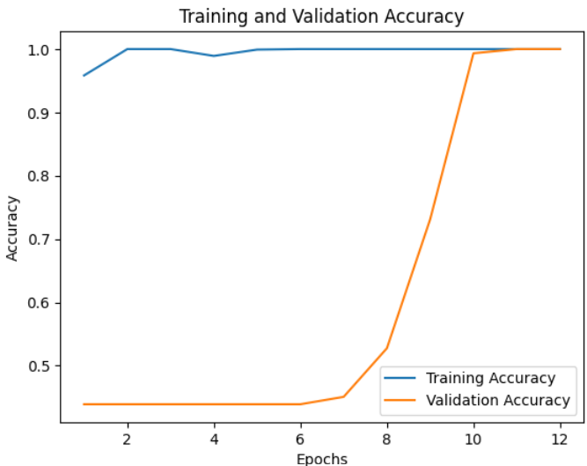
RESULTS-

Slide 26
100% validation accuracy - A red flag?
100% validation accuracy may occur if we are adding a bias in the system or if there is a case of class imbalance, both don’t seem to be the case here since we used a fairly balanced data.

Slide 27
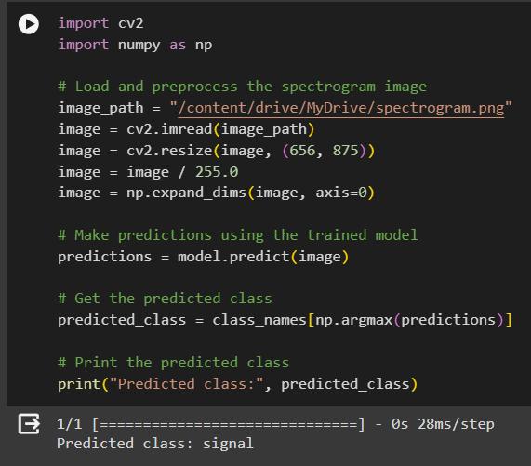
Testing on field data - Performs well!!

Slide 28
Theoretical framework
Theoretical framework
Key terms
Relevant theories
Our framework
Deep Learning
Spectrum Sensing
Transfer Learning
Theory A
Uses Deep Learning while using the best practices and taking it’s model inspiration from really good architectures.
traditional spectrum sensing techniques
Theory B
Machine Learning (ML) in spectrum sensing

Slide 29
Thanks!!
Shashwat Srivastava 2021eeb1210
Siddhartha Arora 2021eeb1213

