Slide 1
Human Action Recognition Shashwat Gupta 14IE10028 Prof. Pranab Kumar Dutta Department of Electrical Engineering

Slide 2
Introduction
Human action recognition is the process of taking a video or a sequence of images and identifying the corresponding actions with labels.
Vision-based human action recognition is affected by several challenges due to view changes, occlusion, variation in execution rate, anthropometry, camera motion, and back- ground clutter.
Robust solutions to this problem have applications in domains such as visual surveillance, video retrieval, robot navigation and human–computer interaction.
3D object reconstruction and motion prediction also make use of action recognition algorithms

Slide 3
Method
The following are the tasks at hand:
Detection: Consider certain points of interest which could be edges, corner points, unique shapes, etc. We have considered corner points as the points of interest as they have an expressive texture and are free from the aperture problem.
Tracking/Matching: Track the points of interest spatio-temporally between frames.
Classification: Classify the action based on the spatio-temporal movements of the interest points using classification techniques like SVM, KNN.

Slide 4
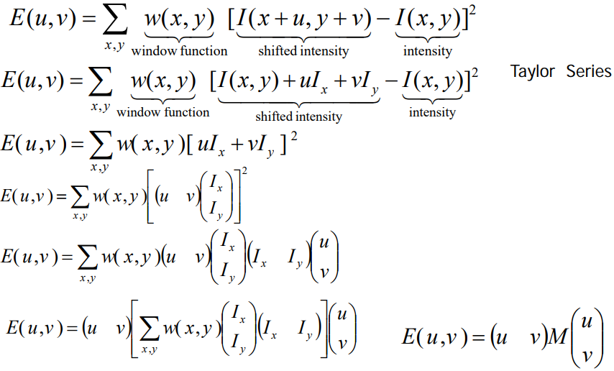
Algorithm for Detection
We use an energy function based on the change in intensity values of the pixels.
We use a Gaussian window function to give greater weight to nearby pixels.
Let λ₁ and λ₂ be eigenvalues of matrix M
We define R as the measure of cornerness in terms of the eigen values. It is large for corner points and hence helps us to identify them in the image.
Take only the points of local maxima of R

Slide 5
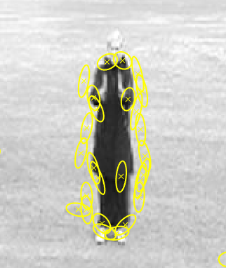
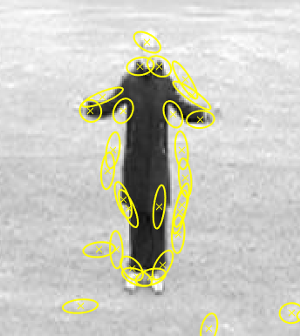
Results
The video is divided into multiple frames. The interest point detection is applied to each frame individually. We take patches of 3X3 in the image and calculate R for each patch.
The code has been implemented on MATLAB. Each interest point is marked with a yellow ellipse and a cross. The length of the major axis of the ellipse represents max(λ₁, λ₂)^{(-0.5)} and the length of the minor axis represents min(λ₁, λ₂)^{(-0.5)}
We take a video of a man exercising and take two frames and apply the algorithm. The results can be seen in Fig.1 and Fig.2.
Fig.1
Fig.2

Slide 6
Future Work
Tracking of interest points spatio-temporally across the entire video sequence
Classification of the action
Motion prediction

