Slide 1
Tom Brady Superbowl Prediction Model
By: Shaswat Maharjan, Lele Zhang, Brandon Panuccio, and Satrant Bains

Slide 2

Motivation
American Football is one of the most popular sports in the United States
According to Gallup 41% of Americans say American Football is their favorite sport
It also generates the highest revenue for any sports league in the world at $20.5 billion.
Tom Brady is the greatest football player of all time
How important is he as a player to team success?
Can a classification algorithm trained only on his regular season stats predict a Superbowl win?
Notes:
Satrant Bains

Slide 3
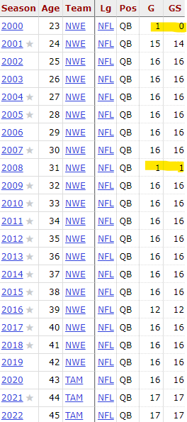
Dataset
To train a model we must go over what data we used to train the model and why.
We used Pro Football Reference’s dataset as they have the most comprehensive stats available.
Data cleanup -> removing years where he did not play
We split the dataset between training and testing
The first test we used years 2002-2009 to train the model and tested it on years 2010-2023
The second test we used years 2002-2009 to train the model and tested it on years 2010-2023
Notes:
Brandon

Slide 4
Models Chosen
We chose a few different models to do our testing
SkLearn Logistic Regression
Pytorch DNN
Tensorflow DNN
XGBoost Classifier
Why use so many models?
To see if any model is generally better suited for sports statistics
We wanted to see if the PyTorch and Tensorflow would show the same results.
XGBoost was used because it is a tree-based model.
Typically from literature, XGBoost outperforms Neural Networks on tabular dataset.
Notes:
Shashwat

Slide 5
Feature Selection
Selecting features requires a certain level of football knowledge
We settled on removing data that is not a raw statistic
Accomplishments such as MVP awards are not considered
We also removed the QBR as it was not tracked prior to 2005 which would cause issues in training and testing
In total we use every measurable QB stat to train and test our models
Including TDs, INTS, YDS, CMP%, Y/C, Passer Rating, Sacks, etc.
In total 26 features
Notes:
Satrant

Slide 6
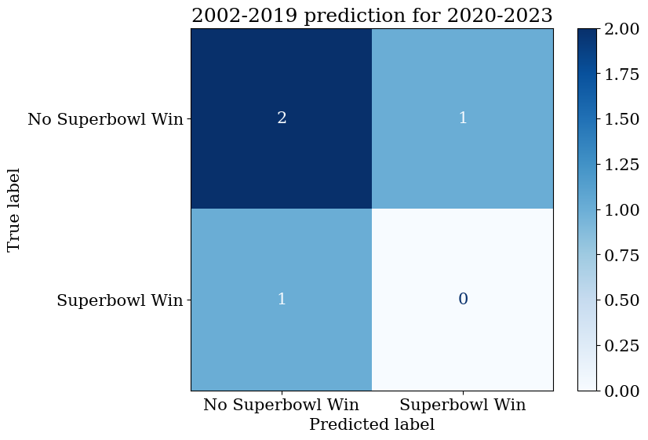
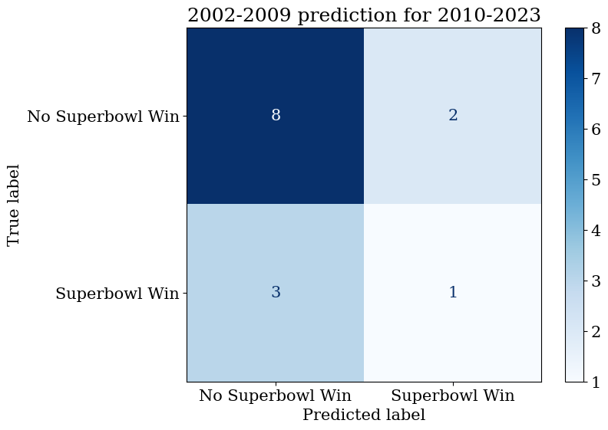
SkLearn Regression Results
Notes:
Lele
Model Metrics for training years 2002 to 2019:The model achieved an accuracy of 50%, which means that half of the predictions were correct.Both precision and recall are 0%, leading to an F1 score of 0%. This indicates that the model failed to correctly predict any Superbowl wins at all.
2002 to 2009:In this case, the model achieved an accuracy of 64.29%, Precision was 33.33%, and recall was 25%. This means that while the model identified some winners, there were still significant limitations, as indicated by the F1 score of 28.57%. The F1 score, being a balance between precision and recall, suggests that the model still struggles

Slide 7
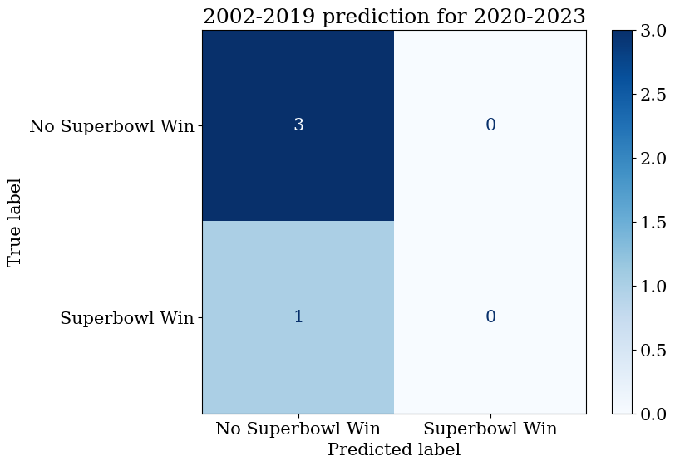
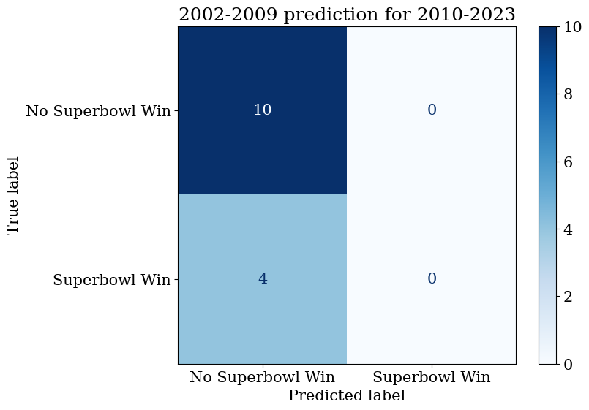
XGBoost Results
Notes:
Lele
Model Metrics for training years 2002 to 2019:The model has an accuracy of 75%, meaning three out of four predictions were correct. However, all correct predictions were for 'No Superbowl Win’. The precision, recall, and F1 scores are all zero. This indicates that the model did not successfully predict any of the positive cases, i.e., no Superbowl wins were identified.
2002 to 2009:The accuracy of this model is 71.43%, which seems relatively high. However, similar to the previous slide, this is mainly due to the model predicting 'No Superbowl Win' in most cases. Like before, precision, recall, and F1 scores are all zero, meaning the model did not predict any positive outcomes (i.e., Superbowl wins) correctly.

Slide 8
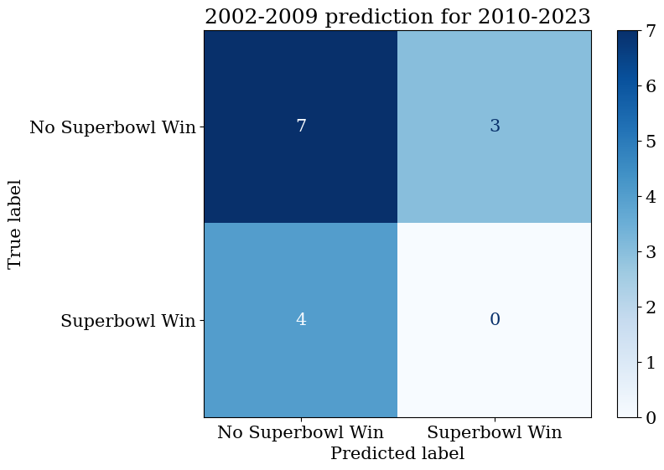
PytorchDNN Results
Notes:
Shashwat
Compared to xgboost results previously, we see a worse results where:
Model Metrics for training years 2002 to 2009:
Accuracy: 50%
Precision: 0.00
Recall: 0.00
F1 Score: 0.00
Model Metrics for training years 2002 to 2019:
Accuracy: 75%
Precision: 0.00
Recall: 0.00
F1 Score: 0.00
Can be attributed to

Slide 9
Tensorflow DNN Results
Notes:
Shashwat
Model Metrics for training years 2002 to 2009:
Accuracy: 50%
Precision: 0.00
Recall: 0.00
F1 Score: 0.00
Model Metrics for training years 2002 to 2019:
Accuracy: 50%
Precision: 0.00
Recall: 0.00
F1 Score: 0.00
One thing to note when analyzing the results are that there are season samples where Tom Brady did really good and reached the superbowl final but did not win it so these values may serve as a distraction to the model when falsely predicting a true positive (superbowl win),.

Slide 10
Analysis of Results
The models generally have a >50% accuracy in predicting whether Tom Brady won a Superbowl or not
The best performing model for our testing was XGBoost with both accuracies being above 70%
Was the model truly accurate at predicting the result?
Only 1 True Positive result -> Only one time the models predict a win and it actually happened.
The models were truly great at predicting when Tom Brady was not going to win a Superbowl.
Why would this happen?
Football is a team sport and its inherently difficult to say, based on one player’s regular season stats, whether they would win it all
Notes:
Brandon

Slide 11
Future Analysis
In the future the models can certainly be honed in on more statistics
Perhaps switch to team-based statistics
Some way to include defensive statistics as well
Randomly sample years instead of looking over windows
Teams generally are better the closer they are to a year they won the Superbowl
Perhaps find a way to include awards as a statistic in training
Notes:
Satrant

Slide 12
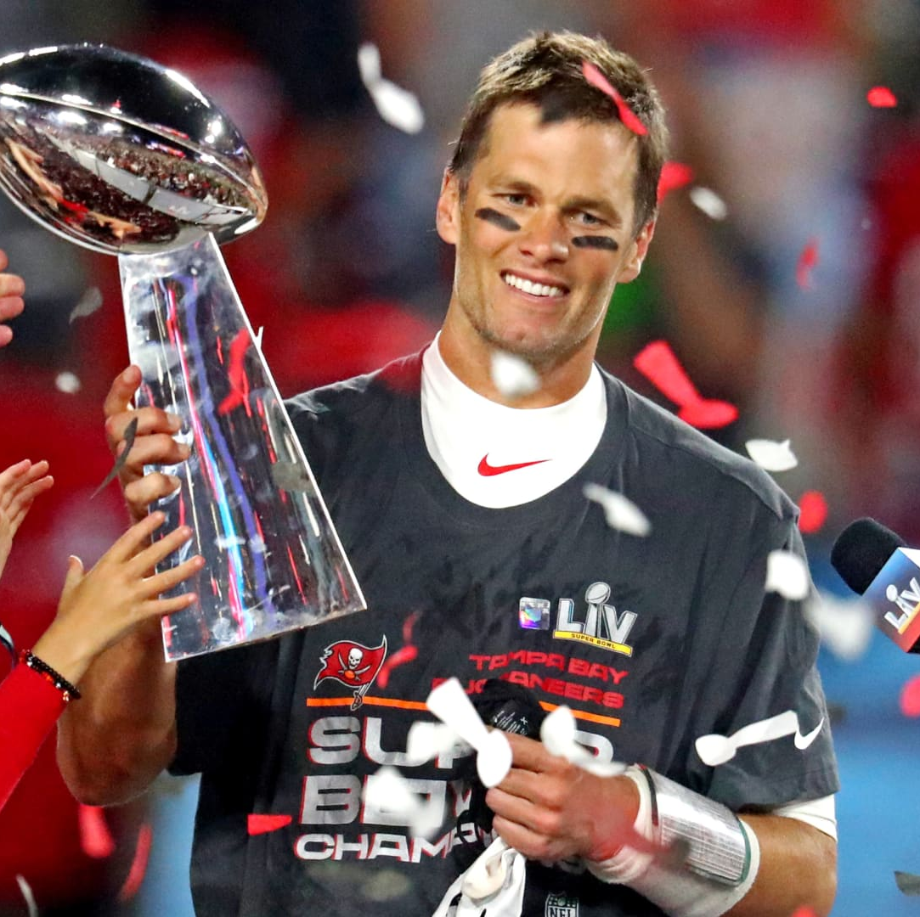
Conclusion
The models became quite accurate at predicting when a season did not end in a Superbowl for Tom Brady
Simple accuracy is not the best measure of a model for analysis such as this.
Precision provides a better look
More data may help
We could include game by game stats to see if more granular data may help the model predict wins.
Notes:
Shashwat
Precision provides a better look because our original goal is to accurately predict when Tom Brady will win the superbowl.

Slide 13
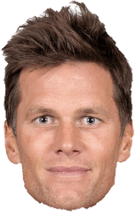
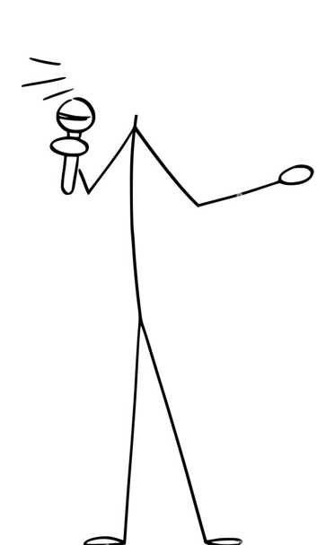
Questions?

