Slide 1
Linear and Discrete Optimization
3. Graphs: introduction and spanning trees
Ola Jabali

Slide 2
Content
Graph applications
Graphs terminology
Graph reachability problem
Subgraphs, trees and spanning trees
Minimum cost spanning trees
3.5 Prim’s algorithm

Slide 3
3.1 Graph applications
Transportation and distribution problems,
Network design (communication, electrical,..)
Location problems (services and facilities)
Project planning, resource management
Timetable scheduling
Production planning
¨ …

Slide 4
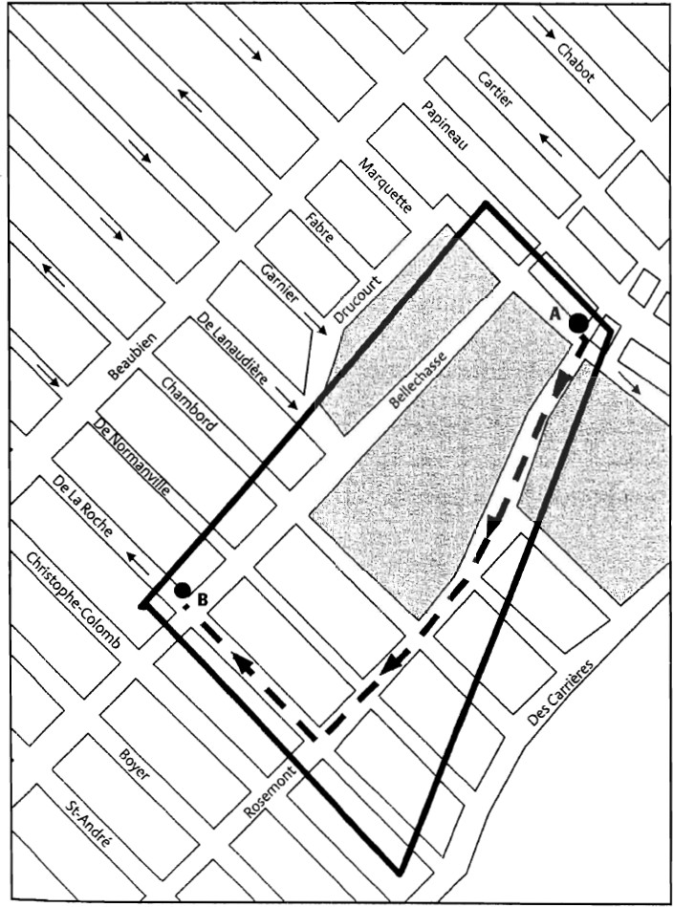
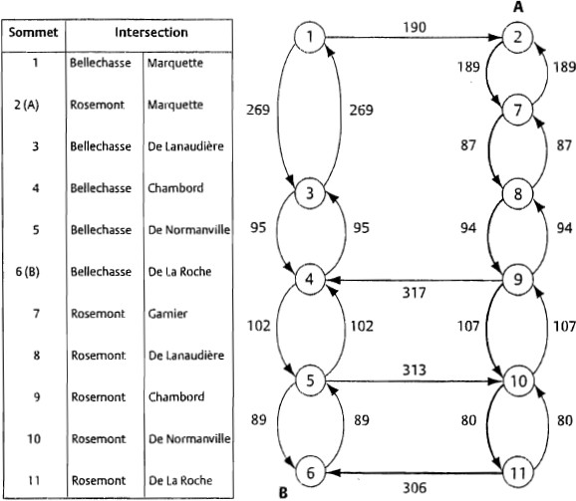


Shortest cycling path
node
Source: « Méthodes de planification en transport », Y. Nobert, R. Ouellet, R. Parent, PUM, 2005.

Slide 5



















3.2 Graphs terminology
1
2
Example
N={1,2,3,4,5} E={[1,2],[1,3],[1,4],[1,5],[2,3],[2,5],[3,4],[3,5],[4,5]}
n=4 and m=9
5
3
4
Definitions
A graph G = (N, E) which consists of a set N of nodes (vertices) and a set E of edges
connecting them.
n = |N| and m = |E|

Slide 6
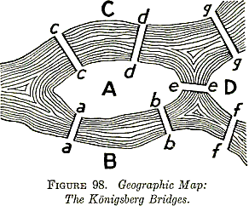












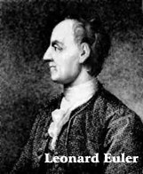
History: bridges of Konigsberg
C
A
D
B
Source: ‘Kraitchik, M. §8.4.1 in Mathematical Recreations. New York: W. W. Norton, pp. 209-211, 1942.

Slide 7

















Graphs: terminology
1
2
Example
nodes 1 and 2 are adjacent
edge [1,5] is incident in nodes 1 and 5
node 1 has degree 4, node 4 has degree 3
5
3
4
Definitions
Two nodes are adjacent if they are connected by an edge
An edge e is incident in a node v if v is an endpoint of e
The degree of a node is the number of incident edges

Slide 8











Paths
1
2
Example
[v₁, v₂], [v₂, v₃], [v₃, v₅]
5
3
4
Definitions
A sequence of consecutive edges [v₁, v₂], [v₂, v₃],…, [v_{k-1}, v_{k}] is a path which connects nodes v₁ and v_{k}
v_{i}, v_{j} ∈ N are connected if there exists a path connecting them
A simple path is a path with no repeated arcs

Slide 9
























Connected graph
Definition
G = (N, E), is connected if v_{i}, v_{j} are connected ∀ v_{i}, v_{j} ∈ N
1
2
1
2
5
3
5
3
4
4
Connected
Not connected

Slide 10


















Directed graph
Definition
Directed graph G = (N, A), where A is a set of ordered pairs of nodes (v_{i}, v_{j}) called arcs
1
2
5
3
4

Slide 11





Directed path
Definition
A sequence of consecutive arcs (v₁, v₂), (v₂, v₃),…, (v_{k-1}, v_{k}) is a directed path from v₁
to v_{k}
1
2
5
3
4
directed path from 1 to 2

Slide 12














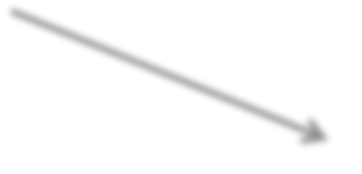
















Cycle/circuit
Definitions
A cycle is a path with v_{k} = v₁
A circuit is a directed path with v_{k} = v₁
1
2
1
2
5
3
5
3
4
4
cycle
circuit

Slide 13












Complete graph
Definitions
G = (N, E) is complete if E = { [v_{i}, v_{j}] : v_{i}, v_{j} ∈ N, i < j }
m=6
1
2
n=4
Property
For any graph G with n nodes, the number of edges satisfies:
m ≤(n(n-1))/2 if G undirected
m ≤ n(n-1) if G directed
In both cases, we have equality for complete graphs
4
3

Slide 14













Graph representation
For dense directed graphs, n×n adjacency matrix: a_{ij} = 1 if (i,j) ∈ A and a_{ij} = 0 otherwise
For sparse directed graphs, list of successors or predecessors
1
2
S(1) = {2, 4}
4
3
S(2) = {3}
S(3) = {1}
S(4) = {2,3}
(i,j) | 1 | 2 | 3 | 4
1 | 0 | 1 | 0 | 1
2 | 0 | 0 | 1 | 0
3 | 1 | 0 | 0 | 0
4 | 0 | 1 | 1 | 0

Slide 15

Cut
Definitions
Given an undirected graph G and a subset of nodes S ⊂ N, the cut induced by S denoted by 𝛿(S), is the subset of edges with an endpoint in S and the other endpoint in N \ S.
1
2
3
N \ S
4
5
6
δ(S) = δ(N \S)
S

Slide 16


Cut
Definitions
Given a directed graph G and a subset of nodes S ⊂ N,
the outgoing cut induced by S is δ⁺(S) = { (v, w) ∈ A : v ∈ S, w ∈ N \ S } the incoming cut induced by S is δ⁻(S) = { (v, w) ∈ A : w ∈ S, v ∈ N \ S}
1
2
3
N \ S
S
4
5
6

Slide 17


3.3 Graph reachability problem
Problem
Given a directed graph G = (N, A) and a node s, determine all the nodes that are reachable from s.
Successor lists :
S(1) = {2, 4}
S(2) = {5}
S(3) = {5, 6}
S(4) = {2}
S(5) = {4}
S(6) = {2}
s
1
2
3
4
5
6

Slide 18
Graph reachability problem
Devise an (efficient) algorithm that allows to find all nodes reachable from s
Input: G = (N, A) with n = |N| and m = |A|, described by the successor lists, and a node s.
Output: Subset M ⊆ N of nodes of G reachable from s.
We use a “queue” Q containing the nodes reachable from s and not yet processed (First-In First-Out policy)

Slide 19
Graph reachability problem
s = 1
Q = {1} and M = Ø
1
2
3
and M = {1}
Q = { 1 }
Q = { 2, 4}and M = M ∪ {2}
Q = { 4, 5} and M = M ∪ {4}
Q = { 5 } and M = M ∪ {5}
Q = ∅
4
5
6
Subset M = {1, 2, 4, 5} of nodes that have been labeled is the subset of nodes reachable from s = 1
Observation: No arcs exit M and enter N \ M !

Slide 20
Graph reachability problem
1
2
3
N \ M
4
5
6
M
The algorithm (exploration) stops because δ⁺(M)=Ø,
δ⁻(M) is the set of arcs with head in M and tail not in M.

Slide 21
Pseudocode for the graph reachability algorithm
output
Subset of nodes M (reachable from s)
BEGIN
Q := {s}; M := ∅;
WHILE Q ≠ ∅ DO |  | /* process | a | node | h ∈ Q */
Select a node h ∈ Q and set |  |  |  | Q := | Q \ {h};
M := M ∪ {h}; |  | /* label | h | */
FOR EACH | j ∈ S(h) DO
IF j ∉ | M AND j ∉ Q THEN |  | Q := Q ∪ {j} END-IF
END-FOR END-WHILE
END

Slide 22















3.4 Subgraphs, trees and spanning trees
Example
Design a communication network so as to connect n cities
1
2
5
3
4
n=5
Model
Graph G = (N, E) with n = |N|, m = |E|

Slide 23























Subgraphs
Definition
G’ = (N’, E’) is a subgraph of G = (N, E) if
N’ ⊆ N
E’ ⊆ E only contains edges with both endpoints in N’
1
2
1
2
5
3
5 3
N’ = {1,2,3,5} ⊆ N
E’ = {[1,2],[1,5],[2,3],[2,5],[3,5]} ⊆ E
4
G=(N, E)

Slide 24








Trees
Desired properties of a communication network:
Since every pair of cities must be connected, N’ = N and G’ must be a
connected subgraph of G
Since we do not want to waste resources, G’ must be an acyclic subgraph (without cycles) of G
1
2
Definition
A tree G_{T} = (N’, T) of G is a subgraph of G that is both connected and acyclic.
5 3
T={[1,5],[2,5],[3,5]}

Slide 25
















Spanning trees
Definition
G_{T} = (N’, T) is a spanning tree of G = (N, E) if it contains all the nodes of G (namely N’ = N ).
1
2
n=5
5
3
4
Definition
The leaves of a tree are the nodes of degree 1.

Slide 26
4.2 Minimum cost spanning trees
Applications
network design (communication, electrical,...)
IP network protocols
compact memory storage (DNA)
¨ …

Slide 27









































Examples of Spanning trees
1
2
c(T)= is the total cost of spanning tree T
1
4
2
3
6
2
4
5
2
3
A few feasible solutions
4
5
n=5
2
1
1
1
1
2
1
2
2
3
2
3
6
5
3
2
2
4
5
3
5
3
4
5 c(T₁)=16
4
4
5
c(T₂)=9
c(T )=11
3

Slide 28




Minimum cost spanning tree environment
1
1
2
4
2
3
Example
6
2
Design a minimum cost communication network so as to connect n cities at minimum total cost such that:
Each pair of cities must communicate (connected subgraph containing all the nodes)
2
4
5
3
4
5
n=5
Model
Graph G = (N, E) with n = |N|, m = |E| and a cost function c : E ⟶c_{e} ∈ R, with
e = [v,w]∈ E, find a spanning tree of minimum total cost

Slide 29















Properties of trees
Every tree T with n ≥ 2 nodes has at least 2 leaves
Every tree with n nodes has n – 1 edges
3) Any pair of nodes is connected via a unique path
1
2
5
3
...otherwise there would be a cycle!
4) By adding to a tree any edge that it does not contain, we create a unique
cycle.
1
2
5
3

Slide 30






















Properties of trees
5) Exchange property
Let G_{T} = (N, T ) be a spanning tree of G = (N, E)
Consider an edge e ∉ T and the unique cycle C of T ∪ {e}
(Property 4).
For each edge f ∈ C \ {e}, the subgraph T ∪ {e} \ {f } is also a spanning tree of G.
1
2
1
2
e
G_{T}
f
5 3
T ∪ {e} \ {f }
5
3
C
4
4

Slide 31




4.6 Prim’s algorithm
Idea
Iteratively enlarge a partial tree until obtaining a spanning tree
Description
At each step, add to the current partial tree an edge of minimum cost among those which connect a node from the current partial tree to another node that does not belong to it

Slide 32
Prim’s algorithm example
Given G =(N,E) with edge costs
1
2
4 5
1
4
2
2
6
3
2
3
4
5
Procedure:
S = {1}
1*
S = {1, 2}
1
1
2
1
2*
2
2
4
4
T ={[1,2]}
T =Ø
3
6
6

Slide 33
Prim’s algorithm example
S = {1, 2, 5}
1
S = {1, 2}
1
T
1
2*
2
2
1
4
2
4
T
3
6
2
3
2*
6
4 5
S = {1, 2, 3, 5}
S = N
1
2
4* 5
1
2
1
1
2
2
T
T
6
2
5
2
3
3
4
5
4
c(T)=9

Slide 34




Exactness of Prim’s algorithm
Definition
Definition: An algorithm is exact if it provides an optimal solution for every instance, otherwise it is heuristic
Proposition
Prim’s algorithm is exact
We show that each selected edge belongs to a minimum spanning tree
As we shall see, exactness does not depend on the choice of the first node

Slide 35







Exactness of Prim’s algorithm
Cut property
Let F be a partial tree (spanning nodes in S ⊆ N) contained in an optimal tree of G. Consider e =[v,h]∈δ(S) of minimum cost, then there exists a minimum spanning tree of G containing e.
Proof by contradiction: Let T*⊆ E be a minimum spanning tree
with F ⊆ T* and e ∉ T*
Adding edge e creates the cycle C. Let f ∈ δ(S) ∩ C.
If c_{e}=c_{f} then T* ∪{e}\{f} is (also) optimal since it has same cost of T*.
If c_{e}< c_{f} then c(T* ∪{e}\{f}) < c(T*), hence T* is not optimal.
S
_{T}*
v
h
e
F
C
f

Slide 36

Greedy algorithms
Definition
A greedy algorithm constructs a feasible solution iteratively by making at each step a “locally optimal” choice, without reconsidering previous choices
Observation
Prim’s algorithm is a greedy algorithm
At each step a minimum cost edge is selected among those in the cut
δ(S) induced by the current set of nodes S
For most discrete optimization problems greedy-type algorithms yield a feasible solution with no guarantee of optimality

Slide 37





Optimality condition
Definition
Given a spanning tree T, an edge e ∉ T is cost decreasing if when e is added to T it creates a cycle C with C ⊆ T ∪ {e} and ∃ an edge f ∈ C \ {e} such that c_{e} < c_{f}
f
e
c_{e} < c_{f}
C
T
c ( T ∪ {e} \ {f})< c(T)

Slide 38

Optimality condition
Tree optimality condition
A tree T is of minimum total cost if and only if no cost-decreasing edge exists.
The optimality condition allows us to verify whether a given spanning tree G_{T} is optimum:
1
2
4 5
1
4
2
1
2
2
1
2
G =(N,T)
G=(N,E)
6
3
2
T
6
4
e
4
3
₅ 2 ₃
4
5
c(T)=9
It suffices to check that each e ∈ E \ T is not a cost-decreasing edge

