Slide 1

Jaypee University of Engineering & Technology, Guna (MP)
Project Name :- Connecting-JUET
Project Number :- 52
Project Members: Project Guide:
Ayush Srivastava (171B041) Dr.Ratnesh Litoriya
Kartikey Chandra (171B058)
Shashwat Shukla (171b117)

Slide 2
Contents
Project Introduction
Motivation
Requirement Gathering
Technology Used
Software Development Model
Use Case Diagram
Activity Diagram
Data Flow Diagram
Implementation of Web Application

Slide 3
Project Introduction
It is a Social media website which helps user to connect with each other.
Students and Faculty both can register.
Private Messaging.
Stakeholders: User and Admin.
User can add friend, upload photos etc.
An Admin has some extra privilege.

Slide 4
Motivation
Need of the project:
Social media websites are not student centered.

Slide 5
Requirement Gathering
Hardware Requirement :-
OS: Any modern version of MacOS, Windows, or Linux.
Processor: Intel Celeron or above.
Memory: 2GB or more
Storage: Around 200MB of free space for project files.

Slide 6
Software Requirement :-
Browser: Browser such as Chrome version 63.0.132 or above, Firefox, Safari, Opera, etc.
A code editor or IDE such as Visual Studio Code or Sublime text.
Python2.7 or above and pip installed.
Django .

Slide 7
Technology used
Frontend: HTML5, CSS3, Bootstrap, Javascript
Backend: Django.
Database: SQLite.
Version control : Github.
Platform used for hosting: Heroku

Slide 8
Software Development model
Agile Model:
Why: Because we are making smaller project where requirements are clearly defined and very well understood. Also working model is not required to deliver in each phase.

Slide 9

Use Case Diagram
Register
Login
Add products
View home page
Search product
Delete products
User
Create order
Admin
List all products
Display orders
Update products
Edit cart
List all orders
Enter Address
Place order
Checkout

Slide 10
Activity Diagram For User Side
Login credentials
Invalid
Check
Valid
Search product
Add to cart
Place order
Enter address
Make payment
Logout

Slide 11
Activity Diagram For Admin Side
Login
Invalid
Check
Valid
Add item
Delete product
List products
Manage order
Edit previous item
Add new item
Confirm/Cancel order
Logout

Slide 12
DATA FLOW DIAGRAM
Pro-info
product
customer
Admin
Login/register
res
product
req
Authentication
Status
View Product
customer
status
product
cancel
status
Cart
login
cancel
status
Receipt Gen
Cart-info
Admin
Order
res
req
confirm
store
Admin
Card-info
res
Bank
order
req
res
bank

Slide 13
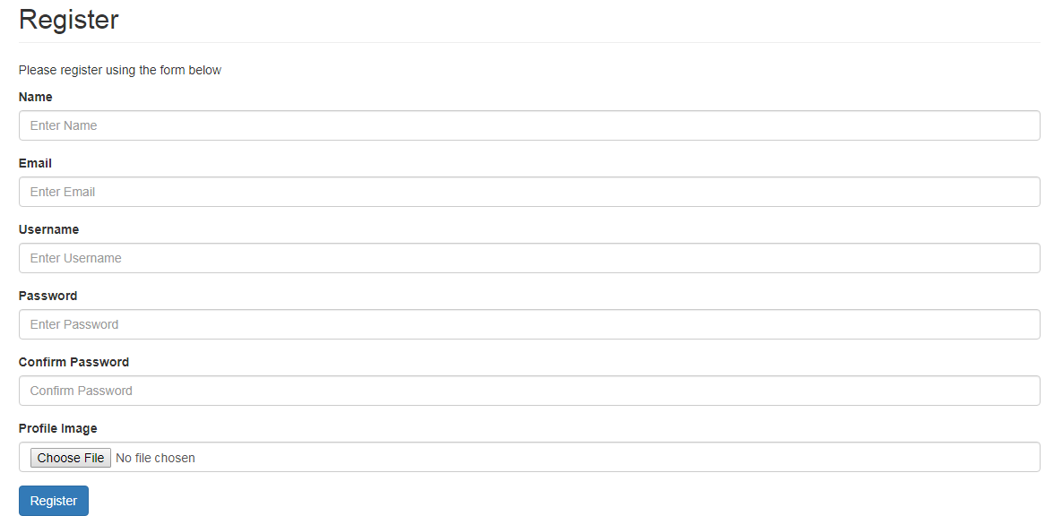
Implementation of Web Application
Register Page:

Slide 14
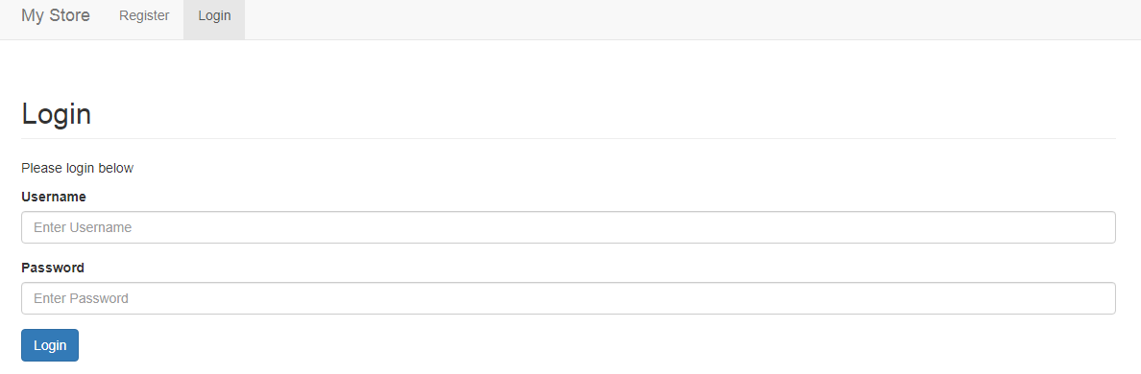
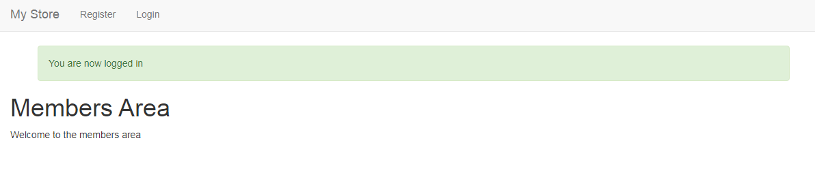
Login page:
Home page:

Slide 15
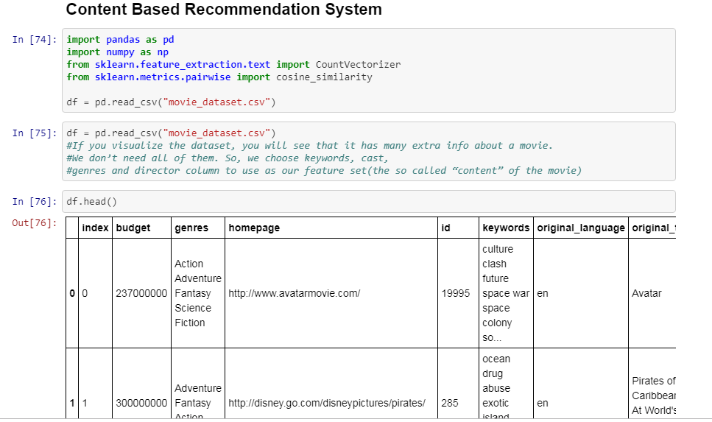
Recommendation system:

Slide 16
THANK YOU!

